Slide 1
Prince George’s County
URBAN Specifications and standards for roadways and bridges
Urban Street Design Standards
Overview of Project and Details
Association of Pedestrian and Bicycle Professionals (APBP)
Professional Development Seminar (PDS)
Memphis, TN
June 29,2017

Slide 2
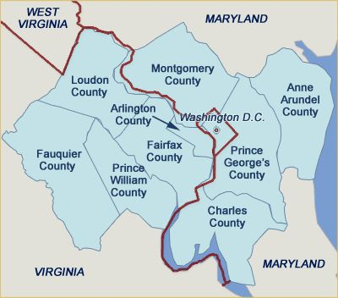
Prince George’s COUNTY, MaRYLAND
  Population approximately 900,000
  Three tiers of development (developed/developing/rural)
  Longest average time of commute in the Washington Region
  Effort to focus on TOD/walkable communities
  Major projects supporting “smart growth” goals
  have come to fruition or in process
  Recognition of need to re-tool plans and policies

Slide 3
Urban Street Standards: HOW, WHAT, Where
  County Council Bill on Urban Standards
  “The County hereby adopts an urban street design policy and principles, consistent with the Council's 2014 approval of its most current general plan for the County, Plan Prince George 's 2035.”
  Urban Design
    “Design standards focused on the public streetscape within urban areas, such as streets, sidewalks, street furniture and amenities, including bicycle facilities that form a high-quality, pedestrian- friendly sense of place.”
  Part of broader update to Specifications and Standards
  Comprehensive overhaul of County Standards and Specifications for Roadways & Bridges, first component is Urban Standards.

Slide 4
Process & STAKEHOLDERS
Expedited 9-month process of staff & stakeholder engagement, development and revision
Steering Group
      Comprised of key agencies: Permitting, Transportation, Environmental, Planning
Other agencies consulted
      Fire/EMS, Police Department
Organizations consulted
      Utility companies, Builders and Developers, Smart Growth and other Advocates

Slide 5
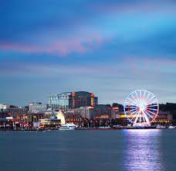
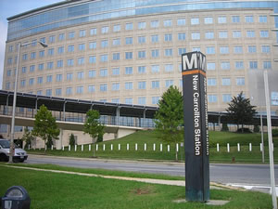
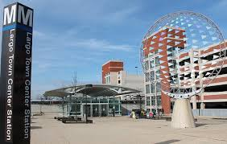
Urban street standards
Resolution approved by the Council
“A RESOLUTION CONCERNING ROADS AND SIDEWALKS - DESIGN AND CONSTRUCTION STANDARDS AND REQUIREMENTS for the purpose of incorporating urban street design standards and specifications as consistent with Plan Prince George's 2035 for Regional Transit Districts and Local Centers in Prince George's County, striving to balance the needs of all users that are business-friendly, walkable, bike-able and transit friendly; generally regarding design and construction standards and urban street designs.”

Slide 6
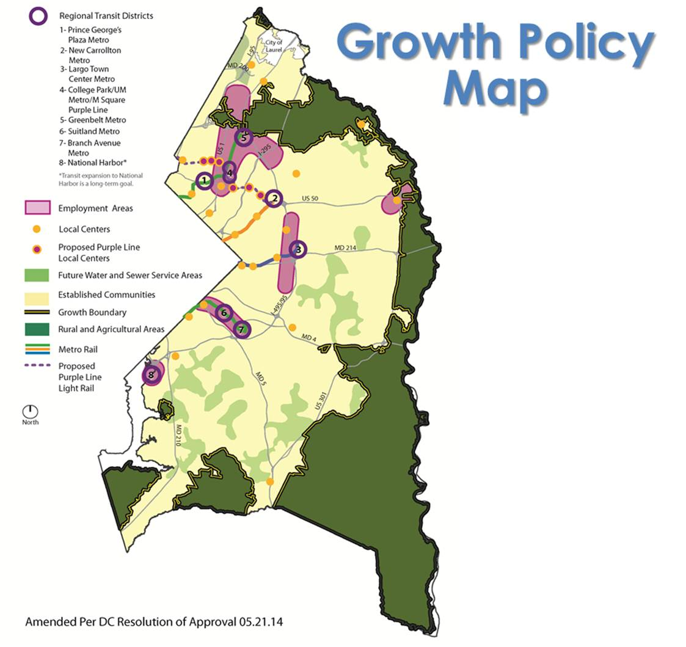
Urban street standards

Slide 7
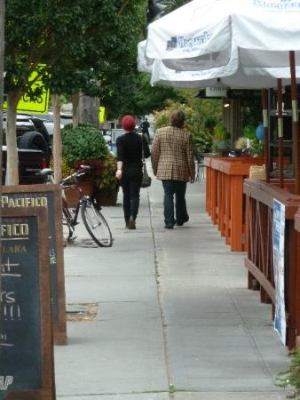
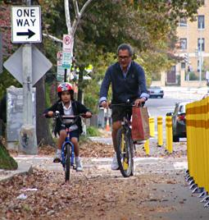
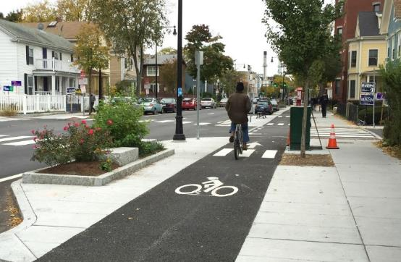
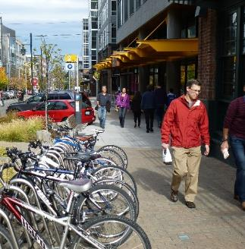
Complete streets-Vibrant Streets
Meet the needs of pedestrians, bicyclists, transit users and vehicles:
  Slower speeds
  Shorter crossing distances
  Reduced curb radii
  Wider sidewalks
  More bicycle facilities
  Pedestrian amenities

Slide 8
Summary of Work sessions
Held series of work sessions to achieve consensus on important topics relevant to urban street design:
  Functional Class / Street Typologies
  Design Speed
  Lane Widths
  Stormwater management
  Curb Radii
Comprehensive Education Process for Agencies
  Implementing Agency buy-in was key

Slide 9
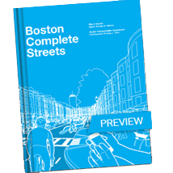
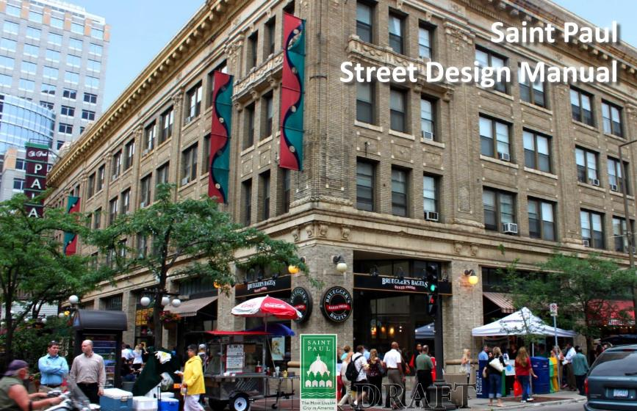
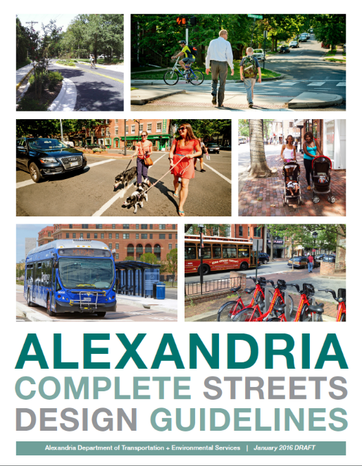
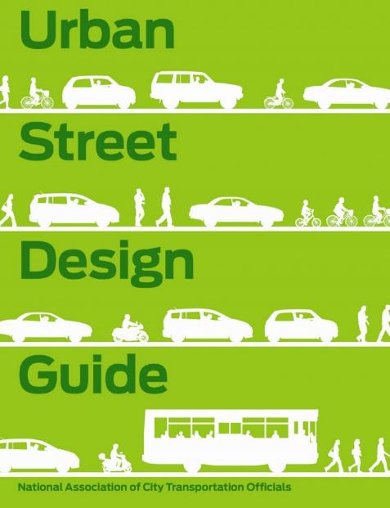
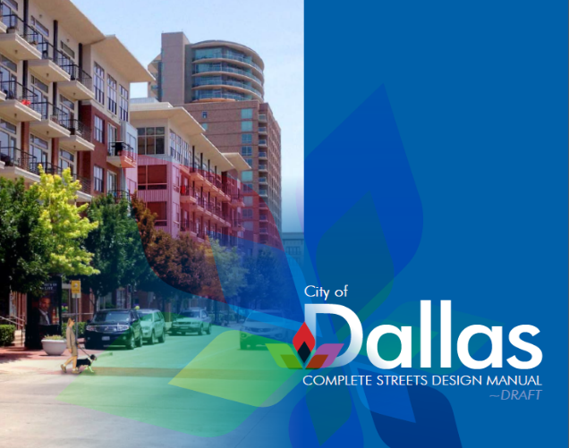
Based on Best Practices in Urban Street Design

Slide 10
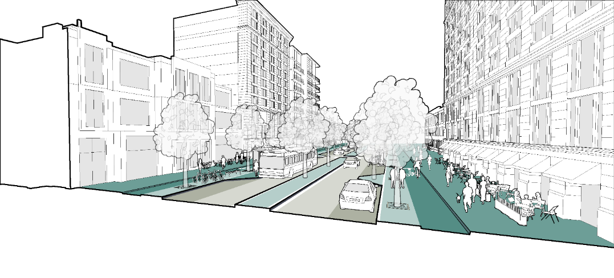
New Standards-Urban Street Types
Mixed-Use Boulevard
  2, 3 & 4 lanes
Neighborhood Connector
Neighborhood Residential
Industrial Road
Shared Street
Alley
Notes:
How can we revise your current standards for urban streets in a way that will help you get the desired outcome in regional transit districts and local centers??
Current standards are not very pedestrian, bike or transit friendly…multiple travel lanes, high design speeds
7 classifications of roadway in current standards relate to urban environment in name
ROW
▪Travel widths (i.e., 10-ft travel lanes instead of 11-ft minimum)
▪Median widths (8-10-ft median instead of 16-ft minimum)
▪On-street parking restrictions and width (i.e., 7-ft minimum instead of existing 11-ft)
▪Design speeds (Reduction to 25-30mph)
▪Corner radii (reduction to 10-15ft to reduce crosswalk widths, larger as required. currently 45-50ft; emphasize effective radii rather than actual)
▪Sidewalk width (in commercial zones, need to have minimum 8-ft clear pedestrian zone AND landscape buffer or amenity zone rather than current min 12-ft sidewalk zone; remember frontage zone as well)

Slide 11
Summary of New Urban Street Standards
Notes:
How can we revise your current standards for urban streets in a way that will help you get the desired outcome in regional transit districts and local centers??
Current standards are not very pedestrian, bike or transit friendly…multiple travel lanes, high design speeds
7 classifications of roadway in current standards relate to urban environment in name
ROW
▪Travel widths (i.e., 10-ft travel lanes instead of 11-ft minimum)
▪Median widths (8-10-ft median instead of 16-ft minimum)
▪On-street parking restrictions and width (i.e., 7-ft minimum instead of existing 11-ft)
▪Design speeds (Reduction to 25-30mph)
▪Corner radii (reduction to 10-15ft to reduce crosswalk widths, larger as required. currently 45-50ft; emphasize effective radii rather than actual)
▪Sidewalk width (in commercial zones, need to have minimum 8-ft clear pedestrian zone AND landscape buffer or amenity zone rather than current min 12-ft sidewalk zone; remember frontage zone as well)

Slide 12
CONSIDERATIONS
  Increased cost of maintenance
    Use of MOUs and other negotiations with the developers could help mitigate
  Access for fire fighting apparatus
  Determination of street types for application of these standards
    Revisions to plans by planning agency
  Interim application of Urban Street Standards during ongoing update to Roadway & Bridge Standards
  Urban treatments generally cost more
    Can provide greater long term economic benefits

Slide 13
Typical sections

Slide 14
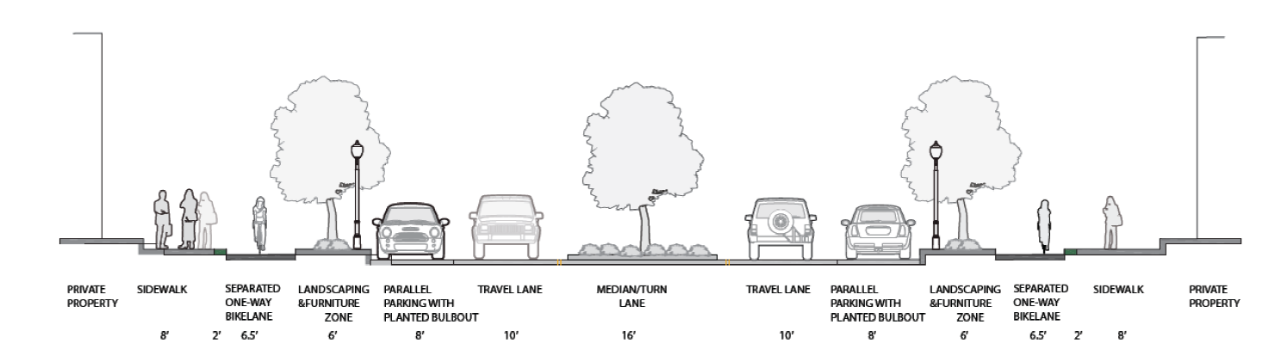
Mixed Use Boulevard – 2 & 4 lanes
New Street Type | Description | Features
Mixed Use Boulevard | Buildings close to street Mix of land uses Medium to high density land use High volumes of vehicles and transit Medium to heavy ped/bike activity Reduced vehicular speeds | 2-4 travel lanes Median Sidewalks & bike facilities Street furniture & enhanced lighting On-street parking

Slide 15
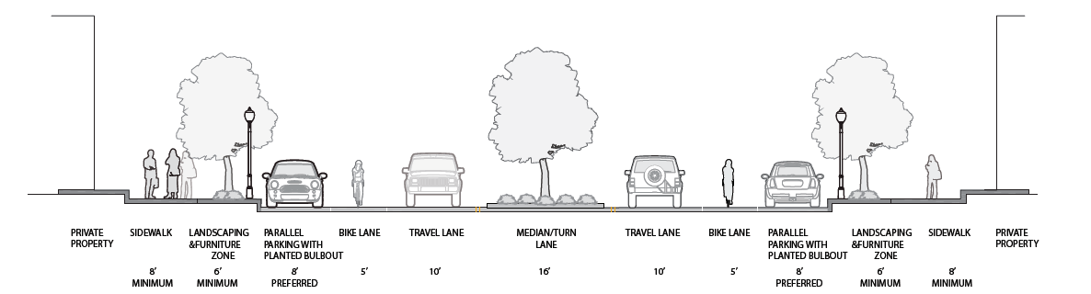
Mixed Use Boulevard – 2 & 4 lanes (B)
New Street Type | Description | Features
Mixed Use Boulevard | Buildings close to street Mix of land uses Medium to high density land use High volumes of vehicles and transit Medium to heavy ped/bike activity Reduced vehicular speeds | 2-4 travel lanes Median Sidewalks & bike facilities Street furniture & enhanced lighting On-street parking

Slide 16
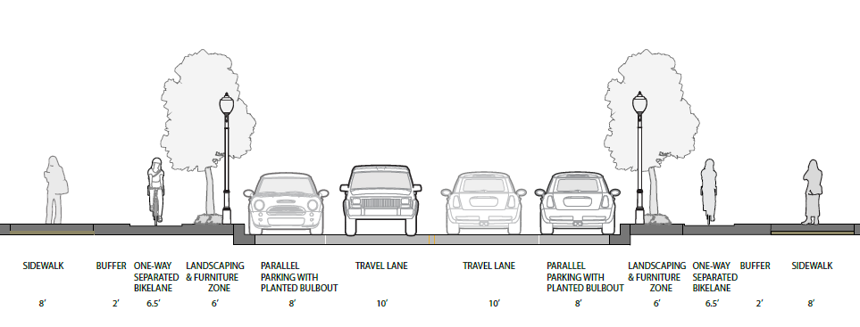
Neighborhood Connector
New Street Type | Description | Features
Neighborhood Connector | Connect multiple neighborhoods Medium density land uses, Buildings close to street May feature mixed land uses or mostly residential w/ occasional businesses Heavy pedestrian/bike activity; Provide continuous walking and bicycling routes Some are major bus routes; Slow speeds (20-25 mph) | 2 travel lanes Bike facilities, Sidewalks, Lighting Enhanced streetscape In mixed-use/retail areas, space for street furniture, outdoor events & dining On-street parking

Slide 17
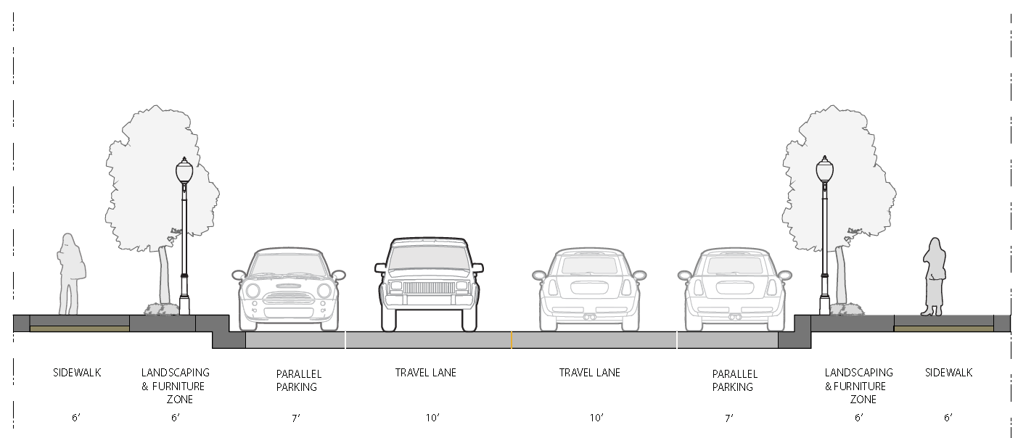
Neighborhood Residential
New Street Type | Description | Features
Neighborhood Residential | Provide immediate access to single-family and multi-family residences Focus on pedestrian safety, space for children to play, and well defined bicycling and walking paths Slow speeds | 2 travel lanes Sidewalks Street trees Lighting

Slide 18
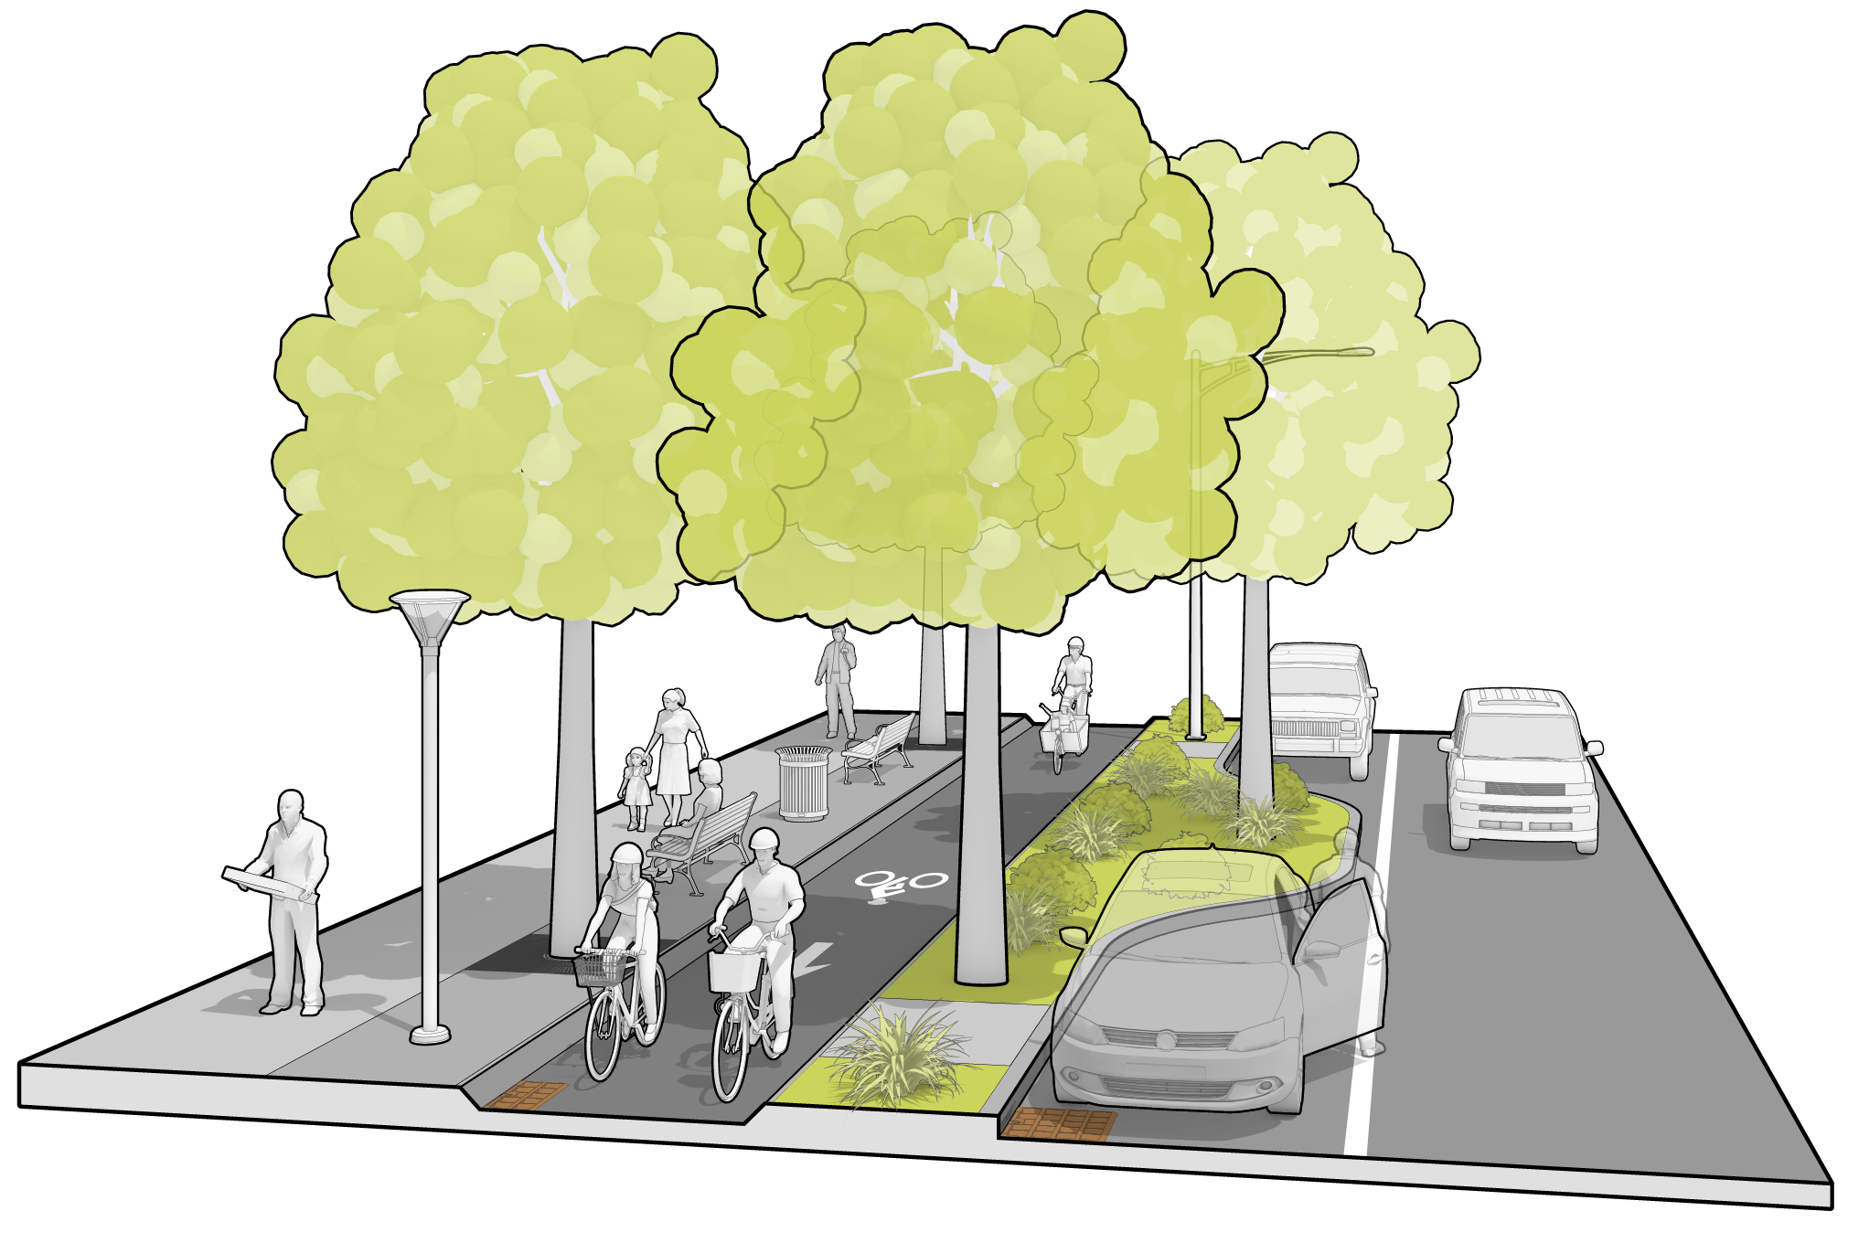
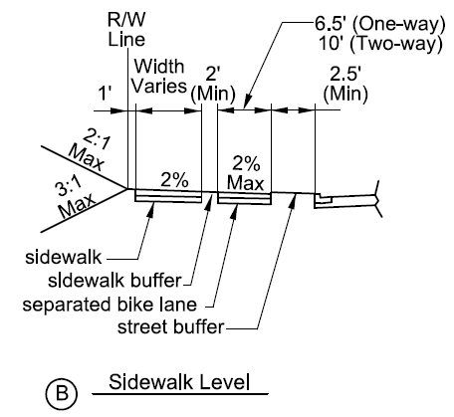
Separated Bike Lanes

Slide 19
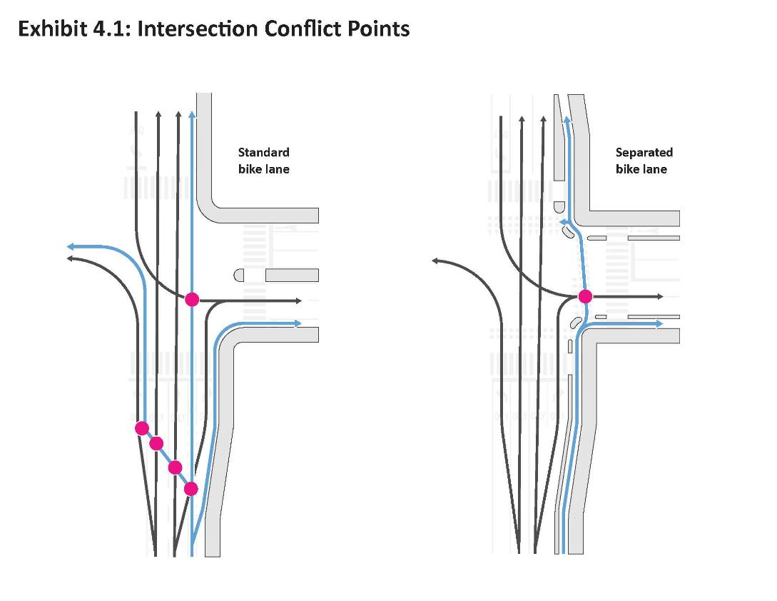
Separated Bike Lanes

Slide 20
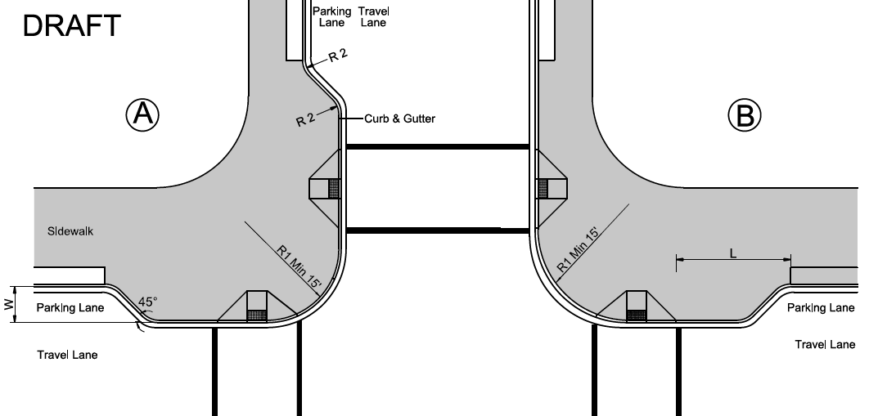
Perpendicular curb ramp

Slide 21
Next Steps
Continued coordination with Planning Department on zoning ordinance re-write
Coordinate with development of Comprehensive Roadway Standards
Work with sister agencies on implementing the Urban Standards
Work with developers and external stakeholders on understanding and implementation
Work with County Council on further codification

Slide 22
Thank you
Victor Weissberg
Special Assistant to the Director
Prince George’s County
Department of Public Works and Transportation
vweissberg@co.pg.md.us

Slide 23
Questions / Discussion

