Slide 1
A Case Study of the Effect of Crosswalk Enforcement Operations on Driver Yielding Behavior at Unsignalized Mid-Block Crosswalks in Raleigh, NC
APBP Professional Development Seminar
June 29th, 2017
Sarah Searcy
Research Associate
sesearcy@ncsu.edu
NC-GHSP Sponsored Project

Slide 2




Project Team
Mathew Palmer, MURP
Research Scholar
ITRE
Daniel Findley, PE, PhD
Senior Research Associate
ITRE
Sarah Searcy
Research Associate
ITRE
Kristy Jackson
Project Manager/Planner
Stewart, Inc.

Slide 3
Background Motivation
From 2010-2014, 172 pedestrians on average were killed on NC roadways per year*
  ~10% of all fatal crashes in NC
WatchForMe NC Campaign was launched in the Triangle in 2012
  Goal to reduce the number of crashes by changing driver behavior toward pedestrians
  Enforcement component consists of targeted operations by police to increase driver yielding at crosswalks
Only a handful of pedestrian safety operations have been formally and thoroughly evaluated
*Source: North Carolina Pedestrian and Bicycle Crash Data Tool (maintained by NCDOT’s Division of Bicycle and Pedestrian Transportation)

Slide 4
Previous Research
Evaluation of the Watch For Me NC Campaign occurred over a 6-month period from 2013-2014*
  Yielding rates did not change at crossings that did not receive enhancements (targeted police operations or low-cost engineering improvements)
  Yielding rates improved between 4-7 percentage points on average at enhanced locations
*Source: Sandt L.S., Marshall S.W., Rodriguez D.A., Evenson K.R., Ennett S.T., Robinson W.R. (2016). Effect of a community-based pedestrian injury prevention program on driver yielding behavior at marked crosswalks, Accident Analysis and Prevention, 93, 169-178.
Notes:
“BACKGROUND:
Few studies have comprehensively evaluated the effectiveness of multi-faceted interventions intended to improve pedestrian safety. "Watch for Me NC" is a multi-faceted, community-based pedestrian safety program that includes widespread media and public engagement in combination with enhanced law enforcement activities (i.e., police outreach and targeted pedestrian safety operations conducted at marked crosswalks) and low-cost engineering improvements at selected crossings. The purpose of this study was to estimate the effect of the law enforcement and engineering improvement components of the program on motor vehicle driver behavior, specifically in terms of increased driver yielding to pedestrians in marked crosswalks.
METHODS:
The study used a pre-post design with a control group, comparing crossing locations receiving enforcement and low-cost engineering treatments (enhanced locations) with locations that did not (standard locations) to examine changes in driver yielding over a 6-month period from 2013 to 2014. A total of 24,941 drivers were observed in 11,817 attempted crossing events at 16 crosswalks in five municipalities that were participating in the program. Observations of real pedestrians attempting to use the crosswalks ("naturalistic" crossing) were supplemented by observations of trained research staff attempting the same crossings following an established protocol ("staged" crossings). Generalized estimating equations (GEE) were used to model driver yielding rates, accounting for repeated observations at the crossing locations and controlling other factors that affect driver behavior in yielding to pedestrians in marked crosswalks.
RESULTS:
At crossings that did not receive enhancements (targeted police operations or low-cost engineering improvements), driver yielding rates did not change from before to after the Watch for Me NC program. However, yielding rates improved significantly (between 4 and 7 percentage points on average) at the enhanced locations. This was true for both naturalistic and staged crossings.
CONCLUSIONS:
This study provides evidence that enhanced enforcement and low-cost engineering improvements, as a part of a broader program involving community-based outreach, can increase driver yielding to pedestrians in marked crosswalks. These data are important for the staff and decision-makers involved in pedestrian safety programs to gain a better understanding of the different engineering and behavioral mechanisms that could be used to improve driver yielding rates.”

Slide 5
Project Objective
“How much enforcement is needed to change driver yielding behavior to pedestrians in a crosswalk?”
  Test the intensity and duration of (4) different intervention plans
    Intervention = 2-hour enforcement period
  Differing treatment plans designed to evaluate the impacts of officer time and department resources on driver yielding rates
    Determine where diminishing returns may coincide with investment in the time spent on enforcement

Slide 6
Site Selection
(5) crosswalks (4 treatment and 1 control) in Raleigh, NC that met the following criteria:
  Bi-directional, two-lane street
  Posted speed limit at or below 35 MPH
  Crossings located at uncontrolled intersections or midblock locations
  Presence of marked crosswalk
  Existing pedestrian activity
  No known construction planned that would impact site infrastructure

Slide 7
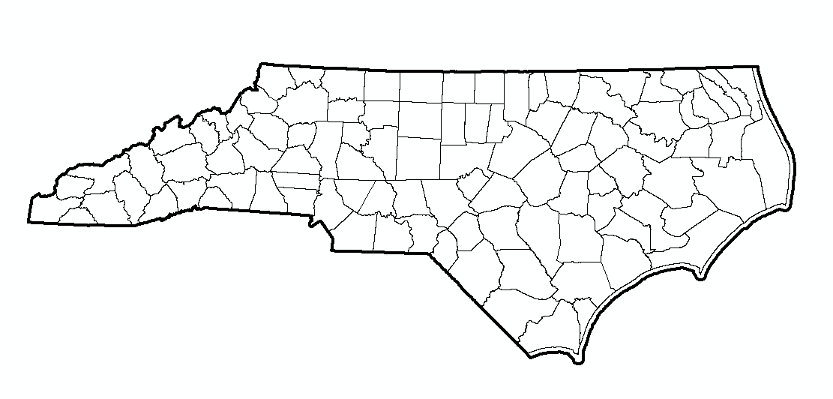
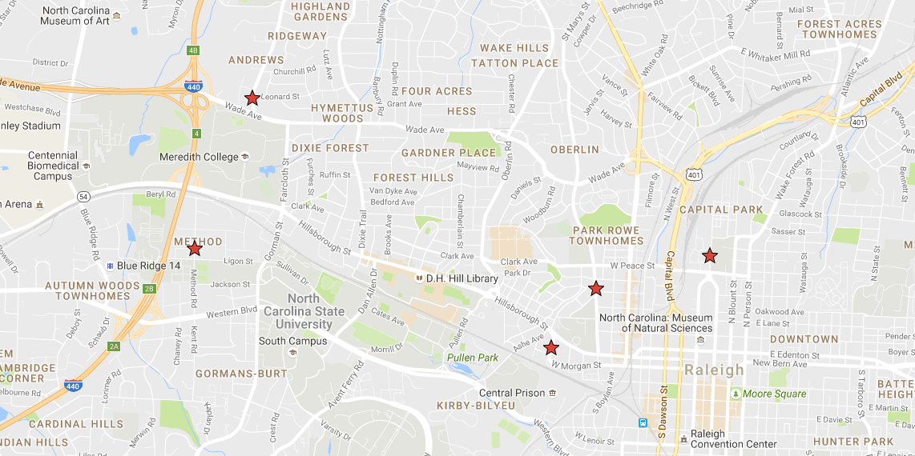
Site Selection
Ridge Rd – High Intensity, Long Duration
Method Rd – Low Intensity, Long Duration
Halifax Rd – Medium Intensity, Long Duration
St. Mary’s St – High Intensity, Short Duration
Morgan St – Control Location

Slide 8
Site Selection
Mid-Block Crosswalk Location | Treatment Type | Duration of Enforcement Campaign | Schedule | Estimated Number of Enforcement Interventions (Actual) | Estimated Number of Law Enforcement Hours (Actual)
A St. Mary’s St | High Intensity, Short Duration | 2 Weeks | Two 5-day interventions, then no enforcement events | 10 Periods (10 Periods) | 20 Hours (20 Hours)
B Ridge Rd | High Intensity, Long Duration | 20 Weeks | Two 5-day interventions, then one per week | 32 Periods (30 Periods) | 64 Hours (60 Hours)
C Halifax Rd | Medium Intensity, Long Duration | 24 Weeks | One 5-day intervention, then one per week on alternating weeks | 15 Periods (13 Periods) | 30 Hours (26 Hours)
D Method Rd | Low Intensity, Long Duration | 20 Weeks | One per week on alternating weeks | 11 Periods (8 Periods) | 22 Hours (16 Hours)
E Morgan St | Control Site | N/A | No enforcement | N/A | N/A

Slide 9
Local Agency Coordination
Raleigh Police Department
North Carolina State University Police Department
  Officers were previously trained on targeted pedestrian safety operations protocol during the Watch for Me NC Campaign in 2013
  Refresher training occurred in March 2016 ahead of study enforcement efforts
  Officers were officially off-duty and were compensated through project funds

Slide 10
Enforcement Campaign Protocols
Performed operations in one direction of roadway
  NB direction at each treatment site based on adjacent intersections and available space for law enforcement set-up and apprehension activities
Operations occurred during a two-hour window from 4pm-6pm
Scheduled teams of three officers:
  Two apprehension units
  One plain clothes officer

Slide 11
Enforcement Campaign Protocols
Citing North Carolina’s Failure to Yield law, motorists were stopped in accordance with G.S. 20-173(a) paraphrased on an informational handout (Appendix A) distributed to motorists in non-compliance:
  Yield to Pedestrian Traffic: Without yielding the right of way to a Pedestrian in a Crosswalk which was clearly marked as a crosswalk or crossing at or near an intersection where no crosswalk marking exists.

Slide 12
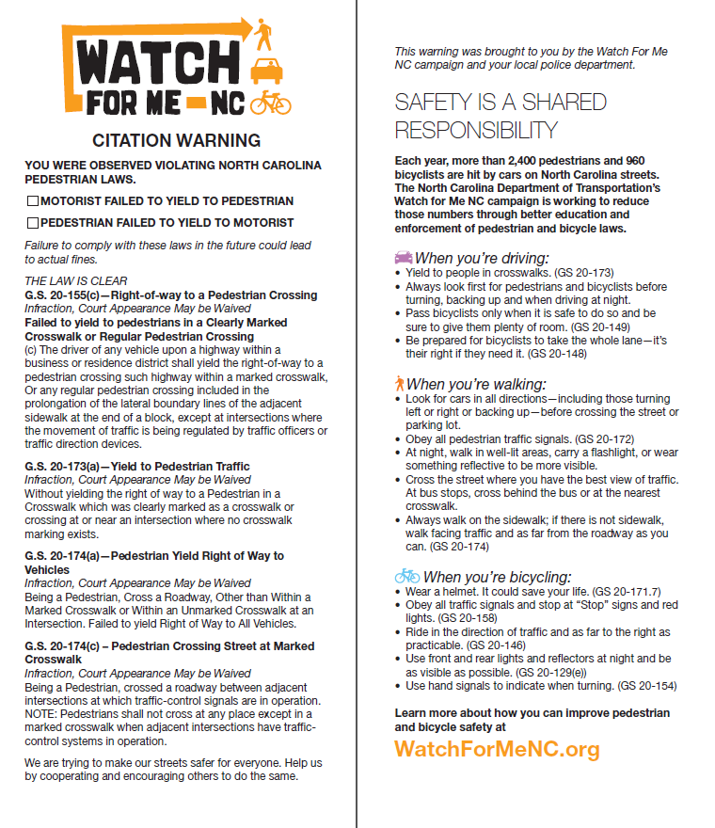
Enforcement Campaign Protocols

Slide 13

Enforcement Campaign Protocols

Slide 14
Yielding Assessments
Staged pedestrian crossings were conducted using the same research staff member
  Data were collected on dry-weather weekdays during the afternoon commute period (4-6pm)
  Staged pedestrian crossings were recorded and reduced by research technicians
  Driver yielding rates and pedestrian crossing rates were calculated for near lane yielding
Notes:
Data were collected from the pedestrian crossings for evaluation of driver yielding behavior. The number of motorists yielding and/or not yielding to the staged pedestrian was recorded by lane for each crossing attempt. A motorist was recorded as yielding if he or she stopped or slowed to allow the pedestrian to cross. A motorist was recorded as not yielding if he or she passed in front of the pedestrian and would have been able to stop (beyond the dilemma zone) when the pedestrian arrived at the crosswalk.
The distance less than that needed by a driver to safely stop for a pedestrian is referred to as the dilemma zone. This distance takes into account driver reaction time, safe deceleration rate, the posted speed, and the grade of the road to calculate this interval for the amber indication (Sandt et al., 2014). This formula-derived distance was be used to identify the distance beyond which a driver could easily stop for a pedestrian by multiplying the time by the speed limit. Using this method, a landmark was established at the dilemma zone distance on each side of each crosswalk by placing a traffic cone near the curb or edge of the road. Data collectors ensured that the cone was visible to them from the marked crosswalk as well as to the video setup.
Depending on the posted speed limit, the dilemma zone was estimated at:
- 40 MPH Posted speed: 231 ft
- 35 MPH Posted speed: 183 ft
- 30 MPH Posted speed: 141 ft
- 25 MPH Posted speed: 104 ft
- 20 MPH Posted speed: 72 ft
If the speed was not posted, the data collectors used the dilemma zone for a 35MPH speed limit. No sites were posted at higher than 35 MPH.

Slide 15
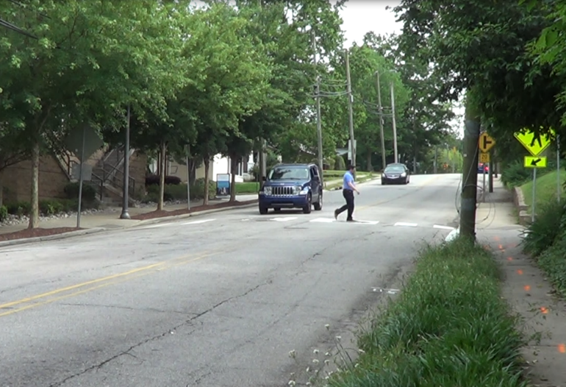
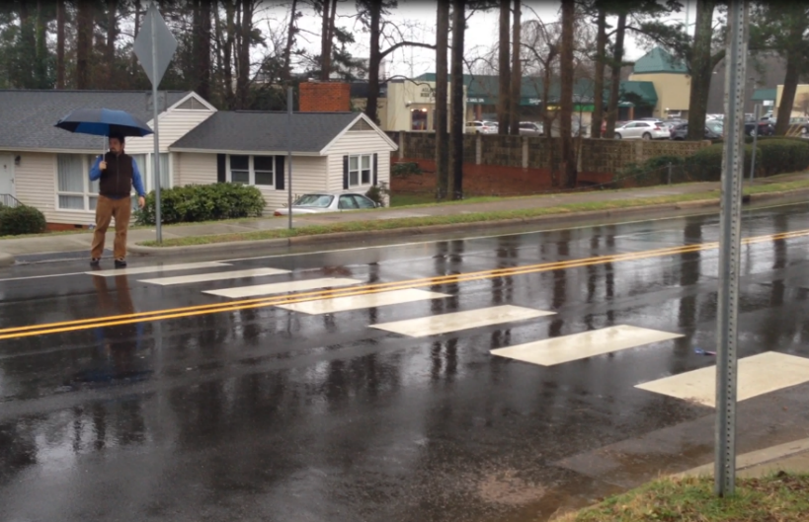
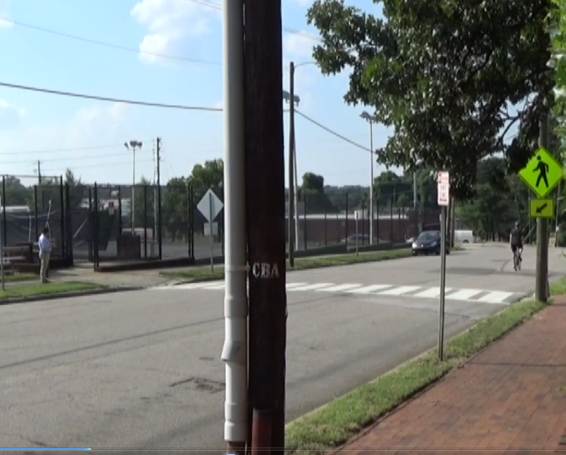
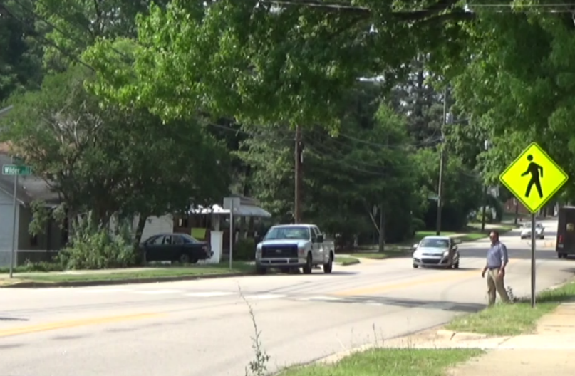

Slide 16
Results
>60 enforcement interventions
  ~122 enforcement hours total
  >1350 impressions (verbal warnings)
Six yielding assessments were conducted at each study crosswalk and the control crosswalk
  1 baseline, pre-enforcement
  5 post-enforcement

Slide 17
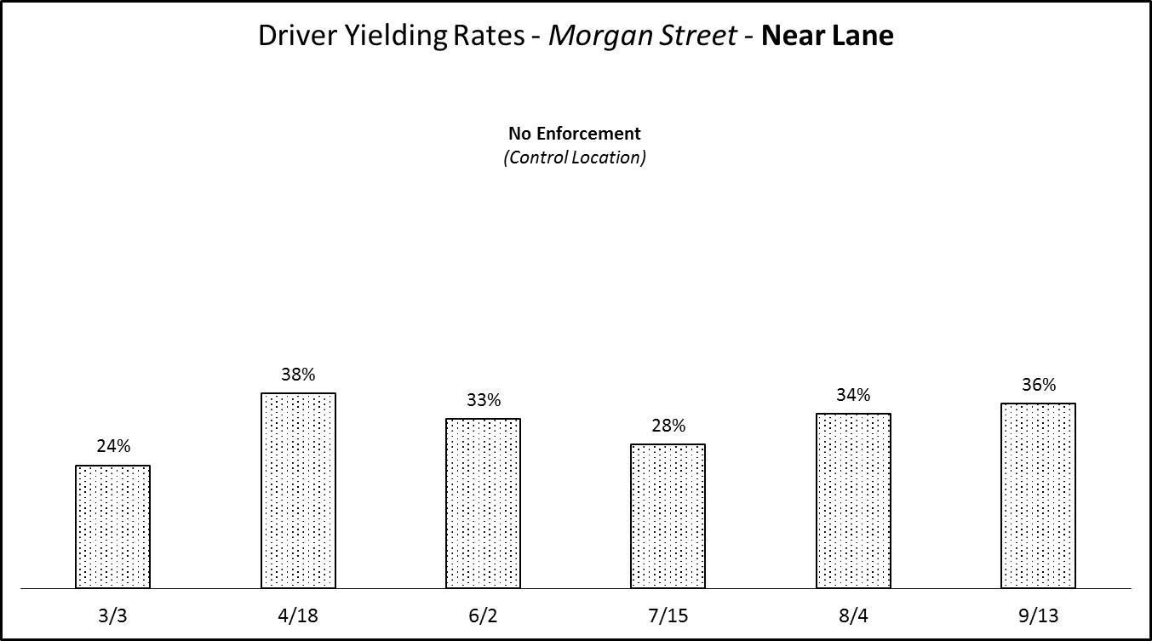

Slide 18
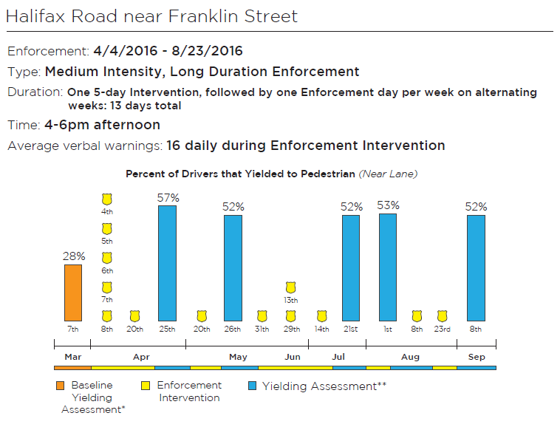
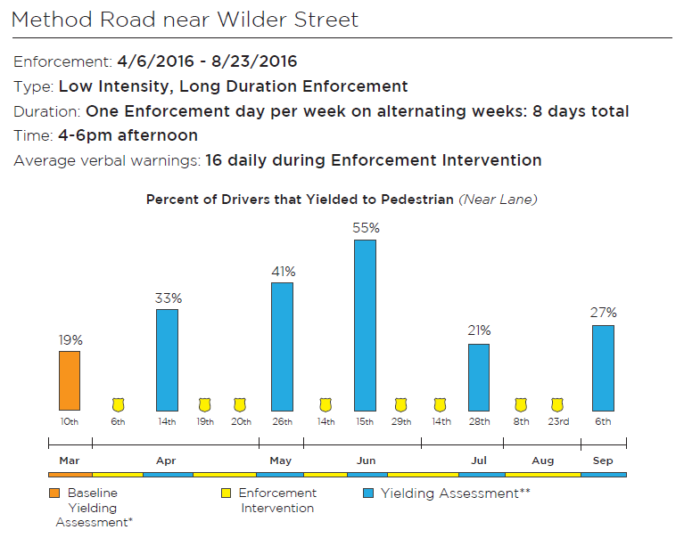
Medium intensity, long duration (Halifax Road) and Low intensity, long duration (Method Road)
  Enforcement scenarios had a sustained effect on driver yielding behavior during time periods when it appeared that the driver population utilizing the corridors did not change
Notes:
Halifax Road – a local road that links a major shopping and dining destination with a residential area and two major collectors with possibly less transient driver population
Method Road – proximity to NCSU, Al-Iman School, and the Islamic Center of Raleigh possibly accounts for some variation in yielding with a consistent driver population exposed to the enforcement campaign for the first three months of the study with a turnover in student driver population reflected in the yielding rate drop
Proximity to NCSU, Al-Iman School, and the Islamic Center of Raleigh likely accounts for some of the variation in driver yielding at the Method Road crosswalk. It is hypothesized that a consistent driver population was exposed to the long duration enforcement campaign for the first three months of the study, and that the drop in both driver yielding and pedestrian crossing rates reflected in the 7/28 and 9/6 yielding assessment results are in part the result of turnover in the student driver population utilizing the corridor from the summer to the fall semester.
Halifax Road is a local road that links Seaboard Station, a shopping and dining destination, and the Mordecai neighborhood to two major collectors, Peace Street and Salisbury Street. The driver population utilizing the portion of Halifax Road at the study crosswalk is possibly less transient and this consistency, along with the long duration of enforcement at the study location, could have contributed to the more sustained effect from enforcement.

Slide 19
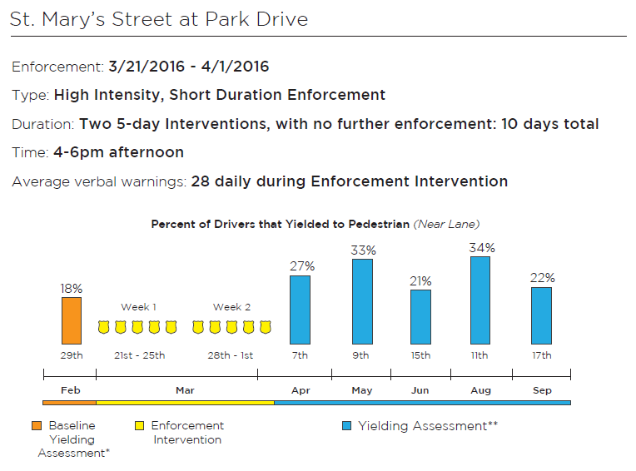
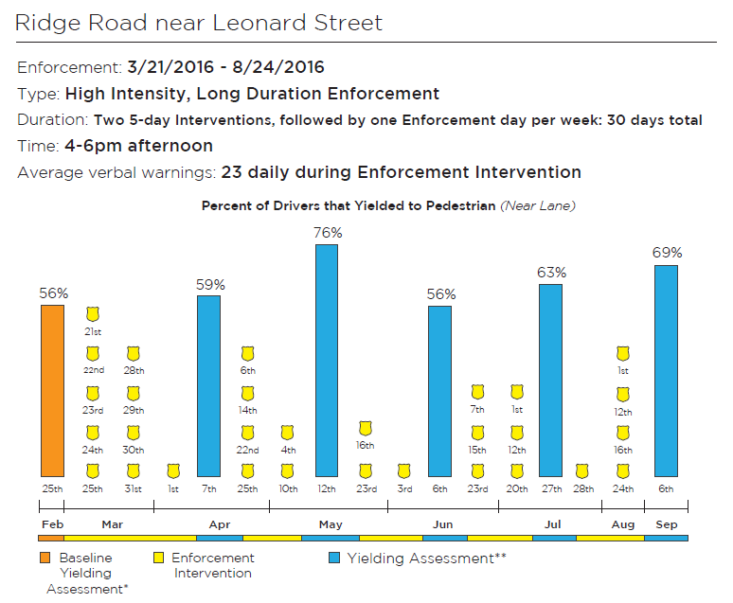
St. Mary’s Street and Ridge Road – some variation in driver yielding possibly attributable to the mix of regular and non-regular drivers that travel through the corridors
Notes:
For the crosswalks on St. Mary’s Street and Ridge Road, it is possible that some variation in driver yielding can be attributed to the mix of regular and non-regular drivers that travel through the locations. St. Mary’s Street is a major collector that links two principal arterials, Glenwood Avenue and Wade Avenue, to a major commercial district known as Glenwood South and a minor arterial, Hillsborough Street.
The portion of Ridge Road where the study crosswalk is located is also a major collector that provides a cut-through from US Highway 70 to Wade Avenue. Both the driver yielding and pedestrian crossing rates at these locations fluctuate in a similar pattern to those from the Method Road control location. An additional consideration at the crosswalk on St. Mary’s Street is the elevation change along the corridor. The crosswalk is located at the crest of a steep hill which might contribute to a reluctance for drivers to yield at the location.

Slide 20
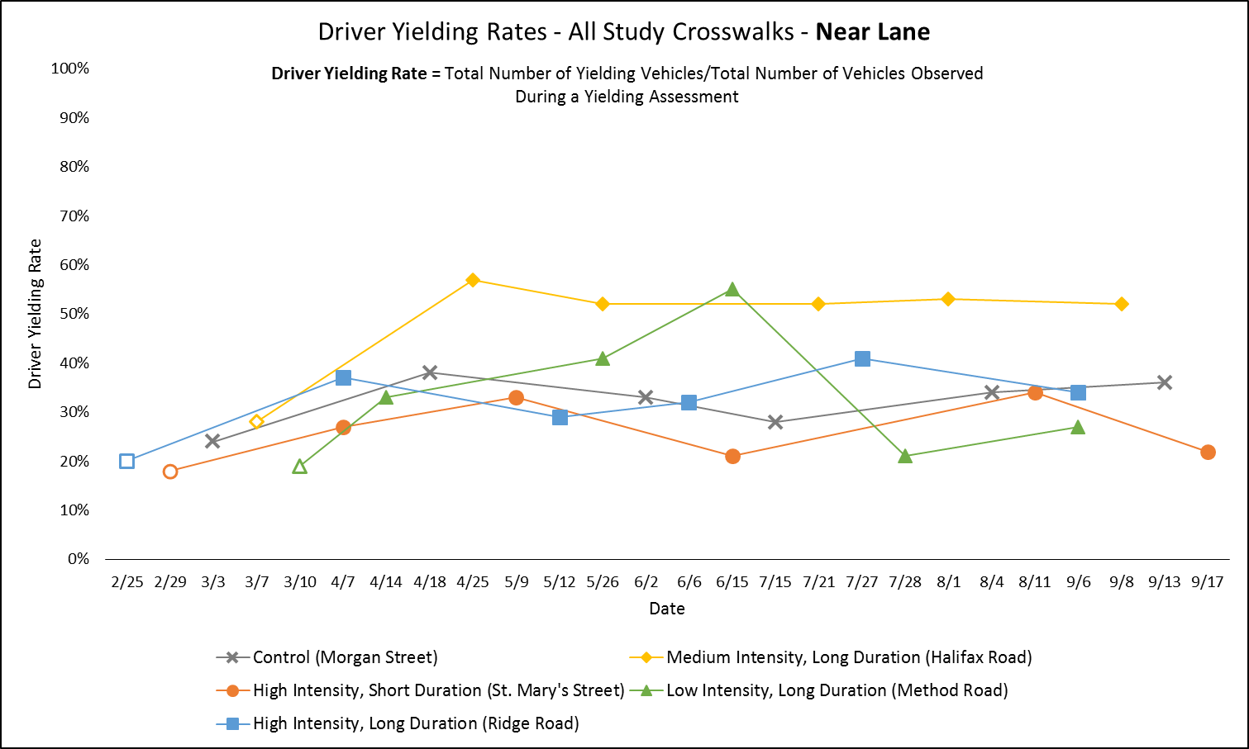

Slide 21
Discussion
When examining how much of the variation in driver yielding can be attributed to different enforcement scenarios, site-level characteristics must also be considered as factors influencing yielding behavior
  Consistent vs. transient driver population
  Environmental characteristics (e.g., crosswalk located on hill crest)

Slide 22
Thank You!
Questions?
Sarah Searcy
Research Associate
919-513-3482
sesearcy@ncsu.edu

