Slide 1


Bike/Ped Innova2ons and Placemaking in Mexican Ci2es
2017 APBP Professional Development Seminar

Slide 2






Presenta2on
• 2008
• 2014
Cycling Strategy Coordinator
Mexico City
• 2014
• 2015
Senior Consultant (Planning)
Mexico, Brasil, Colombia, London
• 2016
• 2017
Non Motorized Mobility Director
State of Colima

Slide 3
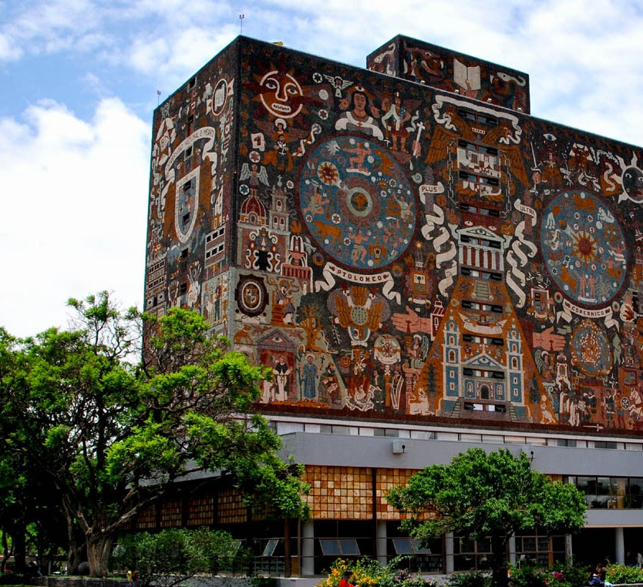

MEXICO CITY
Bicycle Mobility Strategic Alliances
Mexico City engaged with Mexico’s NaLonal Autonomous University (UNAM) to develop the documents under the guidance of Gehl Architects.
The strategy was developed as the core reference for policy development, ciLzen and government acLons.
It includes:
Integrated vision
Bicycle Mobility Strategy
Bicycle Infrastructure Toolkit
Bicycle Culture and SocializaLon
Best PracLces
Monitoring and EvaluaLon
Cartography (addiLonal support volume)

Slide 4
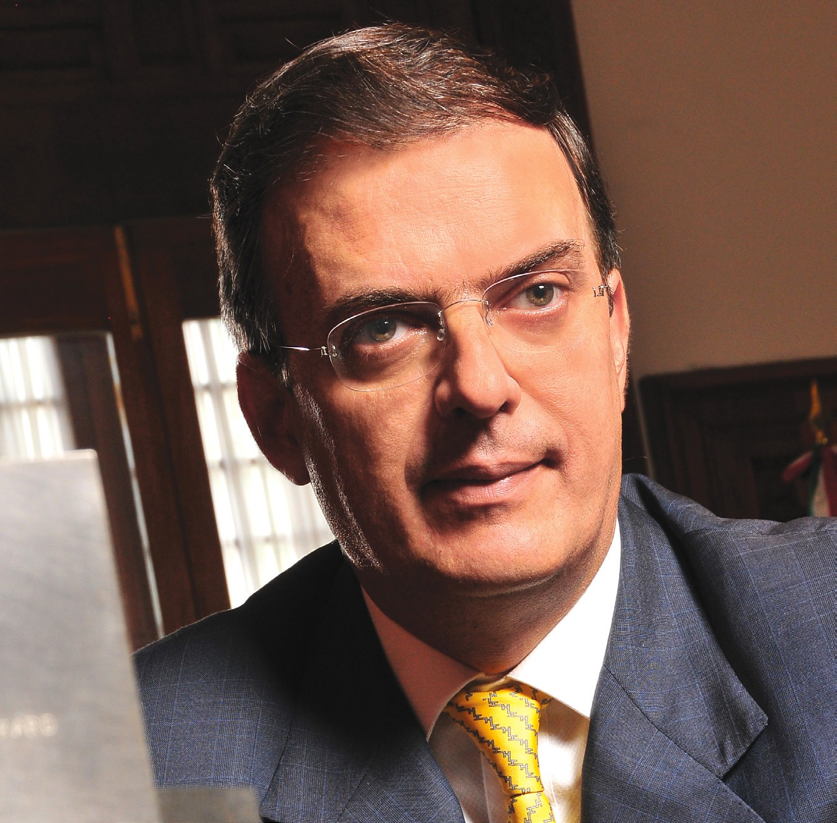
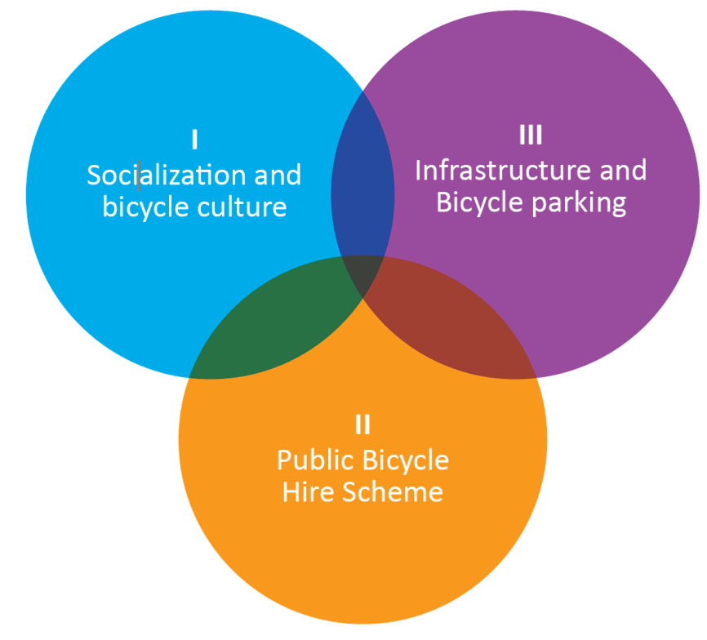
Project Champion
MEXICO CITY
Transforming the city’s transport system required a common agenda and shared goals across mulLple government ministries.
Led by the the City Major, the highest government posiLon and the individual able to overcome possible breakdowns in communicaLons.

Slide 5
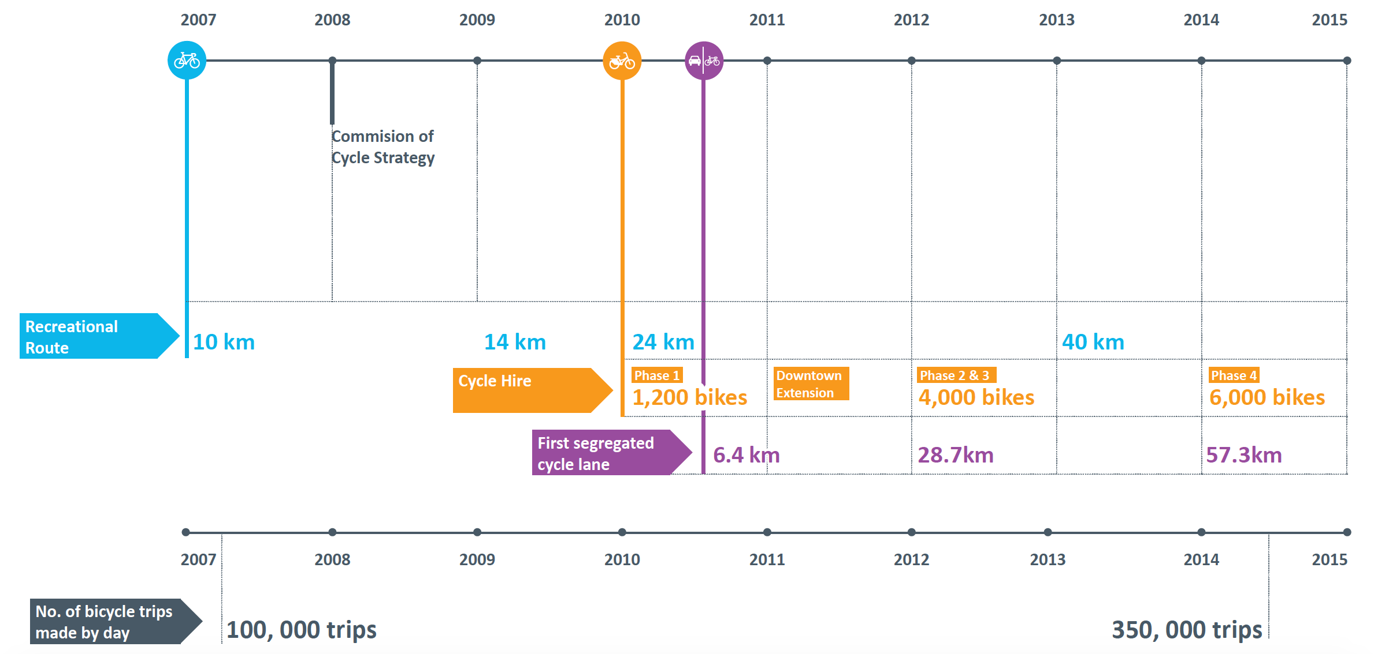
Bicycle Interven2ons (2007 – 2012)
MEXICO CITY

Slide 6
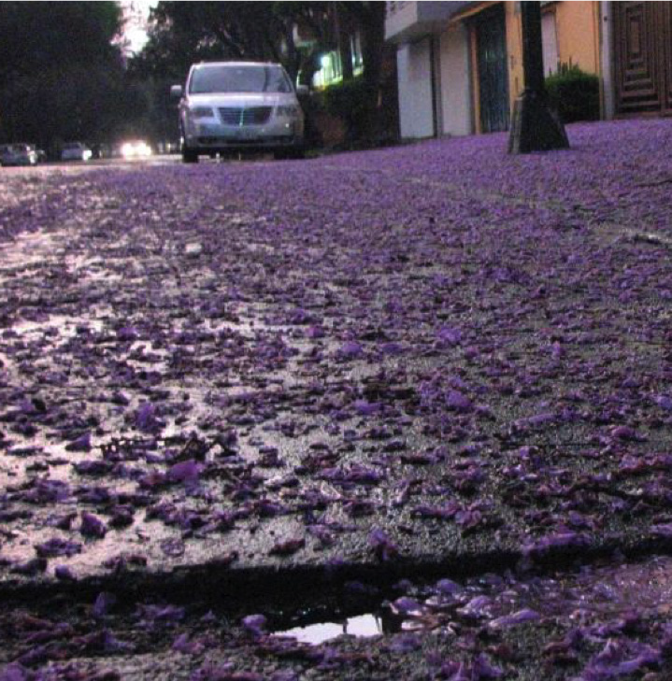
Insights
MEXICO CITY
PoliLcal decisions include:
AdverLsing companies will always look for proﬁt (public bikes scheme operators); so establishing levels of service is vital
Not providing cycle parking faciliLes may end in conﬂicts between pedestrians and cyclists
Bicycle accounts are needed and needed to be delivered year aYer year in the same date so data may be comparable
Alliances between projects may result in beneﬁts for both of them (Parkimeters and bike share schemes working as complementary projects for example)

Slide 7

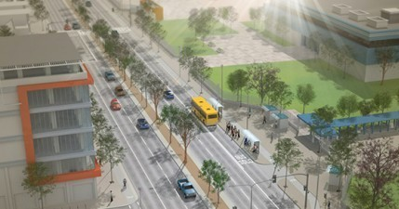





CONSULTANCY
Design for Movement
A mulL-disciplinary approach to the design of public spaces, transport faciliLes and the ameniLes they contain; ranging from concept and detailed design, to design standards, guidelines and policy.
Urban and landscape design
Wayﬁnding, signing and cartography
Pedestrian and cycle planning and design
Transport facility and interchange design
Accessibility audits

Slide 8
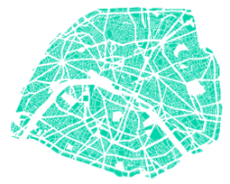
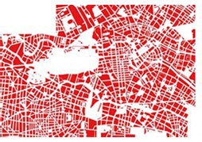
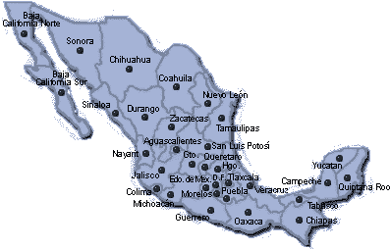
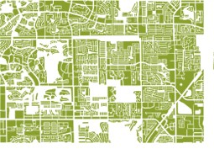
Diﬀerent Ci2es; Diﬀerent Solu2ons
CONSULTANCY

Slide 9

















GDL MEXICO CITY
MTY
SUBWAY
LIGHT TRAIN
BRT
BUSES
TROLLEY
TAXI
BIKE SHARE PROGRAM PARTICULAR
FREIGHT RURAL VEHICLES

Slide 10



MA México City: 24’000,000 MA Monterrey: 4’500,000
MA Guadalajara: 4’300,000
State of Colima: 700,000
10 municipalities
3 principal zones
50% municipalities as one large zone

Slide 11









SUBWAY
LIGHT TRAIN
BRT
TROLLEY
BIKE SHARE PROGRAM
BUSES
TAXI
COLIMA
PARTICULAR
FREIGHT
RURAL VEHICLES

Slide 12
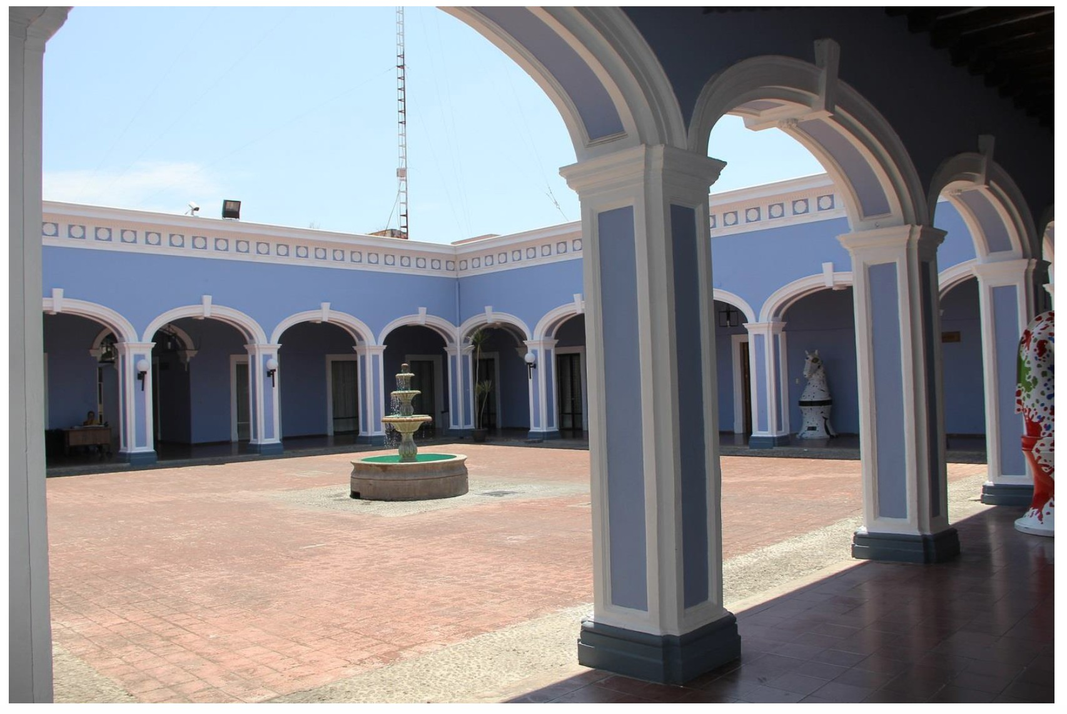
Study Case: COLIMA

Slide 13
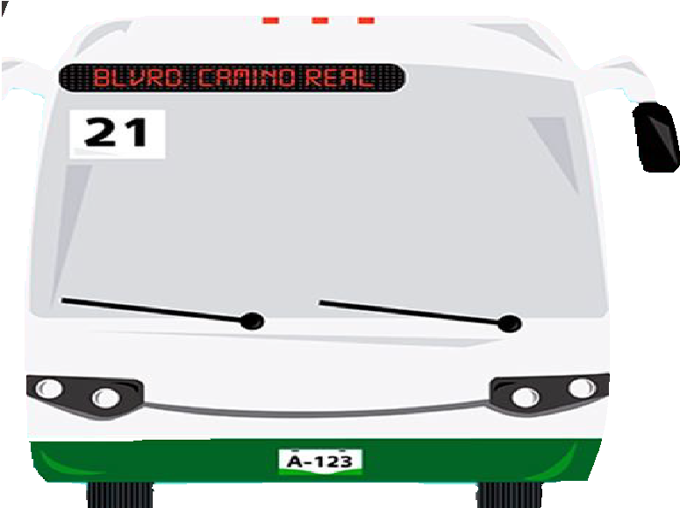
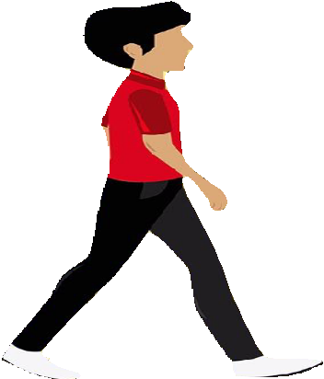
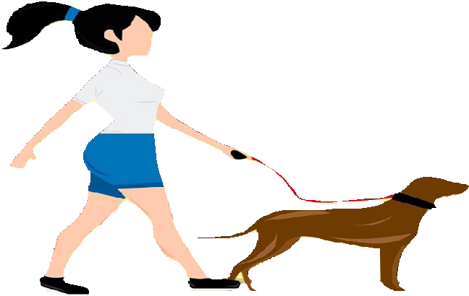
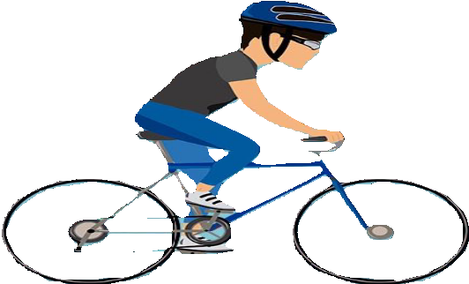
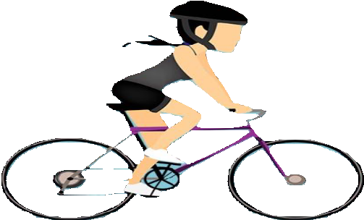
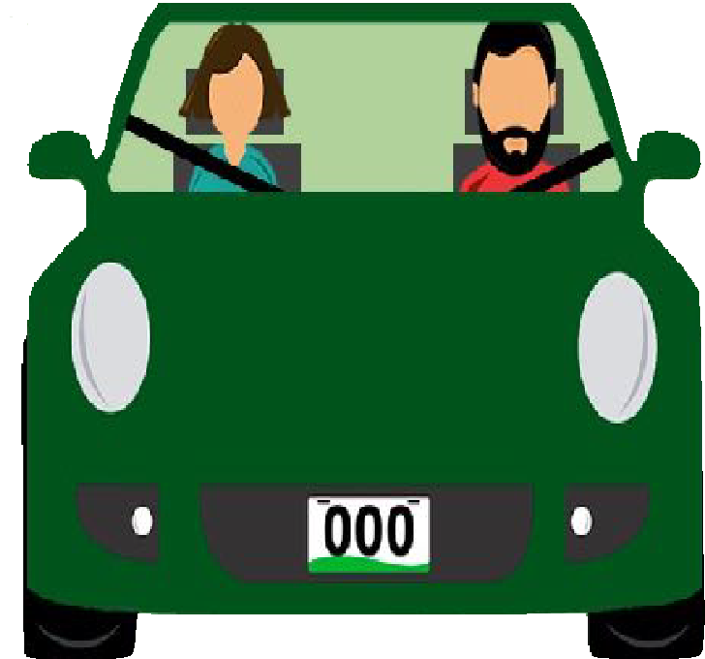



Mobility Law
COLIMA
La Ley de Movilidad busca transitar hacia un nuevo Sistema de Movilidad en donde las personas estén al centro

Slide 14
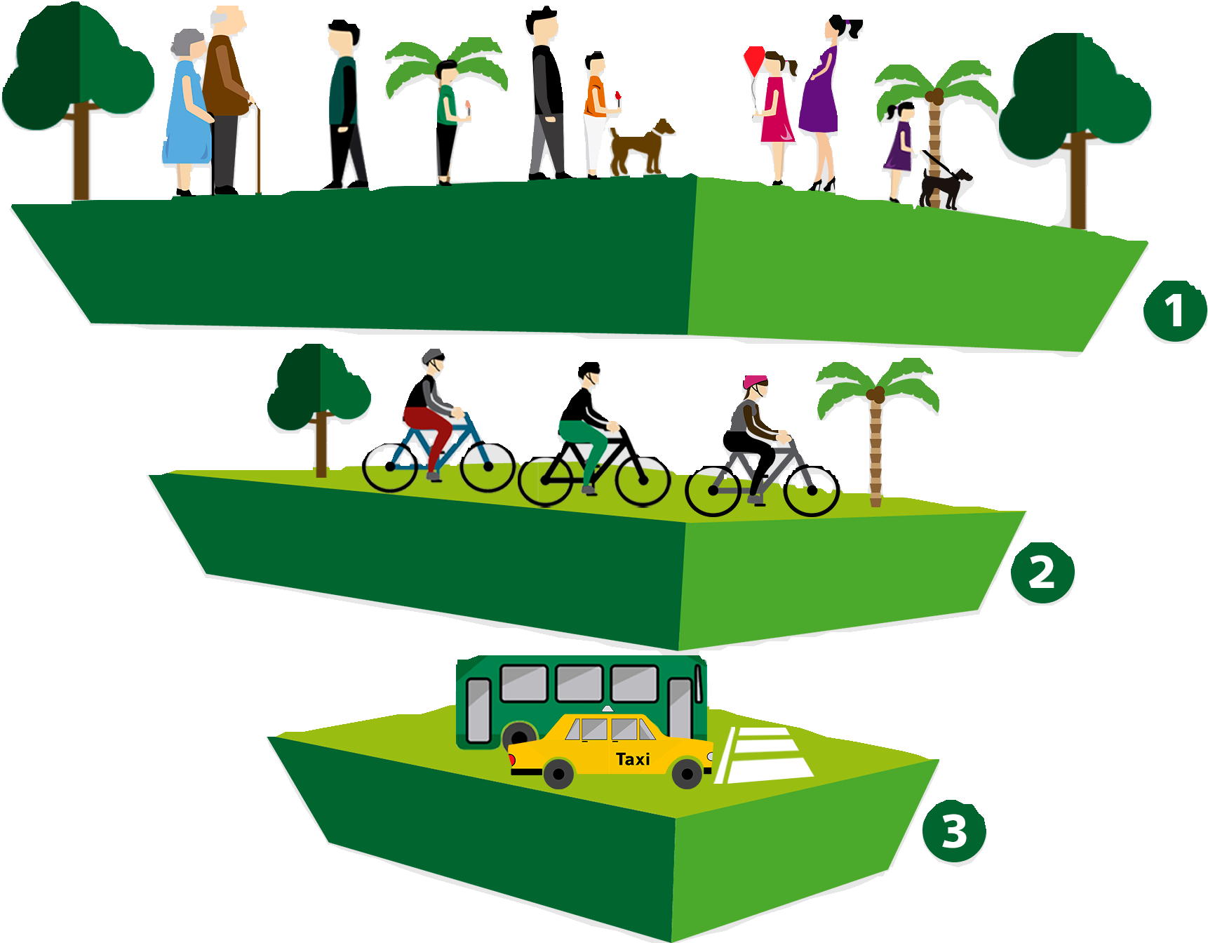



















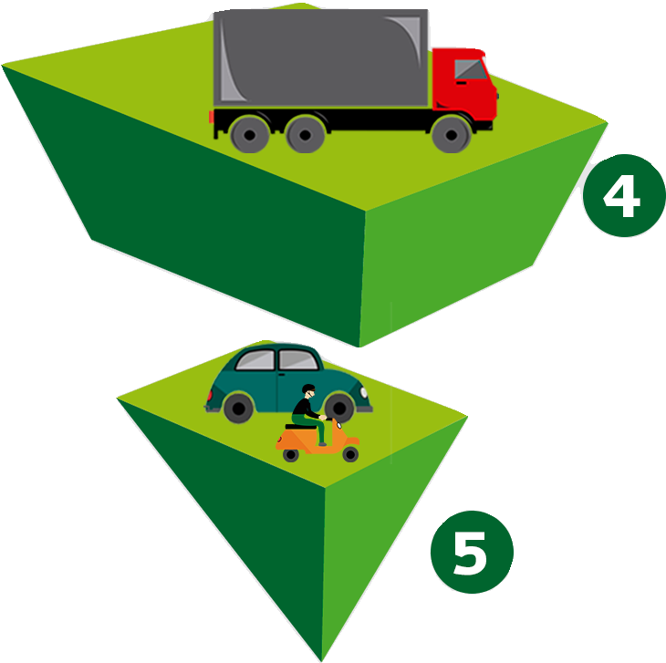







Mobility Hierarchy
COLIMA

Slide 15









Design Toolkit
Urban Mobility and Public Spaces
CDMX
Guadalajara
Monterrey
Mazatlán
Chihuahua
Ministry of Mobility, 2018

Slide 16


Content
Section 1. About the Toolkit
Glosary
Urban and Rural Structure
Section 2. Technical Criteria
Principles
Municipality
Urban image
Accesibility
Bicycle Infrastructure
Urban furniture
Transit
Wayfinding
Section 3. Criteria
Parks and recreation
Pavement and mediums
Roads criteria

Slide 17



Current situation
COLIMA
Existing bicycle infrastructure
Metropolitan Area Colima-Villa de Álvarez
14.8 miles
City of Manzanillo
1.7 miles
Metropolitan Area Tecomán - Armería
11.2 miles

Slide 18
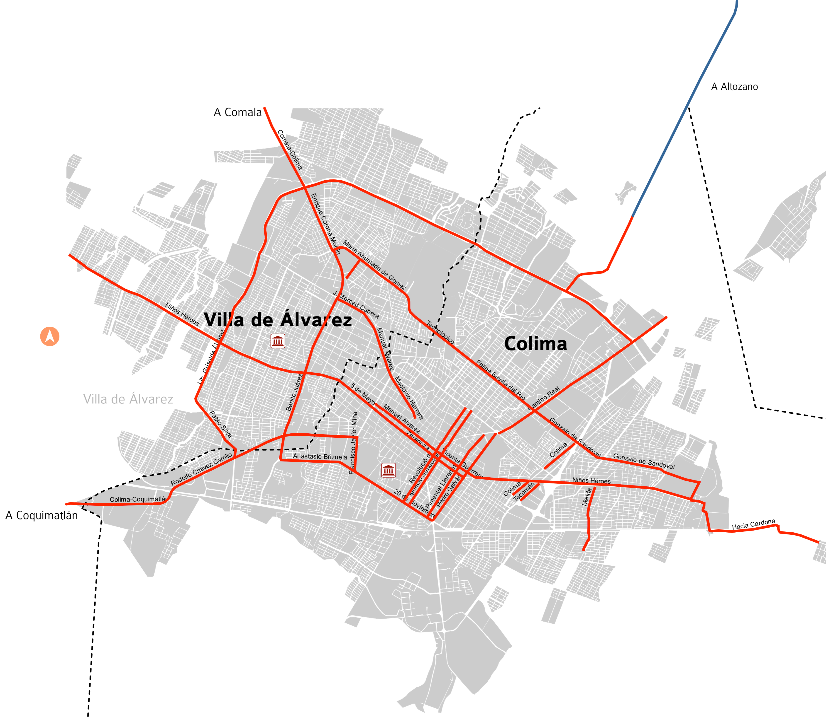
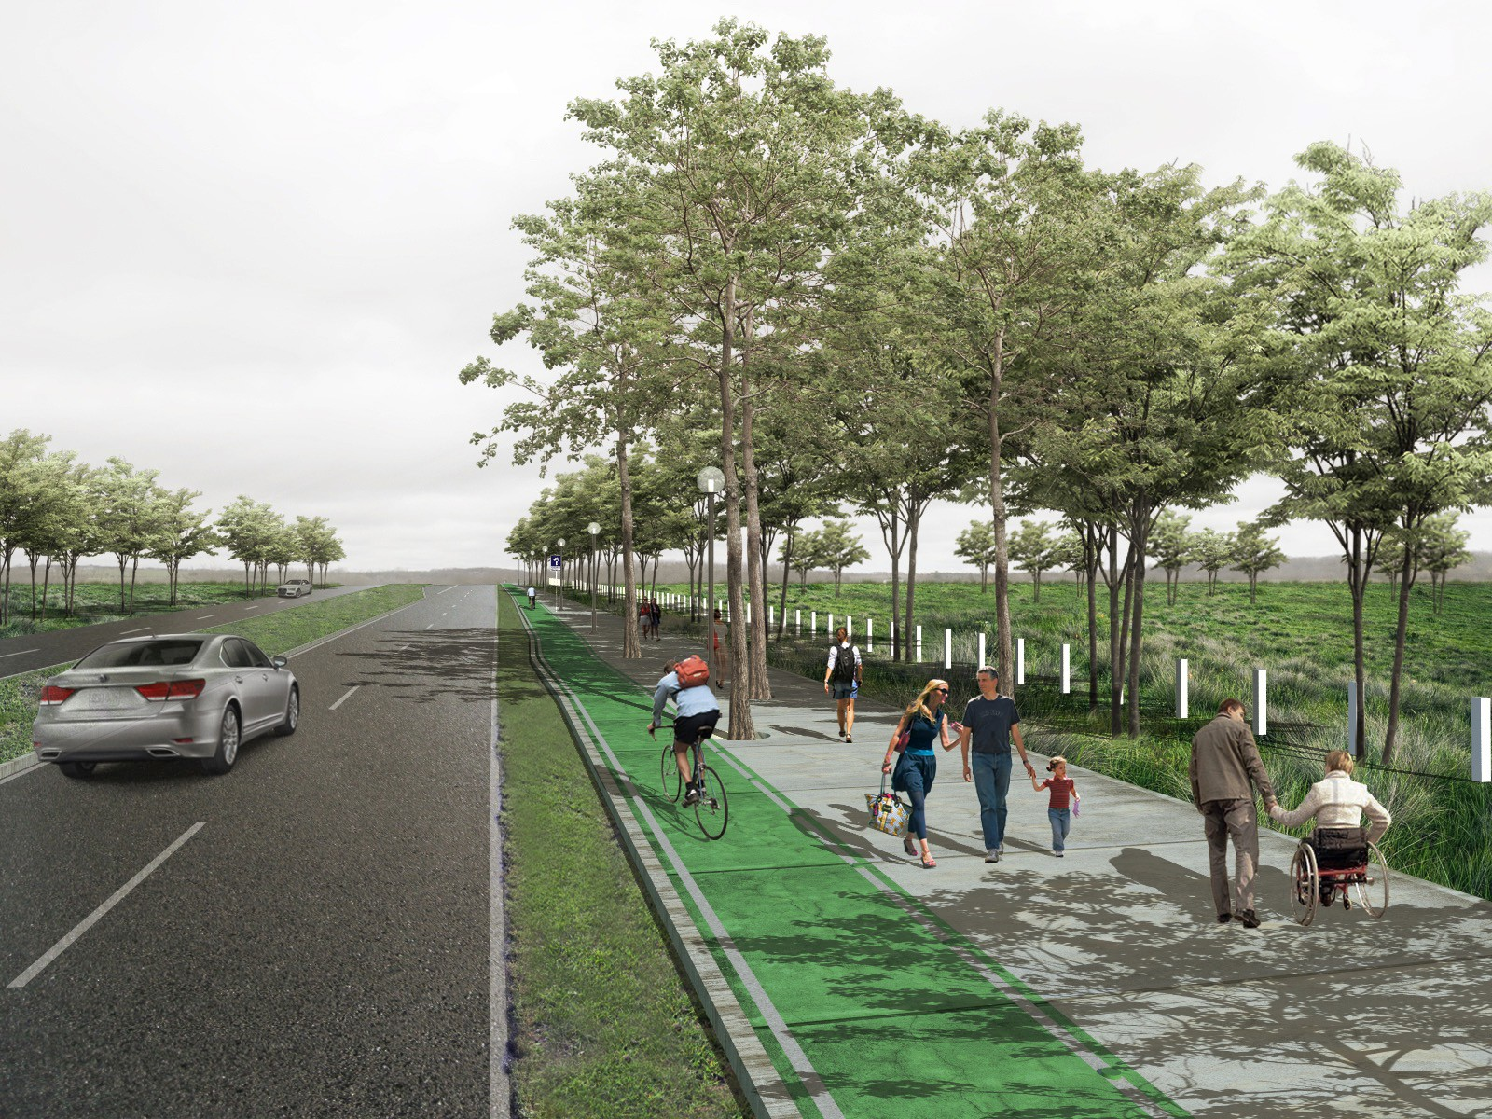
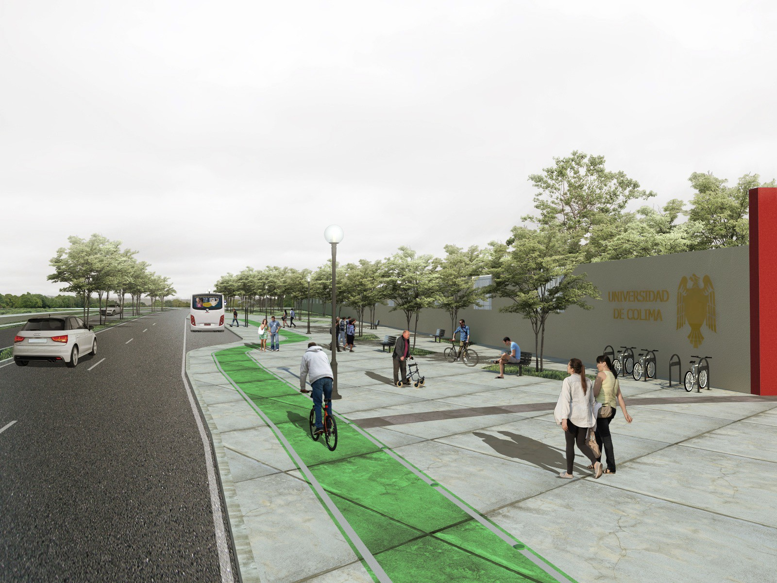
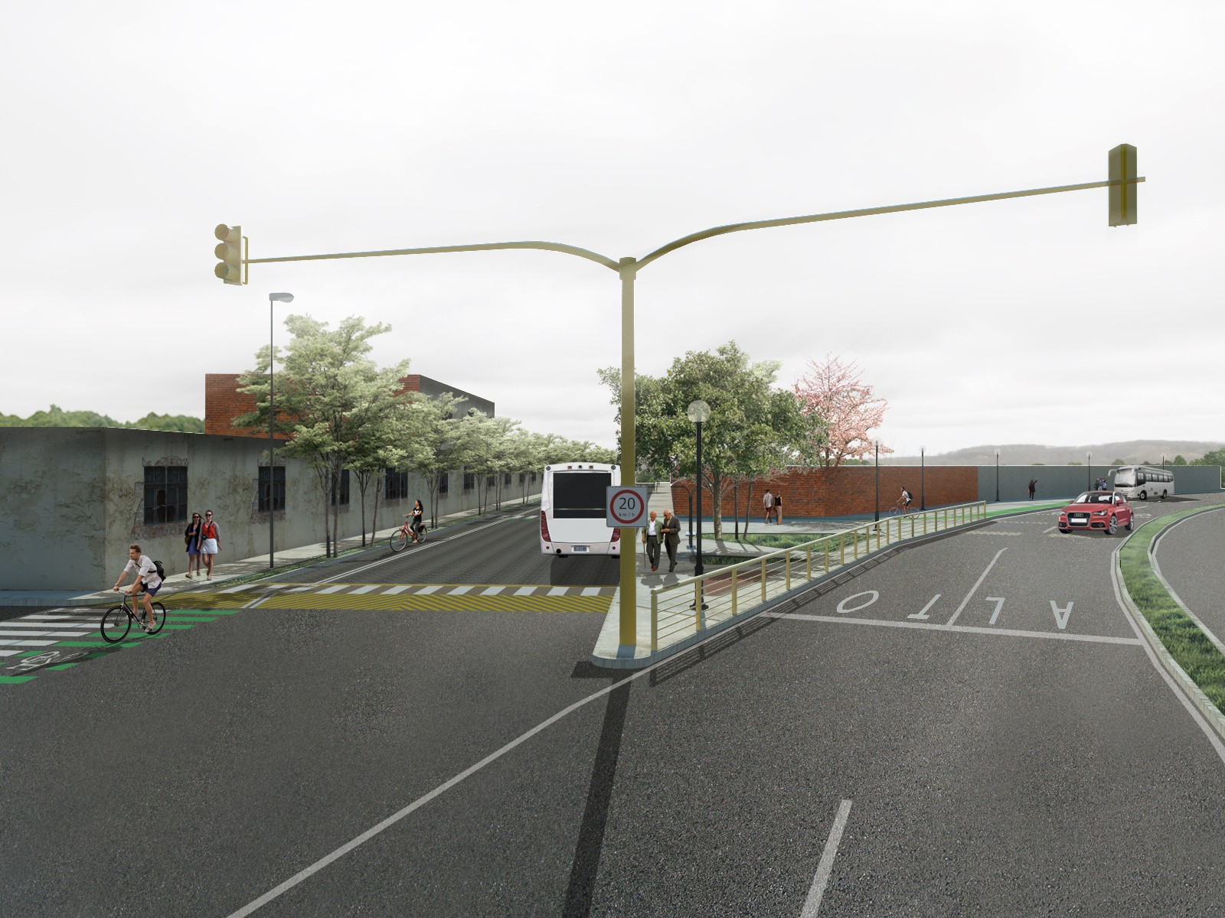
Bicycle Infrastructure Network
COLIMA

Slide 19










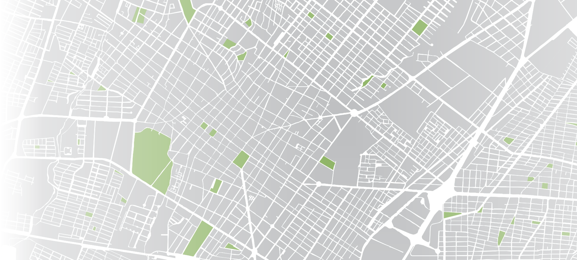
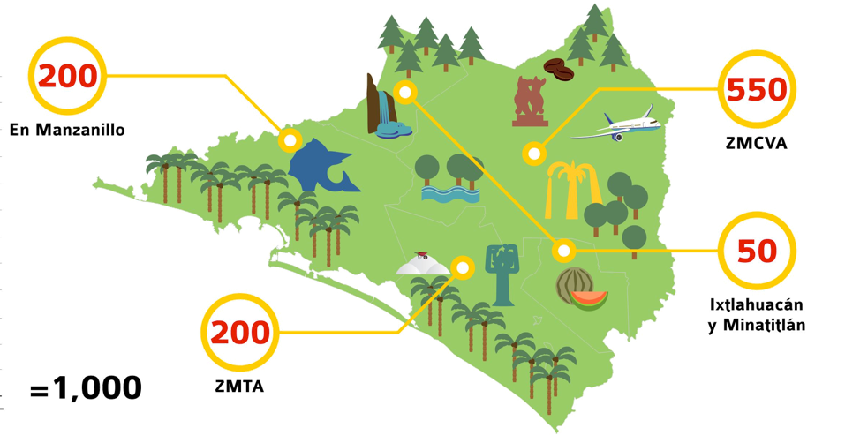




COLIMA
Culture
8daZXi^kd X^Xa^hiV
EVgi^X^eV Zc aV ZaVWdgVX^c YZa
BVcjVa YZ 8^Xa^hbd YZa :hiVYd YZ 8da^bV
IZbVh YZ X^Xa^hbd/
JgWVcd"Ijghi^Xd"GZXgZVi^kd"9Zedgi^kd
>c^X^VgZbdh Xdc aV XdadXVX^c YZ W^X^ZhiVX^dcVb^Zcidh
µ>chXg^WZ
ij egdejZhiV!

Slide 20
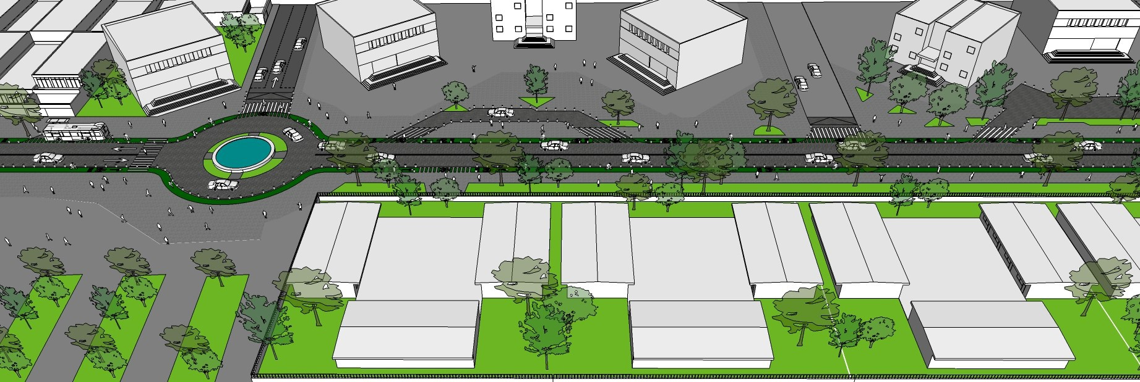
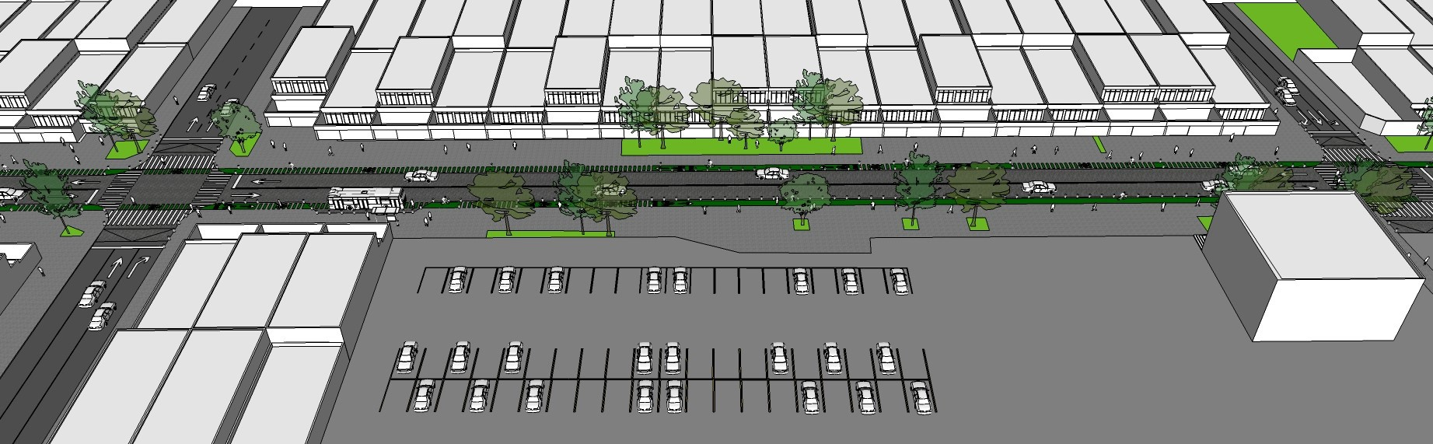
COLIMA
Community Generated Solu2ons

Slide 21
COLIMA
ROAD SAFETY
Ministry of Mobility

Slide 22





Strategic Alliances
08
ONG’s
04
Movilidad
02
Gobierno del Estado
07
Tránsito
01
Presidencia Municipal
03
INCODIS
05
09
INEGI
Cruz Roja
06
IPCO

Slide 23
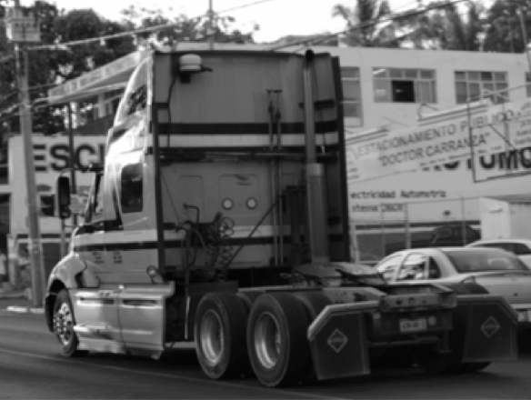
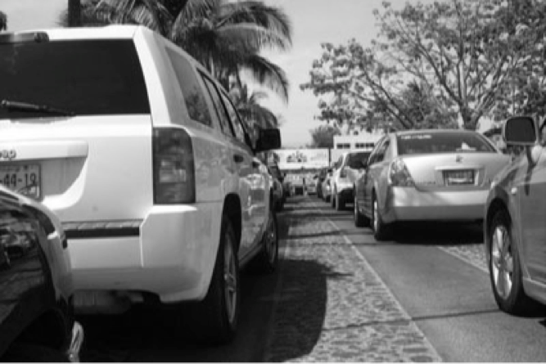
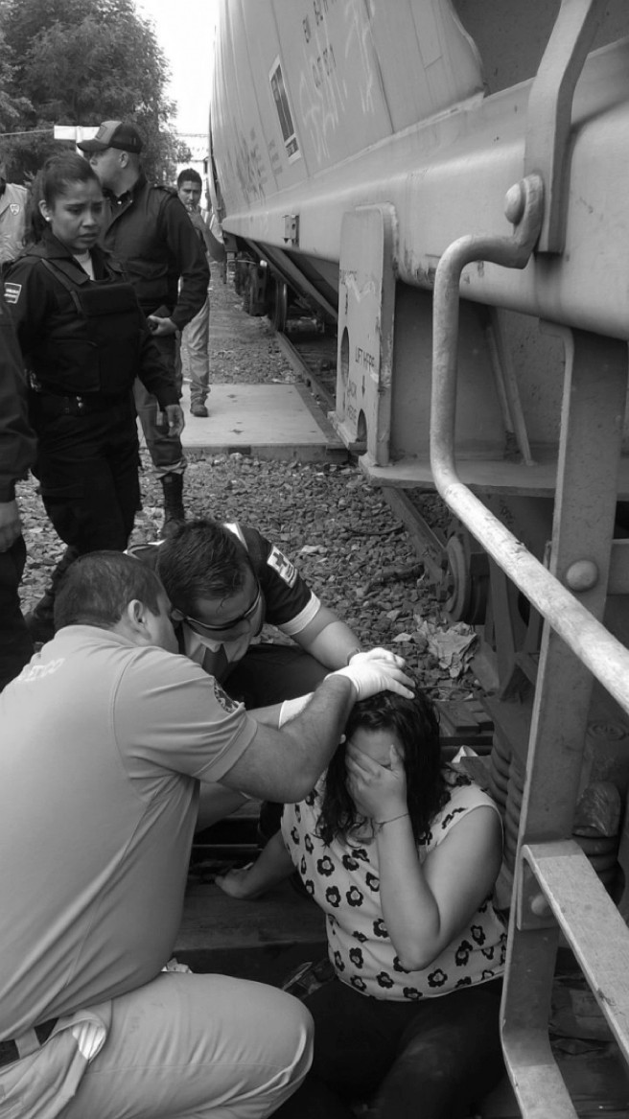
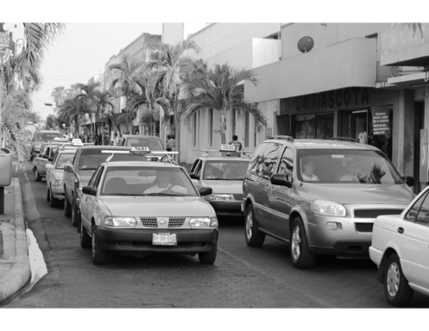
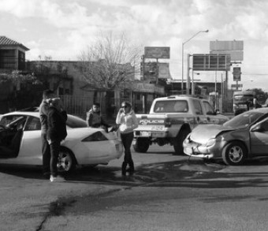
Road Safety
COLIMA

Slide 24

OBJETIVE
COLIMA
To reduce the number of deaths and injuries caused by road incidents.
To promote people-centered road safety towards a zero-incident-fatality view
STRATEGY

Slide 25
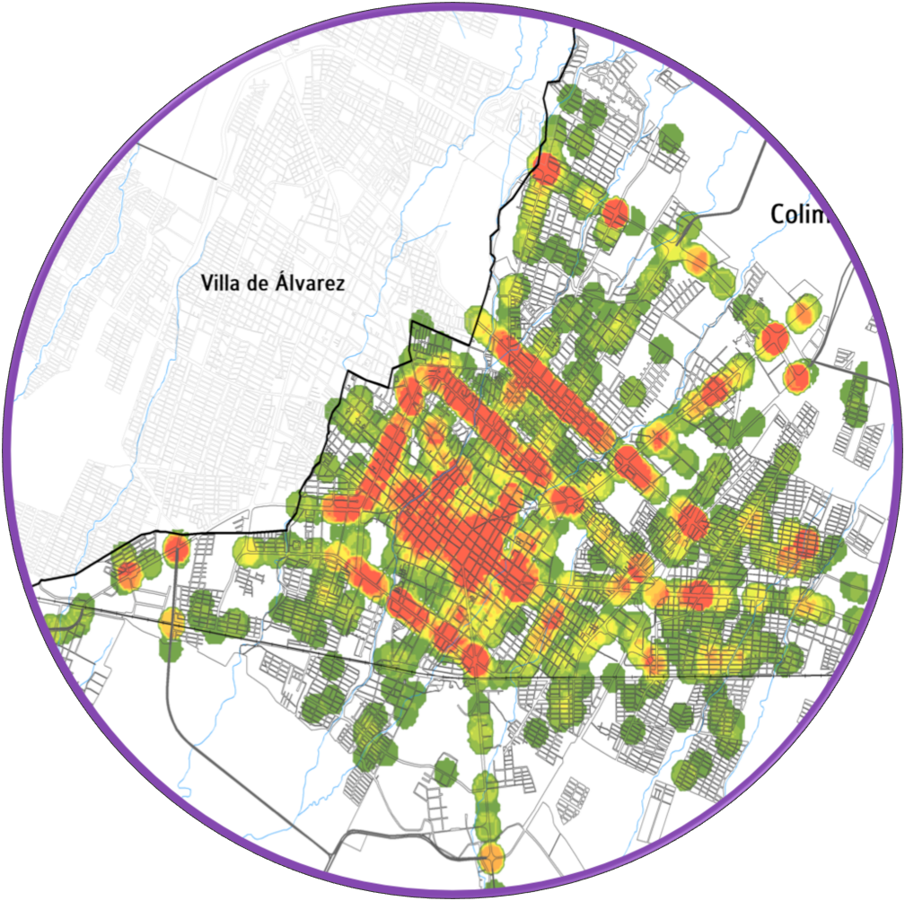
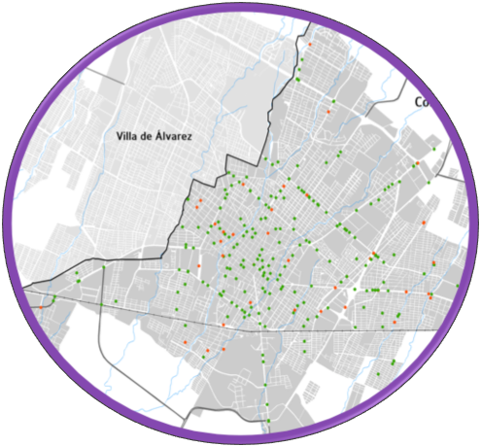
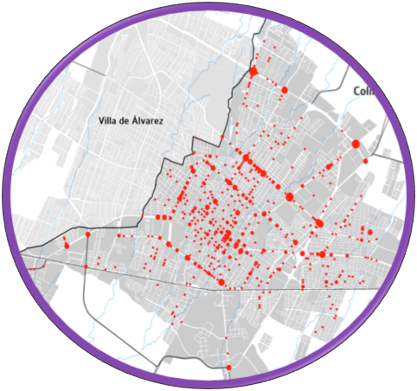
Road Audits
Safety

Slide 26
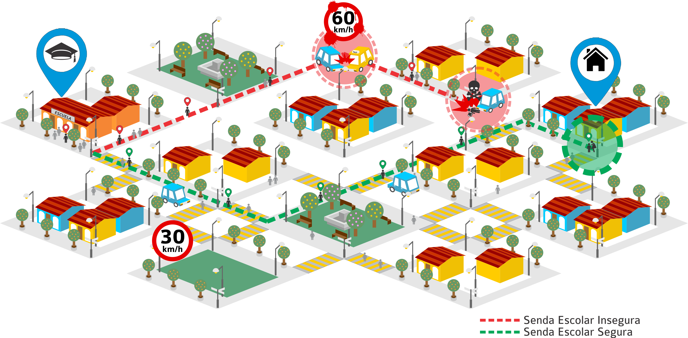
Safe Routes to School
^{5 E’s} ENGINEERING ^{EDUCATION} EVALUATION
^{ENFORCEMENT} ENCOURAGEMENT

Slide 27

Rodrigo Guerrero Maldonado M.
Non Motorized Mobility Director
Road Safety Director
rodrigo.guerrero.semov@gmail.com
+521 5521154832
“If you can change one street, you can change the world”
Jane^e Sadik-Khan, Former Transport Comissionate for New York

