Slide 1

Building Connected Multimodal Networks in Rural and Suburban Communities

Slide 2
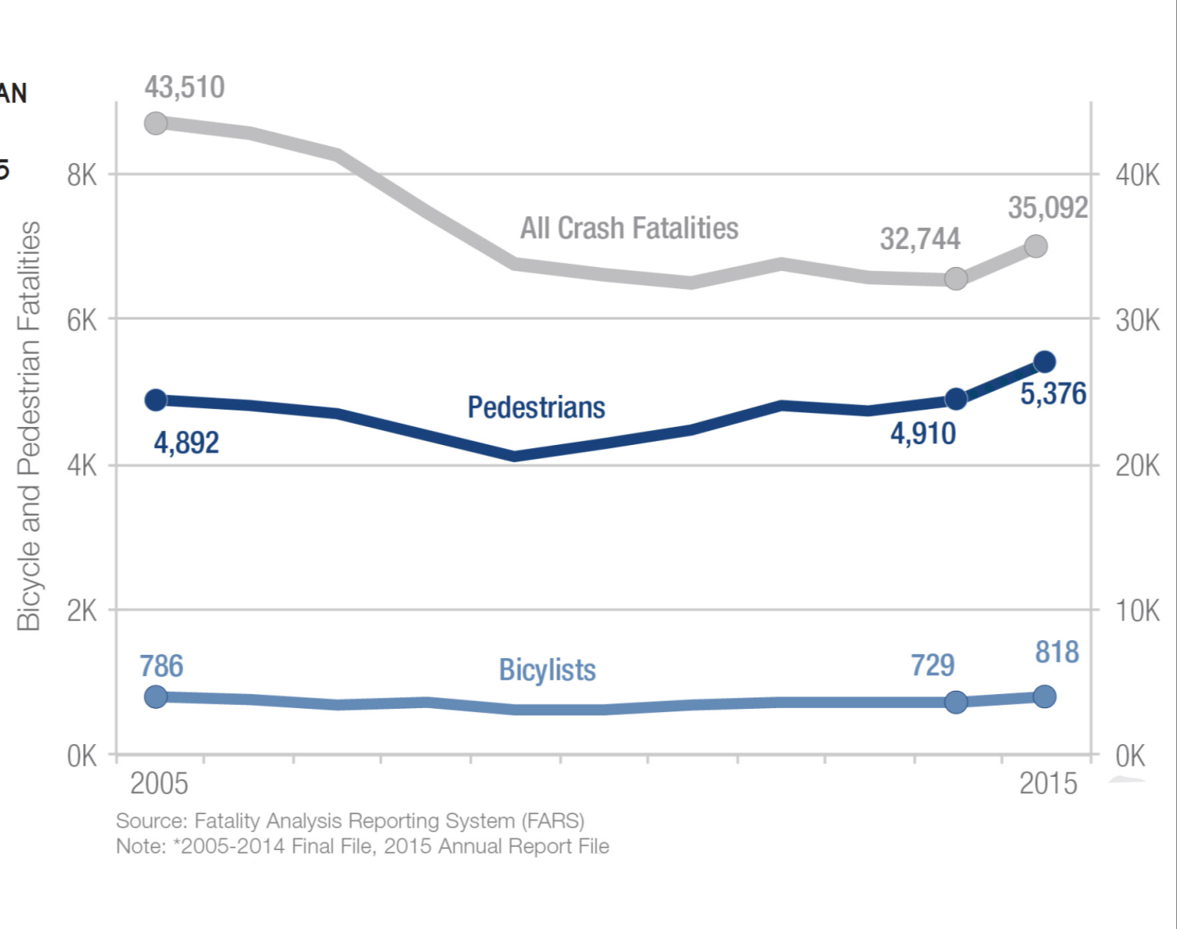

Slide 3
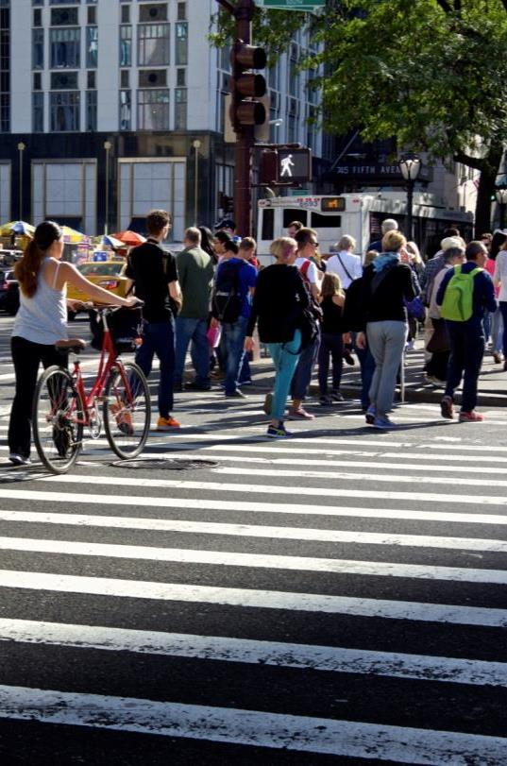
National Context
  FHWA Support For
  An integrated, safe, accessible, and convenient transportation system for all users
  Background
  Safety is the #1 priority
  State and local demand
  Design flexibility
  Accelerated project delivery
  System efficiency
  Economic development

Slide 4
Policy and Guidance
  Policy Statement on Bicycle and Pedestrian Accommodation
  The DOT policy is to incorporate safe and convenient walking and bicycling facilities into transportation projects. Every transportation agency, including DOT, has the responsibility to improve conditions and opportunities for walking and bicycling and to integrate walking and bicycling into their transportation systems. Because of the numerous individual and community benefits that walking and bicycling provide — including health, safety, environmental, transportation, and quality of life — transportation agencies are encouraged to go beyond minimum standards to provide safe and convenient facilities for these modes.

Slide 5
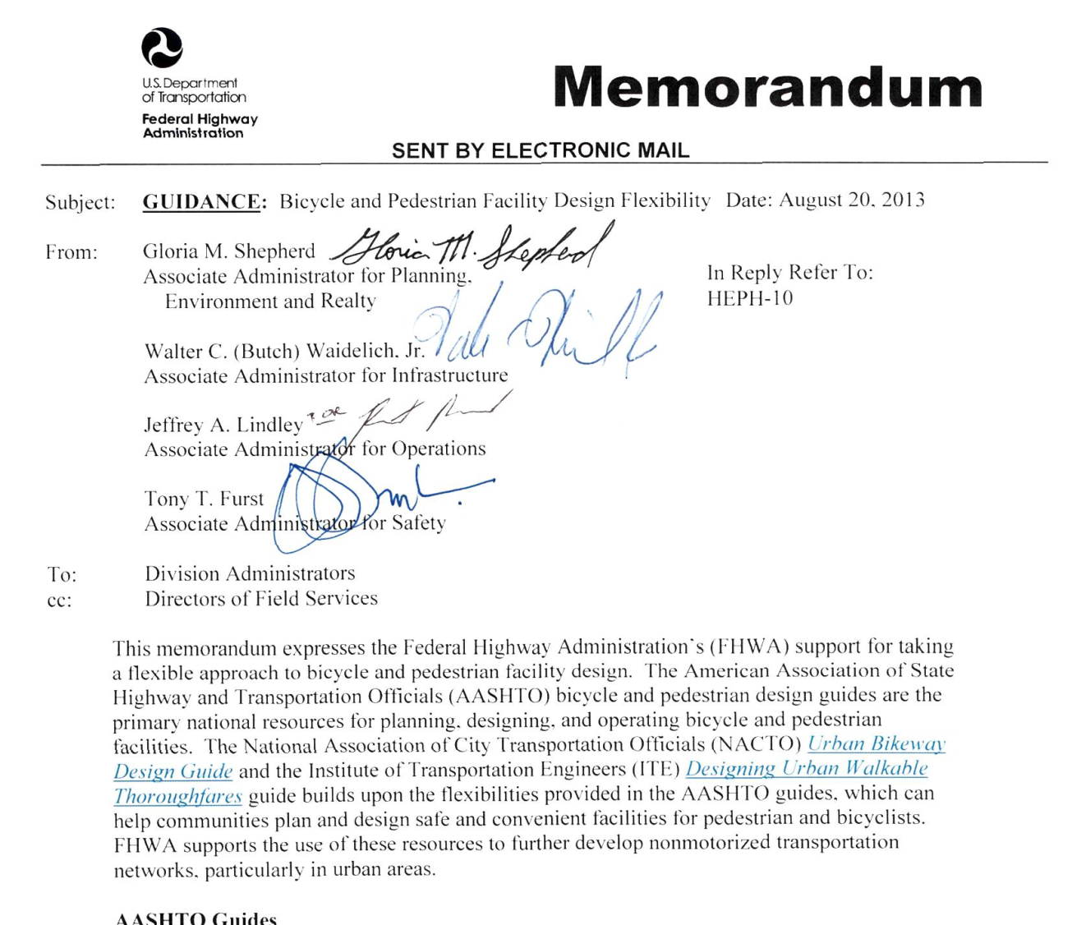

Slide 6
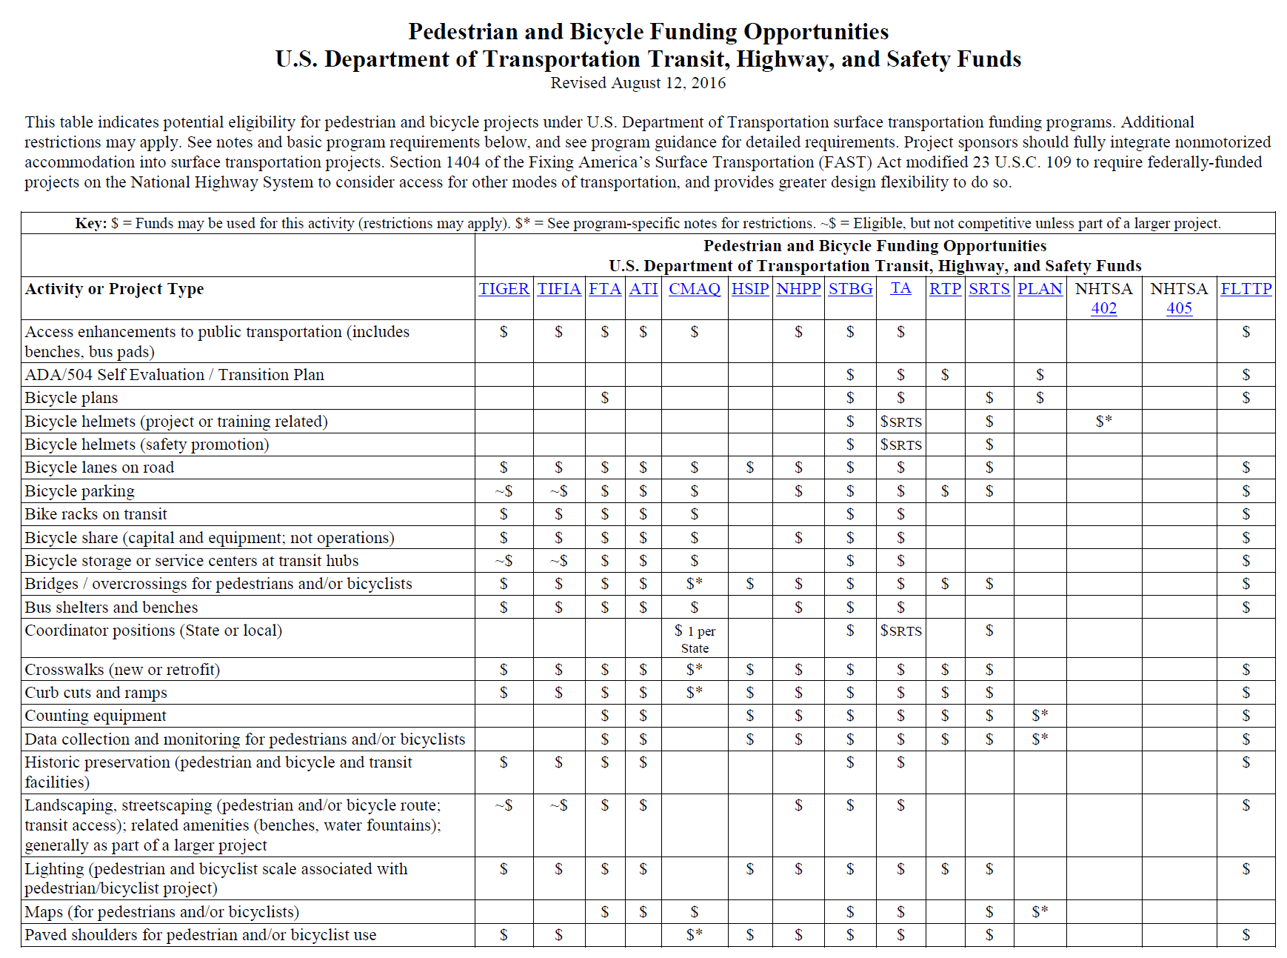
Available at www.fhwa.dot.gov/environment/bicycle_pedestrian

Slide 7

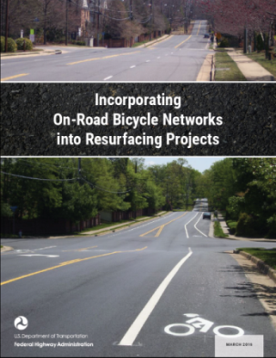

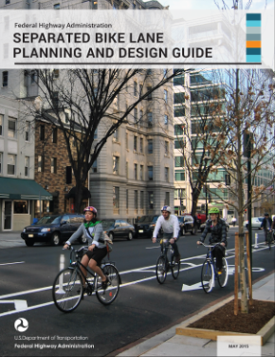
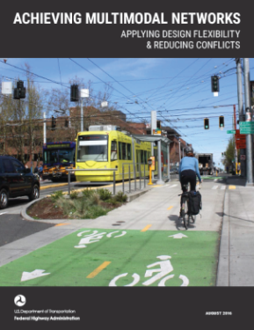



Planning and Design Guidance

Slide 8
Multimodal Networks
Multimodal networks are interconnected pedestrian and/or bicycle transportation facilities that allow people of all ages and abilities to safely and conveniently get where they want to go.
FHWA Case Studies in Delivering Safe, Comfortable, and Connected Pedestrian and Bicycle Networks

Slide 9
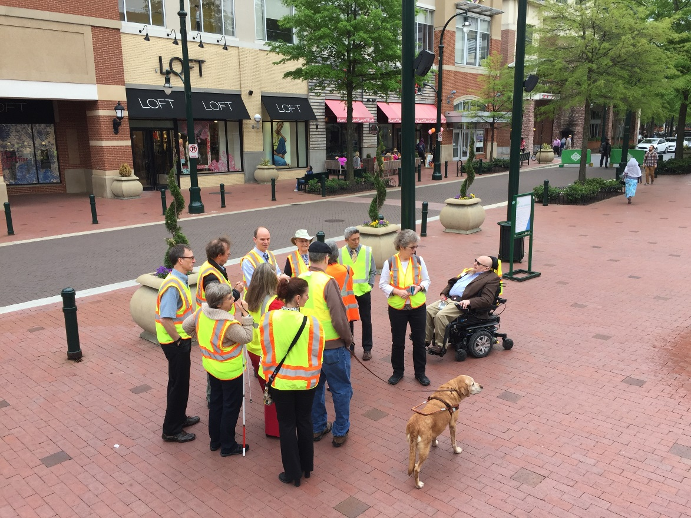
Multimodal Network Principles
  Cohesion
  Directness
  Accessibility
  Alternatives
  Safety and Security
  Comfort
FHWA Case Studies in Delivering Safe, Comfortable, and Connected Pedestrian and Bicycle Networks

Slide 10
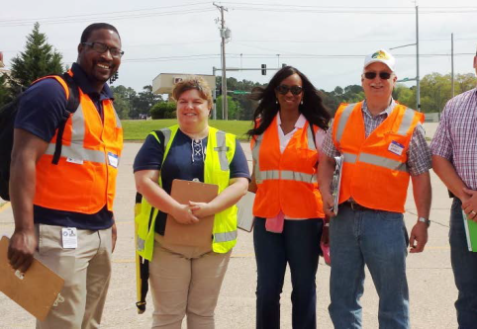
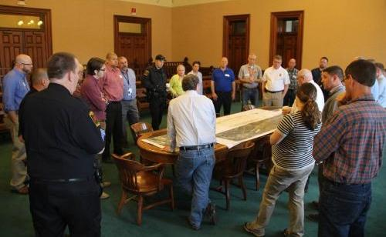
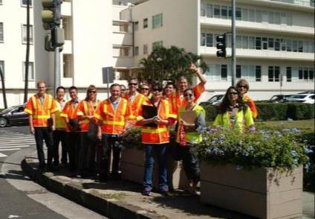
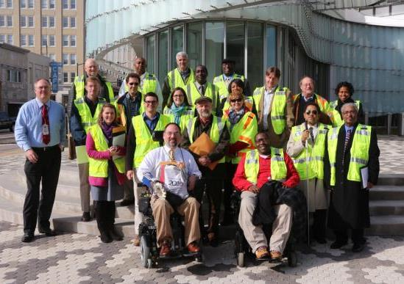
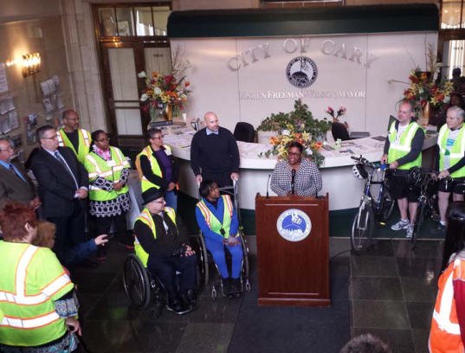
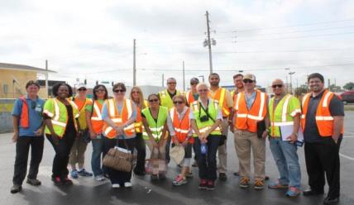
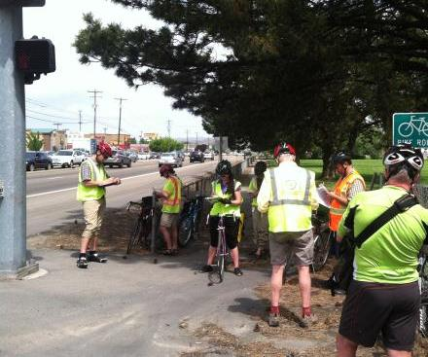
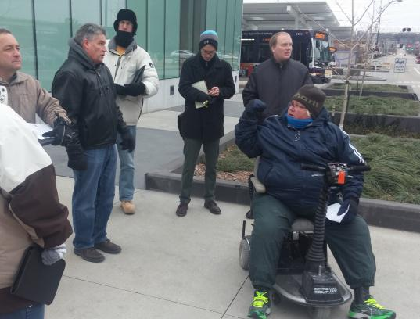
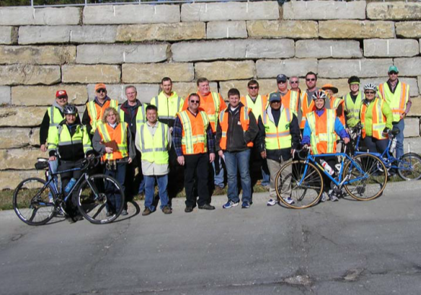

Slide 11
Filling Gaps — Resources in Development
Measuring Multimodal Network Connectivity
  How to measure multimodal network connectivity and track change in connectivity over time?
Bike Facility Selection Guide
  How to identify the most appropriate bike facilities?
Innovative Street Design and Accessibility
  How to ensure that people with disabilities can navigate around new and emerging designs such as separated bike lanes and shared streets?
Scalable Risk Assessment Methodology
  How to measure exposure to risk for walking and biking?

Slide 12
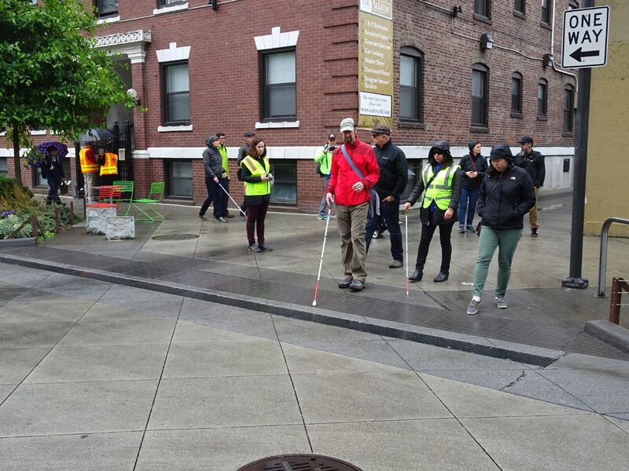

Slide 13
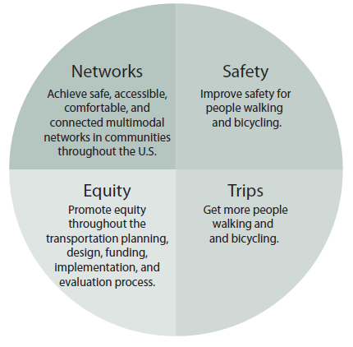


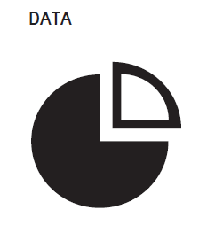

Strategic Agenda for Pedestrian and Bicycle Transportation
Aspirational Goals
Achieve an 80 percent reduction in pedestrian and bicycle fatalities and serious injuries in 15 years and zero pedestrian and bicycle fatalities and serious injuries in the next 20 to 30 years.
Increase the percentage of short trips represented by bicycling and walking to 30 percent by the year 2025. This will indicate a 50 percent increase over the 2009 value of 20 percent. Short trips are defined as trips 5 miles or less for bicyclists and 1 mile or less for pedestrians.

Slide 14
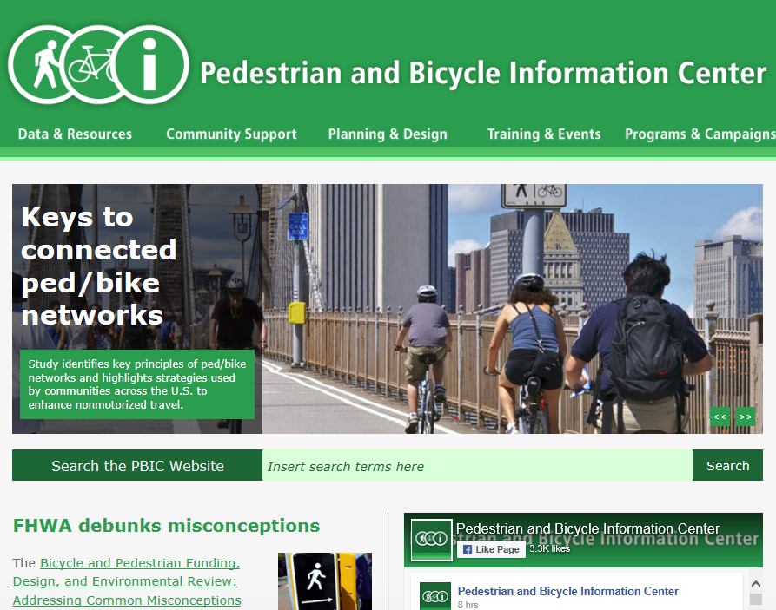

Slide 15

Selected FHWA Contacts
Dan Goodman
Office of Planning, Environment, and Realty
Daniel.Goodman@dot.gov
Christopher Douwes
Office of Planning, Environment, and Realty
Christopher.Douwes@dot.gov
Gabriel Rousseau
Office of Safety
Gabe.Rousseau@dot.gov
Elizabeth Hilton
Office of Infrastructure
Elizabeth.Hilton@dot.gov
Dave Kirschner
Office of Operations
David.Kirschner@dot.gov
For More Information:
www.fhwa.dot.gov/environment/bicycle_pedestrian

