Slide 1
Evolution of a pedestrian and bicycle count program
Marian Mithani
Eco-Counter
APBP Professional Development Seminar
Memphis 2017
Notes:
Greet audience.
This
Other presentation may go more in-depth, but
The purpose of to

Slide 2
Background
Notes:
Eco-Counter’s knowledge comes from our clients. Having worked with hundreds of organizations across North America, in 42 states, 8 Canadian provinces, there is a lot of experiential knowledge to share.
In fact, that was my draw to Eco-Counter. I joined in 2015 and before that, I worked in consulting to help cities create AT plans and design bike/ped networks. I joined Eco-Counter to to understand who, and how, count data is used to inform their bike/ped decisions.
So the information in this presentation comes from:
-
-
-More recently, phone interviews with select clients
FULL DISCLOSURE: in the business of automated counters, focus of this presentation is on count programs from our clients that use this technology. I provide less information about programs that involve manual counts, etc, but can provide context.

Slide 3
You will learn about:
Approaches to build up a count program
Next steps to start or grow a program
Client examples
Try-it-out
As-you-build-it
Plan-it-out
Goals
Outcomes
Lessons / Questions
Trends
Recipe for success
Advice from clients
Notes:
In client examples, I will cover:
GOALS that triggered a count program
OUTCOMES
LESSIONS/QUESTIONS as programs evolve

Slide 4
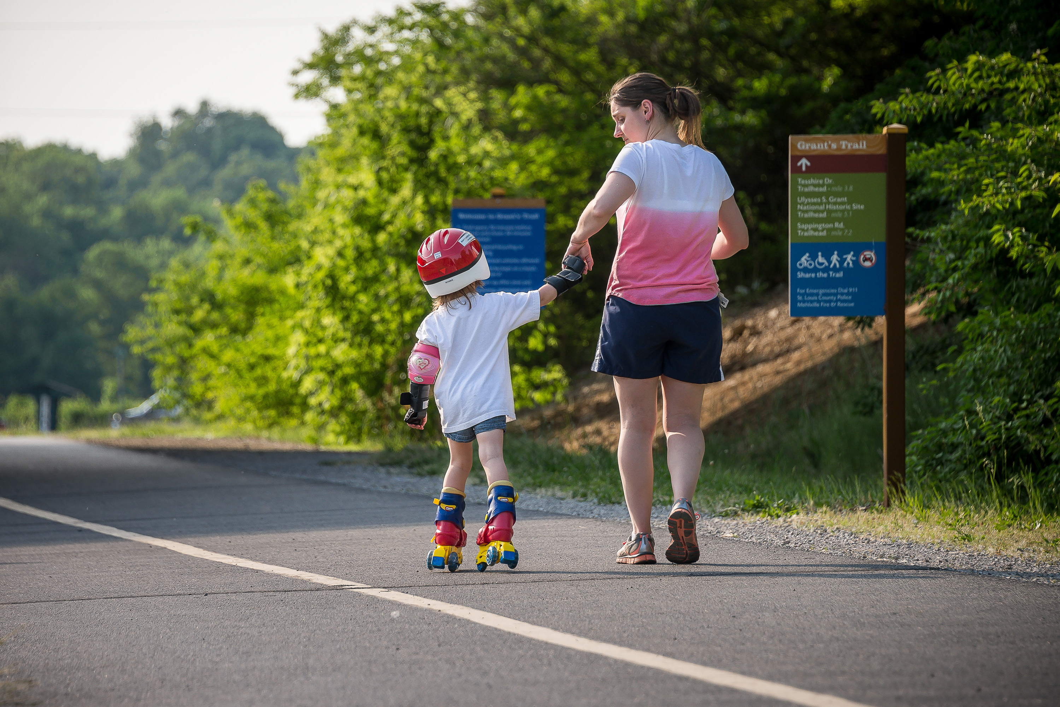
Common themes
Goals:
Complement or “fill in” other data
Outcomes:
Data for decision-makers
Input to other projects
Lessons/questions:
Evaluate impact of AT investments
Become regular practice
Inform planning
Shifting ownership
Maintenance
Role of partnerships
Management in long-term
Reduce need for other data collection practices

Slide 5
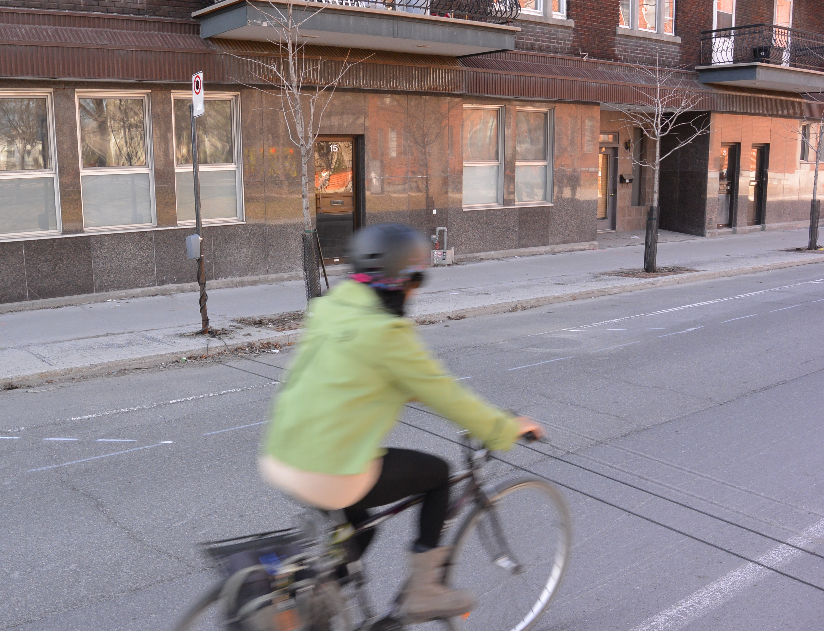
Try-it-out
Advantages
Context
Baseline counts
Less defined outcomes
Learning process
Lower stakes
Less lead up time
Flexible process
Pilot projects
Funding sources vary
Develop framework over time

Slide 6
Hamilton, Ontario
Started in 2011 with portable pedestrian counters
“Graduated” to tube counters in 2013
Helped to identify permanent sites for 2014/15
Focused on permanent counters off-road 2016
On-road bike counts continue where facilities exist, rotating locations
Over 6 years, 100 sites, with 1-week samples for consecutive seasons
Notes:
Hamilton, ON. Population about 550,000 people. About 1h away from Toronto, halfway to Niagara Falls on Lake Ontario.
This is a view from the Niagara Escarpment, which has stairs and trail, with pedestrian counters,
When they started in 2011, they invested in 2 portable pedestrian counters – targeted well-known popular places:
Mostly trails, waterfront, near downtown, pedestrian bridge, etc.
GOAL: baseline, supplement TMCs, quantify known activity,
OUTCOMES: lead to designated fund,
SURPRISES: coordination required to on-street permanent counters,
partners in data management,

Slide 7
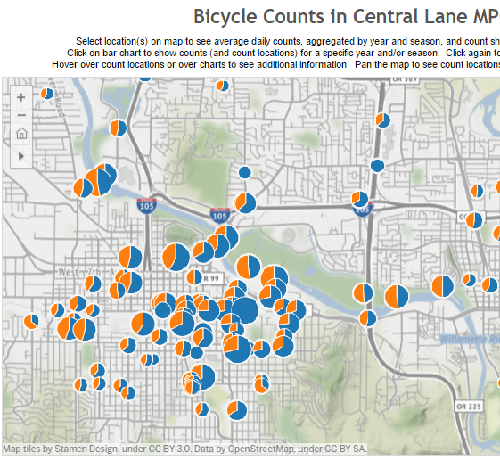
Lane Council of Governments, Washington
Notes:
Lane COG is MPO around Eugene (pop 160,500) and Springfield (pop. 60,000), Oregon. About 1.5h south of Portland.
GOALS:
OUTCOMES: help apply for federal funding,
LESSIONS / CHALLENGES

Slide 8
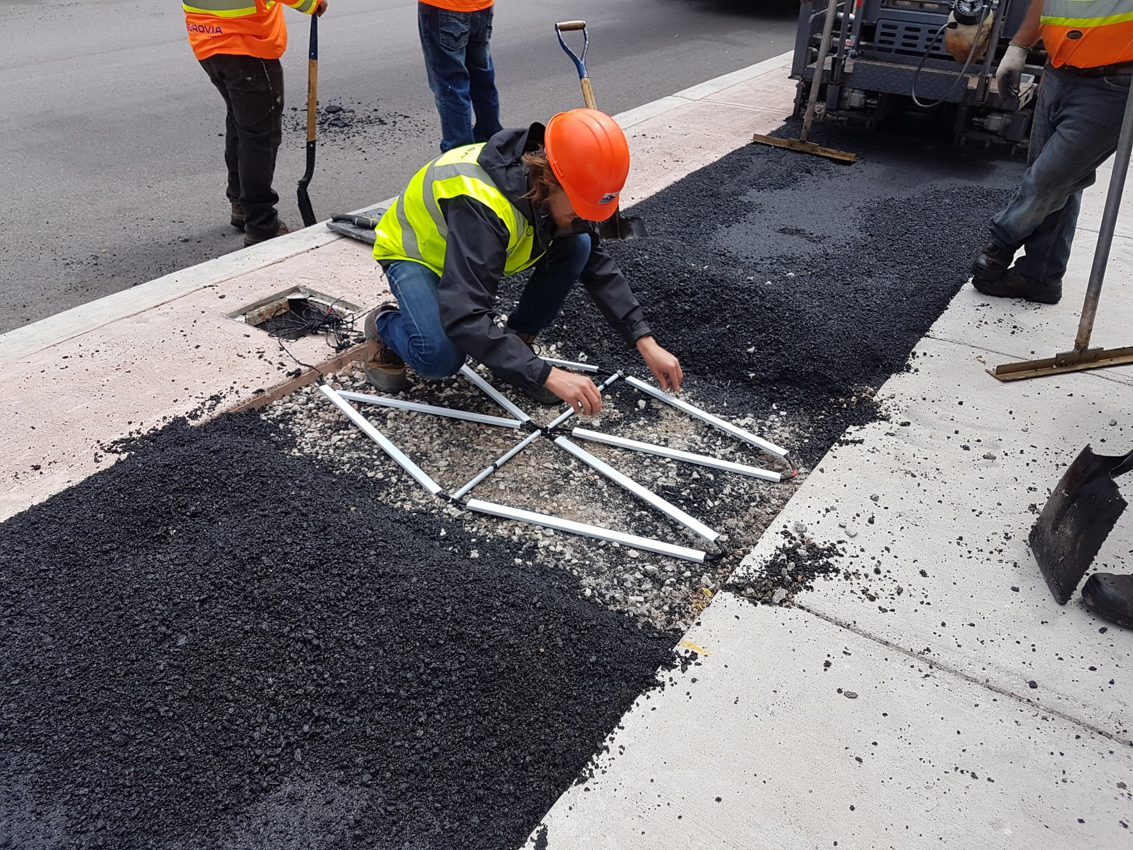
As-you-build-it
Advantages
Context
Project opportunities
Capital vs. operating funds
Link to network development
Data infrastructure concept
Can be high-profile
Requires buy-in early
“Built-in” evaluation

Slide 9
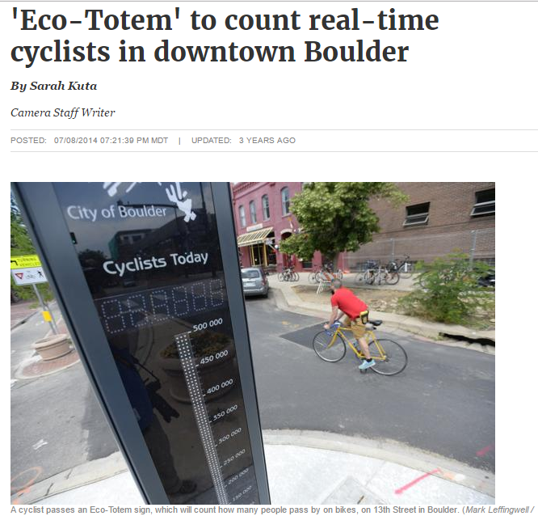
Boulder, Colorado
Started with signature project
First focused on bikes, then pedestrians
Added permanent counter to corridor projects
Starting to add retrofit site
Currently rely on TMC for short-duration counts

Slide 10
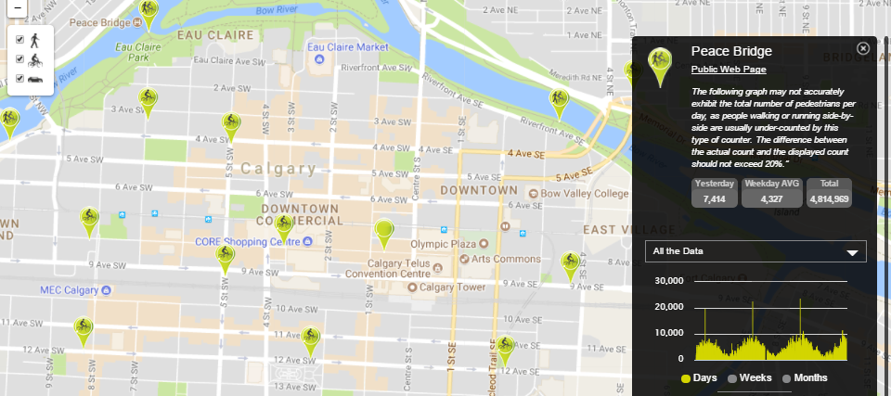
Other client examples
Continuous counts promised as part of grant application
Key corridors identified for permanent stations such as on bridges, protected bike lanes, core trails, etc.
Installed as part of road / bikeway /complete streets projects
Part of minimum grid pilot projects (Calgary)
Counter specifications within tender
Create internal design standards (Ottawa)

Slide 11
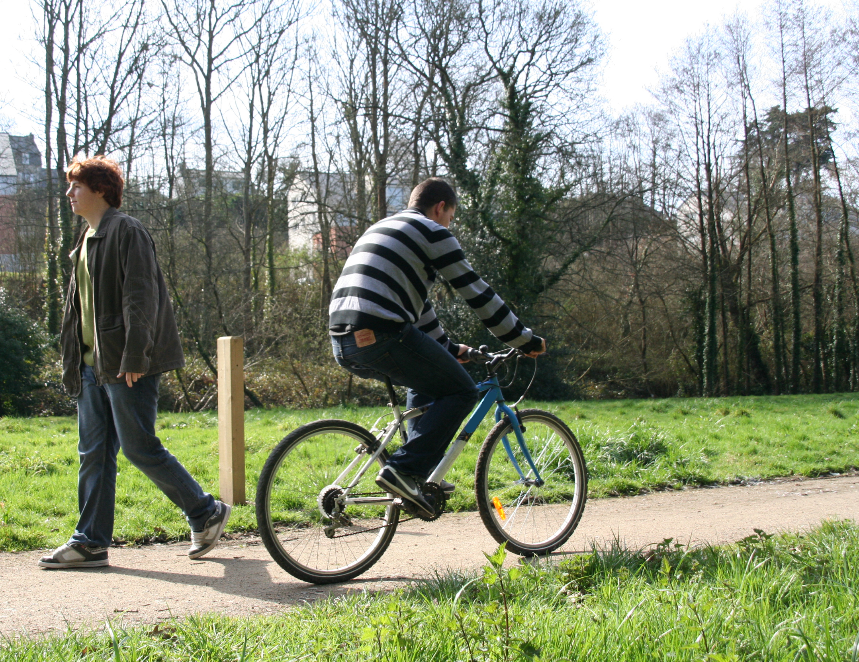
Plan-it-out
Context / aspects
Site selection
Installation
Ownership / maintenance
Data collection, management
Wholesome approach
Built-in consultation
Growth planned
Advantages
Report outcomes pre-determined
Sets basis for future decisions

Slide 12
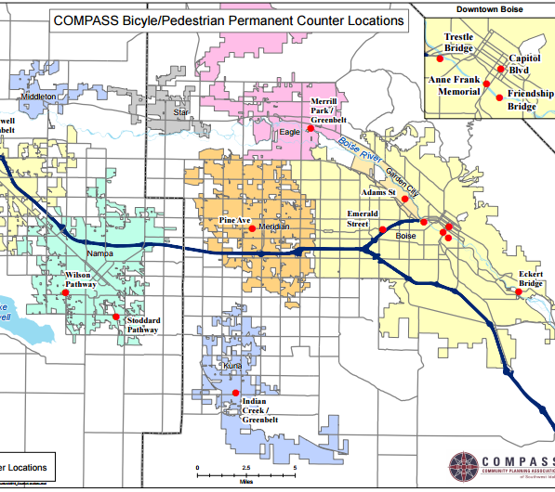
COMPASS Idaho
Key project of newly-formed AT working group in 2014
Met regularly to discuss all things related to data and counters
Installed 8 permanent counters in early 2015, need to be fair
Adding sites to network each year
View of on-going demand

Slide 13
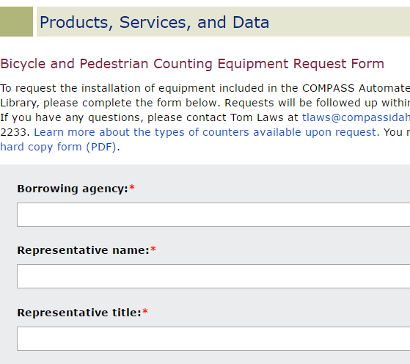
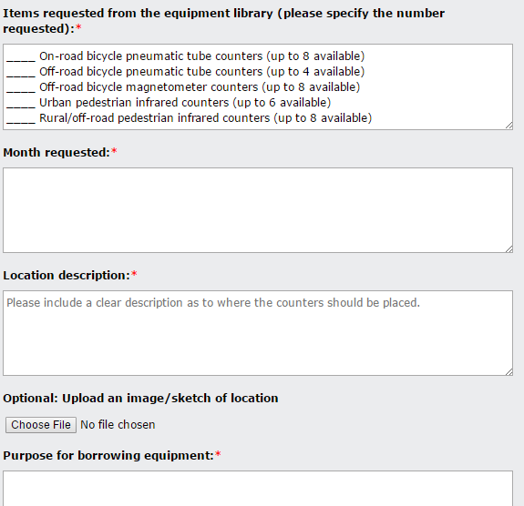
COMPASS Idaho
Working group developed process for count requests
Managed in-house: install and data reports, 1 month interval
Started in 2016 with 20-30 requests, 100+ requests in 2017
Current challenge: person hours, site review,
Considering shift to a counter library
Challenge/concerns: proper installation, care of equipment
Notes:
Success tips for COMPASS: working group to

Slide 14
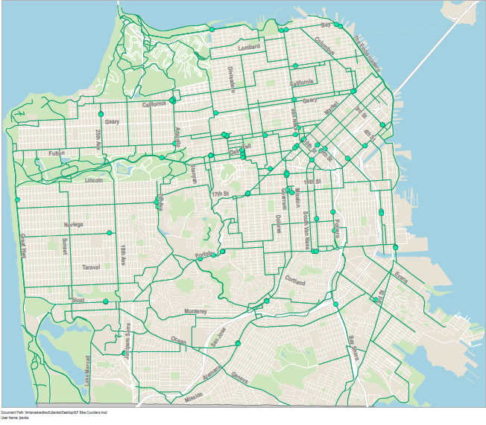
San Francisco Metropolitan Transit Agency
Started annual bike counts in 2006, based on 2h peak periods
First pilot of automated counters in 2009 by Livable Streets
Pilot and expansion to over 75 sites under Livable Streets
Mix of permanent and short-term
Discussions to shift/share responsibilities with Planning
Maintenance contracts in place for next 2 years

Slide 15
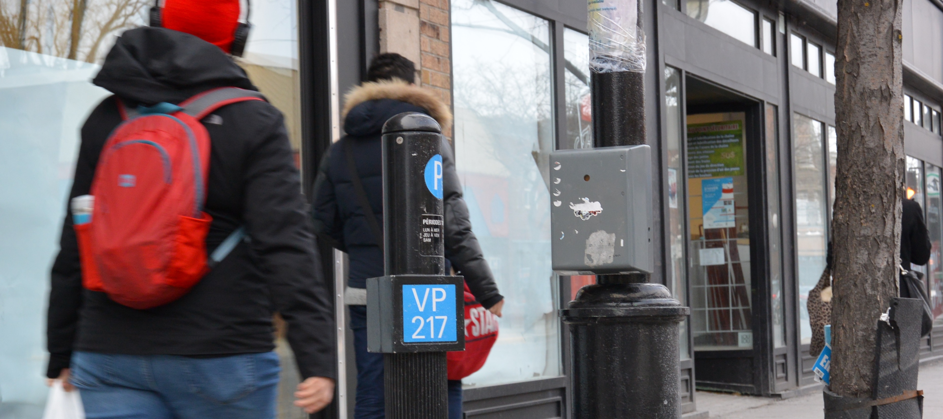
Program Trends
Ownership
Needs a willing lead party
Organization structure affects approach
Awareness:
It takes time to build
Centralized data warehouse
Manageability:
Upfront effort to launch
Different type of effort based on approach
Experience vs. more sites
Notes:
Message for beginners:
-do you have a natural leading party?
-given relationship, what approach works best? Try-out, as-built, or plan-out?
Message for cities with establish programs:
-ask your yourself, what stage is our progress?

Slide 16
Recipe for success
Remember your goals!
May call for different strategy
Share your data
Adjust the approach for your audience
Keep a long view, but take one step at a time

Slide 17
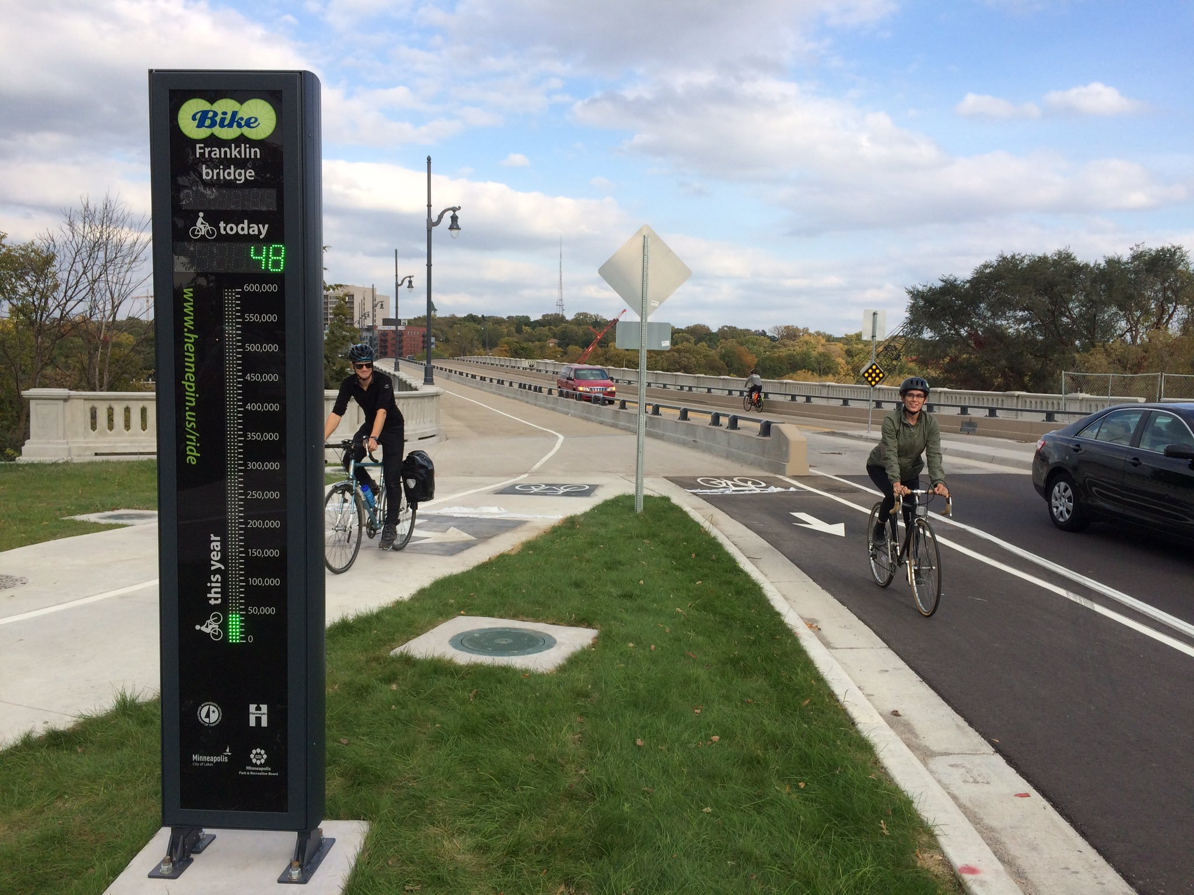
Words of wisdom
Have a story
Have a story to tell from the data. It’s okay to start small. People respond well to information presented in a clear way.
Be patient
Be patient. There will be set backs, but I never heard a comment that the audience did not want this data
–Steve Molloy, Hamilton
Don’t get discouraged
Don’t get discouraged by other cities. It may seem a lot to learn, but you get something really valuable with 24h data.
– Ellen Currier, Lane County COG
–Tom Laws, COMPASS

