Slide 1
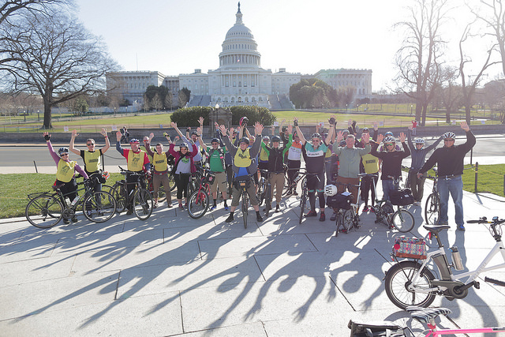
Federal Policy Update
May 2017
Caron Whitaker
caron@clwconsulting.net

Slide 2
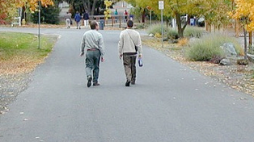
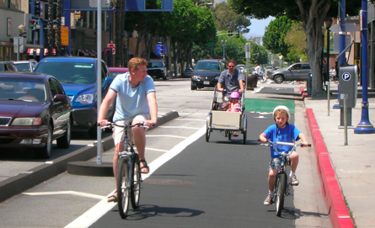
Agenda
Short term
  Public input on Streamlining
  Safety Performance Measures
  Expiring TA funds
Medium Term
  Budget
  Tax Reform
  Infrastructure Proposal
Long Term
  Performance measures
  Local control (i.e.- speed limits)
  Planning process

Slide 3
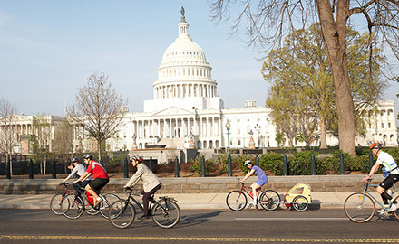
Summer 2017
Public Comments, Performance Measure and TA

Slide 4
Time Line
Month | States | US DOT | Congress
June |  | Announces Public Comment on Streamlining regulations
July |  | Comments due on streamlining regulations | Transportation, HUD budget
August | Safety performance measures due |  | (possibly tax reform)
September/Fall | TA funds expire | Possible redesigned TIGER | Budget

Slide 5
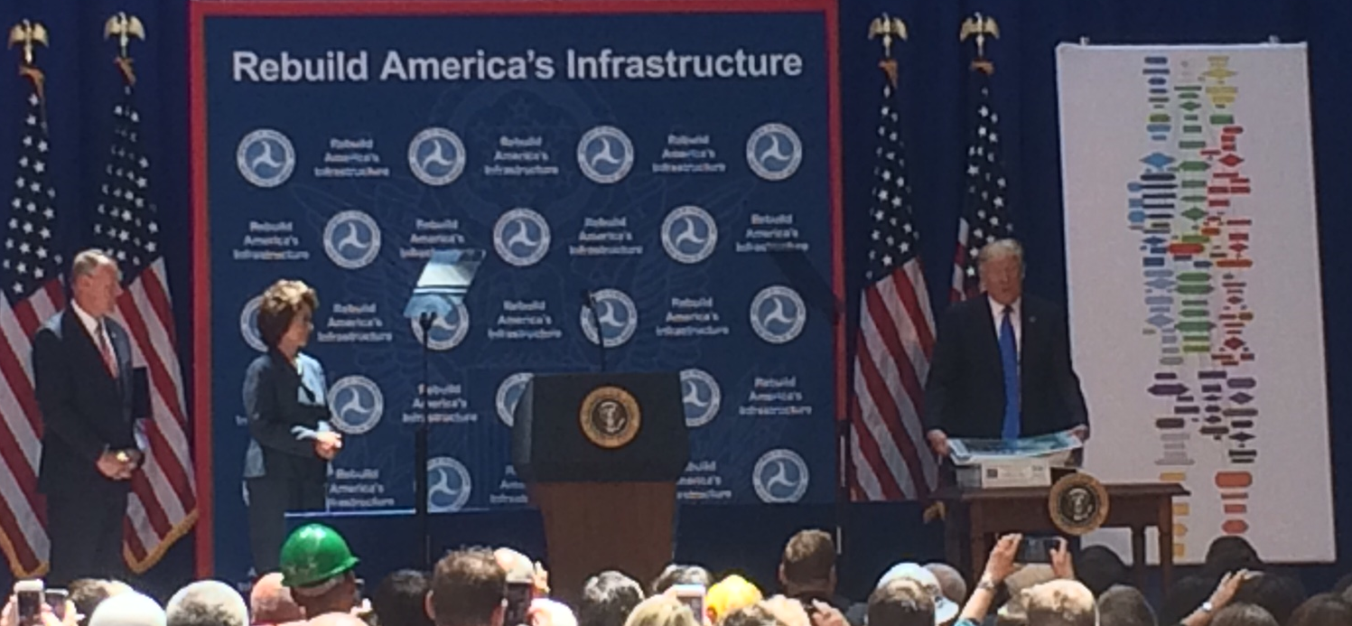
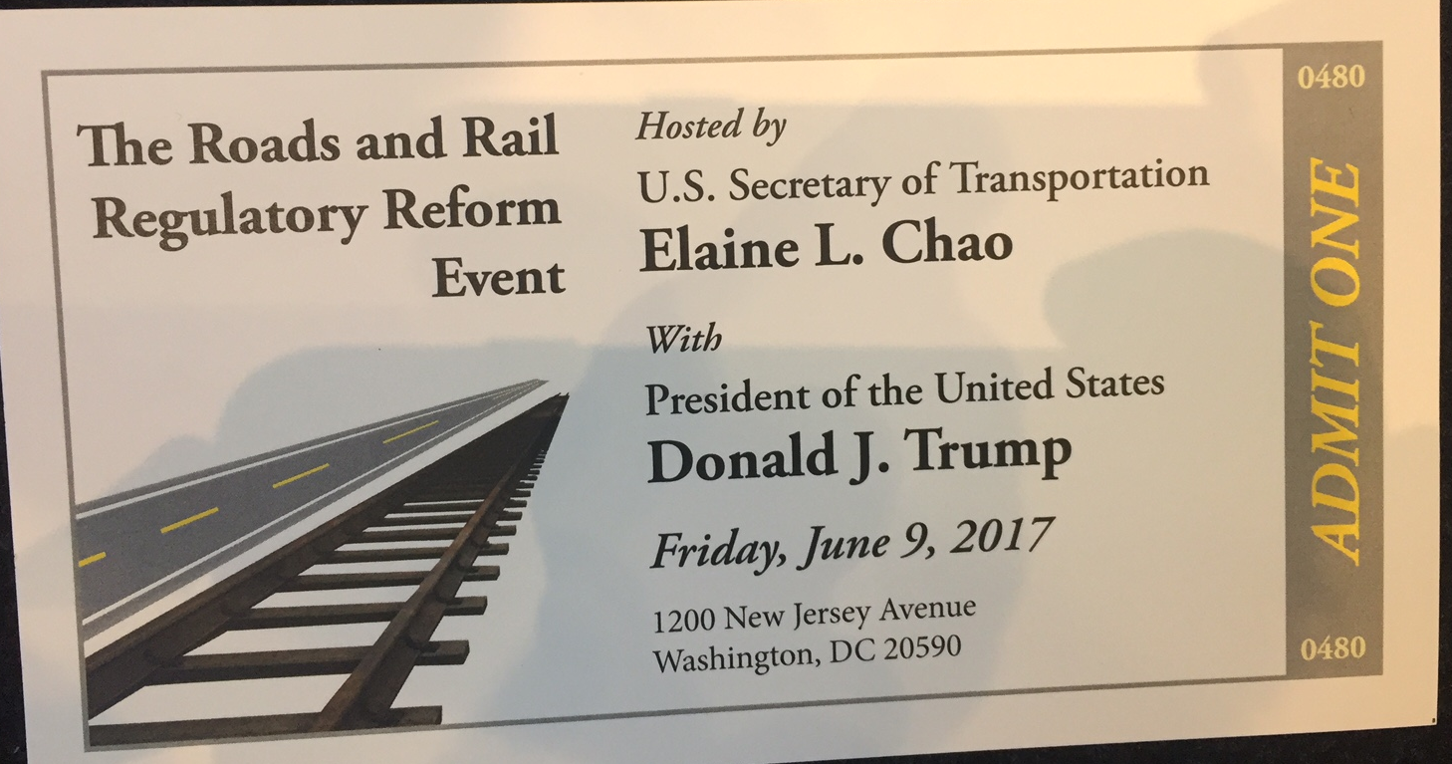
Streamlining Regulations
Part of President Trump’s Infrastructure plan
  Reduce permitting process from 10 to 2 years.
  Announced a council to review rules
  A public dashboard to follow project permitting process.

Slide 6
Public Comment Period
The DOT is reviewing its existing (non statutory):
Policy statements
Guidance documents
Regulations
To identify unnecessary obstacles to transportation infrastructure projects
Requesting affected stakeholders to weigh in
Comments due July 24th
To Comment:
Go to regulations.gov
Search for ID: DOT-OST-2017-0057-0001

Slide 7
Working together
APBP members send me a paragraph describing:
  What regulation you would like changed
  Why? Time or resource intensive
  Suggestion for change (if applicable)
Compile, make sure they are non-statutory
Send back as google file with directions on how to file, sample letter
  Individuals can choose what to put in their comments
  And have benefit of your colleagues.
Board can potentially send in comments for organization

Slide 8
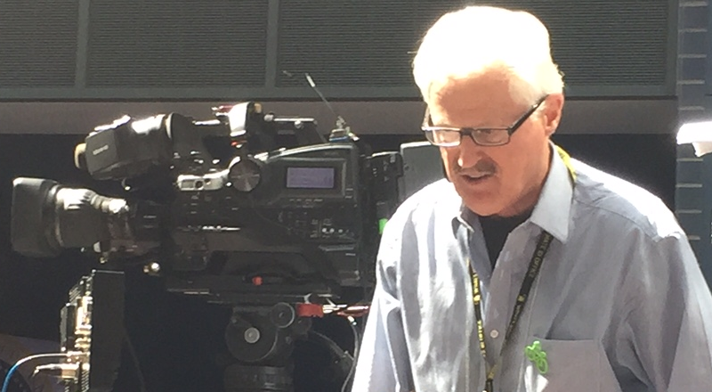

Slide 9
Performance Measures
In 2012, Congress passed directive to US DOT to create performance measures, including:
  Safety
  Congestion mitigation
  Performance of National Highway System
Once created, States and Metropolitan areas will need to set goals and measure their progress

Slide 10
Safety Performance Measures
Total number of Roadway fatalities
Rate of fatalities per 100,000 VMT
Total number of serious injuries
Rate of serious injuries per 100,000 VMT
Total number of non-motorized fatalities and injuries
States and Metropolitan planning organizations (MPOs) must set goals for each

Slide 11
Timetable-
Safety Performance Measures
Safety performance measure includes a total reduction of
bicycle and pedestrians fatalities and serious injuries
Deadline | What’s due
August 31, 2017 | States and MPOs report Initial Targets reported to FHWA
August 31, 2019 | State assess and report on progress
December 2019 | FHWA Assess progress

Slide 12


Slide 13
State TA funds
Recreational Trails funds
come off the top
50% in competitive process run by the state
50% Based on population
MPOs with population >200,000- get funding to run a competitive process
OR
State can transfer funds to other highway programs
<200,000 population (run by the state DOT)
< 5000 Population
(run by the state DOT)
Notes:
Hearing that concern, and knowing that we had one shot to fix the problem
We started talking about local control– and competition for local governments.
Not afraid of competition we just want to give local governments and mayor an even playing field.
Thanks to Senator Cardin and Cochran we were able to transform the original transportation alternatives into something that worked for us and Mayors (and we picked up some powerful allies along the way.

Slide 14


Slide 15
Fall 2017
Tax Reform and the Budget

Slide 16
Congressional Schedule
Issue | July | Aug | Sept | Oct | Nov | Dec | Jan | Feb | Mar
Budget
Health care
Tax Reform
Infrastructure

Slide 17
THE PRESIDENT’S BUDGET
What you need to Know
  Congress writes the budget, not the President
    This reflects the White House priorities, and is guidance to the Congress
    Leaders in both parties say budget is “Dead on Arrival”
  Congress is WAY behind in writing the budget

Slide 18
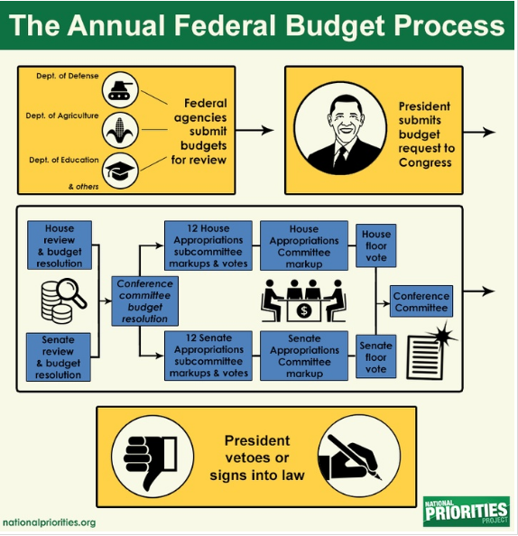
Budget Process
Where we are
Where we should be

Slide 19
The President’s budget overall
(everything else)
EPA 31%
State 29%
Transportation 13%
Commerce
Justice
4%
Defense, Homeland security, Veteran’s Affairs increase
Everyone else got a cut (EPA and State ~30% cuts to 4% for Justice and Commerce)
Transportation got a 13% cut
Defense
Homeland Security
Veterans Affairs

Slide 20

Transportation Funding
Highway Trust Fund (75%)
  Acts as lockbox for transportation Funding set in FAST Act
  Can’t be changed in President’s budget
  Transportation Alternatives in here
Outside Highway Trust Fund (25%)
Eligible for cuts in President’s budget
Funded by general funds
Includes
  Some Transit projects
  Amtrak
  TIGER grants

Slide 21
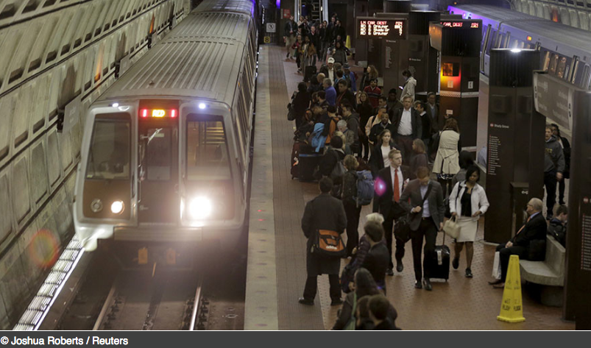

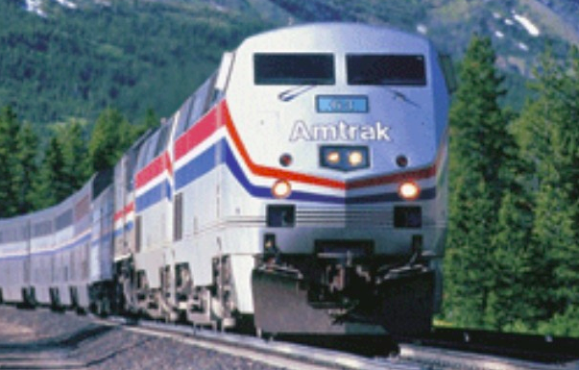
Argument Against: Not Federal Issue
Argument Against: Inefficient

Slide 22
Where bike/ped funding or eligibility could be effected

Slide 23
Budget Takeaways
The President’s budget is unlikely to pass as is.
The logic presented in the transportation – from US DOT - signals opposition to bike/ped funding
  Potential attacks on funding or eligibility could come in late fall/ end of budget process

Slide 24
Tax Reform
Funding for Transportation
  Long term sustainable funding for Transportation
  Vs.
  One time infusion of cash
Changes to Commuter benefits

Slide 25
Funding for Transportation
Administration- One time infusion
  Repatriation from off shore companies
  Selling transportation assets
    (or leasing)
Congress- Long term sustainable funding

Slide 26
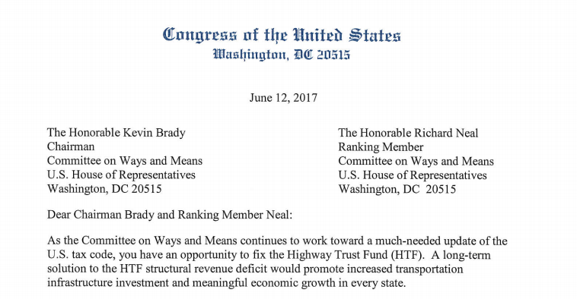
Raise the Gas Tax?
Led by Rep Graves (R-MO) and Del Norton (D-DC)
2nd ranking R and D on House Transportation & Infrastructure Committee
Signed by 250 Members of the House!

Slide 27
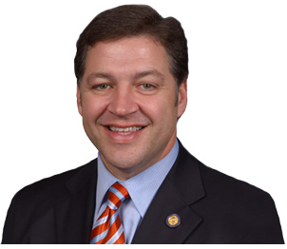
User fee increase?

Slide 28
Commuter Benefits- Advocacy
Defense- Maintain commuter benefits
Offense-
  Improve bike benefit
    Work with transit benefit
    Make it easier for employers to use and report
  Parking benefit
    Make ride share eligible

Slide 29
l
The 115th Congress
President Trump’s
Infrastructure Initiative

Slide 30


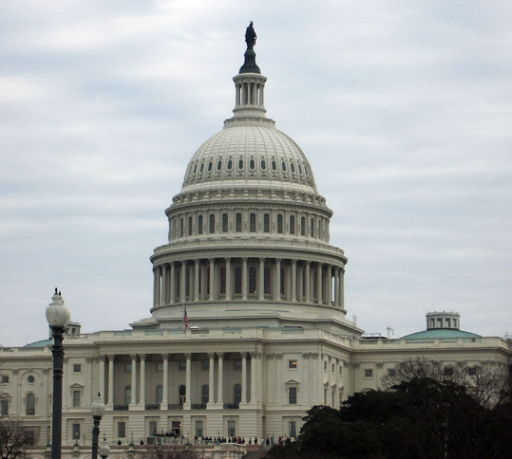
Infrastructure Package
4 prong Approach
  Cut inefficient / non-federal programs
  Remove/ Reduce regulations
  Public Private Partnerships
  Direct Investment - $200 Billion
    Projects that:
      Rural areas
      “Lift the American Spirit” or are “Transformative”

Slide 31
Congressional Responses
Senate
  Environment & Public Works Committee

Slide 34
Take away from Infrastructure Proposal
Signs that DOT is focusing on big projects
  vs. long – term sustainability
  Watch for opportunities to explain benefits
Biggest long term effect
  Regulations and policy changes
  Priorities during this administration
Don’t expect significant funding

Slide 35
Longer Term
Performance Measures, Reauthorization

Slide 36
Performance measures
MAP-21 Measure | USDOT Proposed Measure | League Ask | Final Rule (Obama Admin) | Final changes (Trump Admin)
Performance of the National Highway System (NHS) Non- interstate | Reliable Travel Times for vehicles | Separate reliability measure for bike/ped | Percent of person-miles traveled that are reliable | Percent of person-miles traveled that are reliable
 |  | Measure CO₂ | Percent change in CO₂ emissions on NHS compared to 2017
Notes:
Reliability – trip today like trip tomorrow
Slower than 60% of posted speed limit

Slide 37
Performance Measures
MAP-21 Measure | USDOT Proposed Measure | League Ask | Final Rule (Obama Admin) | Final Changes (Trump Admin)
CMAQ Traffic Congestion On-Road Mobile Source Emissions | Annual Hours of Excessive Delay per Capita |  | Peak Hour excessive delay in person hours | Peak Hour excessive delay in person hours
 |  | Measure bike/ped/transit/ ride share, etc. | % non-SOV travel | % non-SOV travel
 | Asked for comments on measuring CO2 | CO₂ emissions including all stages of the projects | Total emissions reduction
Notes:
Reliability – trip today like trip tomorrow
Slower than 60% of posted speed limit

Slide 38
Timeline for Congestion Mitigation/ NHS Performance measures
Deadline | Due
October 1, 2017 | Applicability determined (specific to CMAQ)
October 1, 2018 | 1st targets reported
October 1, 2020 | State Reports progress
August 15, 2022 | FHWA assesses progress

Slide 39
Thank you!
  Have questions , comments or suggestions-
  Email me at : Caron@clwconsulting.net
May 31, 2017
Caron Whitaker
Bike Walk Action
caron@clwconsulting.net

