Slide 1
Using Bicycle and Pedestrian Counts
THE CENTRAL FLORIDA BICYCLE AND PEDESTRIAN COUNT PROGRAM
BRETT BONCORE, p.e.
ENGINEER / PLANNER
KITTELSON AND ASSOCIATES, INC.
APBP PDS SESSION
Notes:
Brenda greeting☺
1

Slide 2
AGENDA
THE “WHY”
PURPOSE BEHIND THE COUNTS
1
3
WHAT NOW?
THE “HOW”
PROCESS BEHIND THE COUNTS
TRAFFIC MONITORING GUIDE UPDATES
2
4

Slide 3
The Why
The Purpose behind the counts

Slide 4
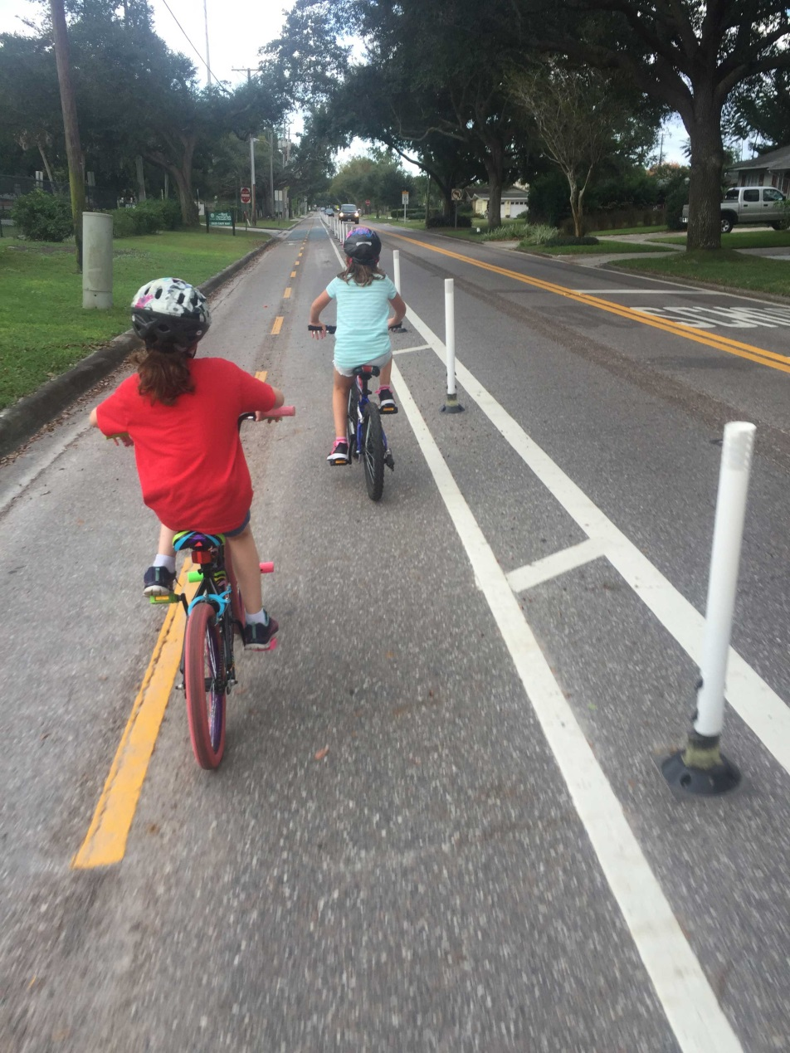
The why
The purpose behind the counts
Ranked as “most dangerous pedestrian environment in the country.” (Dangerous by Design)
Support FDOT Complete Streets policy and implementation
Inform, prioritize, and evaluate bike and pedestrian design decisions
Performance measurement and effective planning
Better understanding of cyclist and pedestrian crash exposure
Supplement and support existing data sources/bike-ped count efforts
Notes:
The last three Dangerous by Design (1) reports have ranked Central Florida in the top three for most dangerous pedestrian environment in the country, with the Orlando area experiencing 575 pedestrian deaths between 2005 and 2014. It is critical for FDOT District Five (District) to evaluate if and how cycling and pedestrian infrastructure investments are effectively improving safety on our State roadways.
Bicycle and pedestrian data that can be used to inform, prioritize, and evaluate the benefit of design decisions, such as addition of bike lane or ADA facilities. For example, asking the question how might the addition of a bike lane affect the level of on-road cycling occurring. Many misconceptions in Central Florida – “a bike lane is good enough”, “this area only sees pedestrian and cycling activity on the weekends”, etc.
A basis for determining potential bicycle and pedestrian activity in areas where we do not have counts. This is done by quantifying the relationship between pedestrian and cyclist activity, land use, and demographics.
Just like we do for vehicles, counts provide a better understanding of cyclist and pedestrian exposure (or the volume of cyclists and pedestrians on various facilities), helping to normalize crash data.
Supplement and support existing data sources and other bicycle/pedestrian count efforts. For instance, as Strava data has recently become available to the FDOT and its governmental partner agencies, bicycle and pedestrian count data can provide information on sampling rates and relative volumes compared to the rest of the District.

Slide 5
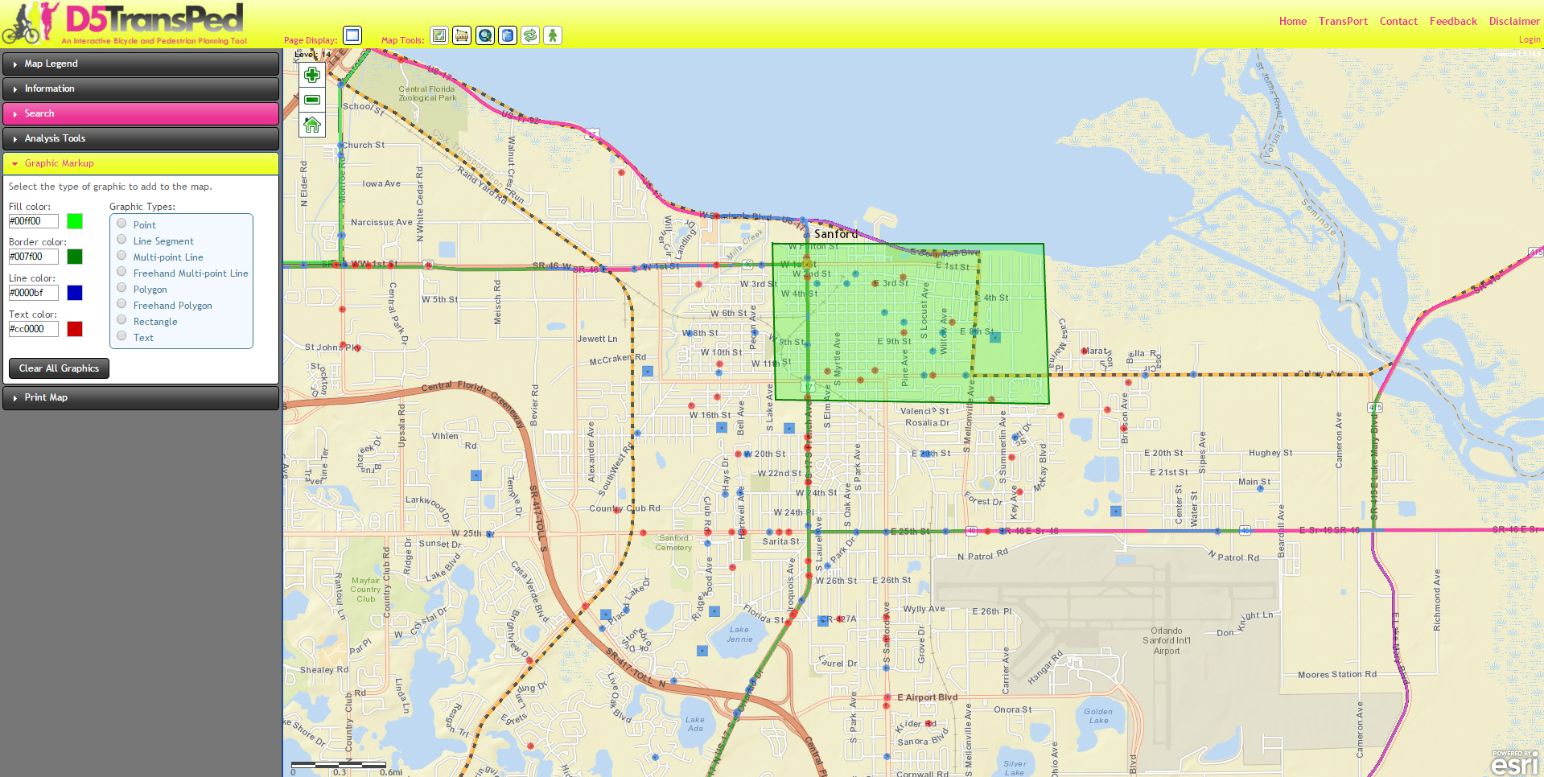
The why
The purpose behind the counts
Notes:
Also, these counts would continue to fill the FDOT TransPed database. This is a repository of all pedestrian and bicycle data in Central Florida. It is used as a data bank, as well as for data visualization, analysis, and prioritization.

Slide 6
The HOW
The Process behind the counts

Slide 7
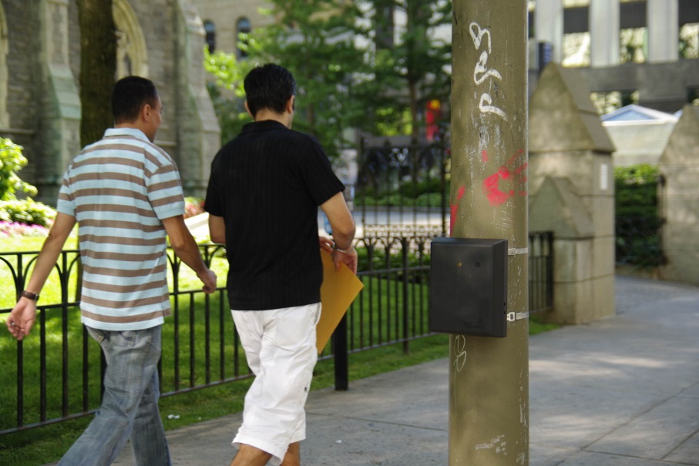

The How
The process behind the counts
AUTOMATED COUNTS
(IN PARTNERSHIP WITH METROPLAN ORLANDO)
MANUAL VIDEO COUNTS
(FDOT)
Notes:
Also, these counts would continue to fill the FDOT TransPed database. This is a repository of all pedestrian and bicycle data in Central Florida. It is used as a data bank, as well as for data visualization, analysis, and prioritization.

Slide 8

The How
The process behind the counts
Automated Counts
Year-long pilot program (2015-16) - partnership between FDOT, MetroPlan Orlando, Orange County, Osceola County, Seminole County, City of Orlando, City of Kissimmee
Goal: decide on one bike-ped counter technology for consistency and data sharing
Device selection based on NCHRP Report 797: Guidebook on Pedestrian and Bicycle Volume Data Collection
Notes:
Device selection was a collaborative effort between FDOT, MetroPlan, City of Orlando, counties, and other stakeholders in the MetroPlan area to determine which technology would be best for the region’s agencies.
NCHRP 797: Guidebook on Pedestrian and Bicycle Volume Data Collection came out last year (2016)
Recommend this book when choosing a new bike-pedestrian count program. This gives quick breakdown of the pros and cons to different technologies available.
It was a guidebook developed, just as we do for vehicle counts, to provide standard guidance data collection:
Address the lack of pedestrian and bicycle volume data, which is a major barrier to planning effective facilities.
Assess the different data collection technologies and methods available (everything from manual counts to infrared technologies. Both of which we used for the FDOT Bike-Ped Count Program)
Develop guidance for practitioners on how to conduct counts

Slide 9
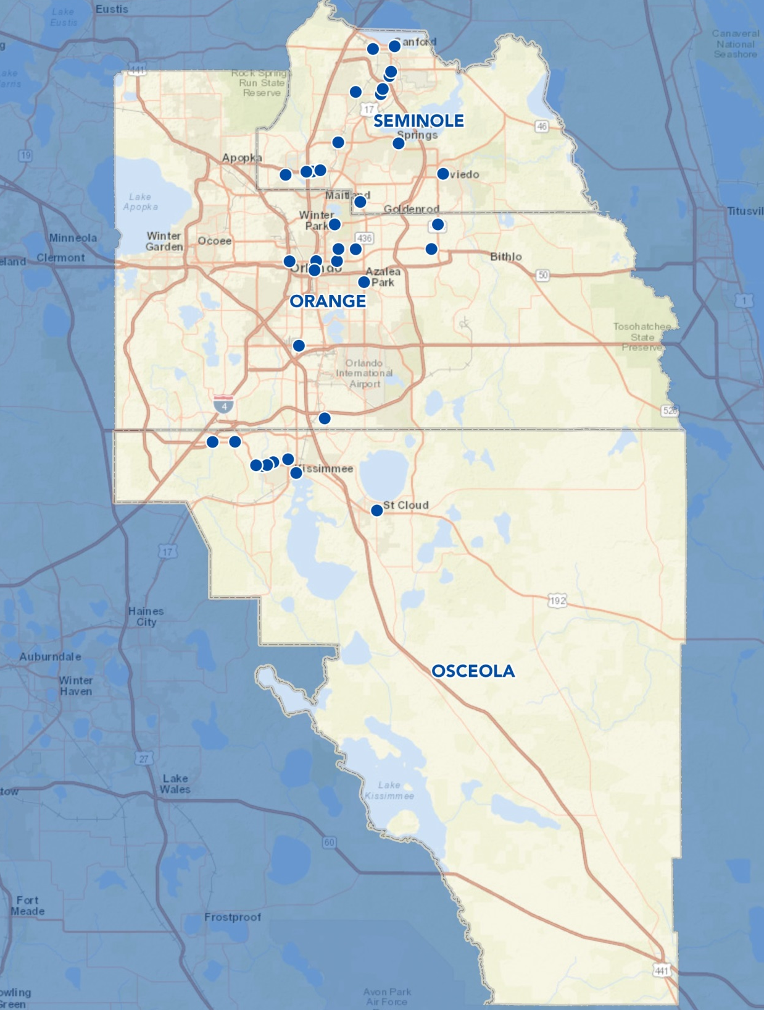
The How
The process behind the counts
Automated Counts
Passive infrared counter technology (Eco Counter Pyro Boxes)
55 locations throughout the MetroPlan tri-county area (Orange, Osceola, Seminole)
    Chose a variety of locations based on:
      Land uses
      AADT
      Safety
      High transit use
MetroPlan owned the counters, FDOT funded the deployment
Rotating to different locations on a monthly basis
Notes:
Device selection was a collaborative effort between FDOT, MetroPlan, City of Orlando, counties, and other stakeholders in the MetroPlan area to determine which technology would be best for the region’s agencies.

Slide 10
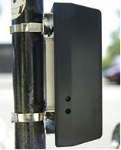
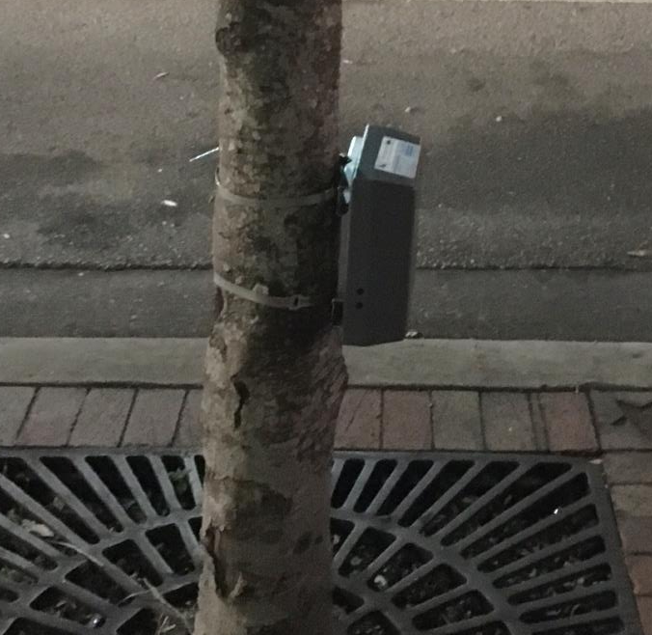
The How
The process behind the counts
Automated Counts
Passive infrared technology
Minimal time/effort to setup
Easily transported and long-term durability with very good battery life
Cost: $1,000-$3,000/device
Good detection range based on needs (15-50 feet)

Slide 11
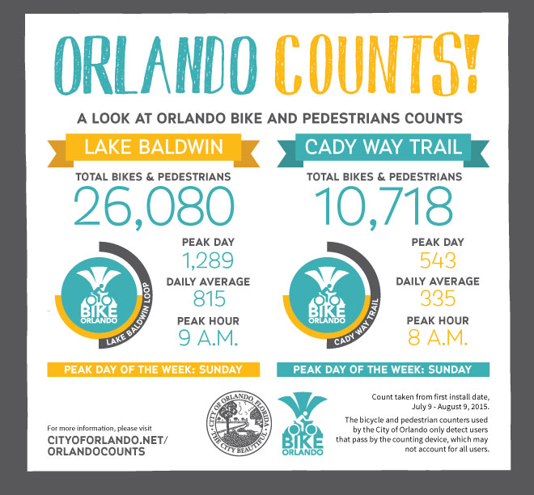
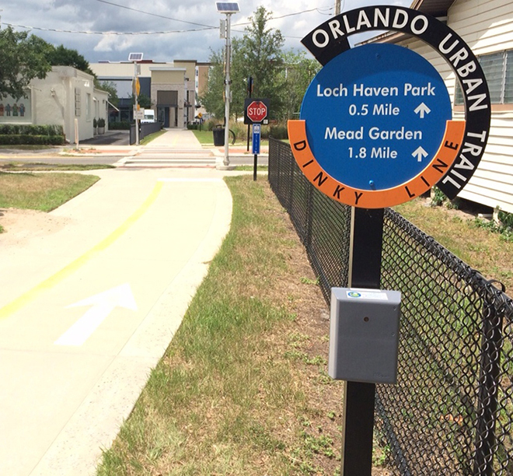
The How
The process behind the counts
City of Orlando Automated Counts
Same PyroBox technology
11 location around Orlando

Slide 12
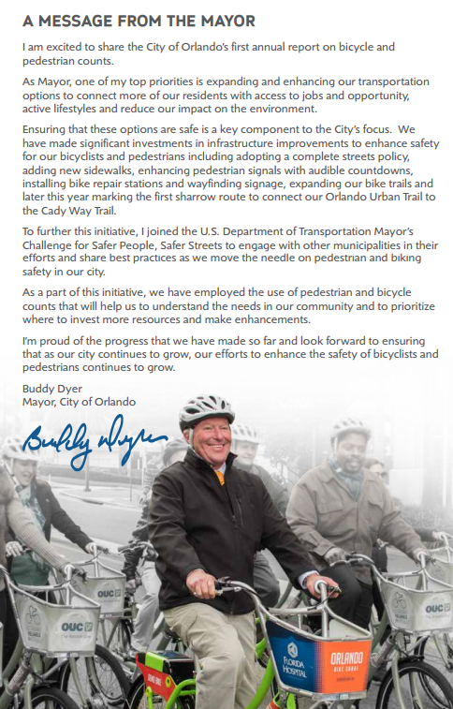
The How
The process behind the counts
City of Orlando Automated Counts
Same PyroBox technology
11 location around Orlando

Slide 13
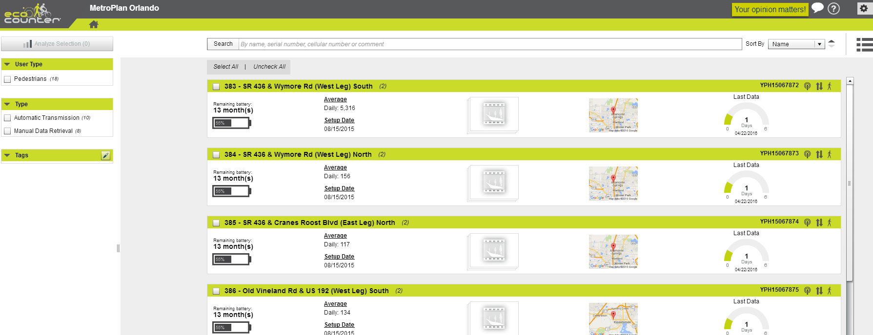
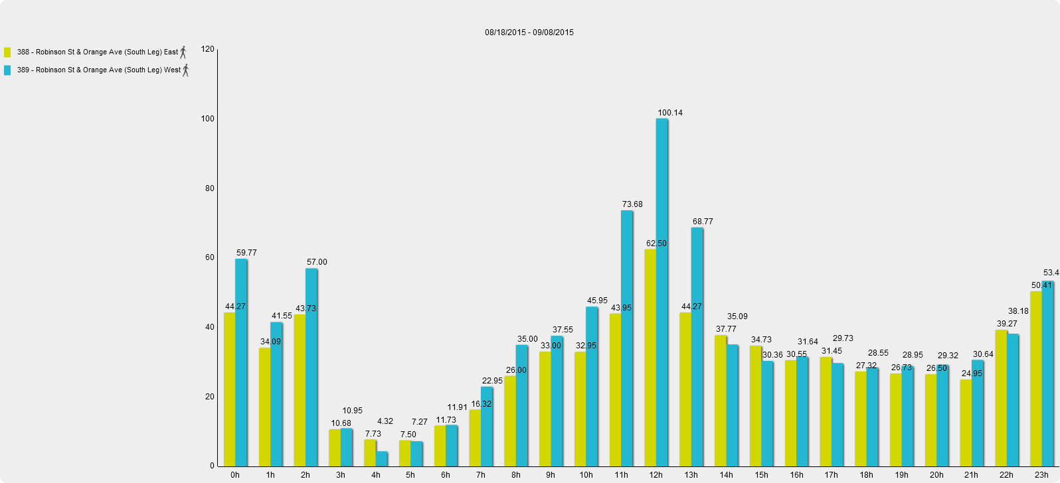
The How
The process behind the counts
Automated Counts
Automatic reporting to live website
Print customized reports based on what you’re looking for. Can be shared with anyone who has the website login.
Notes:
Automatically reports counts in almost live fashion to Eco-Visio website. Can be accessed by whoever you give login and password

Slide 14
The How
The process behind the counts
Notes:
Automatically reports counts in almost live fashion to Eco-Visio website. Can be accessed by whoever you give login and password

Slide 15
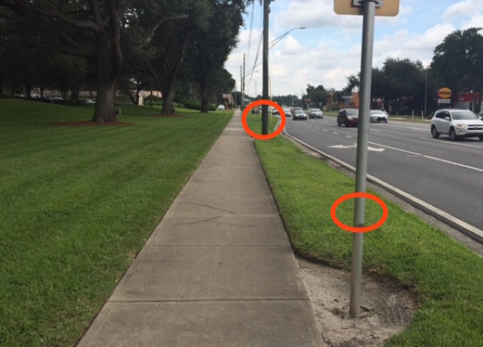
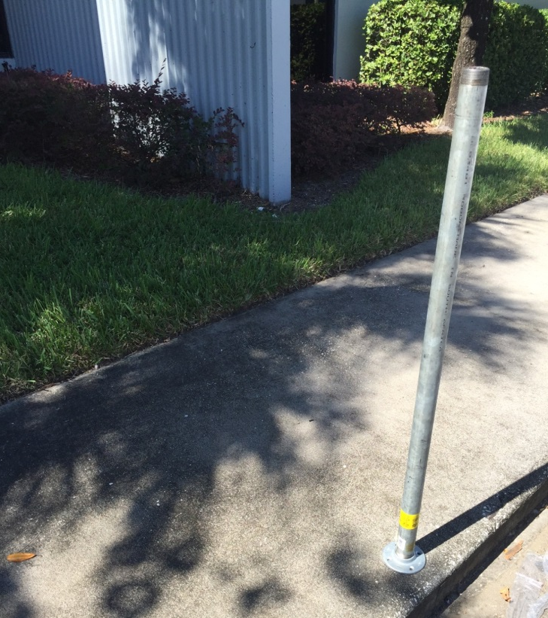
The How
The process behind the counts
Automated Counts
Potential occlusion with groups of pedestrians
Performance may be affected by extreme temperatures
Vertical element location

Slide 16
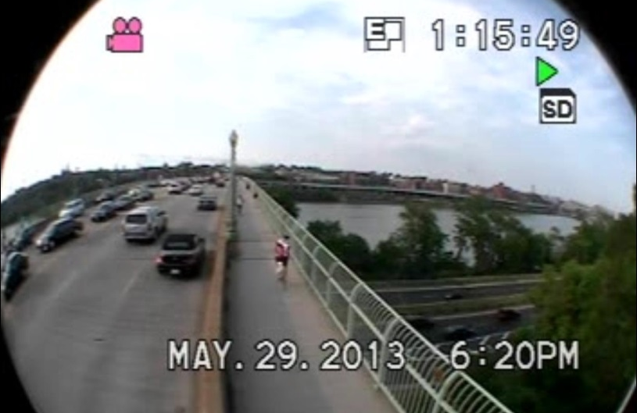
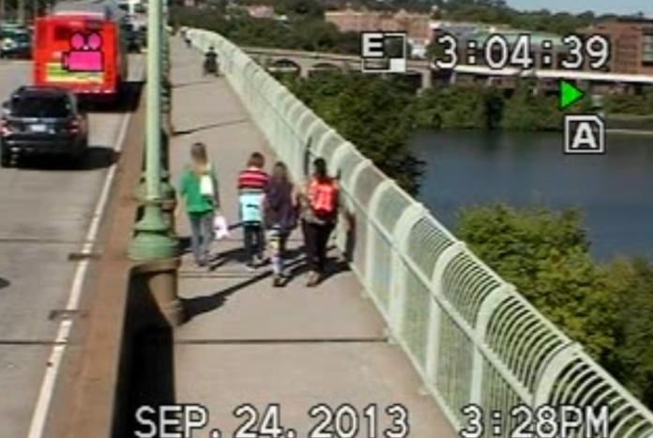
The How
The process behind the counts
Automated Counts
Cannot distinguish between cyclist and pedestrian and cannot count bikes on road
Manual counts done at spot locations for B/P ratio
Minimal but some post-processing time

Slide 17
The How
The process behind the counts
AUTOMATED COUNTS
(IN PARTNERSHIP WITH METROPLAN ORLANDO)
MANUAL VIDEO COUNTS
(FDOT)
Notes:
Also, these counts would continue to fill the FDOT TransPed database. This is a repository of all pedestrian and bicycle data in Central Florida. It is used as a data bank, as well as for data visualization, analysis, and prioritization.

Slide 18
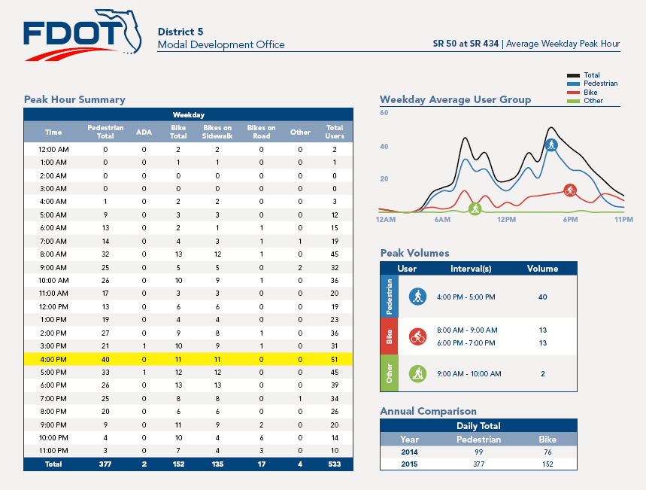
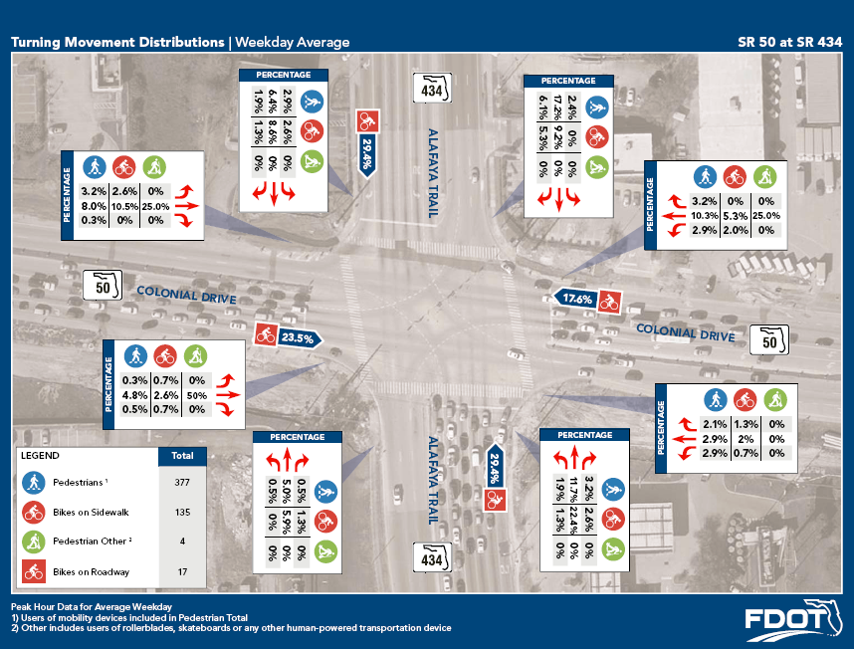
The How
The process behind the counts
Manual Video Counts
Third year of the program (2016)
Video cameras set up at 10-15 locations around the District each year
Obtained more detailed information on the cyclist and pedestrian activity at intersections around the region.
Annual report on daily and hourly averages and intersection turning movements for each mode.
Reported to National Bicycle-Pedestrian Documentation Project (NBPDP)

Slide 19
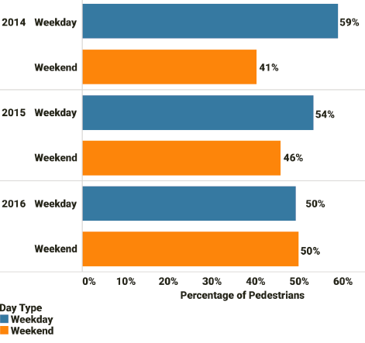
The How
The process behind the counts
Manual Video Counts
Results
  Three years of detailed information on behavior of 26,000 pedestrians and 9,000 cyclists across 28 locations in District Five
  Information to address bicycle and pedestrian misconceptions in Central Florida
  Although there are harsh pedestrian conditions in the region, people still need to get around on foot, AND THEY ARE DOING SO
Notes:
On average for all three years, locations without bike lane showed a “cyclist on roadway” average of approximately 13% when intersections without sidewalks along the major road were excluded from analysis. As a comparison, locations with bike lane showed a “cyclist on roadway” percentage of approximately 19%. This longitudinal data further supports the notion that cyclists are not comfortable riding on the roadway, even with the presence of a conventional bike lane. Other improvements may need to be considered that better address bicycle user safety and comfort (buffered bike lane, physically separated facilities, slower vehicle speeds, etc.).

Slide 20
What now?
Next Steps

Slide 21
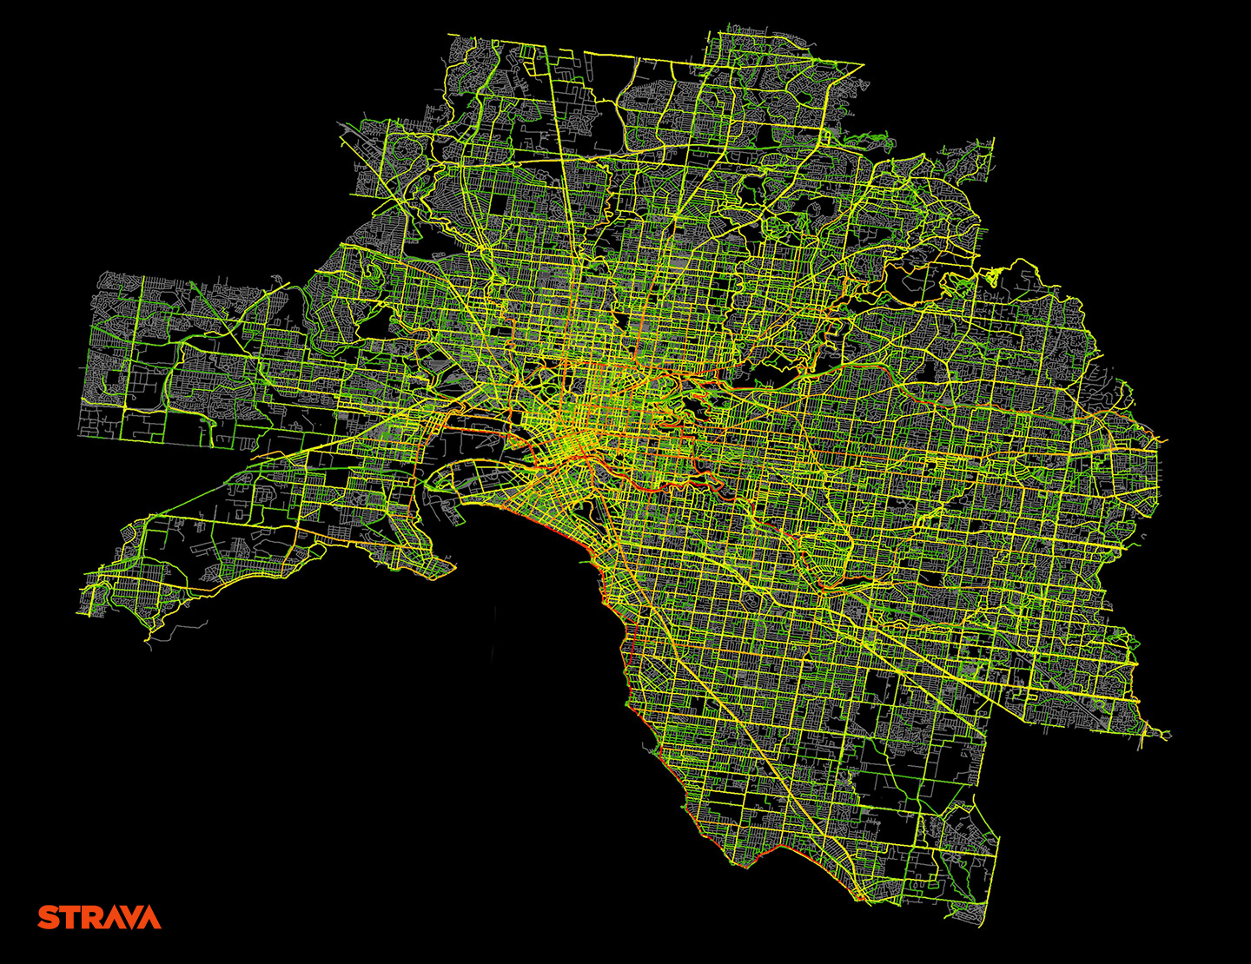
What now?
Next Steps
Manual Video Counts
Supplement and calibrate state-wide Strava data
Continue annual program
Reports for locals/MPOs
Notes:
This data can be used to validate and calibrate Strava data. As Strava has come to be a statewide resource for bike-ped data, these counts can be used to determine sample rates and consistency of data from city to city.
We have brought this to other MPOs and FDOT Districts to encourage them to star programs of their own and we want to continue to do this. Some are have caught on and started their own.

Slide 22
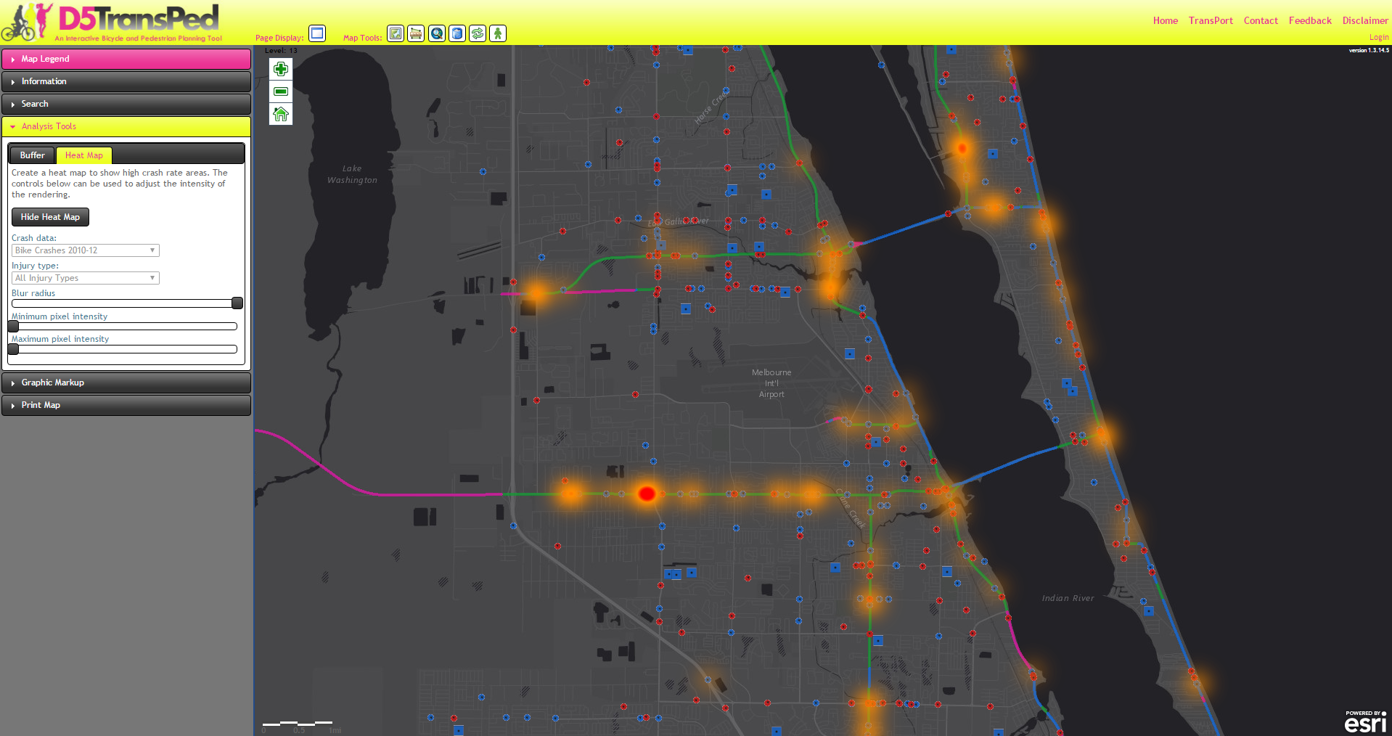
What now?
Next Steps
FDOT District Five TransPed Tool
GIS Data Bank/Repository
  Includes FDOT District Five Bike-Ped Count data and more
Data Visualization
Data Analysis
Notes:
This data can be used to validate and calibrate Strava data. As Strava has come to be a statewide resource for bike-ped data, these counts can be used to determine sample rates and consistency of data from city to city.
We have brought this to other MPOs and FDOT Districts to encourage them to star programs of their own and we want to continue to do this. Some are have caught on and started their own.

Slide 23







Power of Partnership
Provided oversight, regional coordination, and regional repository for data
Initiated pilot program and provided PyroBox Counters
Used similar technology to start program of their own
REGIONAL PARTNERSHIP AND COORDINATION
Provided locations to MetroPlan and used similar technology to start own program
Provided automated locations to MetroPlan
Notes:
This data can be used to validate and calibrate Strava data. As Strava has come to be a statewide resource for bike-ped data, these counts can be used to determine sample rates and consistency of data from city to city.
We have brought this to other MPOs and FDOT Districts to encourage them to star programs of their own and we want to continue to do this. Some are have caught on and started their own.

Slide 24

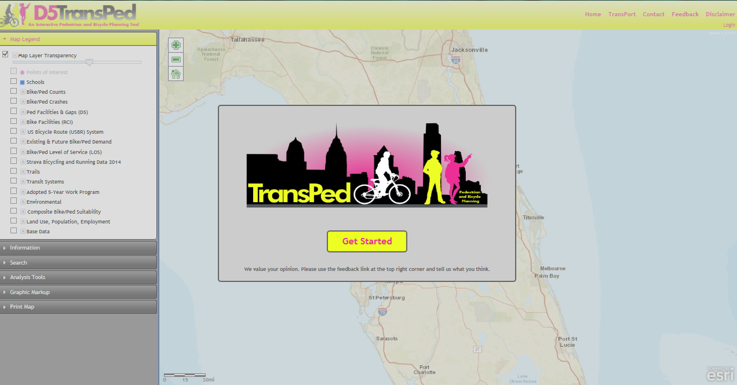
Power of Partnership
Other potential partners:
MPO’s
Cities
Counties
Advocacy groups
Schools
Community groups
Notes:
This data can be used to validate and calibrate Strava data. As Strava has come to be a statewide resource for bike-ped data, these counts can be used to determine sample rates and consistency of data from city to city.
We have brought this to other MPOs and FDOT Districts to encourage them to star programs of their own and we want to continue to do this. Some are have caught on and started their own.

Slide 25
Traffic Monitoring Guide
Update

Slide 26
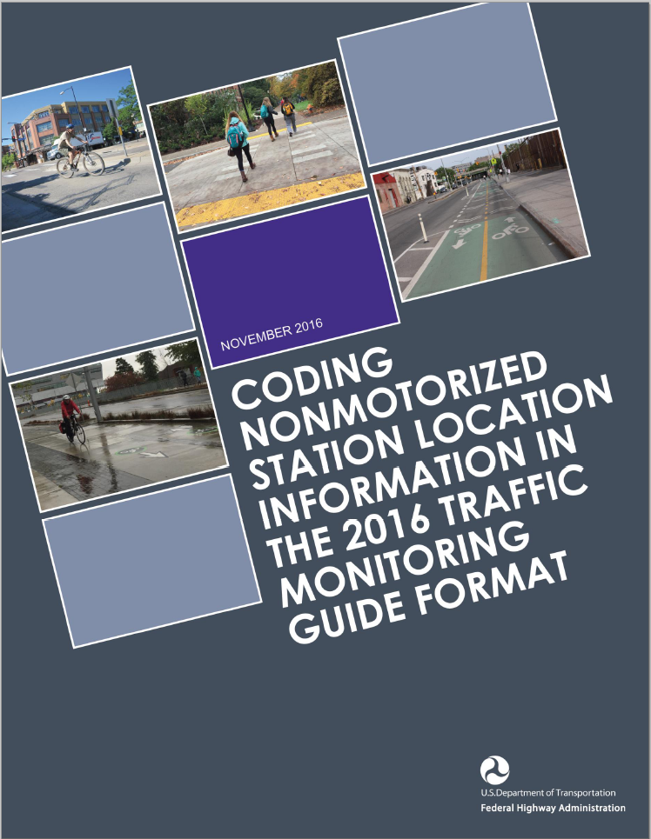
Traffic Monitoring Guide Update
Overview
FHWA Traffic Monitoring Guide (2016)
Intent to create flexible, comprehensive data format
This guidebook’s goal is to make the format accessible
Sections 7.9 and 7.10 updated
Notes:
FHWA has released a 2016 edition of the Traffic Monitoring Guide (TMG) which provides the most up to date guidance to State highway agencies in the policies, standards, procedures, and equipment typically used in a traffic monitoring program

Slide 27
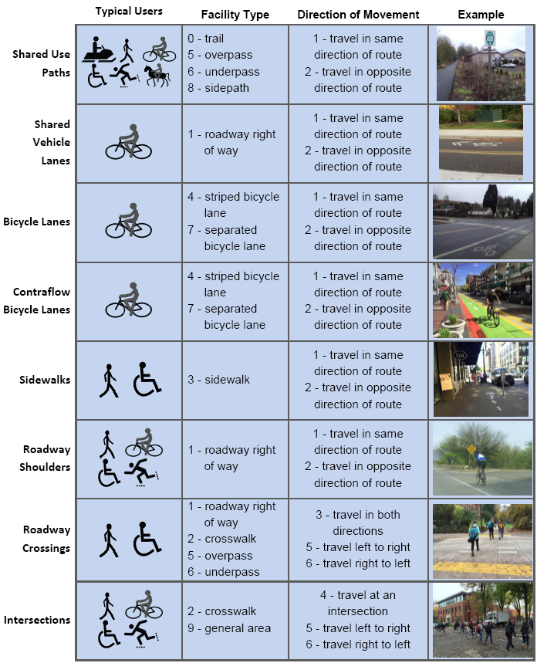
Traffic Monitoring Guide Update
Overview
TMG format
Count station description (location)
Count data
Collecting multiple counts at single location
Facility types and counting examples
Notes:
It focuses on how to record information about the counts, what was counted, and where the counts were collected. It also provides explanations and examples of how to record those counts in the TMG data format..

Slide 28
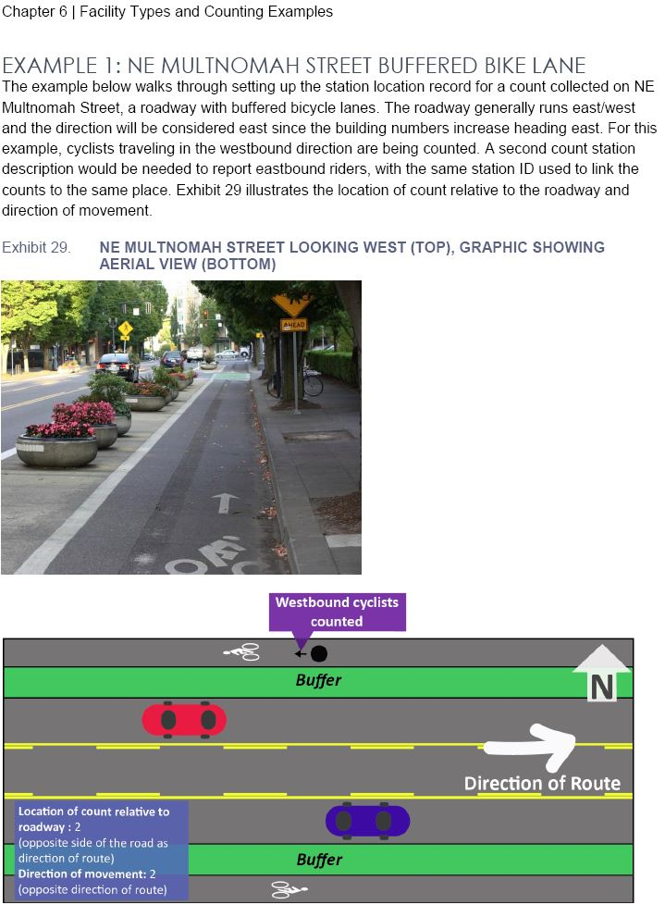
Traffic Monitoring Guide Update
Overview
TMG format
Count station description (location)
Count data
Collecting multiple counts at single location
Facility types and counting examples
Notes:
It focuses on how to record information about the counts, what was counted, and where the counts were collected. It also provides explanations and examples of how to record those counts in the TMG data format..

Slide 29
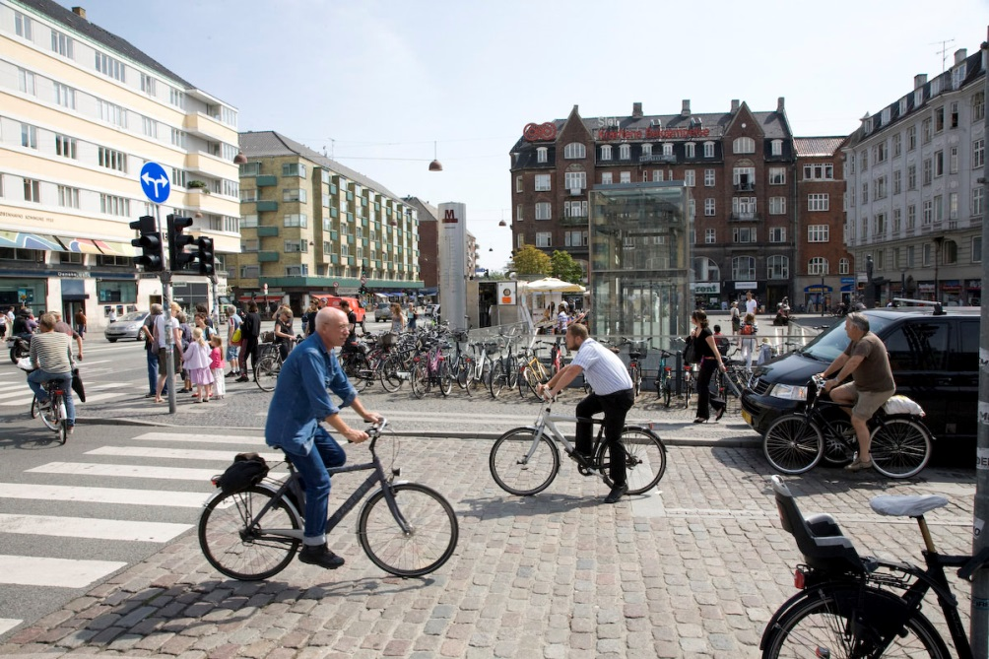
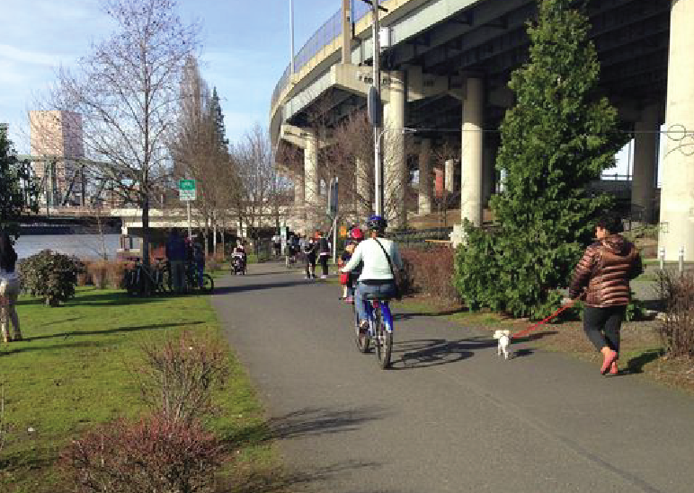
Traffic Monitoring Guide Update
Overview
The Traffic Monitoring Guide: Counting Walking and Biking
Hernando Desoto at 11:15am - 12:45pm
Kelly Laustsen, P.E.
Kittelson and Associates, Inc.
Notes:
It focuses on how to record information about the counts, what was counted, and where the counts were collected. It also provides explanations and examples of how to record those counts in the TMG data format..

Slide 30
Thank You!
ANY QUESTIONS?
Brett Boncore, P.E.
Engineer / Planner
Kittelson and Associates, Inc.
bboncore@kittelson.com

