Slide 1
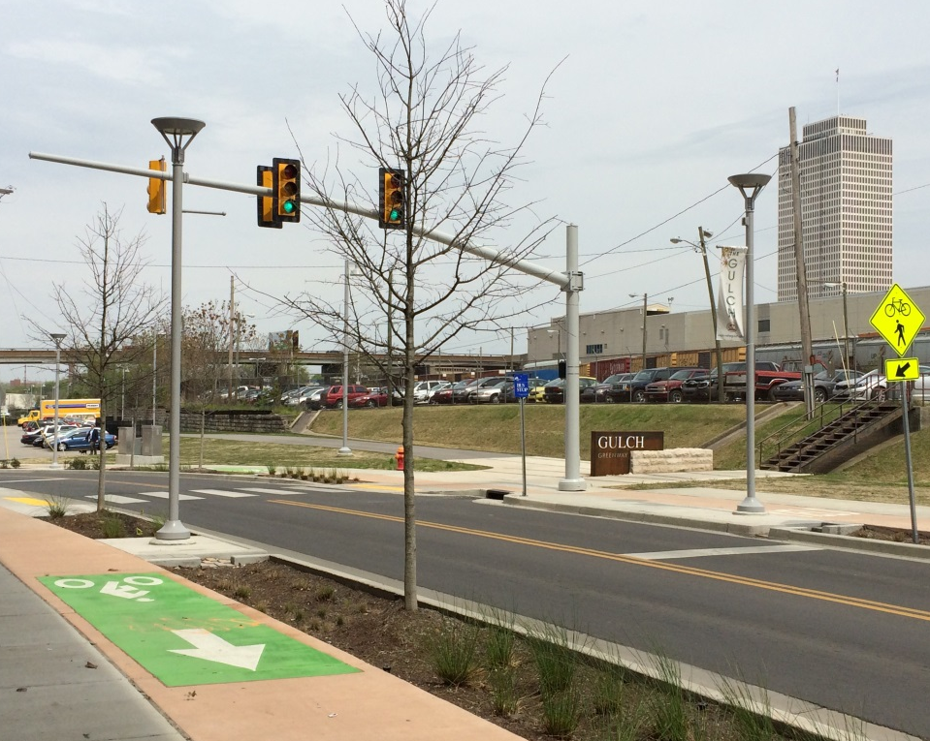
11th Avenue
Complete Street
NASHVILLE, TN
Brandon Taylor, P.E.

Slide 2
Presentation Outline
Initial Planning Process
Project began as a greenway and morphed into a Complete Street
Design Process
Bringing Complete Street features to an urban industrial area
Construction Process
Construction in a historic area
Finished Product and Impact to the Community

Slide 3
Initial Planning Process
Project Timeline
2012 – Metro Parks selected RPM with Hawkins Partners and Collier Engineering to the Greenway Alignment Study and Design

Slide 4
Initial Planning Process
Existing Network
- Project filled a critical gap

Slide 5
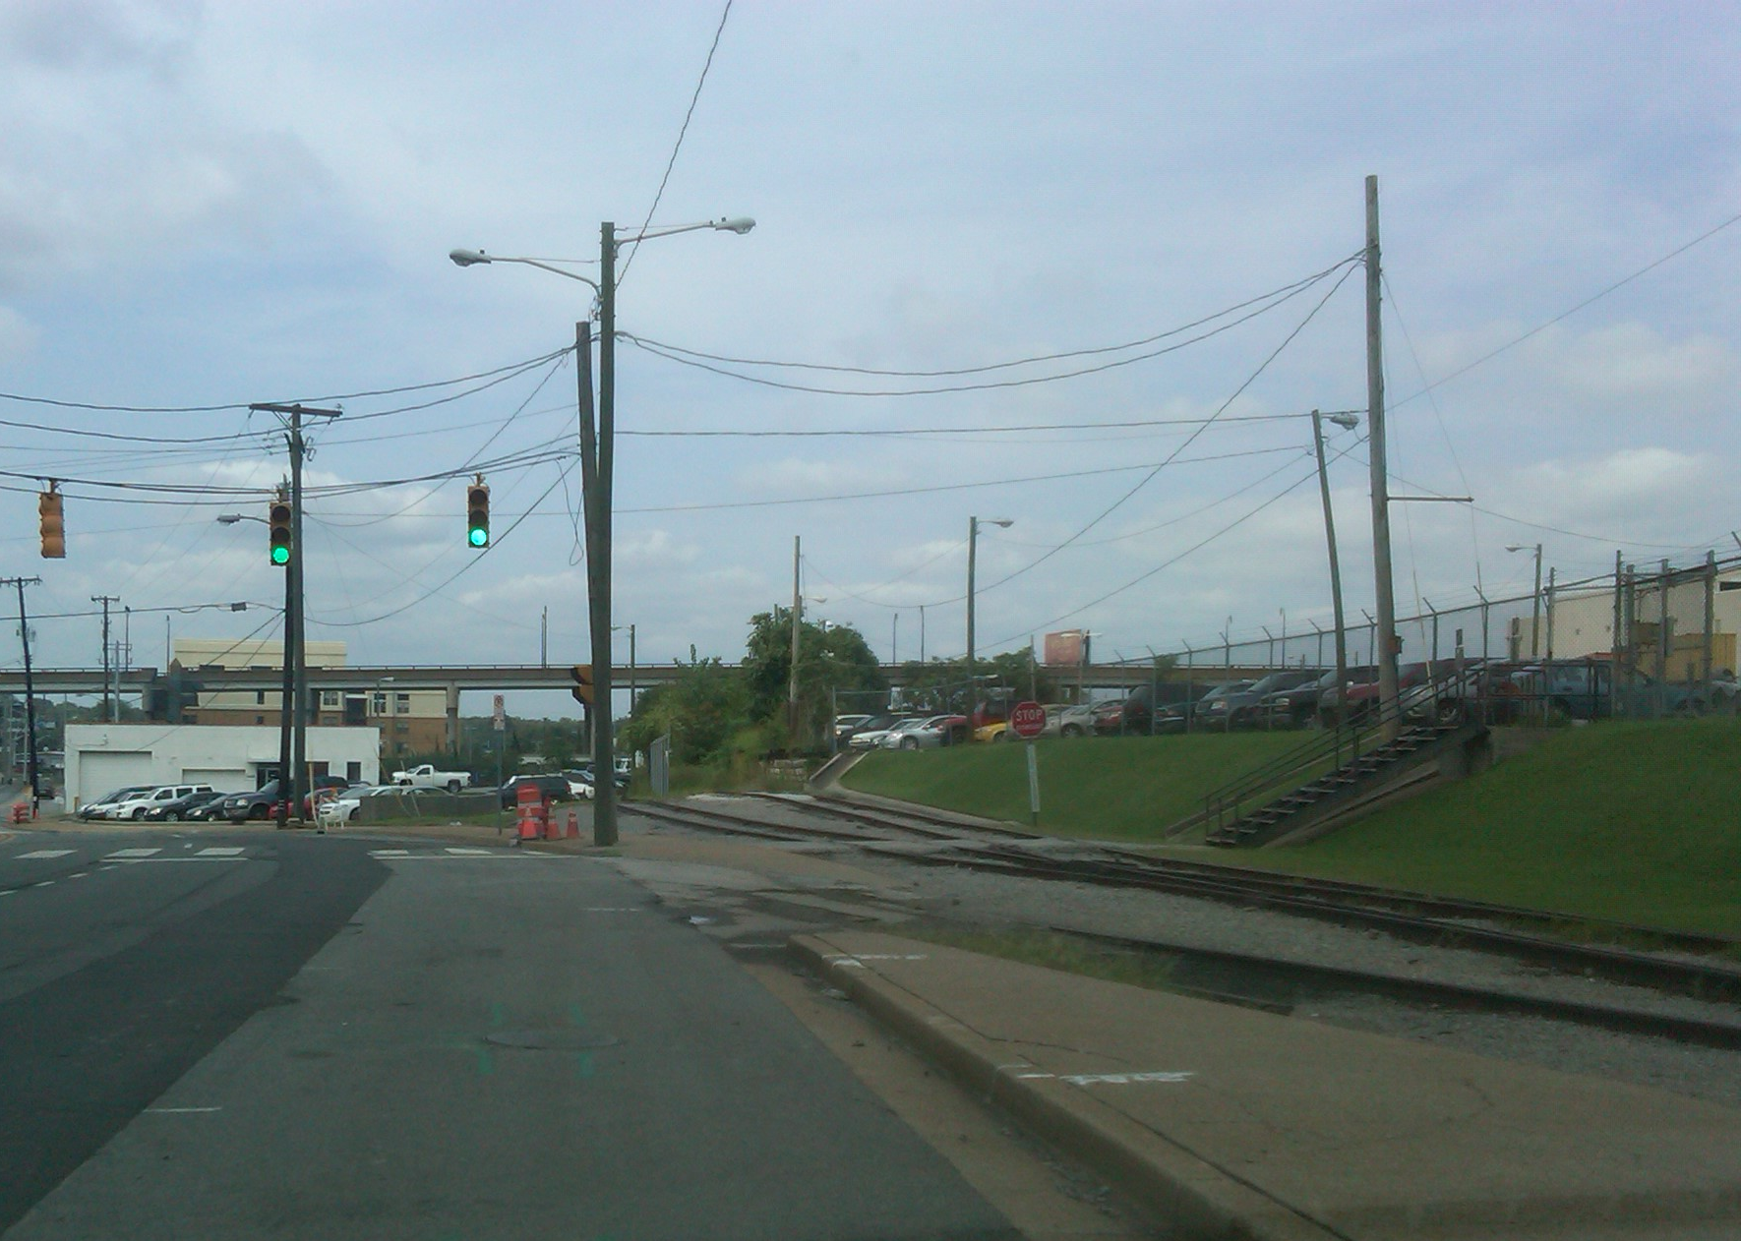
Initial Planning Process
Existing Condition – Multi-lane with Parking and Railroad
Sidewalk drops off
Utility Conflicts
Notes:
Nashville’s historic Gulch District, with its distinct industrial history, originally housed the downtown railroad terminal. From the turn of the century until the 1950s, more than 100 trains arrived and departed from The Gulch daily.
Today, the Gulch District has developed into a hotspot for young urbanites. The Gulch has perfectly combined its industrial background with a modern contemporary style. Old warehouses have been renovated into residential and office space, and upscale restaurants and a vibrant nightlife have made The Gulch one of the hottest neighborhoods in Nashville.

Slide 6
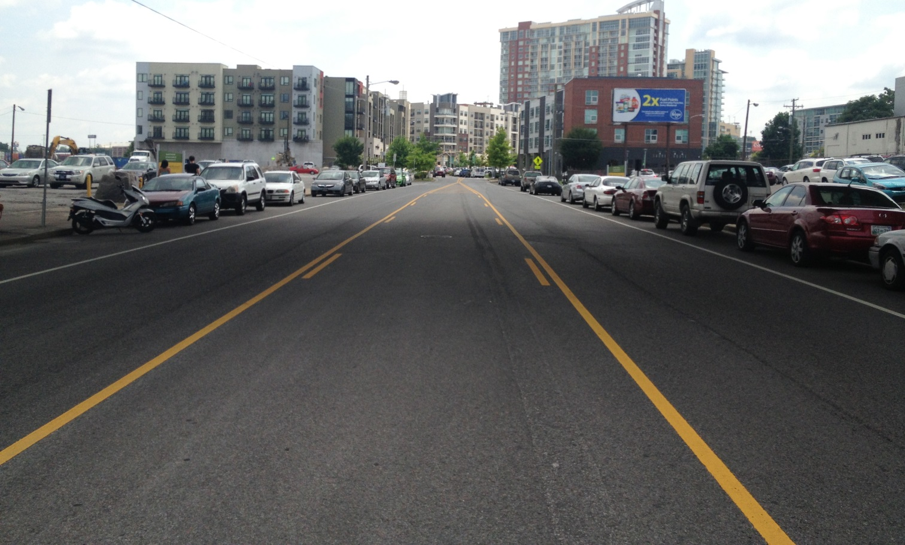
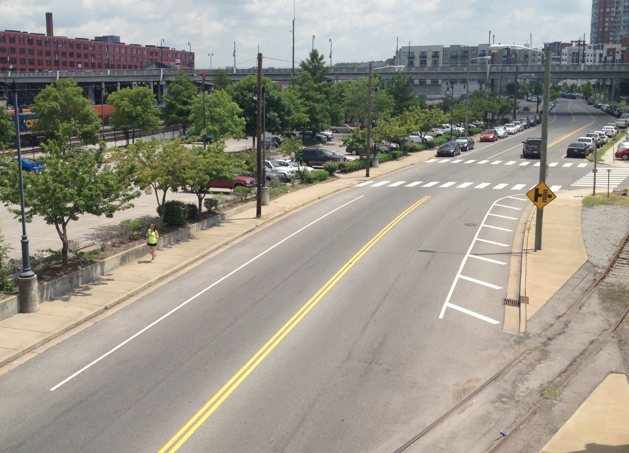
Initial Planning Process
Existing Condition – Multi-lane with Parking and Railroad
Lots of on-street parking

Slide 7
Initial Planning Process
Project Timeline
2012 – 2013 – Development of the Greenway Concept Plans and coordination with property owners which included CSX and many popular restaurants/shops.
7 Property owners in all would be affected

Slide 8
Initial Planning Process
Initial Project Limits
2,300 feet in length

Slide 9
Initial Planning Process
Project Timeline
July 2013 – Complete Street Design Initiated by Metro Public Works
Factors included ROW costs and timeframe
At this point the project changed
Greenway Project
Complete Street Project

Slide 10
Initial Planning Process
New Project Limits
- 800 feet Greenway
- 2,400 feet of Complete Street

Slide 11
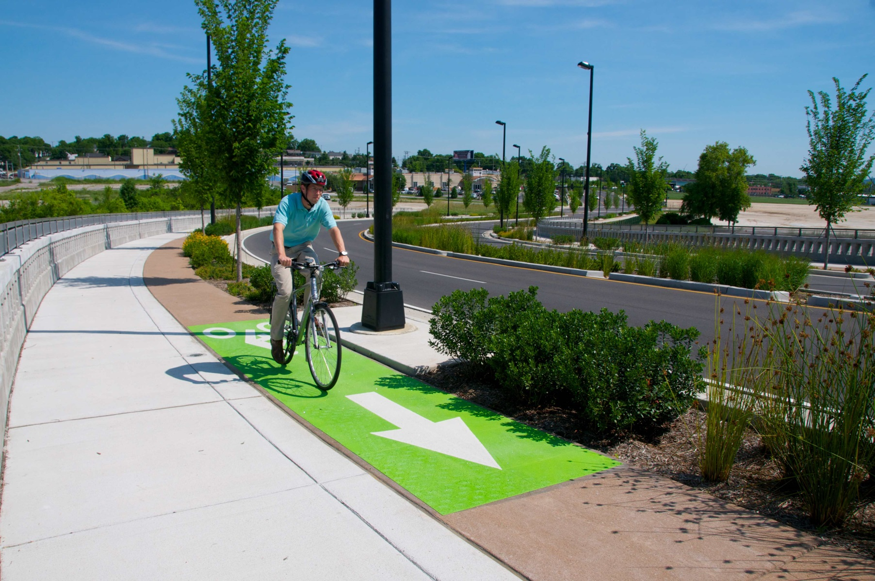
Initial Planning Process
A similar project had recently been completed on the other side of town

Slide 12
Initial Planning Process
Complete Street Option

Slide 13
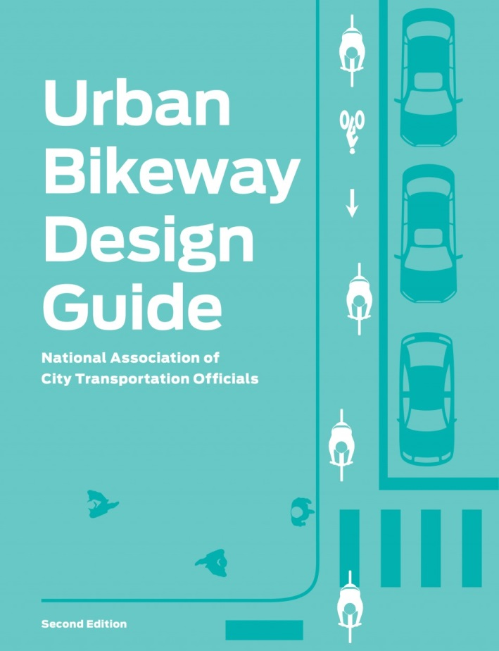
Design Process
Implementing a new cross section in an Urban Environment
One last easement area to work out.
Not necessarily required, but would add a great deal to the project
Meet with neighbors and business owners
Incorporating guidelines from NACTO Urban Bikeway Design Guide
Cycle track and sidewalks will be part of the design
Working with the existing constraints
Walls, ROW, Existing Utility Poles, driveways, etc….

Slide 14
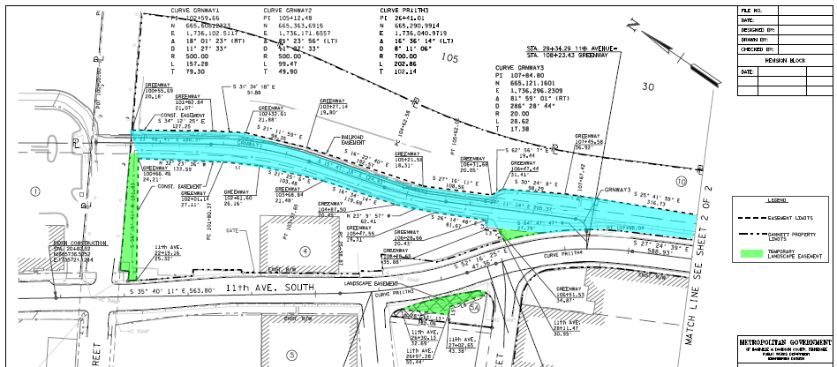
Design Process
One key piece was still not set
Had to get the easement from CSX for the greenway
Required some environmental documentation
Metro Parks worked very hard to secure

Slide 15
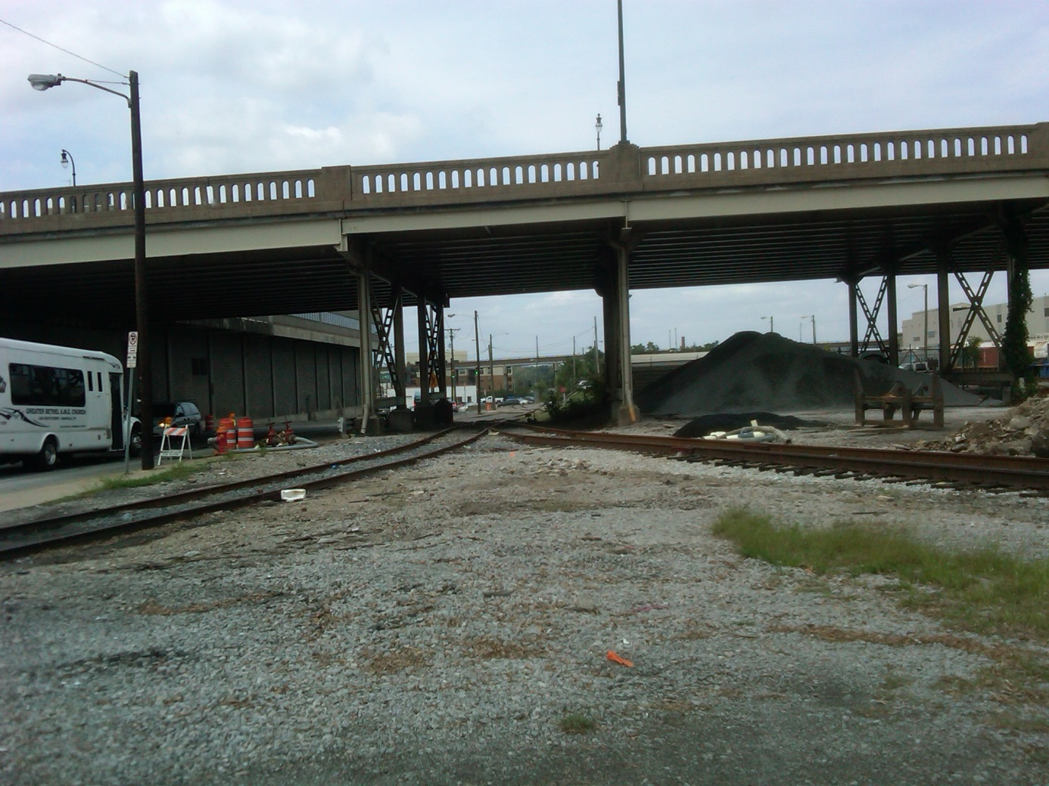
Design Process
Gulch Neighborhood Input
More sidewalks, more pedestrian connections
Open green areas that are safe
Something that cleans up the area
NO BENCHES

Slide 16
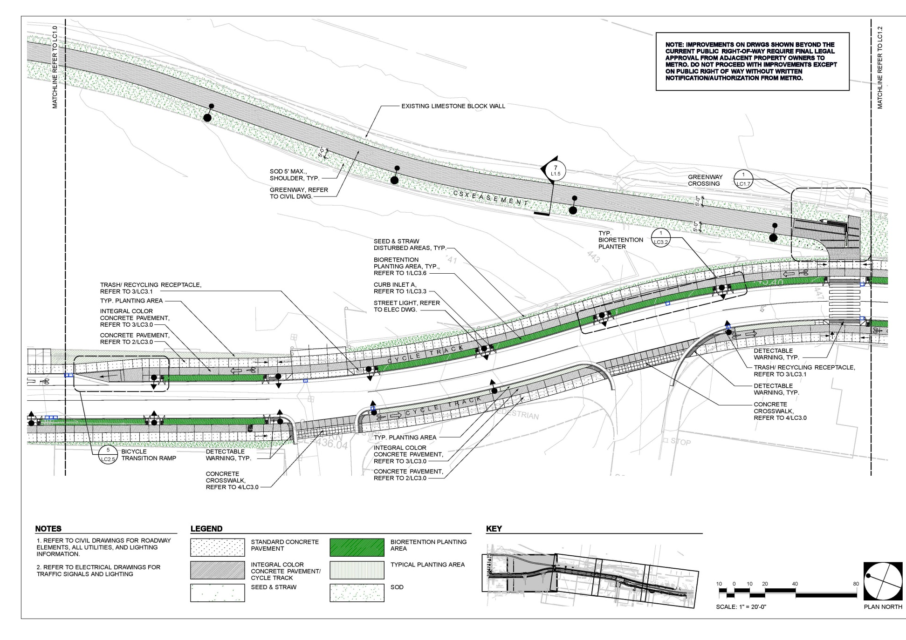
Design Process
Incorporating cycle track
And buffer zone where
applicable

Slide 17
Design Process
Adding more Greenspace and Green Infrastructure to the area

Slide 18
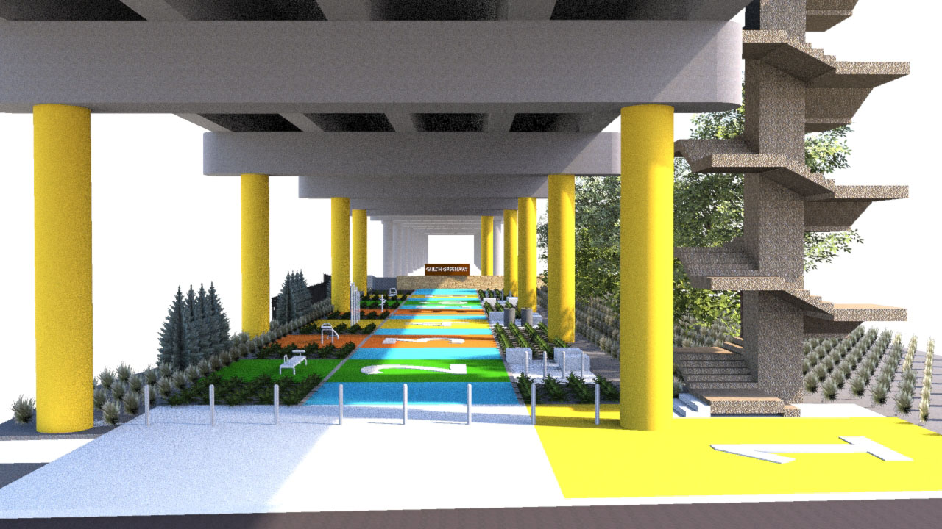
Design Process
Got the OK to use the bottom of Church Street Viaduct
This was a very important addition to the project
Took the project to the next level

Slide 19
Construction Process
Accommodating all businesses during construction
All businesses and restaurants must stay open, must maintain parking and valet
Multiple development projects on-going adjacent to our project
Still a lot of industrial and rail in the area, so large trucks must be accommodated
Unexpected items discovered in the field

Slide 20
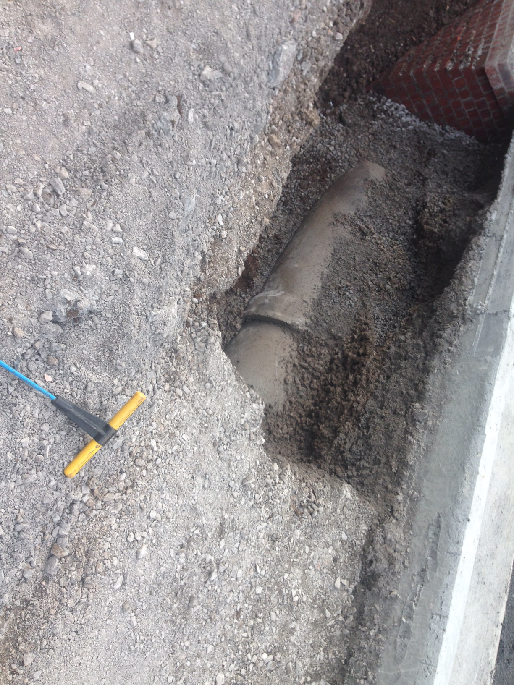
Construction Process
Problems encountered during construction

Slide 21
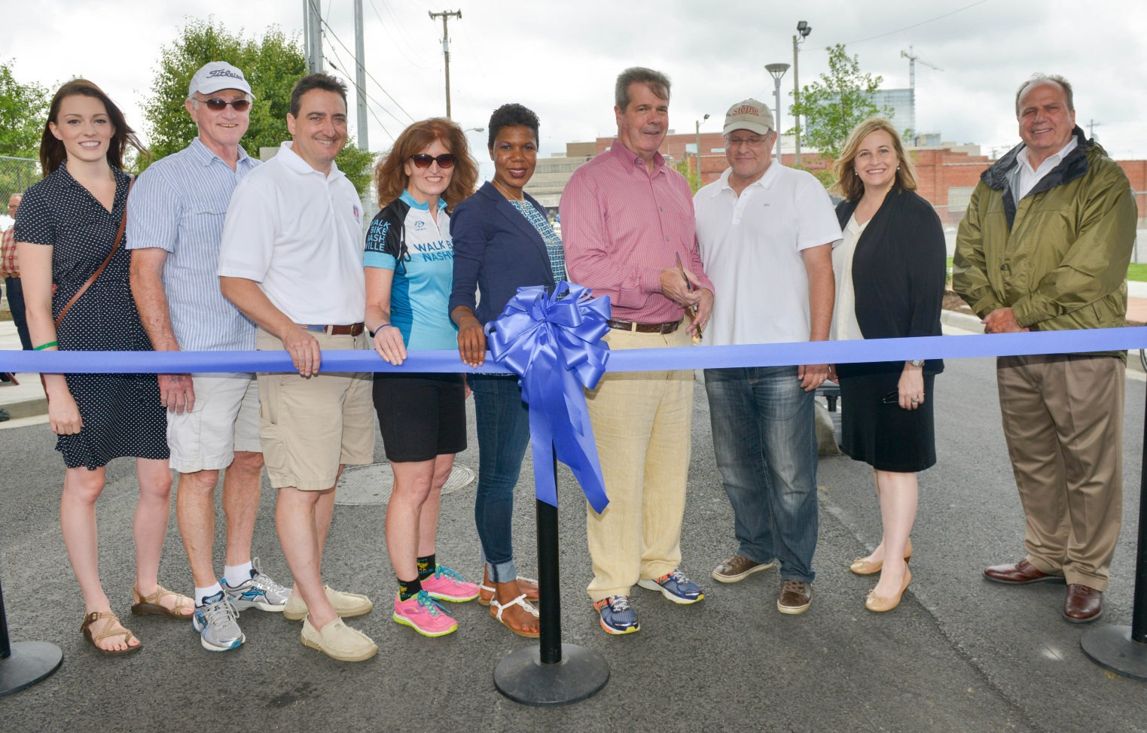
Final Product
Nearing the end of construction
Ribbon Cutting
Open Street Festival
"Commemorating a new complete street in the Gulch and the city's inaugural Open Streets Nashville event is a great way to celebrate Nashville as a healthy, sustainable community," Mayor Dean said. "Eleventh Avenue will offer better connections for walkers and bicyclists, and the Open Streets event will be a way for everyone to experience the Gulch without car traffic."

Slide 22
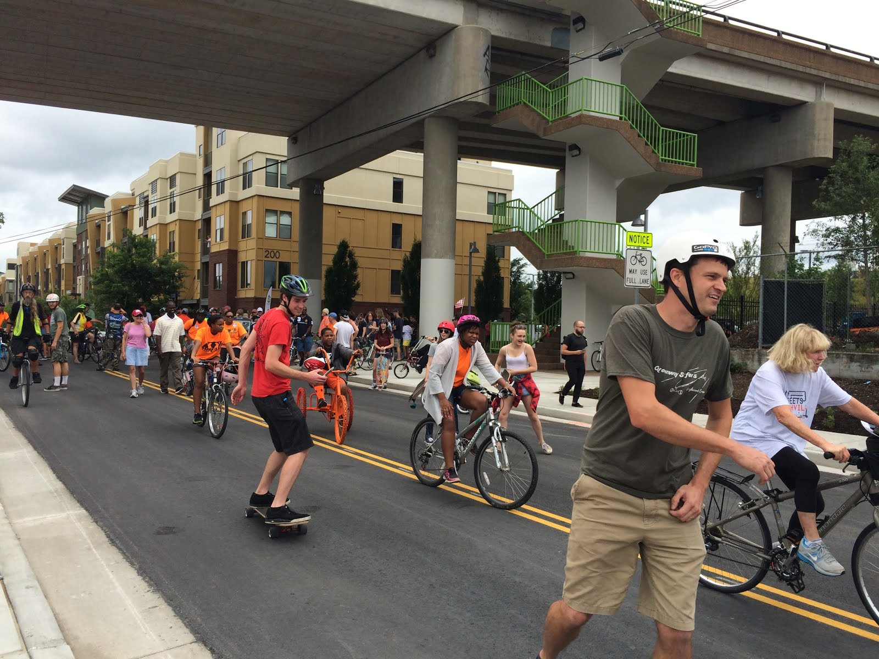
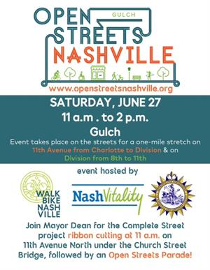
Final Product
Open Streets Festival

Slide 23
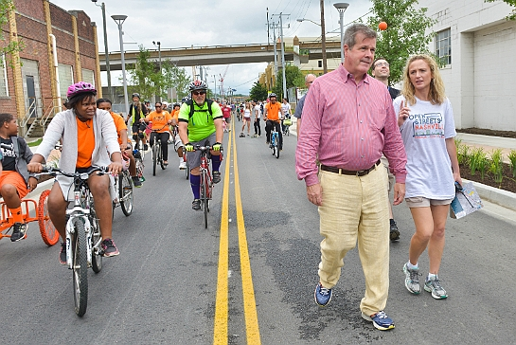
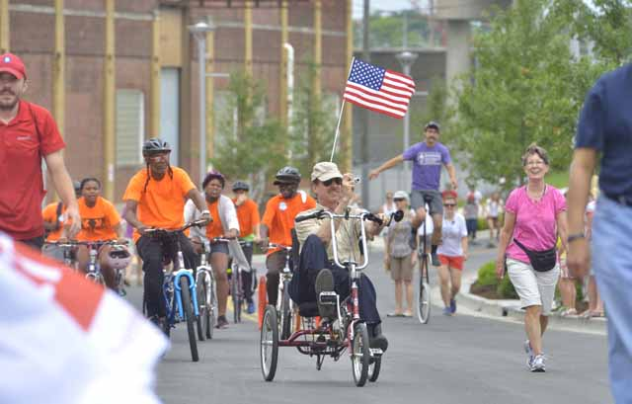
Final Product
More of Open Streets Festival

Slide 24
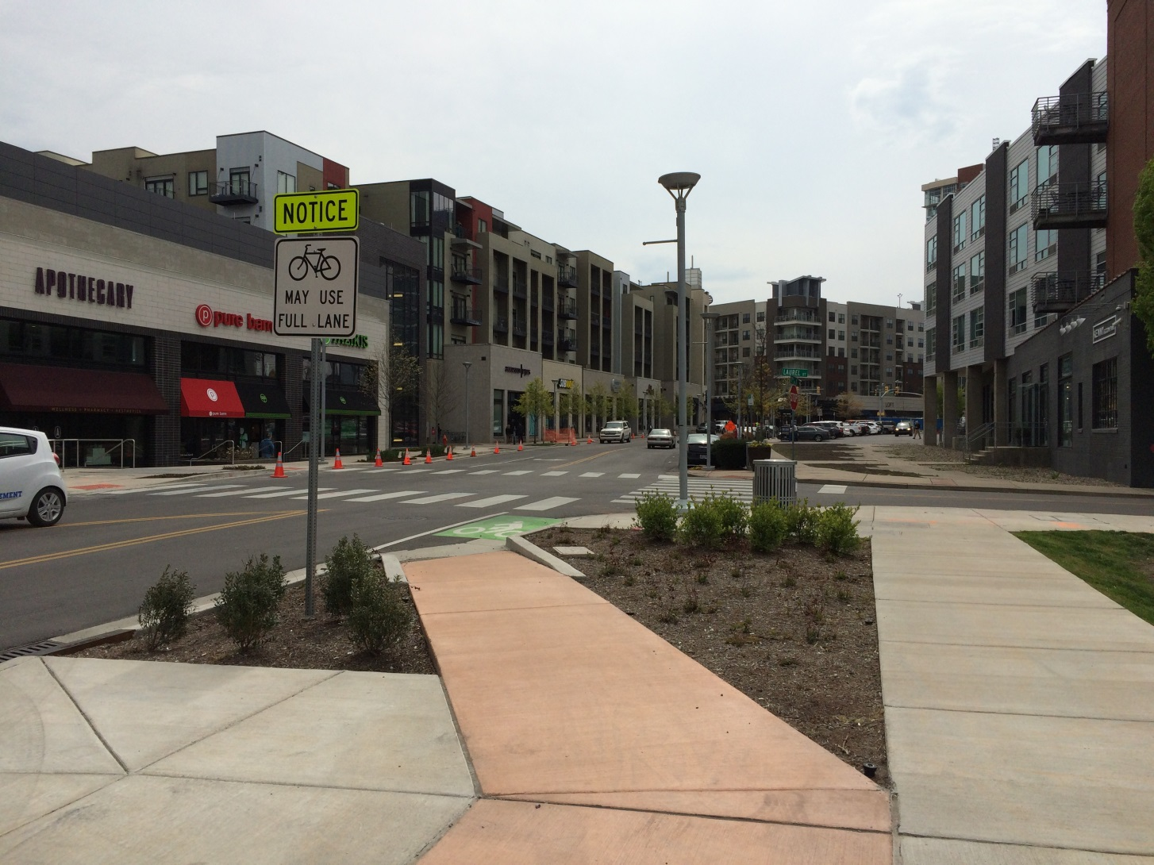
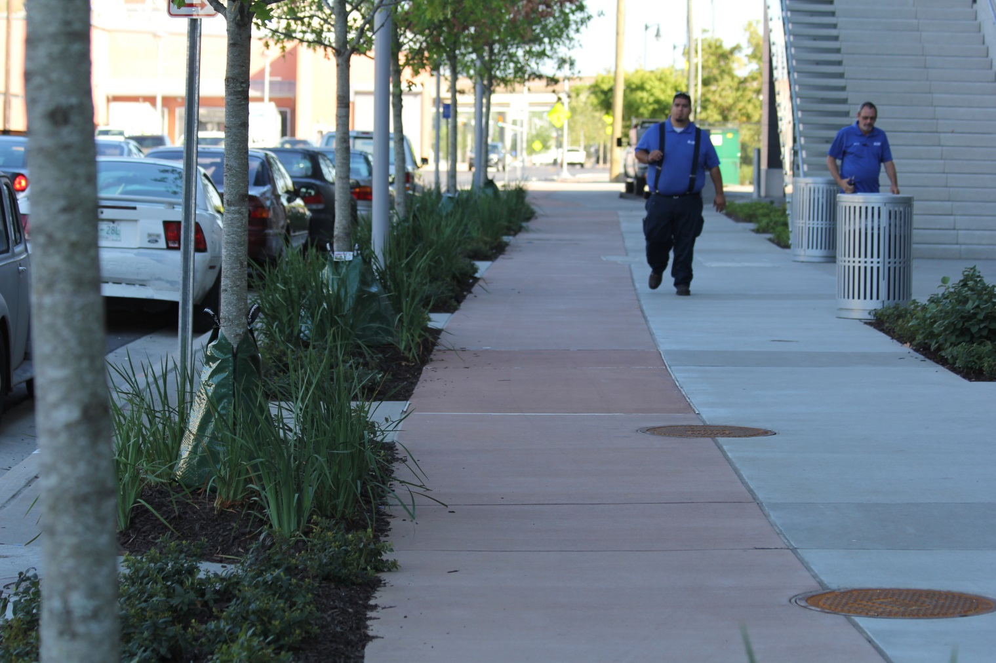
Final Product

Slide 25
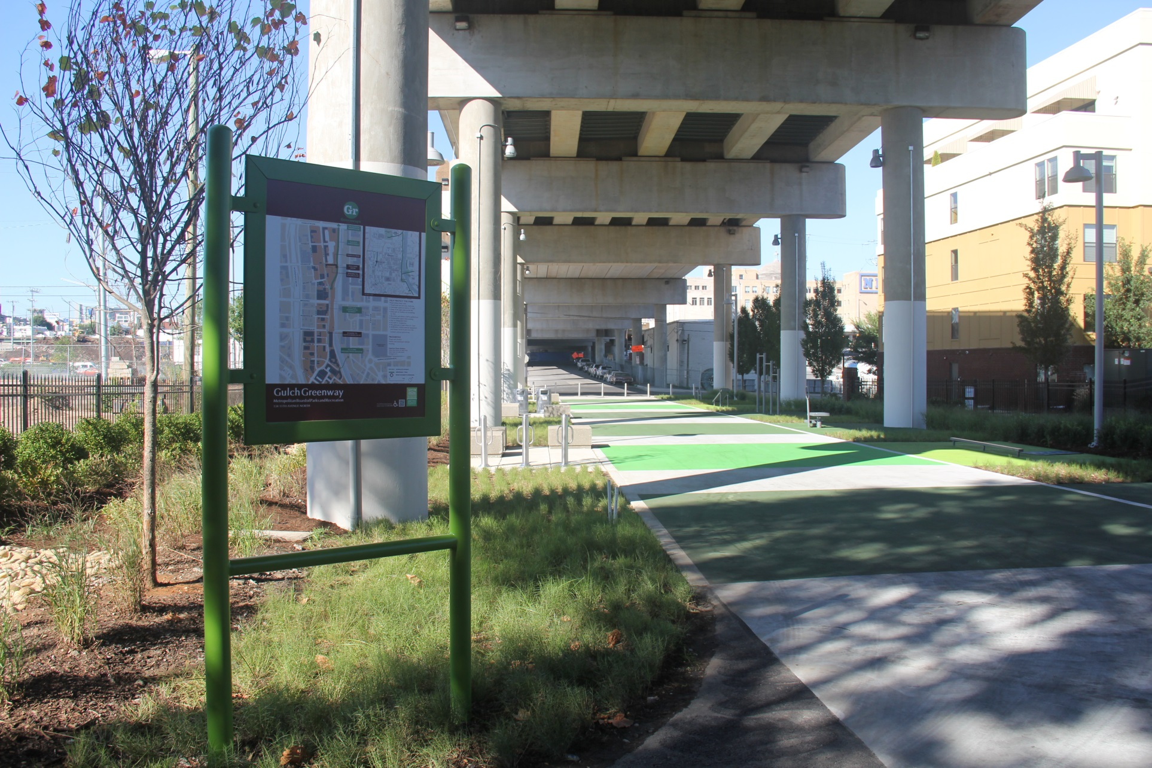
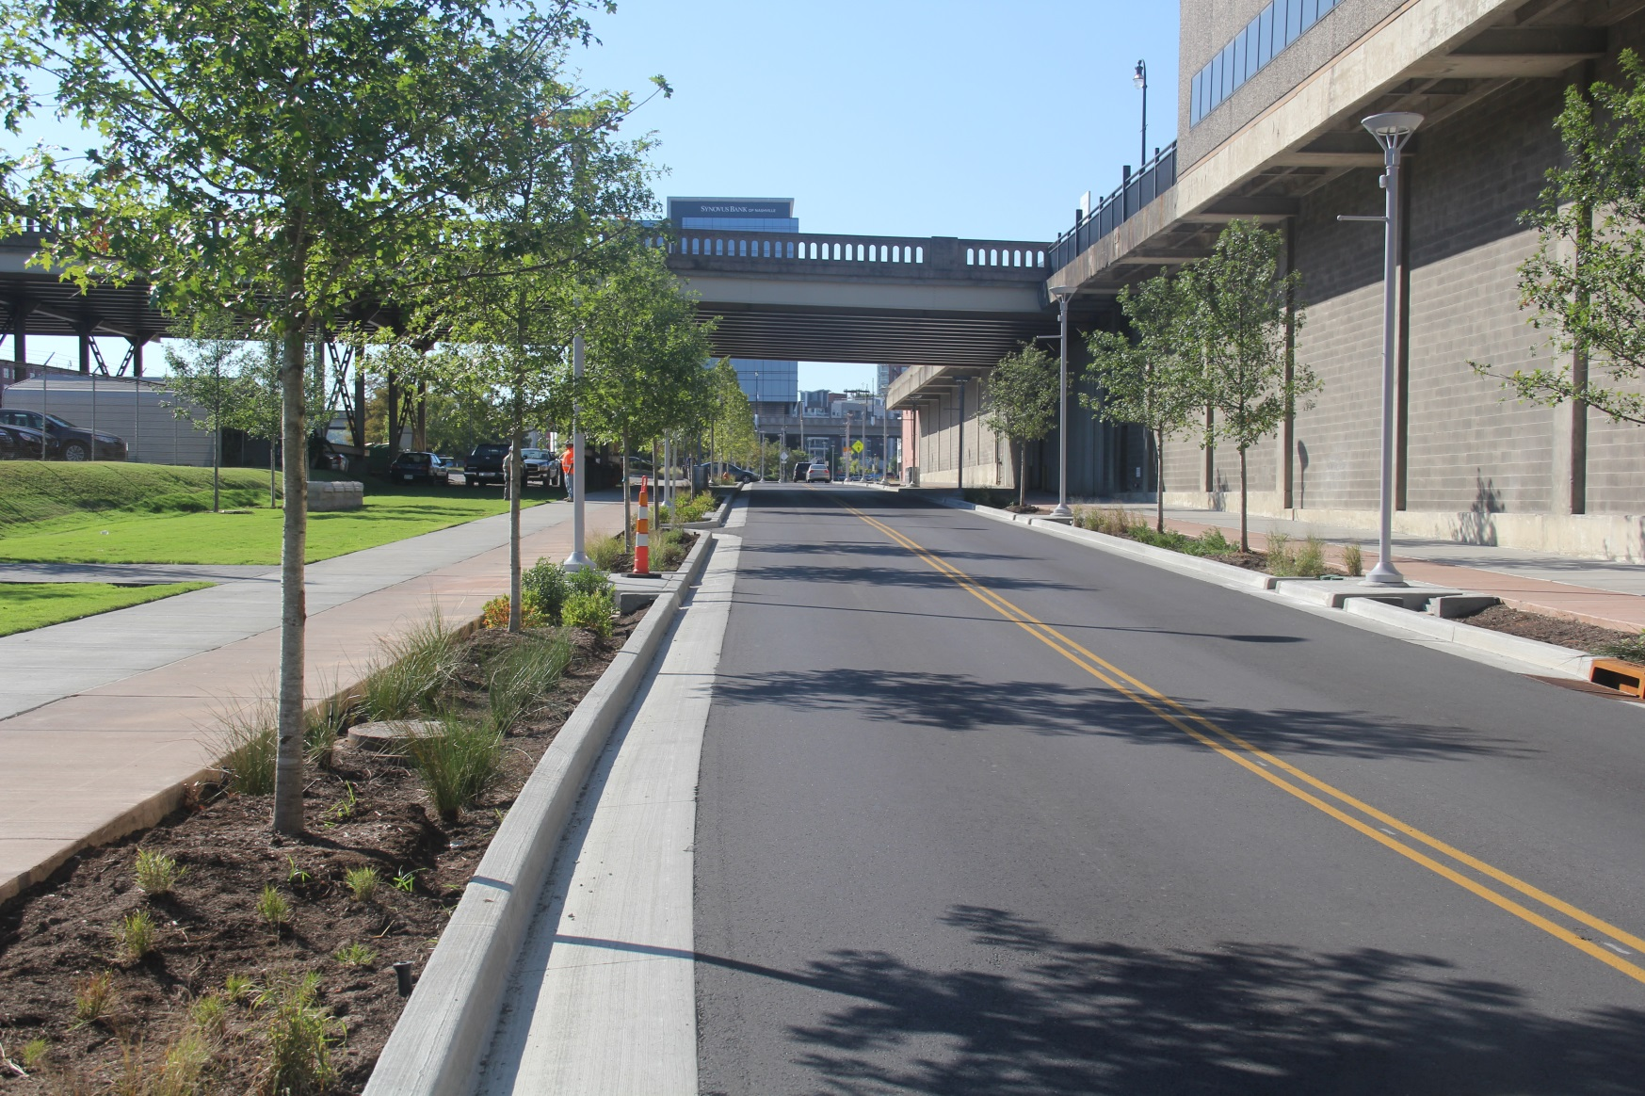
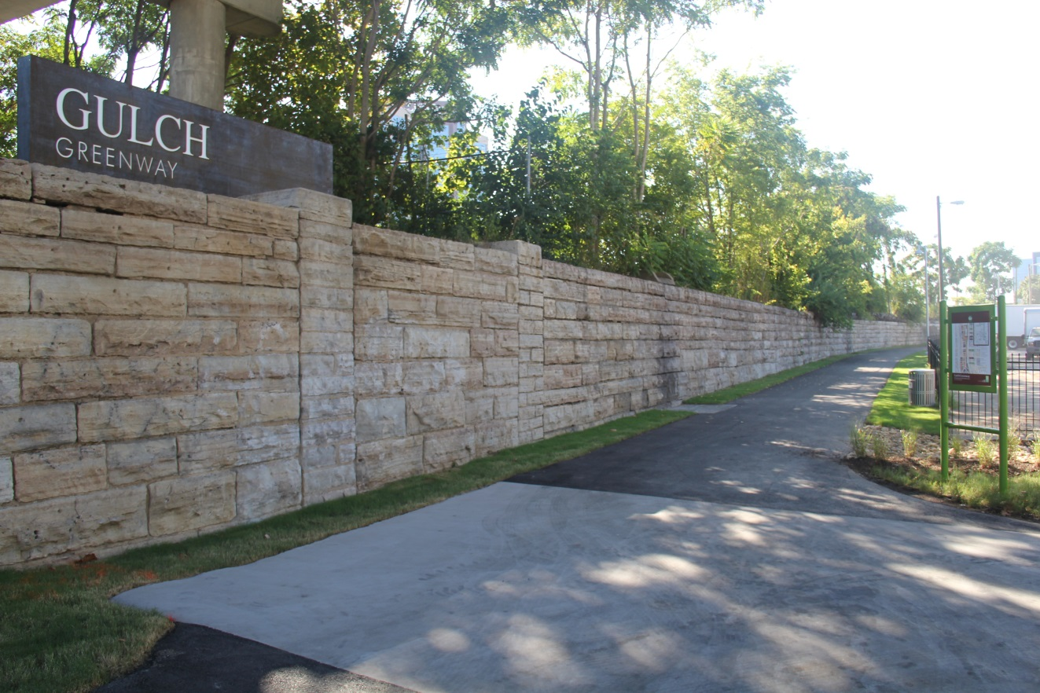
Final Product

Slide 26
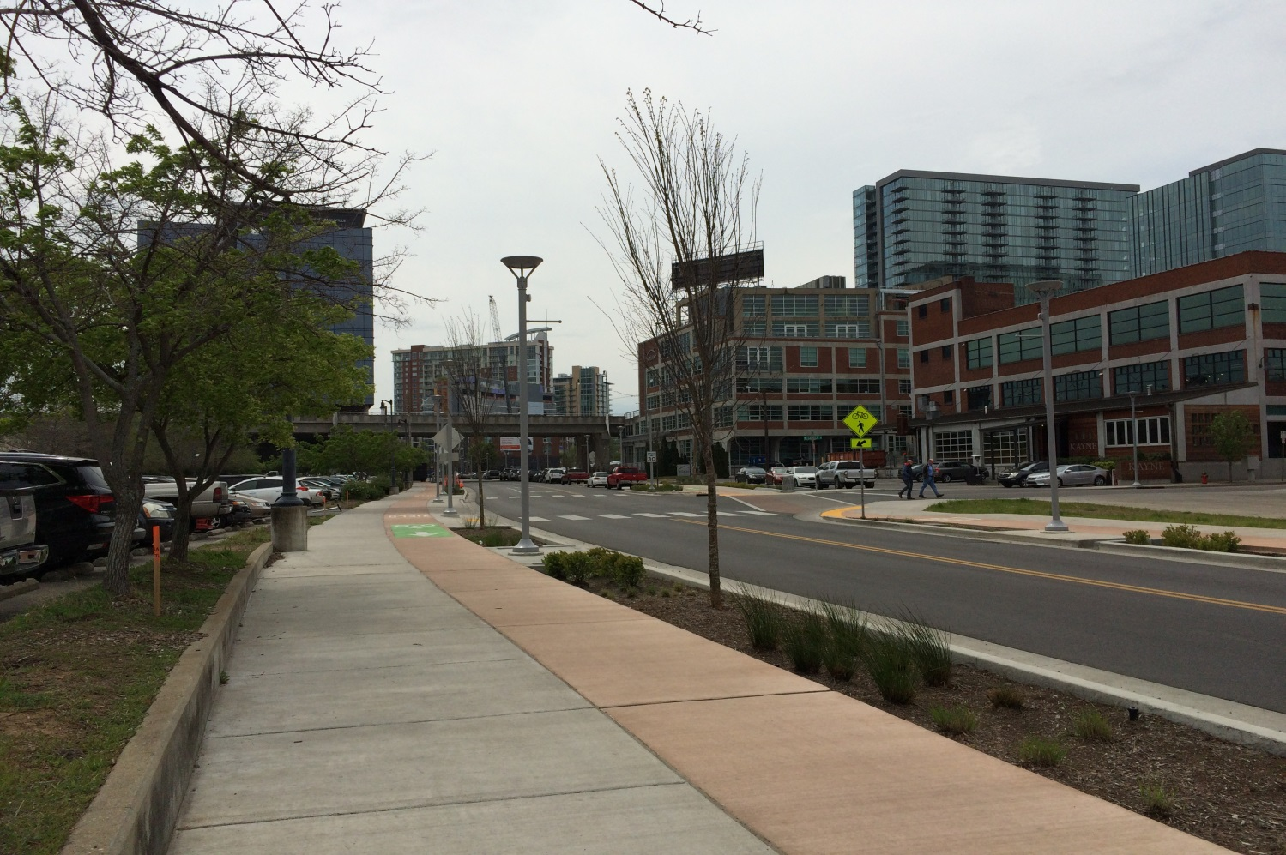
11th Avenue Complete Street
Providing Improvements for all users

