Slide 1

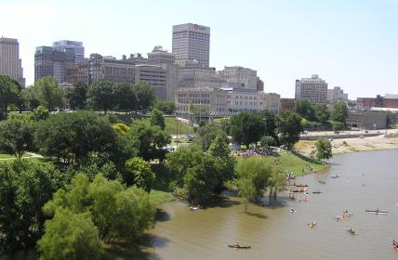
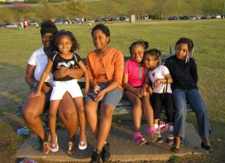
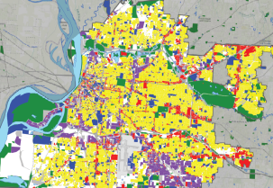
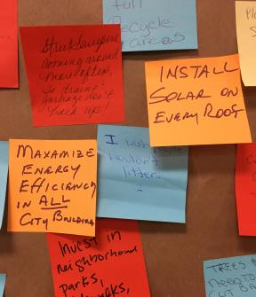
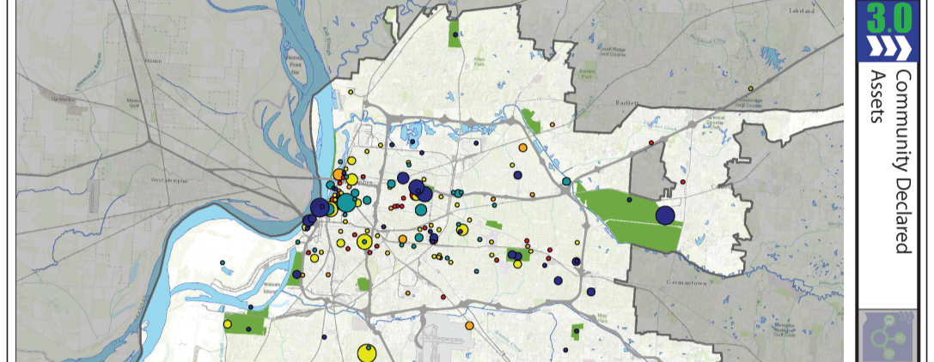
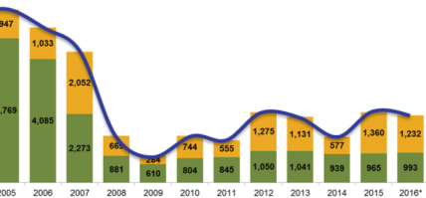

Slide 2

Memphis 3.0 Visioning and Planning Timeline
November 2016
January 2019
BACKGROUND
(Nov 2016 – Feb 2017)
GOAL SETTING AND FUTURE GROWTH
(Mar 2017 – Jul 2017)
VISION
(Aug 2017 – Sep 2017)
SOLUTIONS AND INVESTMENTS
(Oct 2017 – Dec 2018)
FINAL PLAN
(Jan 2019)
Kickoff Rallies
Public Meetings
&
Working Group Meetings
Public Presentations
District Planning
& Working Group Meetings
Public Presentations
Notes:
Plan goals strengthen neighborhoods
expand the economy
guide investments
attract and keep people
create great public places
integrate nature and recreation
increase prosperity and opportunity.

Slide 3
Memphis 3.0 is a comprehensive plan that addresses short and long term strategies for:
Land use
Transportation
Environment
Infrastructure
City systems
Growth and prosperity
Neighborhoods
Civic capacity
Guiding Principles
Pillars

Slide 4




Memphis 3.0 is structured around four pillars
CONNECTIVITY
Transit and meeting transportation demand
Freight
Streets for all users
Preparing for changes in technology and infrastructure
OPPORTUNITY
Workforce and business development
Economic development and growth
Blight and neighborhood improvement
Housing and infill
LIVABILITY
Land use and development
Parks, public spaces, and open spaces
Urban design, art, and historic preservation
SUSTAINABILITY
Efficiency and conservation of resources
Building resilient communities of the future

Slide 5




Five Guiding Principles are interwoven among all
Equity. Historically disadvantaged communities must gain access to resources and opportunities to thrive.
Poverty Reduction. Memphis cannot succeed without lifting its people out of poverty.
Public Safety. Memphis cannot achieve its full potential without creating a safe environment for all.
Health. The people of Memphis cannot thrive without greater access to health improvement opportunities.
Education. Memphis cannot grow, produce, and thrive without universal access to quality education.
Notes:
Mention safety and education and how those are safe environments not police and access and support not county schools

Slide 6
How can Memphis 3.0 be a bold vision for our future and a plan for action today?

Slide 7
How can we keep current residents and attract new population?

Slide 8
How and Where do we want to grow and how do we want our neighborhoods to look?

Slide 9
How can Memphis 3.0 achieve equity and opportunity?
Notes:
Define equity and opportunity

Slide 10
But first…
What is the state of the City of Memphis across these issues?

Slide 11
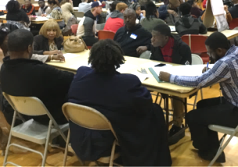
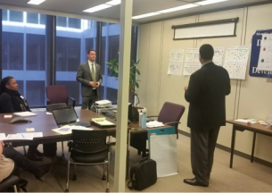
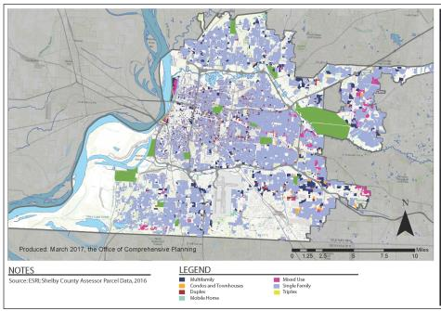
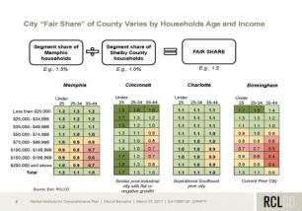
How do we answer that?
Public Input
Working Groups
Data and Research
Consultants

Slide 12
Population growth stalled in 1970s and maintained only through annexation
Since 1970, the population of the City of Memphis has grown by 4% while the land area has grown by 55%
2010
Population:
646,889
1970
Population:
623,530
1910
Population:
131,105
Notes:
Since 1970, population has remained relatively flat and only gains were made through annexation. Since only 4% growth – 45 years. But this is not out of step with our city’s history of growth
State and local policy will make it difficult to continue this pattern of growth by annexations

Slide 13
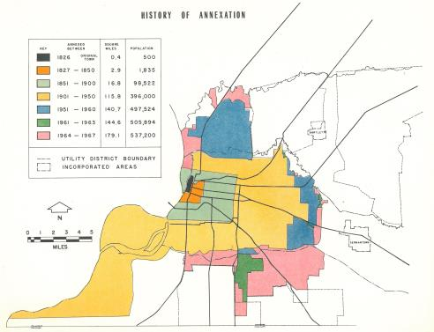
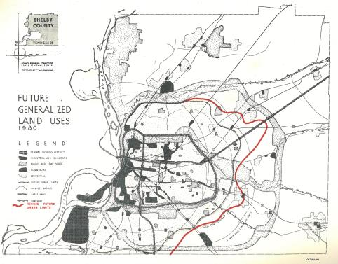
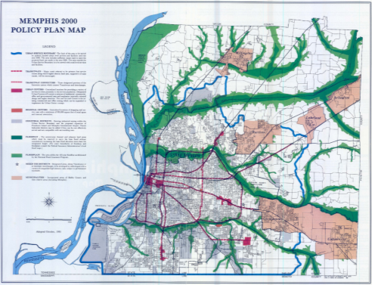
But this is not out of step with our city’s history of growth
State and local policy will make it difficult to continue this pattern of growth by annexations
Memphis Annexations through 1967
Memphis Future Urban Areas Growth Map (1961)
Memphis 2000 Growth Map (1981)
Notes:
For 200 years, that was our method of growth and reflective of our last two major plans – our land use plan of old in the 60s and our last comprehensive plan completed in 1981. That means changing this trajectory will hard.

Slide 14
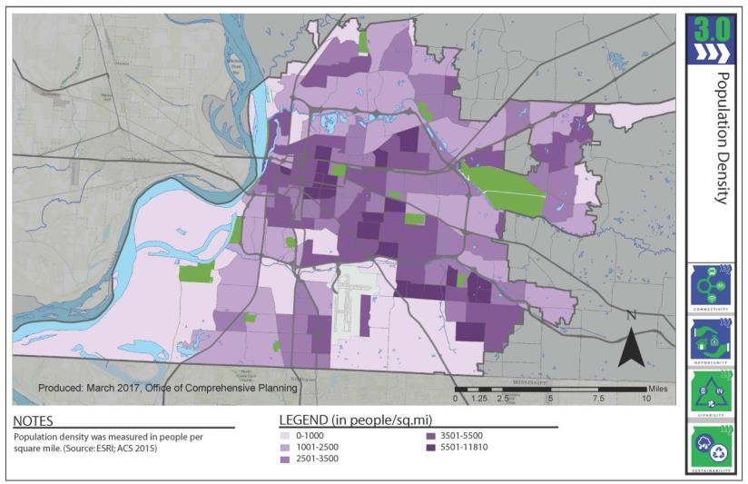
For much of the city, population density is low
Density is greatest primarily along key east-west corridors
Notes:
Over 2K people per square mile which has led to sprawl. Our land-thirsty development patterns have exacerbated the racial segregation and inequalities that plague our city today.

Slide 15
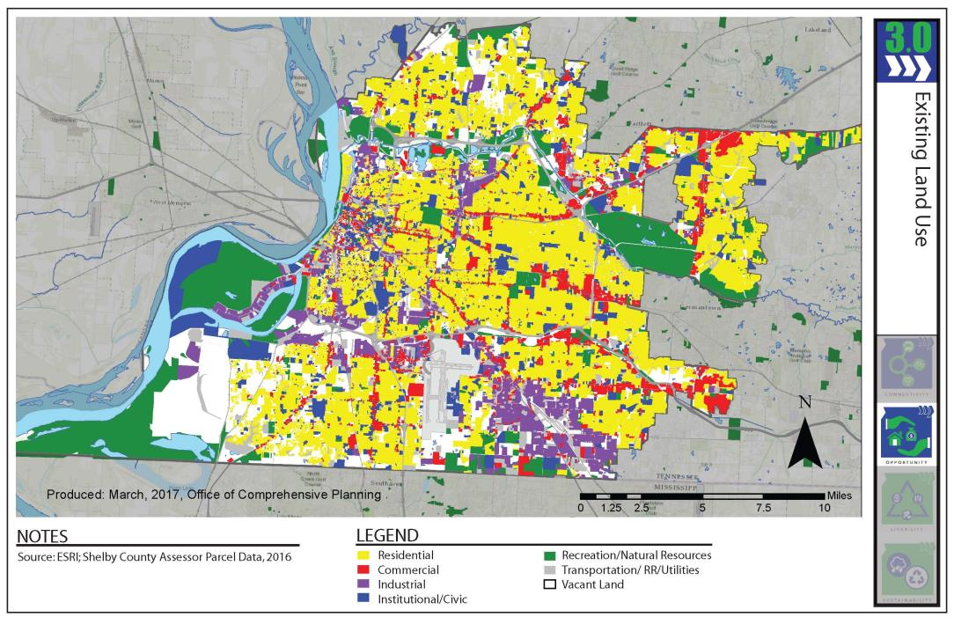
A significant amount of land is single family housing
Approximately 60% of housing units city-wide are single family detached
Notes:
Our land use are fairly isolated and the majority of our housing is single-family detached.

Slide 16
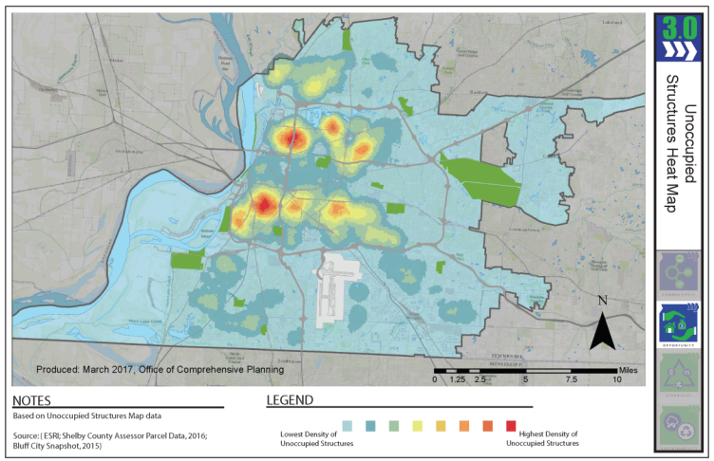
As we have grown outward, high vacancy rates have resulted:
The greatest concentrations of vacancy are in North and South Memphis
People said:
“We need BLIGHT MITIGATION”
Notes:
Over 15% vacancy in red areas -
As our growth has continued eastward and outward, we have left areas of vacancy, disinvestment and blight. 24 % of responses said improvements are needed within our opportunity pillar – namely improving blight & housing conditions. Median Rent is $828. These areas with neighborhood stress disproportionately affect African Americans, over half of the city’s population

Slide 17
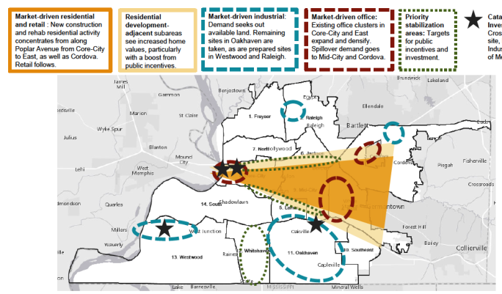
Where’s our market potential?
Notes:
People, employment sites, and opportunity is likely to follow this cone of “market-driven” potential. This doesn’t address the economic segregation in our city or the destabilization of our neighborhoods. It leaves most of Memphis out of the equation.

Slide 18
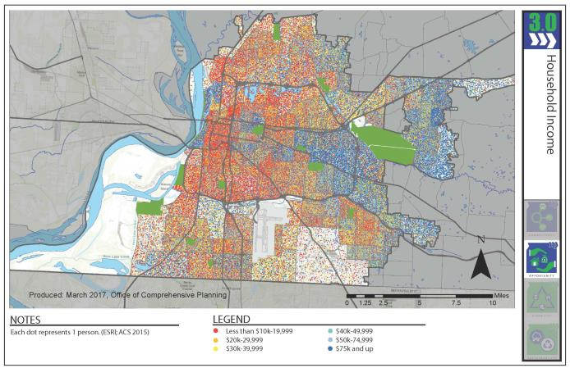
Continuing in this direction favors areas of greater means
Approximately 28% of Memphis residents live below the poverty line
28%
People are waiting on POVERTY REDUCTION!
BELOW
POVERTY
LINE
Notes:
Under $40K is variations of yellow and orange, over $40K is variations of blue. Memphians spend over half of their income on housing and transportation alone. Educational attainment levels reflect this pattern or distribution as well.

Slide 19
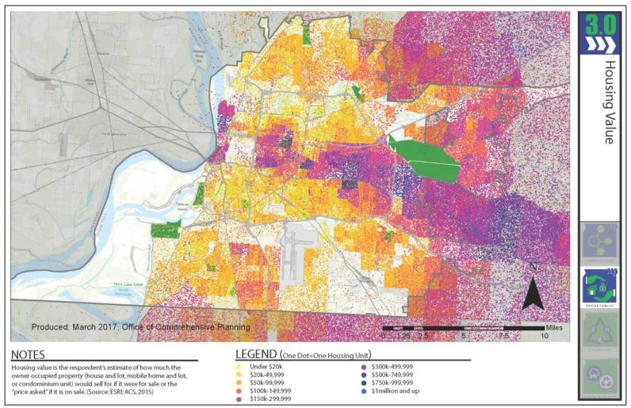
Housing values mirrors household income
Increasing the difficulty for those with fewer means to build wealth.
People said:
“We need HOUSING OPTIONS & landlord accountability”
Notes:
Median Rent is $828. Median home value is $94K. Memphis is 46/48% owner-occupied. What this does is further the financial inequalities of the city, hindering the ability to build wealth for all who live outside of the projected growth area. Unfortunately the minority population is disproportionately affected.

Slide 20
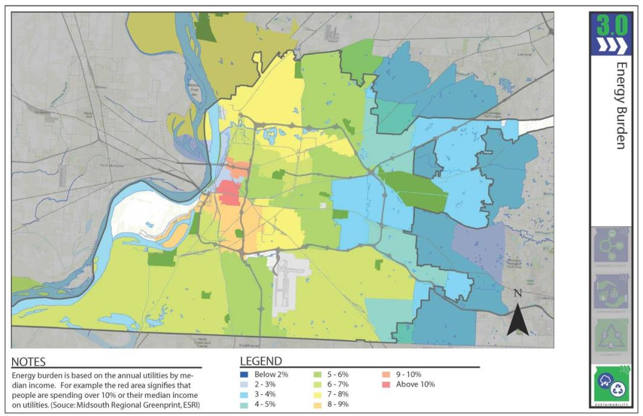
Affordability is undermined by energy and transportation costs.
Although utility rates are low, energy burden is high for those with fewer financial means.
People said:
“Conserve resources and embrace renewable energy”
Notes:
Approximately 28% of Memphis residents live below the poverty line. Once again from the opportunity pillar. Median HH income is $36K. County income is $46K

Slide 21
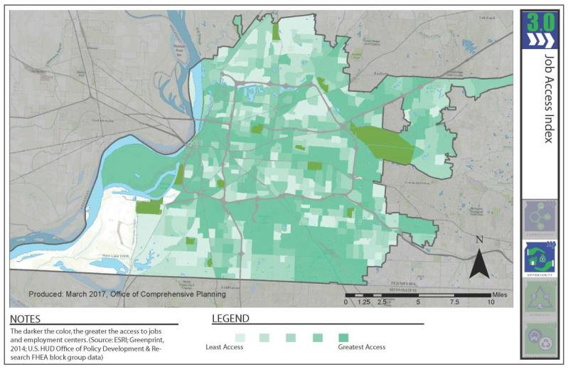
Continuing in this direction does not address the disconnect between areas of fewer financial means and economic opportunities
The majority of
our jobs are
located
HERE:
People said:
“We need ACCESS TO JOBS/SKILLS”
Notes:
Continuing in this direction does not address the mismatch between areas of least means and economic opportunities. Over 60% of jobs in the city are in these three submarkets/districts. Memphis unemployment rate – 6%, but unemployment among racial and ethnic minorities is nearly double that rate.

Slide 22
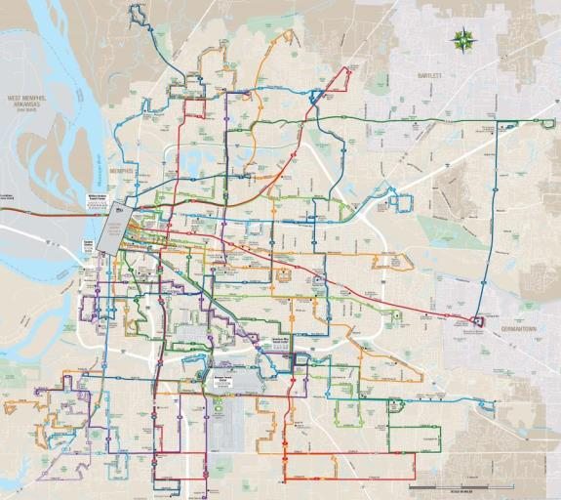
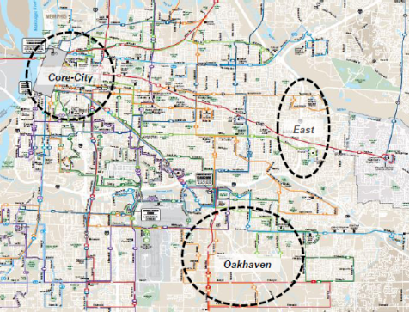
Or the mismatch between major employment centers and access to transit
People said:
“We need BETTER TRANSIT”
Notes:
Are we connecting residents with job opportunities via transit – there appears to be an appetite to do so. By improving transit we provide options, alleviate headache of parents getting kids from one activity to the next, reduce the income burden by decreasing automobile dependence, and better connecting our neighborhoods.

Slide 23
What might the future of Memphis look like in 2040 without a plan?
0.4%
26K
33K
Population Growth (annually)
New Jobs
New Housing Units
Notes:
Nashville’s projected growth is 500K new jobs, 200K new households during relatively the same time period.

Slide 24
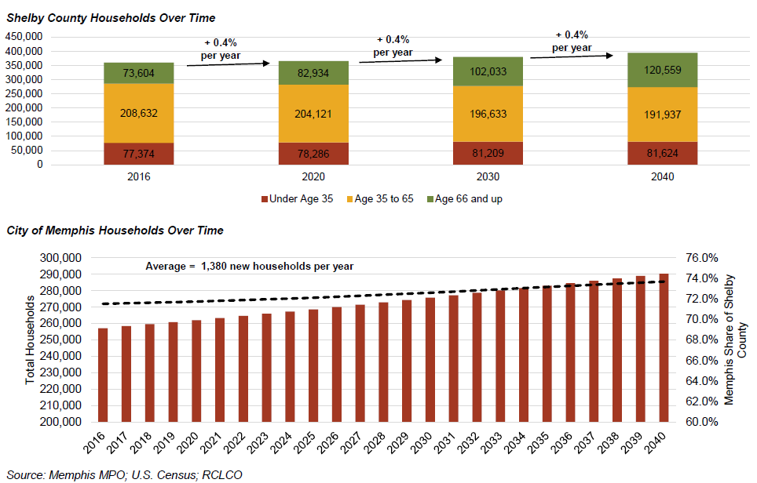
Population forecasts estimate modest future growth
Growth in the City will largely be driven by increasing the city’s share of regional household churn, particularly among younger households
Notes:
Growth is very modest – less than 1% growth. Our opportunity area are capturing younger households, our challenge is keeping them. So we have to understand the demographics and preferences of our opportunity markets.

Slide 25
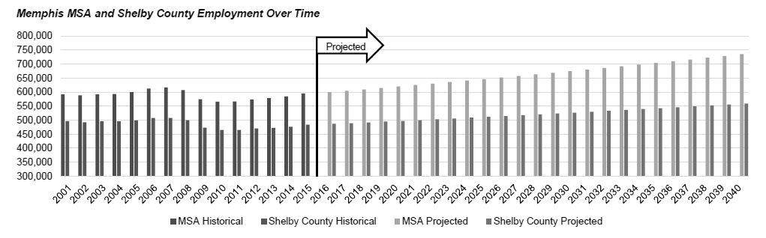
Job forecasts estimate similarly modest growth
Greatest gains are anticipated in Leisure & Hospitality, Construction, and Education & Health
Notes:
Once again, modest, almost flat growth. The key here are the industries. Our growth is anticipated in leisure & hospitality, construction, and education and health.

Slide 26
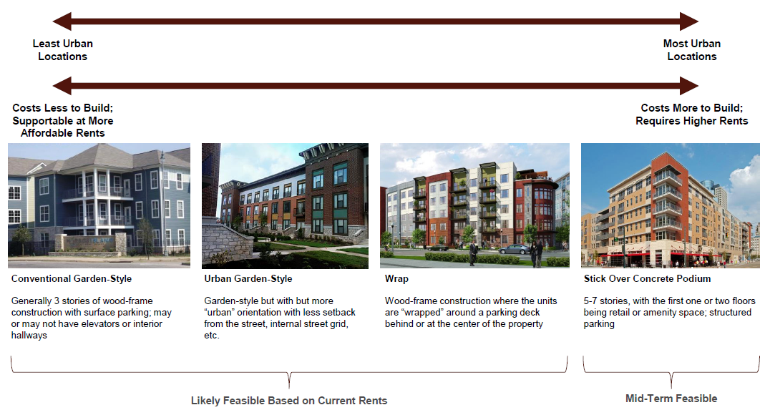
New multifamily units represent nearly half of the city’s future residential demand (total: 33K by 2040)
Among single family units, demand for renovated units outpaces new construction
Notes:
Nearly half of our projected households should be multifamily. Once again due to preferences and trends, people are waiting longer to have children, if at all. Multifamily can look a variety of ways, and it’s up to us to determine what that typology looks like.

Slide 27
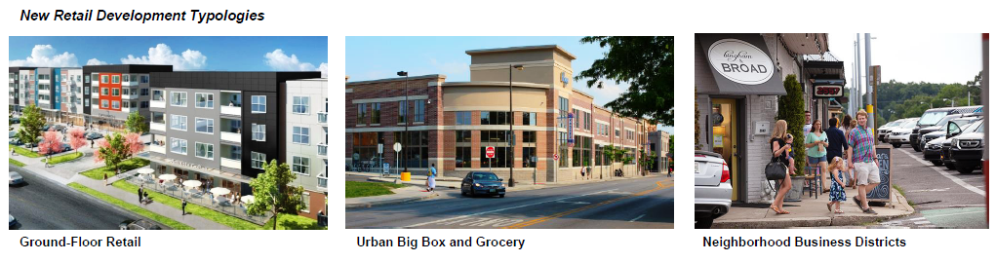
Future retail demand is modest among an already saturated market
Only 1.35 million square feet of retail projected by 2040
Notes:
That’s about the same size as Wolfchase. But what form should that retail take and where?

Slide 28
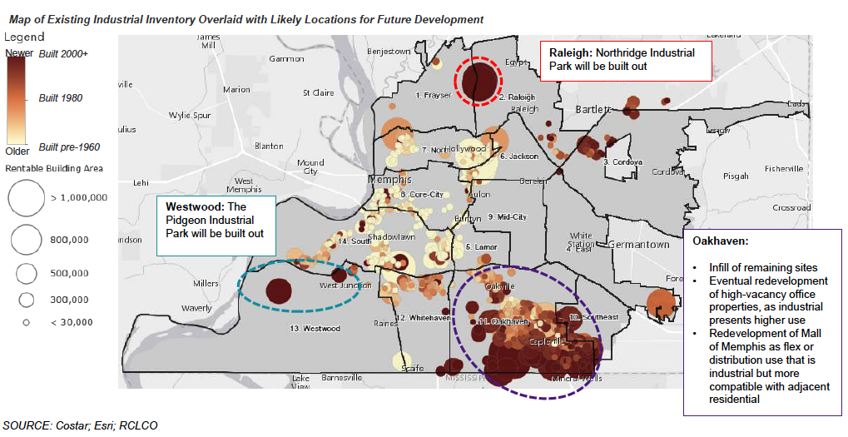
Future industrial demand is modest and favors existing sites with strong infrastructure
The city’s ability to meet demand depends on preparing new sites or redeveloping older sites
Notes:
Industrial sites are more likely to exist in new sites, developed after year 2000. That creates a re-use opportunity for older industrial sites in older parts of the city.

Slide 29
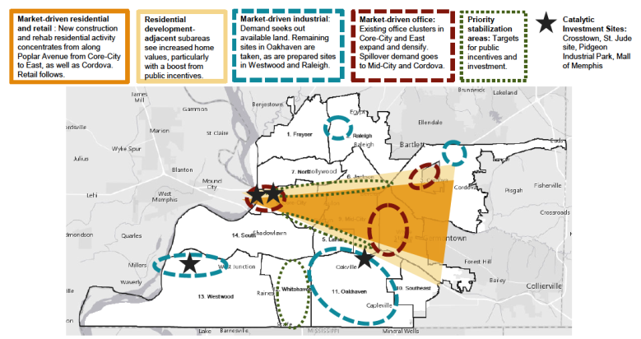
So is this the future we want?
The comprehensive plan gives our city an opportunity to articulate a new direction as we enter our third century
?
Notes:
Knowing what we know, and that we have two big goals – how do we begin to attract population so that 4% growth over 45 isn’t the norm.
How do we increase opportunities for our current demographic, thus lessening the financial gap between those with means and those without.
what’s the mechanism to do that? How do we go from here to (next slide)

Slide 30
What have we heard from you?

Slide 31
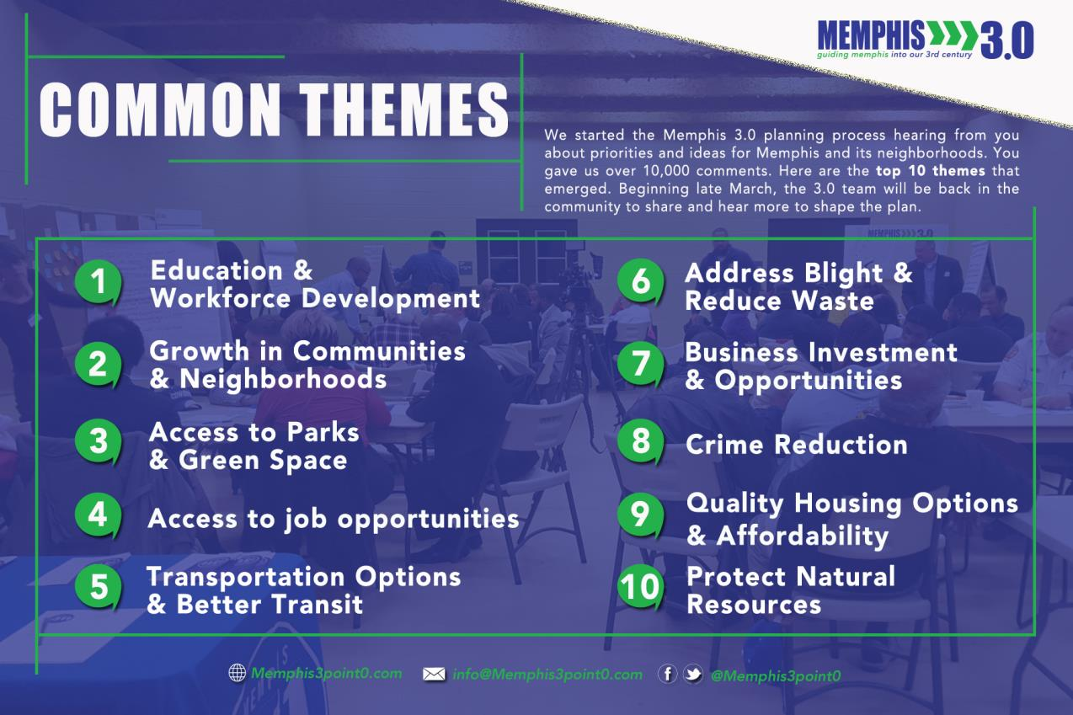
Notes:
We’ve heard common themes that have shaped and guided our work to date. Areas of challenge that our city must address in order to create vibrant communities and become attractive and competitive.

Slide 32
Challenges to progress
Connectivity
More Options
Improved infrastructure
More efficient bus system
Livability
Development concerns
Cultural Resources
Design
Opportunity
Housing (options & Programs)
Blight Mitigation
Workforce/business development
Sustainability
Waste reduction
Resources Conservation
Notes:
This chart shows us responses by pillar. Most people who have participated in the planning process have identified connectivity and transit as the major challenge that needs to be addressed in our city. You can view your packet for more detailed information about the public input. And what categories or responses fall within each pillar.

Slide 33
Practices that resonate so far:
Notes:
After having our community conversations, we held a variety of visioning meetings. We dove deeper into the common themes and the challenges that were presented and developed “practice statements”. We then asked people to select their top 5 or 6 and tell us why they matter. There were also write-in options if folks didn’t see the a statement that reflected their values.
This is just a snapshot. The survey is live and will be until the first week of July. Your packet has more details on statements that Memphians are valuing the most.

Slide 34
Refresher – our plan components:
Memphis 3.0 is a comprehensive plan that addresses short and long term strategies for:
Land use
Transportation
Environment
Infrastructure
City systems
Growth and prosperity
Neighborhoods
Civic capacity
Guiding Principles
Pillars
Notes:
Remembering our plan components, adding the public input and understanding our current and future data. We’ve developed these draft vision statements that we believe reflect what the city has shared.

Slide 35

Draft Vision Statements
By 2040, Memphis is a city…
that VALUES LAND AS AN ASSET,
with CONNECTED COMMUNITIES,
HIGH PERFORMING INFRASTRUCTURE,
and VIBRANT CIVIC SPACES.
Advancing EQUITY & OPPORTUNITY,
and PROSPERITY & AFFORDABILITY
With GREAT NEIGHBORHOODS,
REMARKABLE PEOPLE,
GOOD GOVERNMENT,
and a SUSTAINABLE FUTURE.
Notes:
Taking the components of the plan and what the public said we need to address, we believe these statements are reflective of the city we aspire to be. But they are draft. There’s still an online survey to provide input and shape these statements. Having this foundation of a vision leads us to our next conversations about growth planning for the city.

Slide 36
Memphis 3.0 Visioning and Planning Timeline
November 2016
January 2019
BACKGROUND
(Nov 2016 – Feb 2017)
GOAL SETTING AND FUTURE GROWTH
(Mar 2017 – Jul 2017)
VISION
(Aug 2017 – Sep 2017)
SOLUTIONS AND INVESTMENTS
(Oct 2017 – Dec 2018)
FINAL PLAN
(Jan 2019)
Kickoff Rallies
Public Meetings
&
Working Group Meetings
Public Presentations
District Planning
&
Working Group Meetings
Public Presentations
Notes:
At the conclusion of these meetings, we’ll be here. Determining our future growth – together.

Slide 37
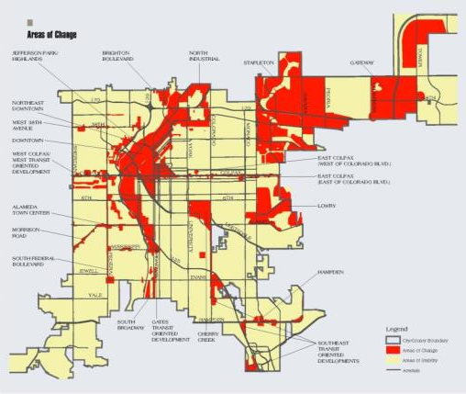
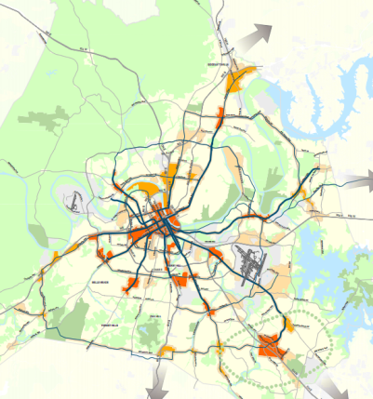
Future Growth Planning
Our opportunity to articulate what’s most important about where we grow
Blueprint Denver
NashvilleNext
Notes:
Many cities do this behind closed doors, showing only the final result. We want the public to take what they know about the city, what they’ve learned through this process, and determine where it makes since to grow. Where does that population and job growth happen? It’s our job to explain the implications of those decision. Other cities have done it and it gives them a guide or a roadmap

Slide 38

Website: http://memphis3point0.com/
Facebook: https://www.facebook.com/Memphis3point0/
Twitter: https://twitter.com/Memphis3point0
This presentation will be available on our website on June 30, 2017.
Notes:
Thank you again for coming tonight.

