Slide 1
Creating healthy, sustainable, equitable communities by maximizing the synergies between walkability and quality public transit
Allan Henderson
SRTS Program Manager
Health by Design
APBP Professional Development Seminar Memphis, Tennessee June 26-29, 2017

Slide 2
Presentation Overview
Transit-Walkability Collaborative
Next Steps & Questions
Benefits of Walkable, Transit, Rich communities
Programmatic & Policy Strategies for Promoting Walkable, Transit Rich Communities

Slide 3
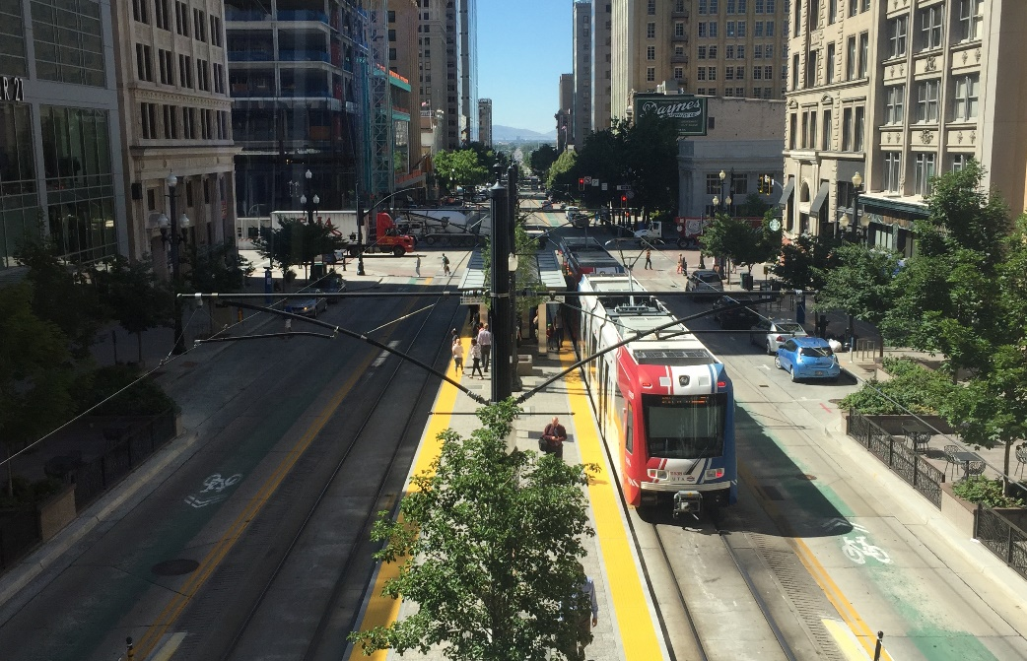
What is the Transit-Walkability Collaborative
The Transit-Walkability Collaborative consists of national, state-level, and local leaders in the walkability and public transit advocacy movements who recognize the synergies between these two transportation modes and the benefits of collaboration.
Moving from individual interventions to policy, systems and environmental (PSE) change:
Making the healthy choice the easy choice
Photo Location: Salt Lake City, UT
Notes:
The Transit-Walkability Collaborative consists of national, state-level, and local leaders in the walkability and public transit advocacy movements who recognize the synergies between these two transportation modes and the benefits of collaboration.

Slide 4
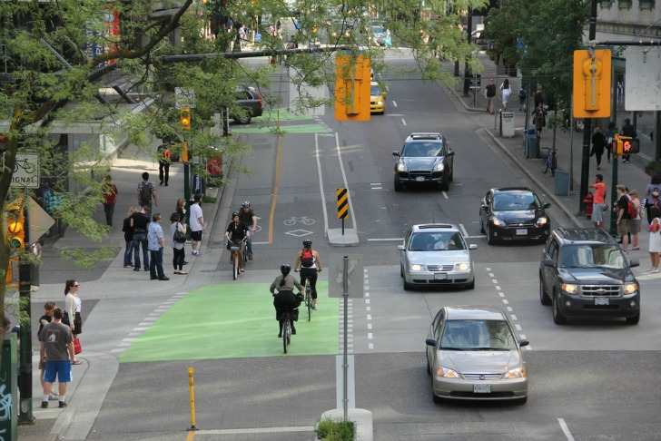
What is the Transit-Walkability Collaborative
The Transit-Walkability Collaborative exists to:
Promote the benefits of walkable, transit-rich communities;
Bring together transit and walkability advocates at the local, state, and national level;
Identify and implement programs and policies that simultaneously expand walkability and transit services in communities across the U.S.
Our shared goals are to improve public health, safety, and transportation equity, by developing complementary planning efforts, increasing funding for active and public transportation, and supporting transit-oriented development that is designed to benefit existing residents and neighborhoods.
Photo Location: Vancouver, BC
Notes:
The Transit-Walkability Collaborative exists to:
Promote the benefits of walkable, transit-rich communities;
Bring together transit and walkability advocates at the local, state, and national level;
Identify and implement programs and policies that simultaneously expand walkability and transit services in communities across the U.S.
Our shared goals are to 1) improve public health, safety, and transportation equity, by 2) develop complementary planning efforts, 3) increase funding for active and public transportation, and 4) support transit-oriented development that is designed to benefit existing residents and neighborhoods.

Slide 5
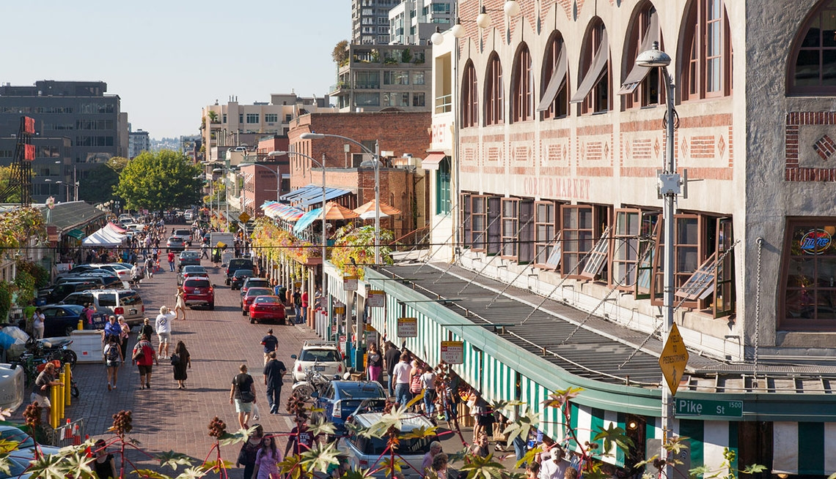
History of the Transit-Walkability Collaborative
Recognizing that walkability and transit advocacy complement each other and accomplish common goals neither can achieve on its own, America Walks convened partners from these two movements in early 2016. After meeting regularly meeting for about 9 months, the organizations formally established the Transit-Walkability Collaborative.
Photo Location: Seattle, WA
Notes:
Recognizing that walkability and transit advocacy complement each other and accomplish common goals neither can achieve on its own, America Walks convened partners from these two movements in early 2016. After meeting regularly meeting for about 9 months, the organizations formally established the Transit-Walkability Collaborative.

Slide 6
Who is the Transit-Walkability Collaborative
Center for Transportation Excellence, www.cfte.org
American Public Transportation Association, www.apta.com/
National Association of Public Transportation Advocates, www.publictransportation.org/NAPTA/
Victoria Transportation Policy Institute, www.vtpi.org/
Circulate San Diego, www.circulatesd.org/
WalkDenver, www.walkdenver.org/
Indiana Citizens' Alliance for Transit, www.indianacat.org/
WalkBoston, www.walkboston.org/
America Walks, http://americawalks.org
1.
2.
3.
9.
Transit-Walkability Collaborative
4.
8.
7.
5.
6.
Notes:
Center for Transportation Excellence, www.cfte.org
American Public Transportation Association, www.apta.com/
National Association of Public Transportation Advocates, www.publictransportation.org/NAPTA/
Victoria Transportation Policy Institute, www.vtpi.org/
Circulate San Diego, www.circulatesd.org/
WalkDenver, www.walkdenver.org/
Indiana Citizens' Alliance for Transit, www.indianacat.org/
WalkBoston, www.walkboston.org/
America Walks, http://americawalks.org

Slide 7
What are the objectives of the Transit-Walkability Collaborative
Research - Current state of the field and best practices in collaboration between transit and walkability advocates will be understood and used to inform strategy.
Communications - Public perceptions will continue to change such that transit, walkability, and social equity are highly valued by residents and decision-makers.
Capacity Building - Local and state-level transit and walkability advocates will expand their ability to collaborate effectively and accomplish their shared goals.
Policy Change - Federal, state, and local investment in walkable communities, quality transit systems, and transportation equity will increase.
Research
Communications
Capacity Building
Policy Change
Notes:
Research - Current state of the field and best practices in collaboration between transit and walkability advocates will be understood and used to inform strategy.
Communications - Public perceptions will continue to change such that transit, walkability, and social equity are highly valued by residents and decision-makers.
Capacity Building - Local and state-level transit and walkability advocates will expand their ability to collaborate effectively and accomplish their shared goals.
Policy Change - Federal, state, and local investment in walkable communities, quality transit systems, and transportation equity will increase.

Slide 8
Why do walkability and transit advocacy complement each other
Quality public transit service benefits communities by providing safe, affordable, and convenient mobility for everyone.
Walkable communities encourage high rates of walking, which improves health, safety, environmental conditions, and quality of life for everyone.
By emphasizing and integrating these two modes of transportation, local officials create safe, affordable, and enjoyable neighborhoods, whose residents complete their daily activities while owning fewer vehicles and driving less often.
By providing a variety of viable transportation options, communities stimulate higher participation in active and public transportation, leading to many benefits including fewer traffic fatalities, significant public and private-sector cost savings, reduced air pollution and greenhouse gas emissions, higher levels of physical activity, and a better quality of life - especially for low-income families.
NOT
A PLAN FO
PEDESTRIAN
ROUTES &
NETWORK
Notes:
Why do walkability and transit advocacy complement each other
Quality public transit service benefits communities by providing safe, affordable, and convenient mobility for everyone.
Walkable communities encourage high rates of walking, which improves health, safety, environmental conditions, and quality of life for everyone.
By emphasizing and integrating these two modes of transportation, local officials create safe, affordable, and enjoyable neighborhoods, whose residents complete their daily activities while owning fewer vehicles and driving less often.
By providing a variety of viable transportation options, communities stimulate higher participation in active and public transportation, leading to many benefits including fewer traffic fatalities, significant public and private-sector cost savings, reduced air pollution and greenhouse gas emissions, higher levels of physical activity, and a better quality of life - especially for low-income families.

Slide 9
Why do walkability and transit advocacy complement each other
Programs and policies that increase investment in transit service and walkability are complementary because these two modes are effective at different scales - the neighborhood level for walking, and the community level for transit.
Because the vast majority of transit rides start and end with a walk, coordinating efforts to improve both modes simultaneously leads to safe and accessible connections to transit and empowers people to live well without a car.
Walkability and transit advocacy complement each other and accomplish common goals neither can achieve on its own.
Notes:
Programs and policies that increase investment in transit service and walkability are complementary because these two modes are effective at different scales - the neighborhood level for walking, and the community level for transit.
Because the vast majority of transit rides start and end with a walk, coordinating efforts to improve both modes simultaneously leads to safe and accessible connections to transit and empowers people to live well without a car.
Walkability and transit advocacy complement each other and accomplish common goals neither can achieve on its own.

Slide 10
What are the benefits of walkable, transit rich communities?
Community Safety and Health Benefits - Vehicle ownership in walkable, transit-rich communities is 50% lower than in automobile-oriented areas. Driving less and relying more on public transportation helps residents build physical activity into their daily lives and greatly reduces their risk of being killed or injured in traffic crashes.
Public transit is ten times safer per mile than traveling by car.
People who walk for local errands and use public transit are more likely to achieve the U.S. Surgeon General’s physical activity targets.
Residents of these communities inhale about half as much air pollution as those in automobile-oriented communities.
Notes:
Community Safety and Health Benefits - Vehicle ownership in walkable, transit-rich communities is 50% lower than in automobile-oriented areas. Driving less and relying more on public transportation helps residents build physical activity into their daily lives and greatly reduces their risk of being killed or injured in traffic crashes.
Public transit is ten times safer per mile than traveling by car.
People who walk for local errands and use public transit are more likely to achieve the U.S. Surgeon General’s physical activity targets.
Residents of these communities inhale about half as much air pollution as those in automobile-oriented communities.

Slide 11
What are the benefits of walkable, transit rich communities?
Economic and Equity Benefits - Policies that lead to walkable, transit-rich communities (known in some sectors as "transit-oriented development” or TOD) strengthen local economic development, create opportunities for disadvantaged residents, and enhance community resilience.
TOD increases worker availability, business productivity, and growth.
Lower-income residents have better access to employment in TOD and greater economic opportunity.
Walking, cycling and transit can eliminate the household expense of one car, saving $4,000 - $6,000 annually. As a result, residents have more money to spend on local goods and services, increasing local economic activity in their community.
Walkability and transit improvements make communities more attractive and accessible to residents and business customers.
TOD reduces the number of parking spaces businesses must subsidize.
Compact development increases economic productivity, leading to job creation, higher tax revenues, and more government investment in the community.
Residents are able to “age in place” and maintain their independence.
Notes:
Economic and Equity Benefits - Policies that lead to walkable, transit-rich communities (known in some sectors as "transit-oriented development” or TOD) strengthen local economic development, create opportunities for disadvantaged residents, and enhance community resilience.
TOD increases worker availability, business productivity, and growth.
Lower-income residents have better access to employment in TOD and greater economic opportunity.
Walking, cycling and transit can eliminate the household expense of one car, saving $4,000 - $6,000 annually. As a result, residents have more money to spend on local goods and services, increasing local economic activity in their community.
Walkability and transit improvements make communities more attractive and accessible to residents and business customers.
TOD reduces the number of parking spaces businesses must subsidize.
Compact development increases economic productivity, leading to job creation, higher tax revenues, and more government investment in the community.
Residents are able to “age in place” and maintain their independence.

Slide 12
What are the benefits of walkable, transit rich communities?
Quality of Life Benefits - Walkable transit-rich communities are livable communities - while many residents drive for some journeys, diverse mobility options improve quality of life in many ways.
More people walking provide “eyes on the street”, which reduces crime.
Walkable neighborhoods with shops, restaurants, and parks give residents many meet, increasing social capital.
Walkability and transit provide mobility independence for adolescents, seniors, and people with disabilities, reducing chauffeuring burdens.
Walking for pleasure or exercise is a highly-rated, quality-of-life benefit of livable communities.
Notes:
Quality of Life Benefits - Walkable transit-rich communities are livable communities - while many residents drive for some journeys, diverse mobility options improve quality of life in many ways.
More people walking provide “eyes on the street”, which reduces crime.
Walkable neighborhoods with shops, restaurants, and parks give residents many meet, increasing social capital.
Walkability and transit provide mobility independence for adolescents, seniors, and people with disabilities, reducing chauffeuring burdens.
Walking for pleasure or exercise is a highly-rated, quality-of-life benefit of livable communities.

Slide 13
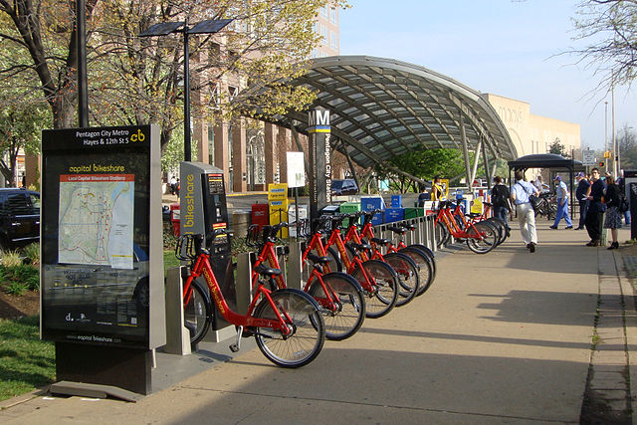
Programmatic and Policy Strategies for promoting walkable, transit rich communities
1. Community planning and ordinance development
Comprehensive planning
Pedestrian planning
SRTS planning
Lot sizes
Setbacks
Building height
Orientation to street
Photo Location: Washington D.C.
Notes:
1. Community planning and ordinance development
Comprehensive planning
Pedestrian planning
SRTS planning
Lot sizes
Setbacks
Building height
Orientation to street

Slide 14
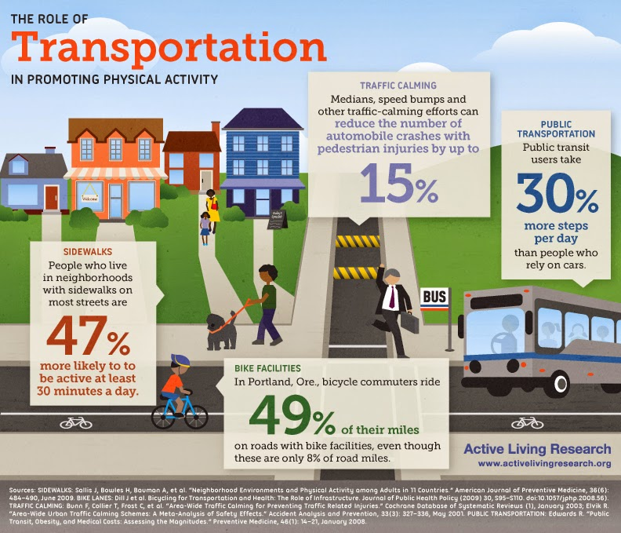
Programmatic and Policy Strategies for promoting walkable, transit rich communities
2. Complete Streets policies
Graphic courtesy of: Active Living Research
Notes:
2. Complete Streets policies

Slide 15
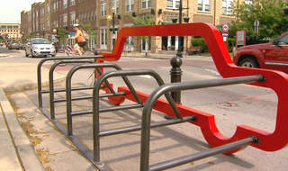
Programmatic and Policy Strategies for promoting walkable, transit rich communities
3. Development policies – parking, traffic impact studies, density
Photo Location: Carmel, IN
Notes:
3. Development policies – parking, traffic/VMT impact studies, density

Slide 16
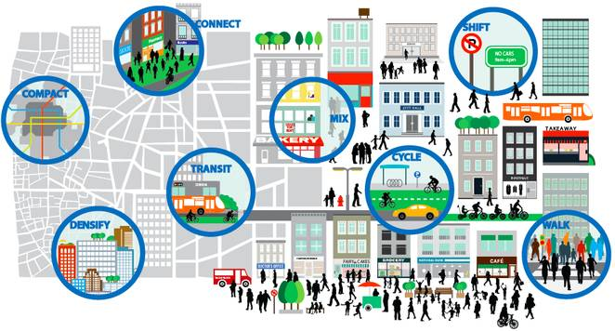
Programmatic and Policy Strategies for promoting walkable, transit rich communities
4. TOD and mixed-use zoning and mixed income housing
Graphic courtesy of: Treehugger.com
Notes:
4. TOD and mixed-use zoning and mixed income housing

Slide 17
Next Steps
http://americawalks.org/the-transit-walkability-collaborative-an-inter-modal-strategy-for-creating-strong-neighborhoods-webinar-april-18-2017/
Questions
We have time for a few questions at this time, but have also reserved time at the end of all of the presentations for more questions and answers.

Slide 18
CONTACT INFORMATION
Allan Henderson
SRTS Program Manager
Health by Design
401 West Michigan Street
Indianapolis, IN 46202
(317) 352-3804 ahenderson@acsm.org

