Slide 1


Achieving Multimodal Networks:
Applying Design Flexibility and Reducing Conflicts
APBP
Professional Development Seminar
June 28, 2017
Notes:
- This is a really exciting and useful document. It's an interesting time to be working with FHWA because they are pushing out many new resources (like the routine resurfacing project that Kevin lead and the project Jim just started on innovative streets and people with disabilities)
- My goal is to have you walk away from this presentation a little more knowledgeable about design flexibility and common misconceptions or barriers practitioners face and also design strategies to reduce and manage conflicts. We also want to wet your appetite so you have a sneak peak at what is in this document so you continue to reference it.
- I will cover the document introduction and also planning to highlight several key points from each design topic.

Slide 2
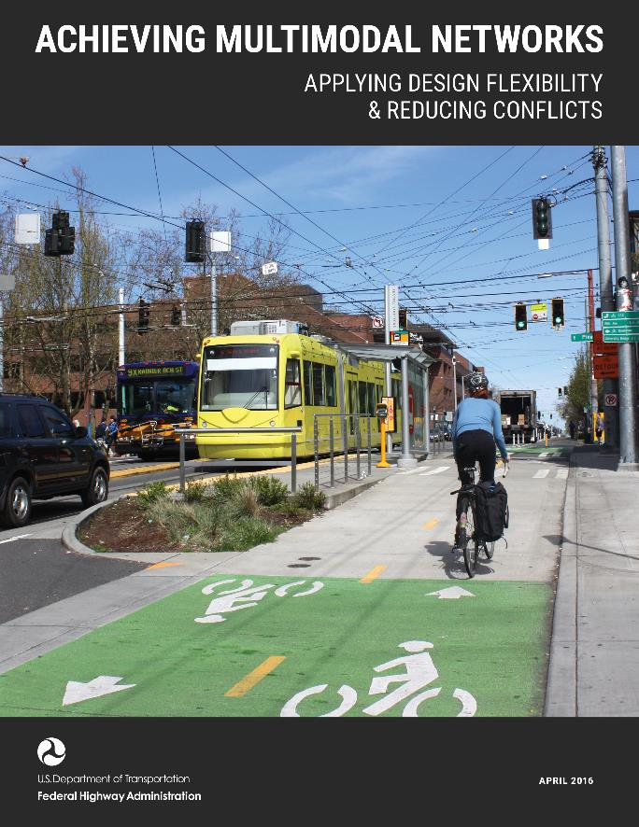
Achieving Multimodal Networks Introduction
Interconnected pedestrian and bicycle infrastructure makes walking and bicycling a viable transportation choice for everyone and this contributes to the health, equity, and quality of life of our communities.
Notes:
Just to provide a little overview of the document
The document is has three sections:
· Introduction – don’t skip this – it’s very important to read and understand this since it gives insight on a flexible design approach
· (12) Design Topics Focused on Flexibility in Design
· (12) Design Topics Focused on Reducing conflict between modes
Important to note that several design topics work together and cross reference each other as appropriate.
- Overarching goal is to help implement interconnected multimodal networks so people have transportation choices to for their trips.

Slide 3
Context: Applying Design Flexibility
These documents state the need for flexibility and encourage engineering judgement:
MUTCD
AASHTO Green Book
Highway Capacity Manual
“The intent of this policy is to provide guidance to the designer by referencing a recommended range of values for critical dimensions. Good highway design involves balancing safety, mobility, and preservation of scenic, aesthetic, historic, cultural, and environmental resources. This policy is therefore not intended to be a detailed design manual that could supersede the need for the application of sound principles by the knowledgeable design professional. Sufficient flexibility is permitted to encourage independent designs tailored to particular situations.”
– AASHTO Green Book
Notes:
There are a lot of misconceptions about the three major resources (MUTCD, AASHOT Green Book and the Highway Capacity Manual). This document debunks many of them, providing you with the references and talking points needed to engage in conversations with engineers who are not supportive of active transportation and complete street design strategies.
First, focus on the flexibility side of things
- Good design takes into account a variety of factors. Much of the design guidance is relatively comprehensive, but guidance cannot take into account all possible real world situations. Or put another way, it can't be a cookbook of solutions.
- Practitioners are often concerned that if they don't strictly adhere to the guidance (or the most conservative values), they are exposing themselves to increased liability and risk.
- So how do we counter this approach? With a flexible design approach!
- so, what is design flexibility? There is flexibility range of values (lane widths, speeds), silence in guidance (i.e. just because the green book doesn’t talk about separated bike lanes, doesn’t mean you can’t design them), interpretation of guidance (if MUTCD say should (as opposed to “shall”) that is a window into flexibility where you can use your engineering judgement to develop the best solution for a project.
- Looking at the three main national guidance out there on transportation design:
MUTCD (for traffic control), Green Book (geometric design) and HCM (analysis),
Each of them states upfront how they understand the need for flexibility and using engineering judgment.

Slide 4
Context: Applying Design Flexibility
Engineering Judgement
“This Manual should not be considered a substitute for engineering judgment.”
– MUTCD
Documentation
“With reliance on complete and sound documentation, tort liability concerns need not be an impediment to achieving good road design.”
- The Maine Department of Transportation’s Highway Design Guide, Chapter 15: Flexible Design Practices
Experimentation
Liability concerns should not limit innovations, experimentation and versatile applications of existing design treatments.
Notes:
A flexible design approach includes these three elements...
- Using good engineering judgement
· Understanding the principles behind the guidance
· Using that understanding and logic and applying that to real world situations.
- When making design decisions (document your decisions especially when applying flexibility). Build the case for why you picked the right solution.
- In the case of Traffic Control, the MUTCD outlines an experimentation process (understanding flexibility is needed and can promote innovation)

Slide 5
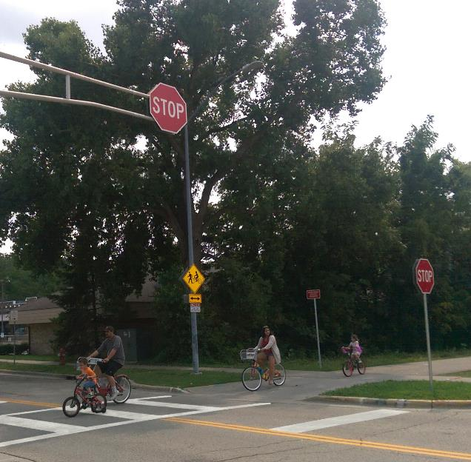
Context: Reducing Conflicts
Guiding Principles
Safety
Accommodation and Comfort
Coherence and Predictability
Context-Sensitivity
Experimentation
Capital City Trail, Madison, WI
Notes:
In the reducing conflicts part of the document, we have 5 design principles that each design topic addresses. Each one address specific questions that designers face….
Guiding Principals
Safety
Do the design, operations, and maintenance decrease the severity and likelihood of crashes?
Accommodation and Comfort
Does the design serve all modes and provide a sense of comfort?
Coherence and Predictability
Are the facilities for each mode recognizable and consistent?
Context-Sensitivity
Does the design incorporate and support the natural environment and adjacent land use, such as transit stations, employment centers, and other destinations, and does it support community health, economic, and livability goals?
Experimentation
Are there innovative and creative solutions that can be tested to reduce conflicts?

Slide 6


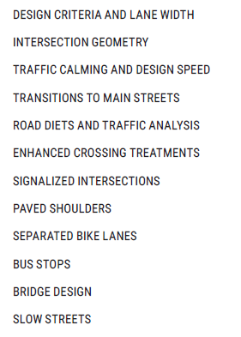
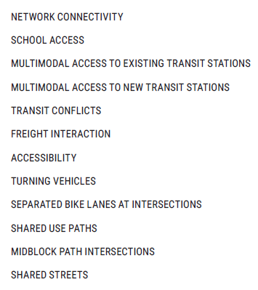
Design Topics
Notes:
We will go through these quickly, but the guide has a lot more detail.
Stand alone 4-pagers
Range of design topics, again, these cross reference each other

Slide 7
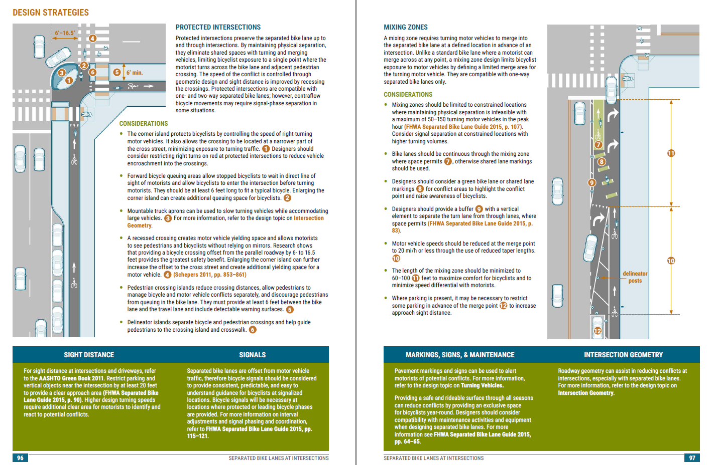
Design Topics Layout
Notes:
Each design topic is stand alone, 4-page document.
Cover page – overview of topic. For flexibility, it includes the “Key Design Flexibility Quote”. For Reducing conflicts, there are diagrams of each typical conflict/crash type and guiding principles.
Middle two pages – design guidance/best practices and graphics.
Last page – case studies.

Slide 8
Document Development Process
Literature review
Technical Work Group
Targeted Interviews
Notes:
A comprehensive literature review explored the flexibility that exists within current guidelines and standards, and documented relevant guidelines, plans, and research for addressing multimodal conflict points. A Technical Work Group, consisting of practitioners from throughout the U.S., provided guidance, input, and review throughout the project. Design topics were selected based on needs identified by the Federal Highway Administration (FHWA), State Departments of Transportation, and local practitioners, as well as input from the Technical Work Group. Additional stakeholder outreach included targeted interviews to gather information on case studies, common challenges, and best practices.

Slide 9
Applying Design Flexibility
Notes:
I am going to highlight a few examples of the design topics from each section, focusing on a few that are particularly useful/relevant in rural and suburban areas.

Slide 10
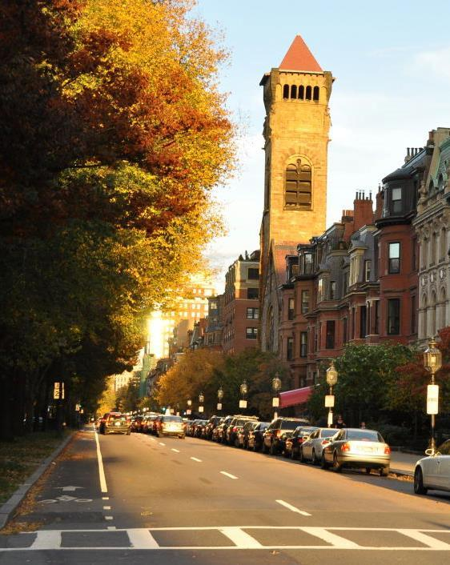
Design Criteria and Lane Width
“A highway has wide-ranging effects in addition to providing traffic service to users. It is essential that the highway be considered as an element of the total environment. The term ‘environment,’ as used here refers to the totality of humankind’s surroundings: social, physical, natural, and synthetic.”
AASHTO Green Book 2011, p. 2-86
Notes:
For the first design topic on design criteria, which are values (such as design speed, lane width, shoulder width) that designers identify early in project development to reflect the desired purpose and function of a street. Designers sometimes adhere strictly to the most conservative values, leading to wider streets, large curves and higher operating speeds. This may result in a design that meets all the design criteria but has a high crash rate compared to expectations.
Regarding design criteria, there is flexibility built in to the green book, which states the importance of
· Understanding the full function of a transportation facility and,
· understanding that a transportation facility has to fit into its surrounding context (social, physical, natural and manmade).

Slide 11
Design Criteria and Lane Width
Setting design criteria
Controlling design criteria and design exceptions
Recommended resources
Conventional
Flexibility Enables Separated Bike Lane
Conventional
Notes:
Historically, 13 design criteria have been identified by FHWA as having sustantial importance to the operational and safety performance of highways – known as the “controlling criteria.” If you don’t meet these criteria, you must request a design exception, which can be a cumbersome process that some engineers aid avoid.
FHWA recently updated it's controlling criteria from a total of 13 on all roads to 10 on high speed roads and 2 on lower speed roads. This makes a flexible design approach easier to implement and reduces barriers to implementing designs by reducing the number of design exceptions and paper work needed. Important note: just because the feds updated their controlling criteria, it might take some time for State DOTs to adapt the same approach.

Slide 12
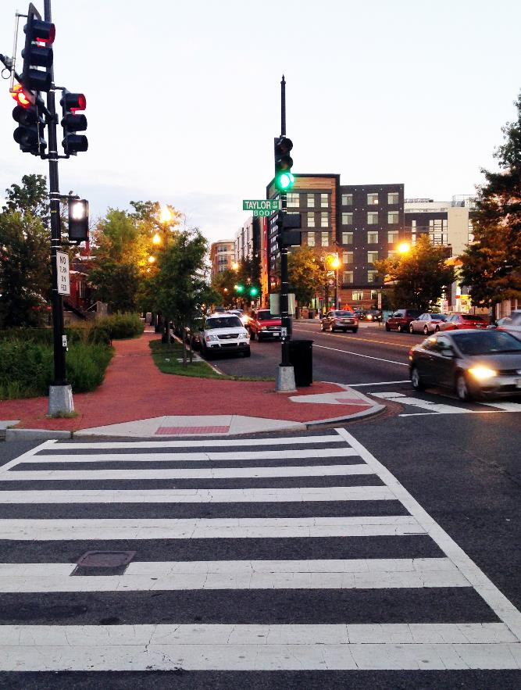
Intersection Geometry
“If turning traffic is nearly all passenger vehicles, it may not be cost-effective or pedestrian friendly to design for large trucks. However, the design should allow for an occasional large truck to turn by swinging wide and encroaching on other traffic lanes without disrupting traffic significantly.”
AASHTO Green Book 2011, p. 9-80
Notes:
Next Design Topic is intersection geometry. To improve multimodal safety, the goal is to design intersections as compact as possible to reduce crossing distances for peds, slow turning speeds. The design vehicle plays a large role in dictating the overall size and scale of the intersection – if you design every intersection for a Mac Truck making every turning movement without encroaching on other travel lanes, you end up with huge tunring radii and huge intersections.
Key flexibility in the green book. You don't necessarily have to design for largest vehicles to make turns to and from the near lanes.
There is a lot of flexibility in this statement.

Slide 13
Intersection Geometry
Design vehicle & encroachment
Truck aprons
Notes:
Design topic shows several strategies to accommodate a design vehicle.
This slide shows three…
- a mountable truck apron that helps channelized smaller vehicles to turn slower, but allows larger vehicle to track onto a mountable area.
- shows encroachment (truck taking two lanes to make the turn)
- Recessed stop bar
(You could tell the story of LRCC and prioritizing infrequent delivery over pedestrian crossing safety)

Slide 14
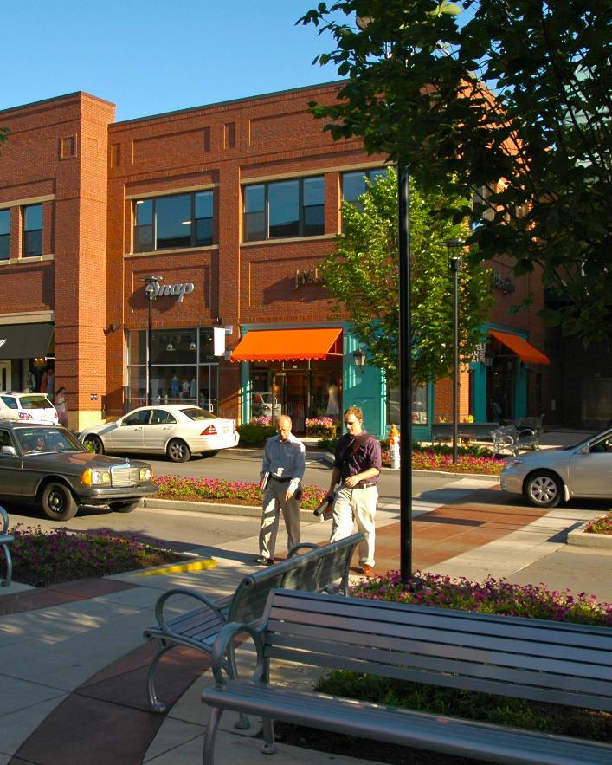
Traffic Calming and Design Speed
The 2011 AASHTO Green Book provides flexibility in selecting appropriate design speeds given the context of a particular roadway:
“Design speed should be a logical one with respect to the anticipated operating speed, topography, the adjacent land use, and the functional classification of the highway. In selection of design speed every effort should be made to attain a desired combination of safety, mobility, and efficiency within the constraints of environmental quality, economics, aesthetics, and social or political impacts”
AASHTO Green Book 2011, p. 2-54
Notes:
This design topic covers both traffic calming and design speed. Design speed is a fundamental factor is roadway design – it affects horizontal/vertical alignment, cross-section features and more.
Key Design Flexibility relates to Design Speed - The Green Book provides flexibility for designer to select a design speed that takes into account many factors beyond automobile efficiency – including adjacent land use, safety and aesthetics.

Slide 15
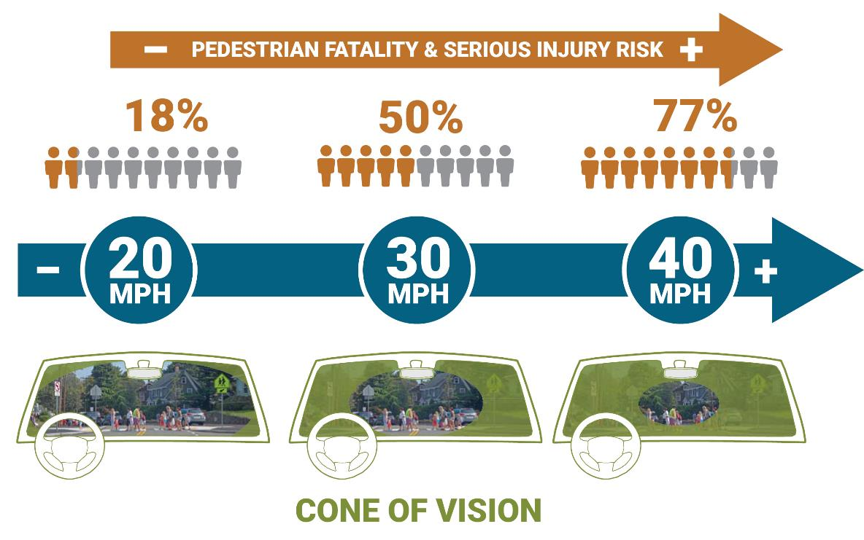
Traffic Calming and Design Speed
“The severity of pedestrian crashes, a significant concern in urban areas, is greatly increased as speeds increase.”
AASHTO Flexibility Guide 2004, p. 19
Notes:
This graphic summarizes the relationship between design speed and crash severity and cone of vision.
As speed increases (from left to right), the risk of fatality or serious injury for a pedestrian involved in a crash increases greatly.
As speed increases, drivers ability to perceive activities in the street and along the street edges decrease.
“The severity of pedestrian crashes, a significant concern in urban areas, is greatly increased as speeds increase. Context-sensitive solutions for the urban environment often involve creating a safe roadway environment in which the driver is encouraged by the roadway’s features and the surrounding areas to operate at low speeds.” – AASHTO Flexibility Guide

Slide 16
Traffic Calming and Design Speed
Myth: Design speed should be greater than posted speed
“Target speed is the highest speed at which vehicles should operate on a roadway consistent with the level of multimodal activity and adjacent land uses to provide both mobility for motor vehicles and a safe environment for pedestrians, bicyclists, and public transit users” - ITE Designing Walkable Urban Thoroughfares
Myth: Clear zones should be applied on all streets
AASHTO Roadside Design Guide recognizes that there are practical limitations to clear zones on low-speed curbed streets and indicates that a minimum offset of 1.5 feet should be provided beyond the face of curb.
Notes:
This design topic is organized a little differently than others – it addresses 7 common misconceptions about setting design speed and traffic calming.
These two myths address the concept of ‘forgiving’ roadway design – meaning that roads designed for higher speeds with large clear zones.
First, common practice has been to use a design that is greater than the posted speed limit with the goal of improving safety. However, national guidance including the ITE Designing Walkable Urban Thoroughfares, suggests that designers should use a “target speed” that focuses on safety of vulnerable users and factors in the level of multimodal activity.
Second, clear zones are a intended to decrease the frequency and severity of fixed object crashes along the road side – while these are appropriate on freeways and high-speed roadways, the AASHTO Roadside Design Guide recognizes that there are limitations to providing clear zones on low-speed curbed streets and states that a lateral offset of 1.5 feet should be provided.
If time: use street trees, furnishings and plantings to create a sense of enclosure.

Slide 17
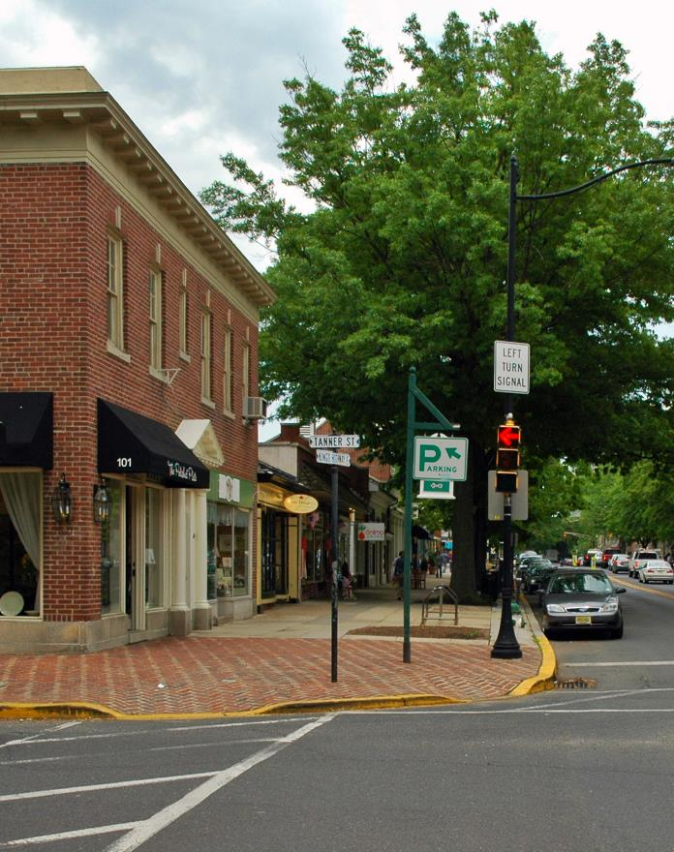
Transition to Main Streets
“A roadway’s formal classification as urban or rural may differ from actual site circumstances or prevailing conditions. An example includes a rural arterial route passing through a small town. The route may not necessarily be classified as urban, but there may be a significant length over which the surrounding land use, prevailing speeds, and transportation functions are more urban or suburban than rural.”
AASHTO Flexibility Guide 2004, p. 12
Notes:
This design topic is a lot about context. A typical example is a rural highway that serves as a main street through a small town. This dual role can result in streets with relatively high volumes and that present safety concerns for users along a main street. In this scenario, the functional classification of a road, like rural arterial, can lock the designer into certain criteria that are not compatible with the adj. land use.
Guidance recognizes that the formal functional classification of a roadway may not be consistent with the function that the road serves. Many areas not typically considered urban, such as a small rural town, may be considered urban from a land use, speed and ped/bicycle activity perspective.

Slide 18
Transition to Main Streets
Functional classification and variable design speed
Gateway treatments
Travel along main street
Notes:
The green book allows for flexibility by providing a range of a design speeds for a given functional classification. Speeds for a rural arterial range from 40-75 mph and urban arterial 30-60 mph. On a main street, more urban design principles apply and designers should use a lower design speed approaching and through the main street environment.
Gateway treatments are a essential design treatment – they are a visual and physical feature that communicate to motorists that they are entering a slower speed environment. They can include roundabouts, chicanes or raised medians.
Once motorists enter the main street, designers should consider traffic calming measures such as landscaping, street trees, on-street parking, and narrower travel lanes.

Slide 19
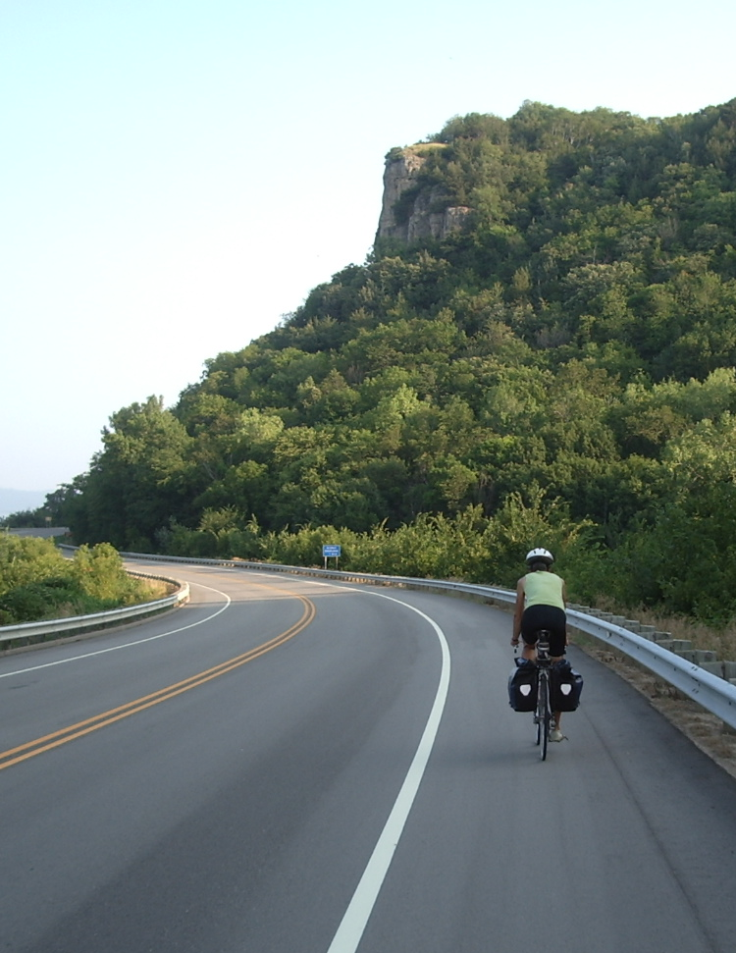
Paved Shoulders
The AASHTO Green Book states the advantages and varied uses of paved shoulders. It also provides ranges for paved shoulder widths:
“Paved shoulders advantages include providing a space for pedestrian and bicycle use, for bus stops, for occasional encroachment of vehicles, for mail delivery vehicles, and for the detouring of traffic during construction.”
2011, p. 4-9
“[Shoulders] vary in width from only 2 ft on minor rural roadways…to approximately 12 ft on major roads.”
2011, p. 4-8
Notes:
Paved shoulders serve many purposes: in addition to providing space for bicycle use, they also provide a recovery area for vehicles and space for delivery vehicles and detouring during construction. There is also flexibility in the range of shoulder widths available: 2 to 12 feet.

Slide 20
Reducing Conflicts

Slide 21
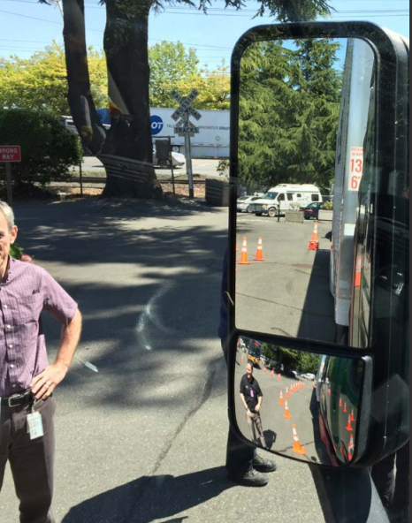
Part 2: Reducing Conflicts

Slide 22
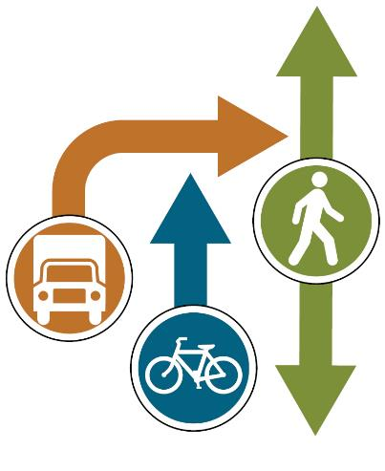
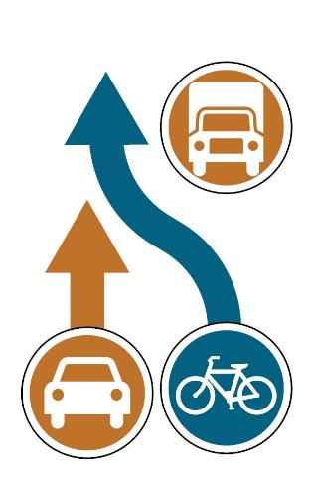
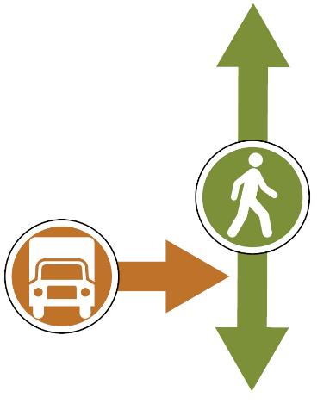
Freight Interaction
Freight driver unable to see pedestrian or bicyclist
Bicyclist leaving facility to overtake a loading vehicle

Slide 23
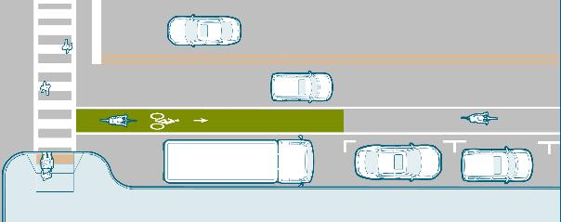
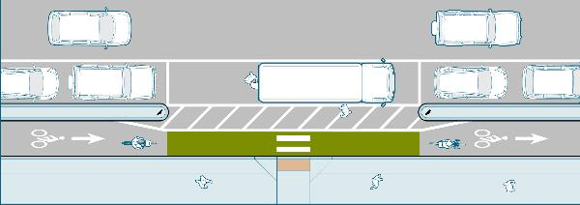
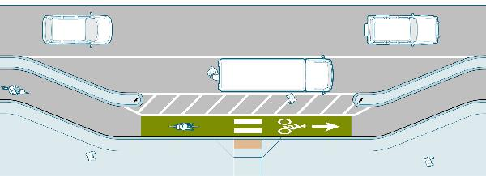
Freight Interaction
Commercial loading and unloading
Considerations:
Locate after intersection
Consolidate if feasible
8-10 ft wide
Provide access aisle
Provide curb ramp
Mark with green colored pavement surface
Loading zone adjacent to standard bike lane
Loading zone adjacent to separated bike lane
with on-street parking
Loading zone adjacent to separated bike lane
without on-street parking

Slide 24
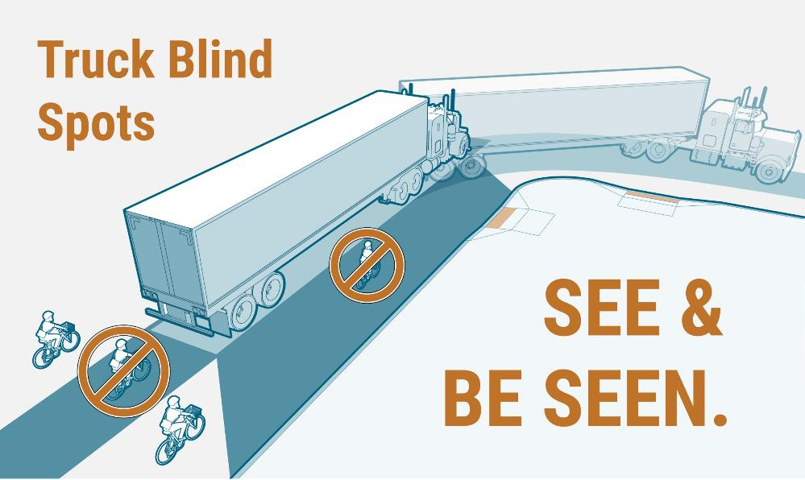
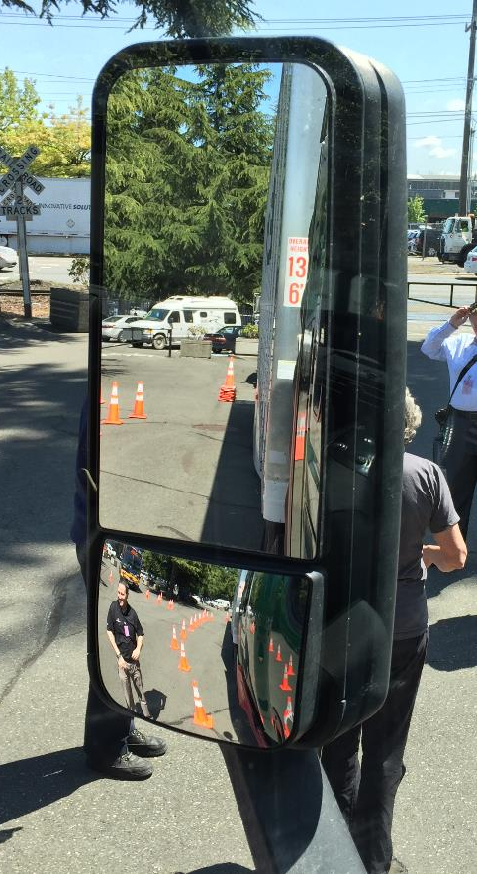
Freight Interaction
Other strategies:
Education
Mirrors, sideguards, and warning systems

Slide 25
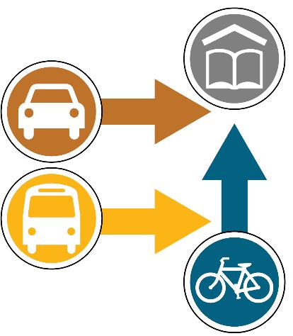
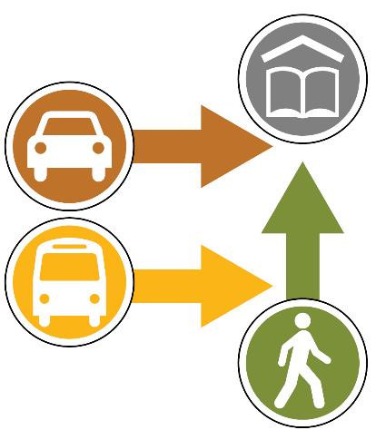
School Access
Poor roadway and intersection design around schools can contribute to crashes involving children walking and biking to school
Notes:
School Access
As multiple modes intersect around schools conflicts can occur.
Walkers
Cyclists
Parent dropping off and picking up
Vehicles (Staff, Students?)
Busses

Slide 26
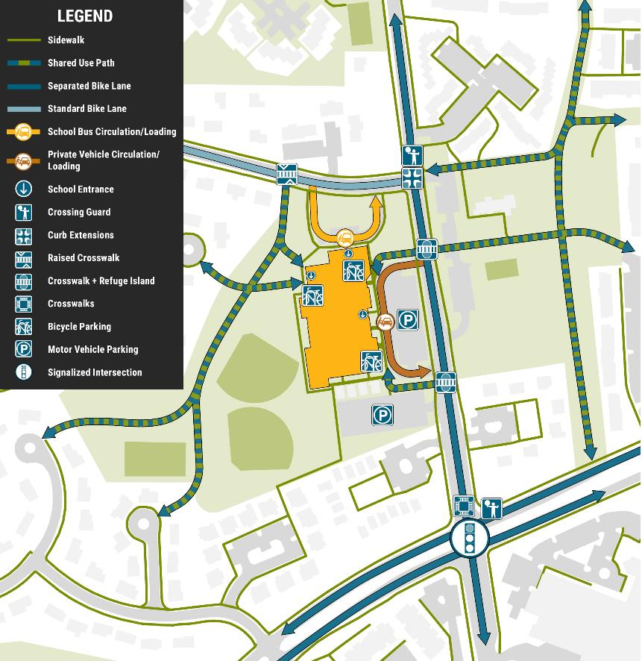
School Access
Design strategies:
On-site improvements
School zones
Street crossings
Other strategies:
Education & Outreach
Crossing guards
Inter-jurisdictional coordination
Notes:
Strategies:
On Site improvements that avoid mixing modes
School zone speed limits
Improved crossings for pedestrians
Education and outreach to parents, students and staff on transportation choices and safety.
Use of staff and crossing guards to help manage transportation
For seamless networks – coordination between education departments, transportation departments, and others is often needed

Slide 27
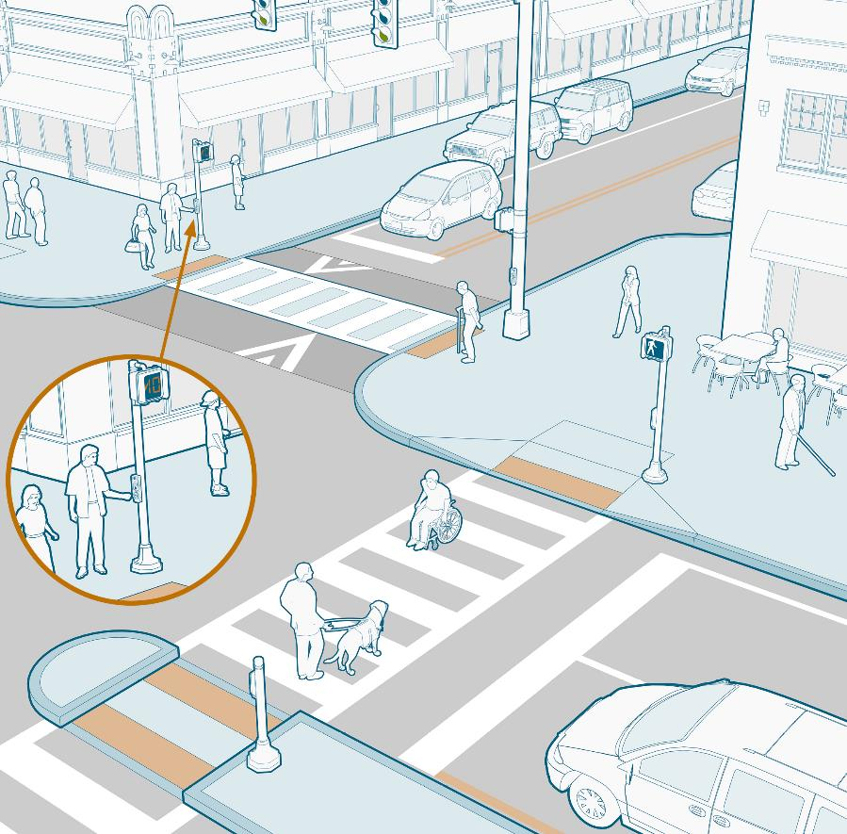
Accessibility
Design strategies:
Sidewalks
Street crossings
Curb ramps
Signals

Slide 28
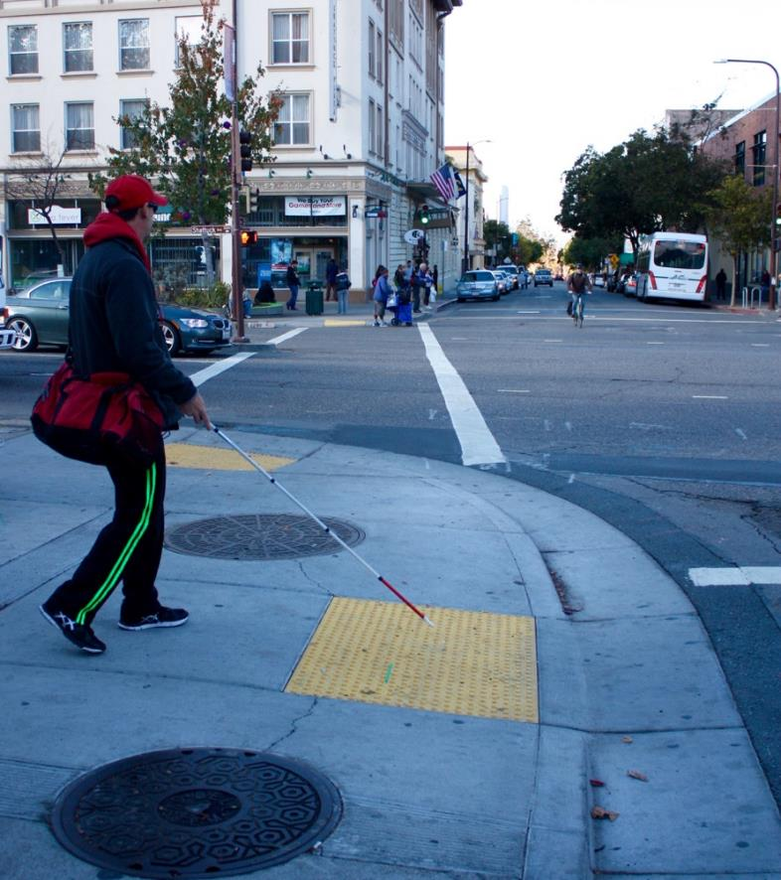
Accessibility
Other strategies:
Surface treatments
Maintenance

Slide 29
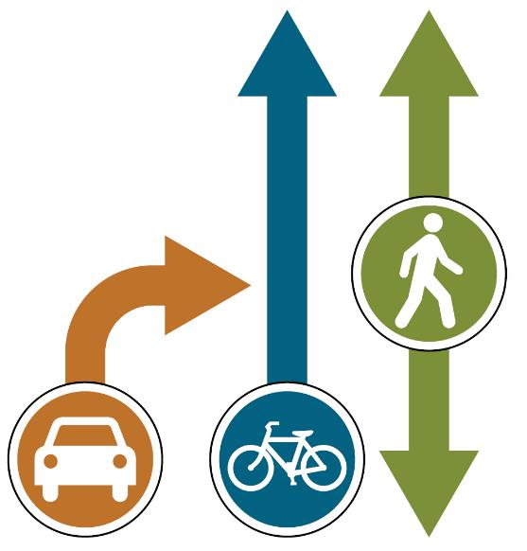
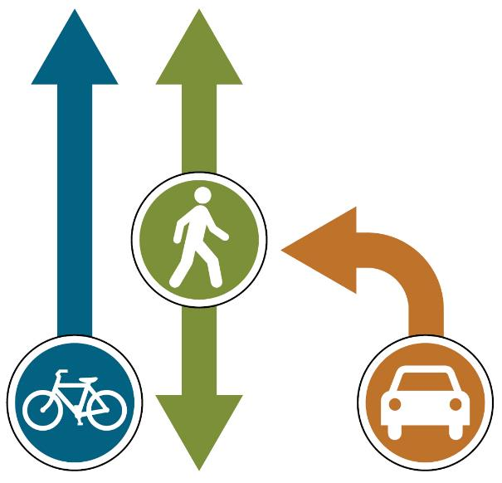
Turning Vehicles
Right-turning vehicles crossing through bicyclists or pedestrians is known as a “right hook” crash
“Left hooks” are similar, where left-turning vehicles come into conflict with opposing traffic traveling straight

Slide 30
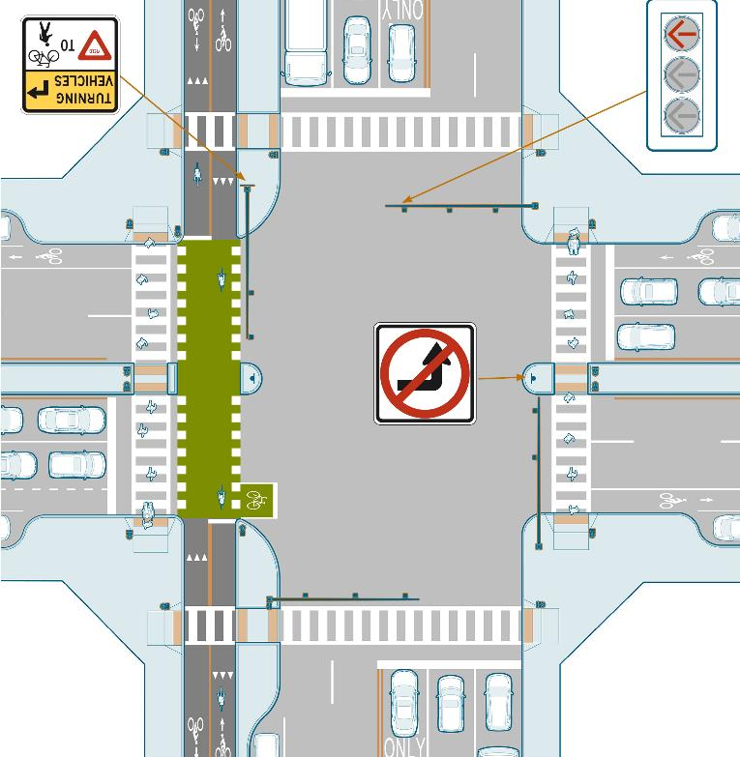
Turning Vehicles
Design strategies:
Signalized intersections
Crossings
Pavement markings
Separated bike lanes
Signs
Intersection geometry

Slide 31
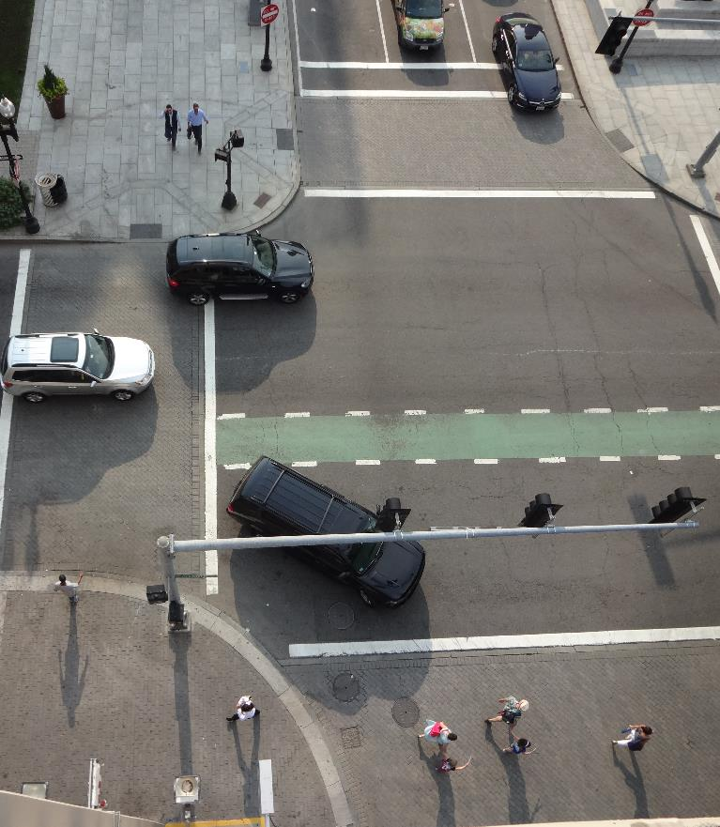
Turning Vehicles
Other strategies:
Education
Access management
Freight

Slide 32
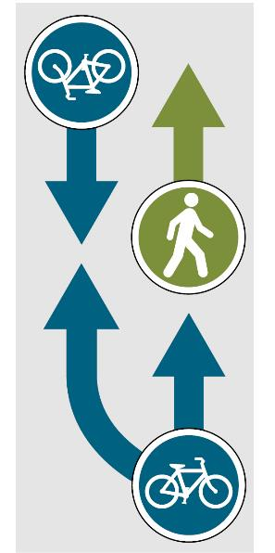
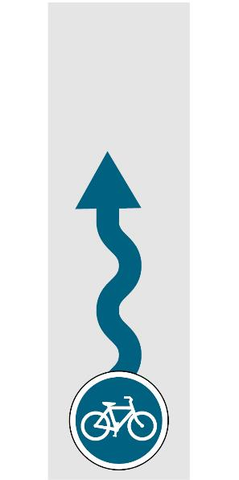
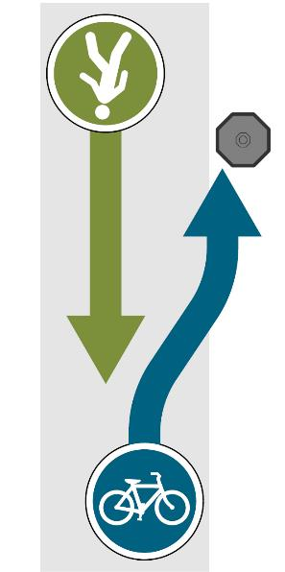
Shared Use Paths
Insufficient path width can contribute to crashes associated with overtaking and passing maneuvers
Surface defects can cause bicyclists to become unstable or lose control
Insufficient path width can contribute to crashes with objects adjacent to a path
Notes:
This design topic discusses shared use path conflicts. A well-designed shared use path can provide direct and comfortable routes to places of employment, recreation, education, and other destinations. As paths attract a wide range of user types, multimodal conflicts can occur. Conflicts on shared use paths most often derive from high volumes of users, path users traveling at different speeds, path users overtaking other users, sharp curves, vertical objects near the edge of the path, and surface defects that effectively narrow the usable width.

Slide 33
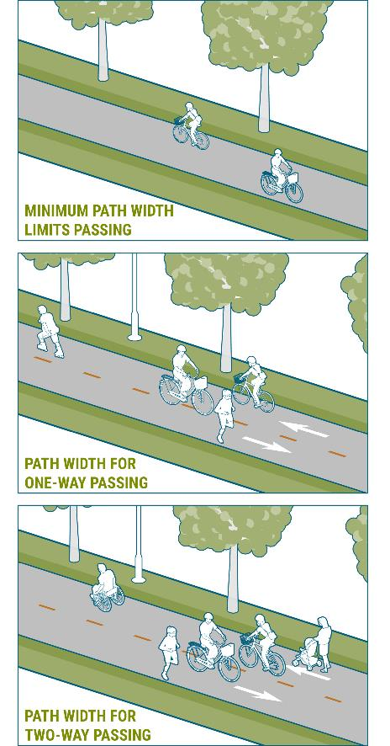
Shared Use Paths
Path width
Considerations:
Based on anticipated user types, speeds, and volumes
FHWA Shared Use Path Level of Service
10 ft minimum
Consider 11 feet for overtaking
Wider in more populated areas
  14 feet in urban areas desired
Notes:
Path width should be determined based on three main characteristics: the number of users, the types of users, and the differences in their speeds. For example, a path that is used by higher-speed bicyclists and children walking to school may experience conflicts due to their differences in speeds. By widening the path to provide space to accommodate passing movements, conflicts can be reduced. Designers can use FHWAs Shared Use Path Level of Service Calculator to determine the recommended path widths based on the user numbers and types of path users. The top graphic shows a minimum path width of 10 feet, the middle graphic is an 11 foot wide path that allows one person to overtake another while avoiding a path user traveling in the opposite direction, and the bottom graphic is a 14 foot wide path for paths that expect high use.

Slide 34
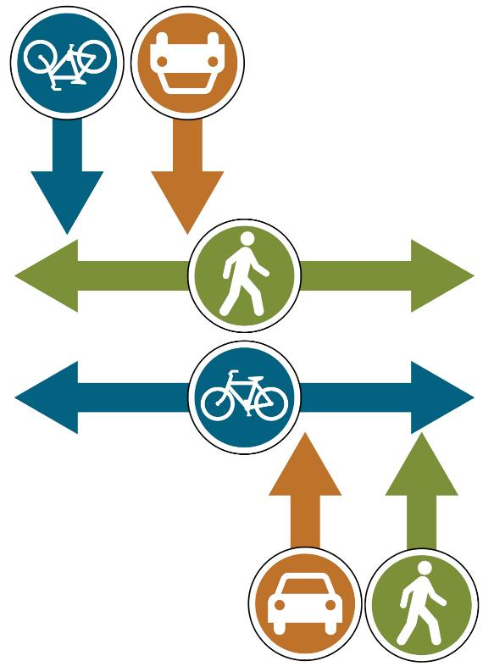
Midblock Path Intersections
Poorly designed path and roadway intersections contribute to crashes

Slide 35
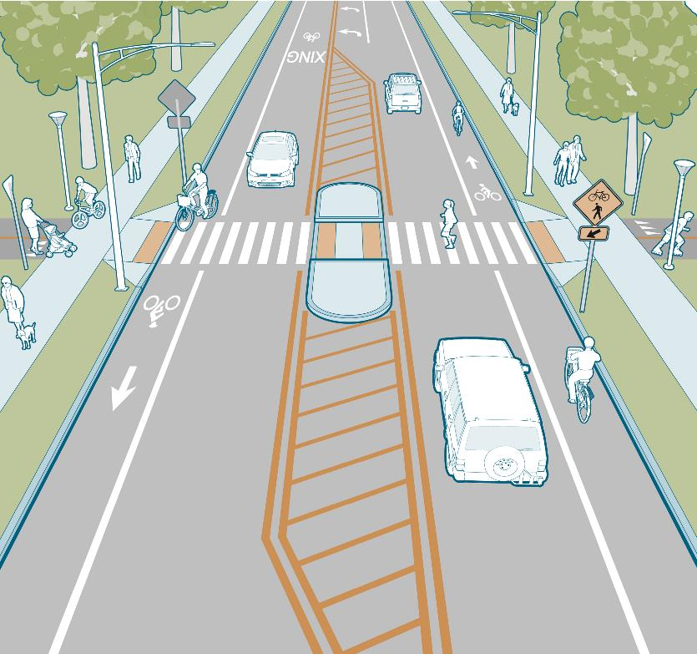
Midblock Path Intersections
Design strategies:
Priority and control assignments
Intersection design
Crossing treatments
Markings and signs
Path width

Slide 36
Questions?
https://www.fhwa.dot.gov/environment/bicycle_pedestrian/publications/multimodal_networks/
Alia Anderson
aanderson@tooledesign.com
www.tooledesign.com

