Slide 1
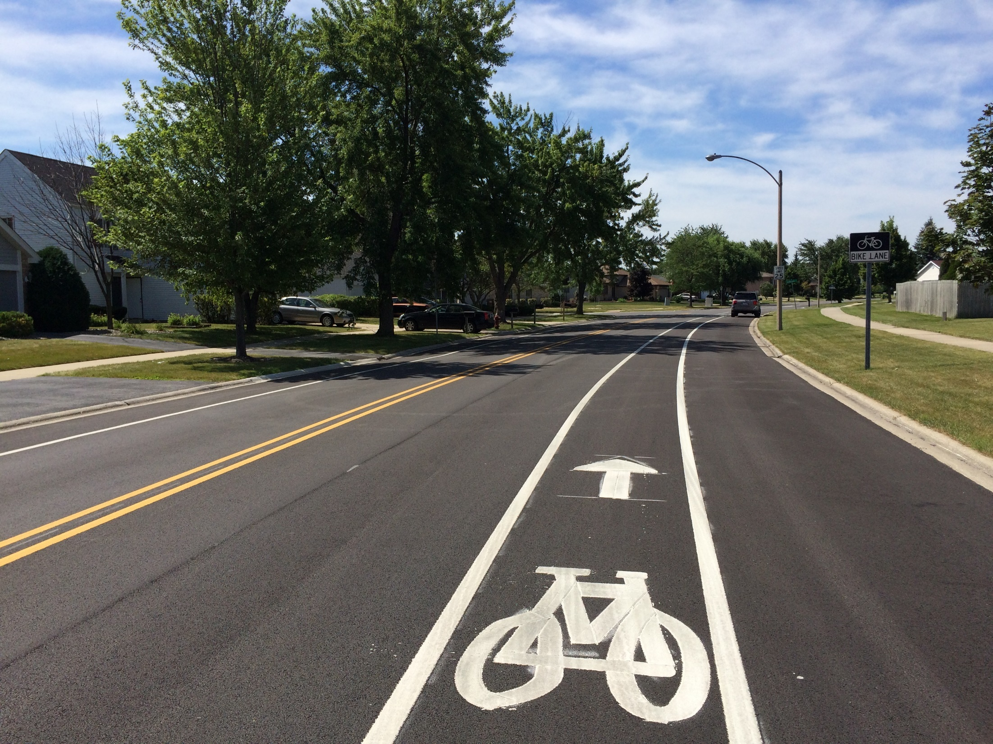
So you have a complete streets policy, now what? Presented by: Heather Schady Senior Transportation Planner, Active Transportation Alliance

Slide 2
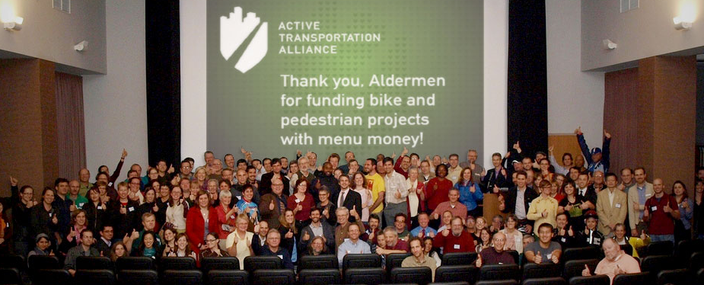
Active Transportation Alliance
Chicagoland’s advocacy voice for better walking, biking and public transit
Member-based not-for-profit organization
Founded in 1985 as the Chicagoland Bicycle Federation
Serve Chicago metro region
20,000 members & supporters
25 full-time staff, plus part-time and seasonal

Slide 3
About Active Trans

Slide 4
Our “50/50/Zero” Goal
By the year 2025, we are aiming for:
50% of all trips are made by walking, biking and transit
All traffic crashes are reduced by 50%
There are zero traffic fatalities and serious injuries
Notes:
Our mission is to make walking, biking and public transportation so safe, easy and fun that we achieve a significant shift away from sedentary, polluting transportation and toward healthy, clean transportation. Our “50/50” vision is for a region that reduces all traffic crashes by half, and where half of all trips are made by walking, biking and transit.

Slide 5
Our Organizational Principles
MOBILITY EQUITY is a fundamental right
Prioritize UPSTREAM APPROACHES
Believe in the POWER OF PARTNERSHIPS
We use both INTERNAL AND EXTERNAL strategies

Slide 6
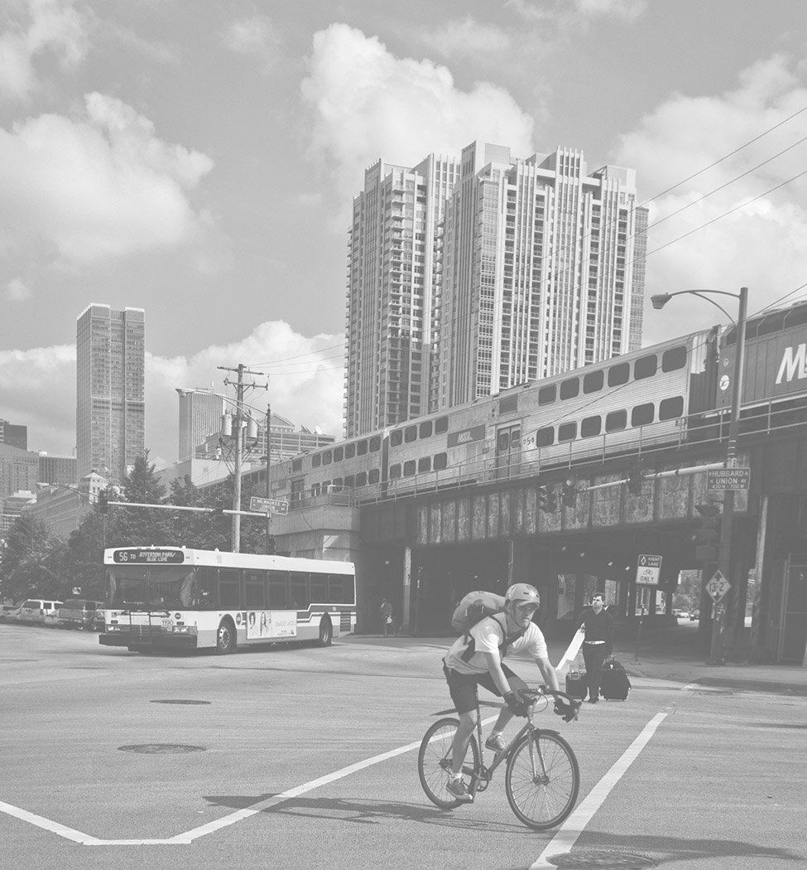
Our Complete Streets Experience
Active Trans has helped craft and pass:
Illinois Complete Streets (state law)
Cook County Complete Streets policy (county ordinance)
Chicago Complete Streets (internal policy)
~25 municipal policies (mostly city/village ordinances)
~50 active transportation plans

Slide 7
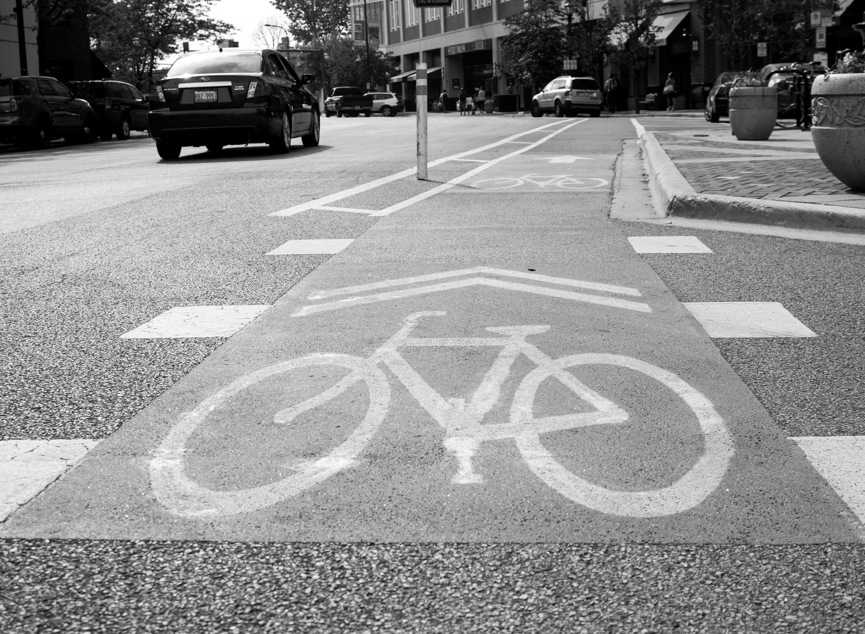
Our Complete Streets Experience
Created Complete Streets, Complete Networks policy and design guidelines manual
Developed City of Memphis’ Complete Streets Project Delivery Manual and Roadway Regulatory Plan
Contributed to Chicago’s Complete Streets guidelines

Slide 8
Question: What experience(s) do you have with complete streets policies or implementation?

Slide 9
Overview of Complete Streets in Chicagoland

Slide 10
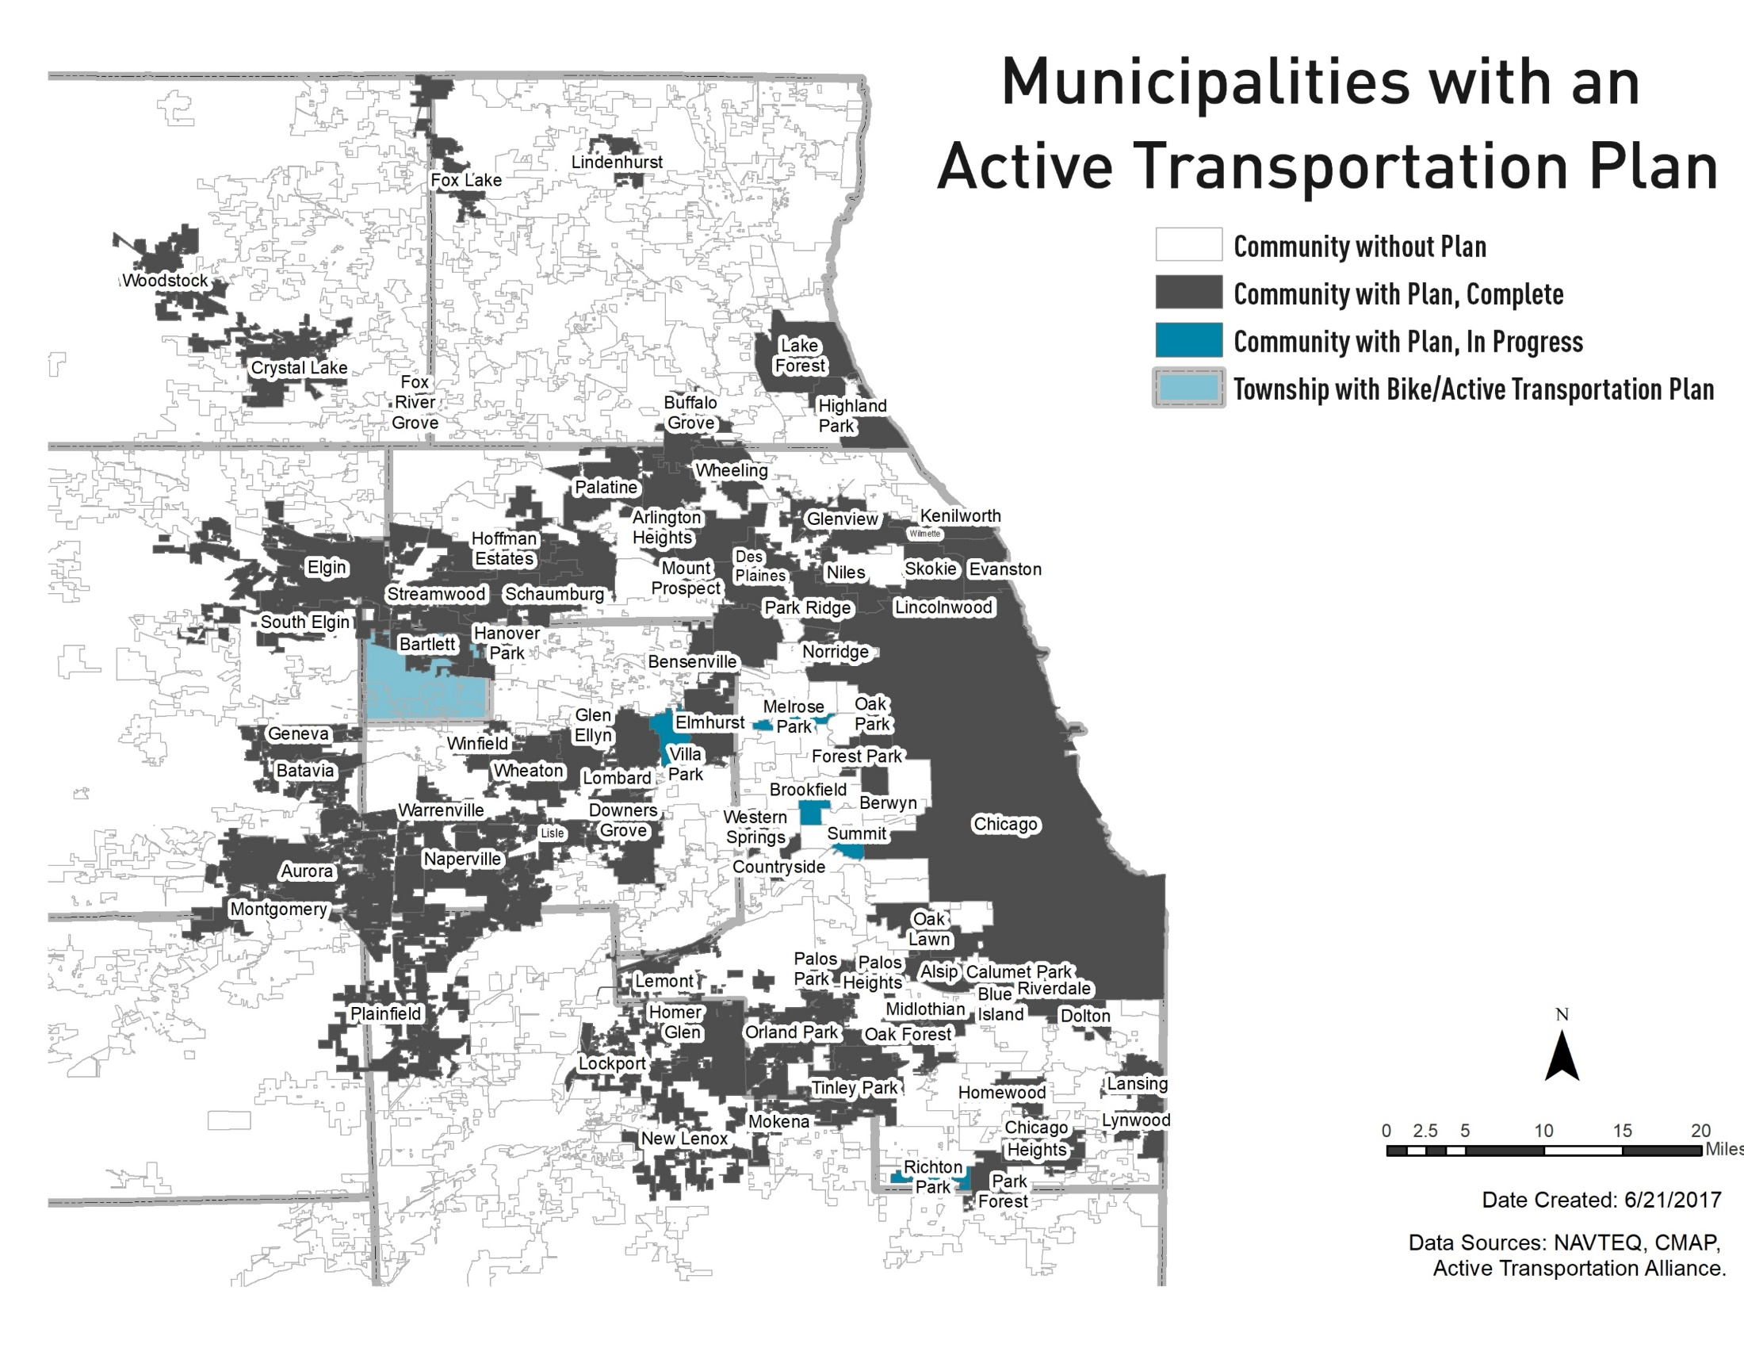

Slide 11
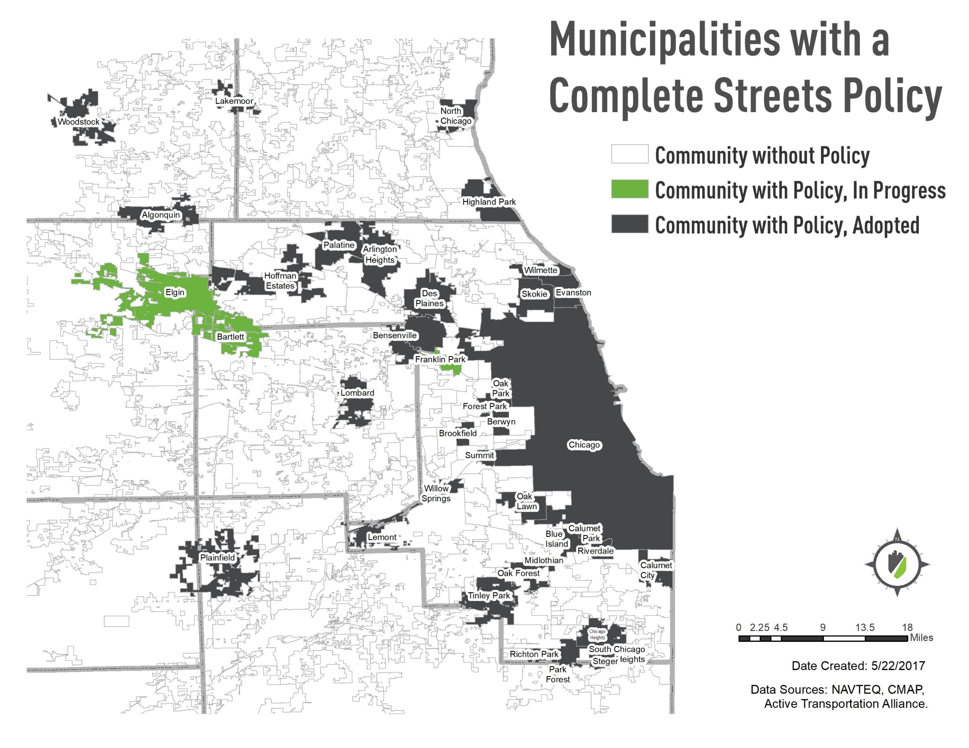
Notes:
CCDOTH and State of Illinois also have policies
Many people have myths about CS lets talk about some

Slide 12
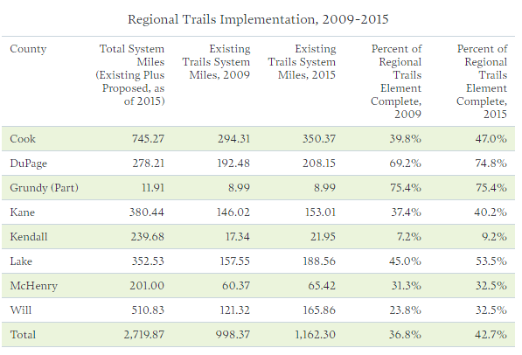
Regional implementation
Source: Chicagoland Metropolitan Agency for Planning

Slide 13
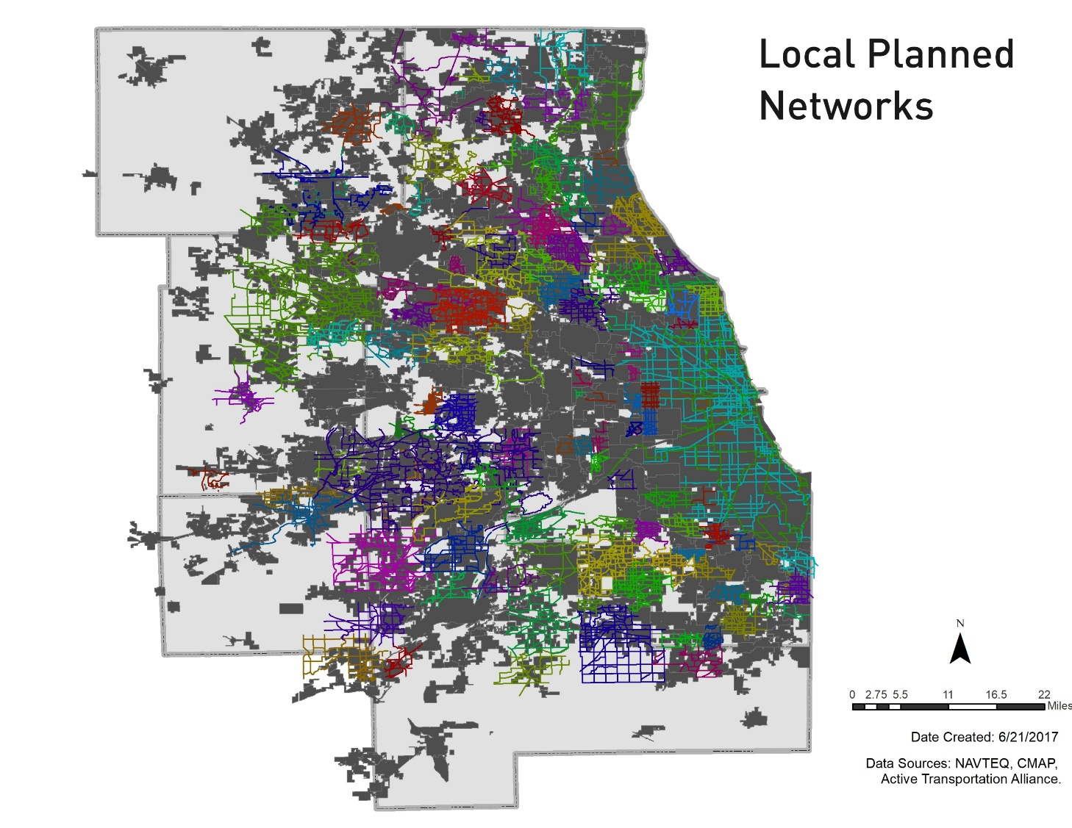
Local implementation difficult to track
?

Slide 14
Problem
Implementation lagging
Know-how lacking
Reliance on federal funding
More success in high income communities than low-income communities
Notes:
We have many plans, some policies, but have not had much implementation
Some communities do not know what to do with their policies once they have them - Lombard, Chicago Heights
Communities that are implementing their policies rely on federal grant funding and usually do not incorporate CS projects into their CIP.
There is a disparity across communities who implement their policies. Those with more means (staff, ability to apply for grants) can more easily implement their policies. Those who do not have staff and financial capacity do not. Evanston, Chicago, Oak Park, Evanston, DuPage County have all been successful in policy implementation, others less so.

Slide 15
Notes:
In 2015, we sent a survey to 26 communities in our region + Champaign Urbana to ask about their complete streets experience. Seven responded to an in-depth interview.

Slide 16
Questions asked
Have staff roles changed since adopting your complete streets policy?
How has the policy changed your decision making process?
How have you overcome barriers to implementation?

Slide 20
Findings
Communities had made minimal changes to their systems post-policy adoption
Project delivery process has not changed
Funding prioritization has not changed
Complete streets are still treated as “special” projects
Notes:
Communities have made minimal changes to their systems post-policy adoption, but much of their project delivery process is the same. Complete streets are still treated as "special" projects

Slide 21
Question: What has your local or regional experience been with complete streets implementation?
Notes:
Have systems been changed? Are procedures changing? Is funding prioritized differently?

Slide 22
COMPLETE STREETS POLICY & IMPLEMENTATION PROJECT

Slide 23
Healthy HotSpot Complete Streets initiative
Develop complete streets policies 10 communities
Develop complete streets implementation strategies in 6 communities
Notes:
In 2015, the Cook County Department of Public Health’s Healthy HotSpot initiative received a grant from the CDC to work on county-wide initiatives related to obesity prevention and tobacco cessation. We were selected as a technical assistance provider to help communities develop complete streets policies and active transportation plans. Our complete streets work focused not only on policy development assistance, but also implementation assistance. We wanted to take a deeper dive with communities on developing tools and procedures related to complete streets and ensure that implementation of their policies was sustained over time.

Slide 24
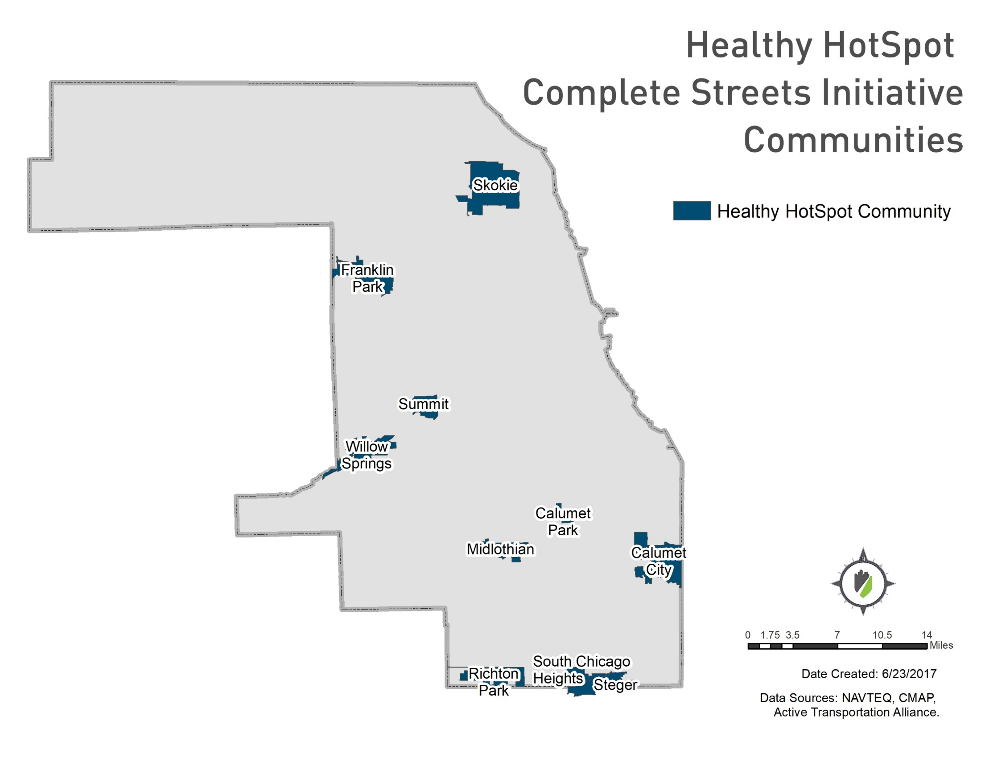
Communities
Notes:
We issued an RFP asking communities to apply for technical assistance, and gave priority to communities with lower incomes and higher rates of chronic disease. These ten communities were selected. I’ll talk a little bit about each community’s background, and then address some of their success stories.

Slide 25
Calumet Park
Population: 7,835
88% Black/African American
Median Household Income: $47,050
Notes:
Higher median HHI, but higher rate of poverty, 17% and an 11% unemployment rate.
Calumet Park borders the southwest side of the city. It has a commuter rail station and bus service to the CTA red line station at 85th Street. It is a typical inner ring suburb with a gridded network of streets, post-war single family homes. It borders the Calumet Sag channel, but was left out of discussions around expanding the Calumet Sag Trail. The community now wants to build connections to the trail to provide access to its residents.

Slide 26
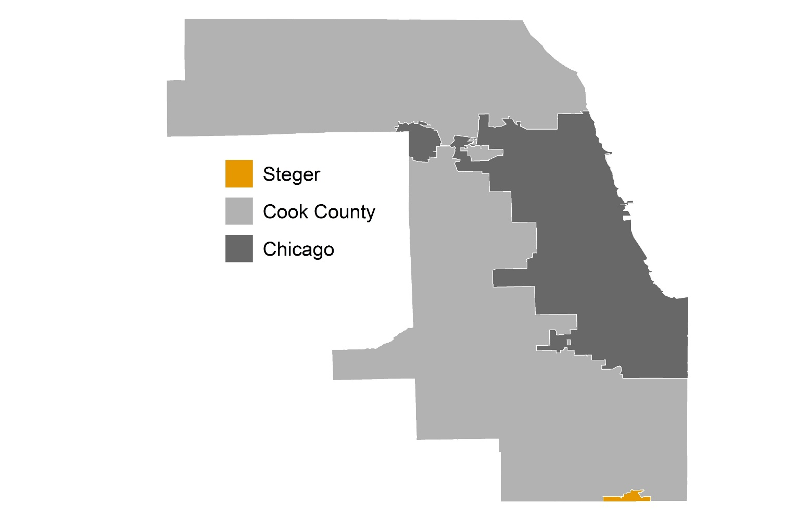
Steger
Population: 9,570
Median Household Income: $43,118
30% below poverty rate

Slide 27
Midlothian
Population: 14,819
Median Household Income: $62,351
Notes:
Changing demographics, more hispanic and latino people are moving in. Older, working class suburb.

Slide 28
Richton Park
Population: 13,646
82% Black/African American
Median Household Income: 77,770
Notes:
Willow Springs is the most affluent community we worked with, though due to its small population, it has a very small staff. The Village has only 2 employees and contracts out its engineer. Like Richton Park, it’s a more typical suburb with limited connectivity. It lies along the I&M Canal and has an extensive network of trails.

Slide 29
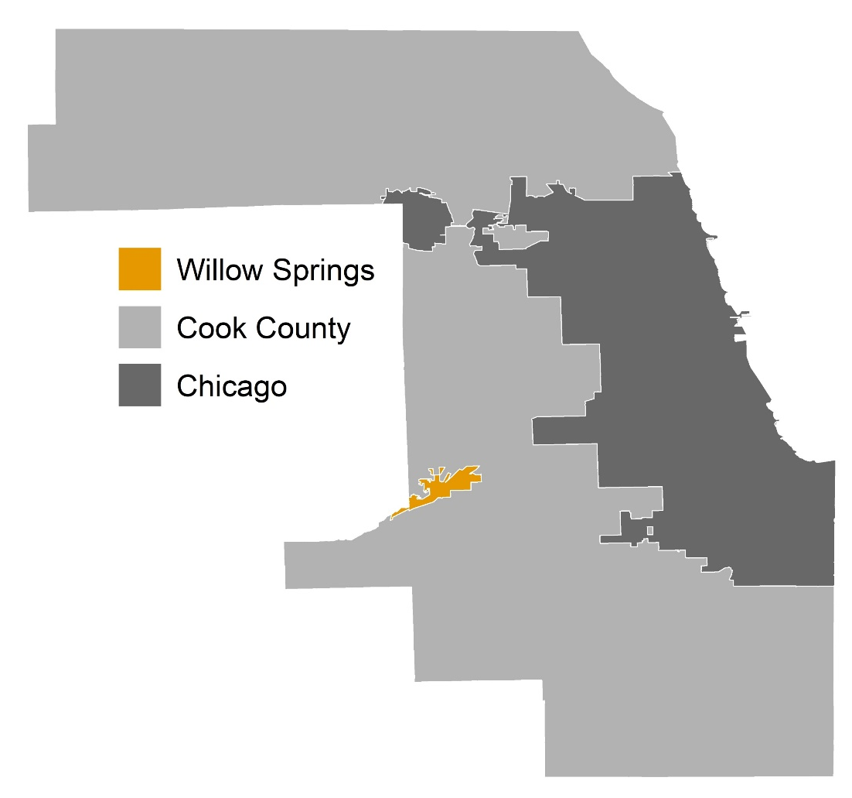
Willow Springs
Population: 5,524
Median Household Income: 53,132

Slide 30
Skokie
Population: 64,784
Median Household Income: 67,000
Notes:
Skokie is also a relatively affluent community, but is incredibly diverse. More than 40% of its population is foreign born. It has a large orthodox jewish population, many of whom do not drive. It also has an aging population that includes many non-drivers.

Slide 31
Summit
Population: 11,054
64% Hispanic/Latinx
Median Household Income: 42,070
Notes:
Industrial community. Borders Chicago. Surrounded by high volume arterials and the i&M Canal. Policy only.

Slide 32
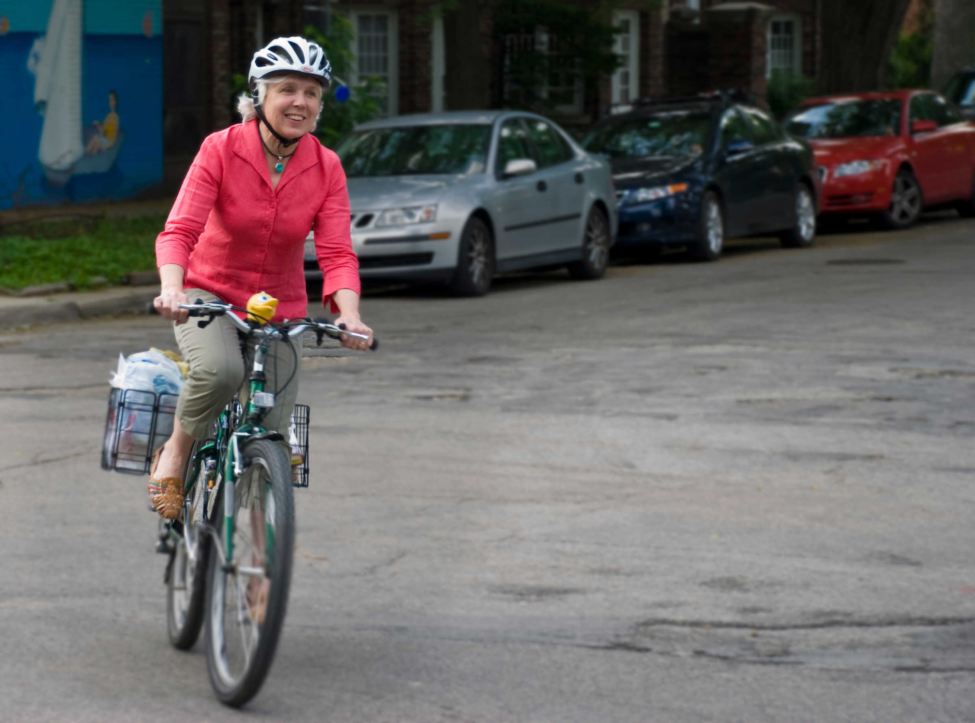
GOAL:
Develop a policy AND an implementation strategy
Notes:
Our previous CS initiatives focused solely on policy development. We didn't have time to work with communities on implementation. We wanted to take the time to work with them to effect real change in the way they do things
We wanted to provide the communities with the tools and know-how to implement their policy
Sustainable implementation post-grant
Develop local champions and experts

Slide 33
Process
Policy development (August 2015 – April 2016)
Assemble steering committee
Board presentation
Conference
3 policy development meetings
Adoption
Policy implementation (April 2016 – Present)
Pop-up project
Conference
Project delivery checklist
Zoning education
Planning activity
Mark Fenton site visit

Slide 34
Steering Committee Lessons Learned

Slide 35
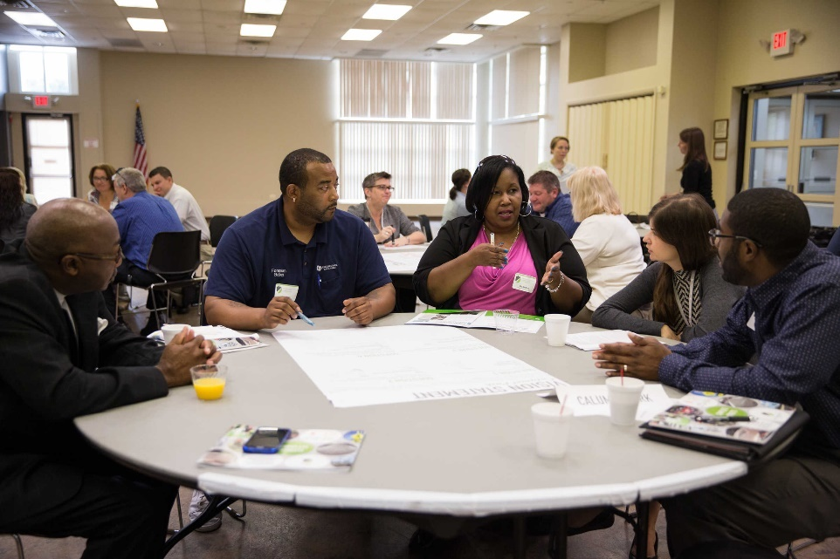
Steering committee formation
Elected officials
Mayor, village board
Staff
Engineering, planning economic development, police, fire, public works, parks, finance
Stakeholders
Neighborhood groups, chamber of commerce, senior centers, bike/ped advocates, disability advocates, schools, hospitals
Notes:
We recommend forming a steering committee that includes diverse representation from departments, elected officials, and community groups. In small communities and under-resourced communities, this can sometimes be a challenge.
For example, in Willow Springs, we had a small committee that included the Village administrator, the contract fire department representative, a contract engineer, and two residents who bike. The Village had the capacity to pay its contractors for their time on this project, but that won’t always be feasible.
In Calumet Park, we had a steering committee made up entirely of staff. No residents participated, nor did the community’s engineer because he worked on an hourly basis and it was not within the budget.
In Midlothian, the Public Works direct participated, but the committee, like most things done in the Village, was run entirely by citizen volunteers.

Slide 36
Dispel myths: steering committee
“Complete Streets means putting bike lanes and sidewalks on every single street.”
“Active transportation facilities add large costs to roadway projects.”
FALSE!
FALSE!
Notes:
Before jumping into the policy development, we began by educating the steering committee. We delivered a CS 101 presentation that included common myth-busting slides. We gave a similar presentation to each Village board at the start of the project to get them acquainted with the work and to let them know that we would eventually be asking them to adopt their policy.

Slide 37
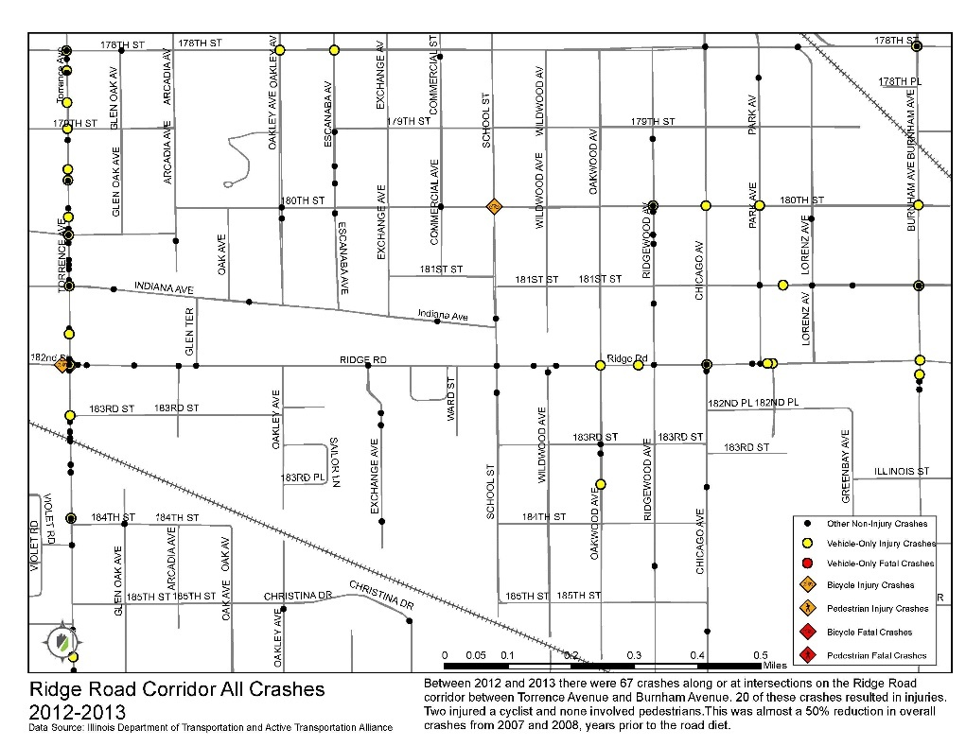
Dispel myths: village board
Almost a 50% reduction in crashes after the right-sizing project!
Notes:
In Steger, board members were concerned about the Complete streets policy because they were wary of a road diet project that had been done in the neighboring community. They had a false belief that the road diet made the street less safe. We crunched the numbers and found a reduction in the number of crashes post-road diet. The board was satisfied with that and eventually opted to fund a local road diet project of their own.

Slide 38
Bring in other experts
Notes:
In addition to the education our team provided, we also had access to NCSC and Mark Fenton through the program. We invited them to help us conduct a two-day training. Day one was focused on general education on complete streets and day 2 focused on a workshop where each community’s steering committee worked together to develop their policy vision statement.

Slide 39
Develop a shared vision

Slide 40
Develop a shared vision, con’t

Slide 41
Talk through each policy element
Source: National Complete Streets Coalition
Notes:
We set a regular meeting schedule where we went through each of the ten elements of the complete streets policy, one by one. We would discuss what the element meant. Look through sample language, and write the policy as a team. While this is not the most efficient process, each member of the committee was able to share what they know and gained a deep understanding of the policy’s meaning and intent.

Slide 42
Question: What policy development approaches have worked for you?

Slide 43
Implementation success stories

Slide 44
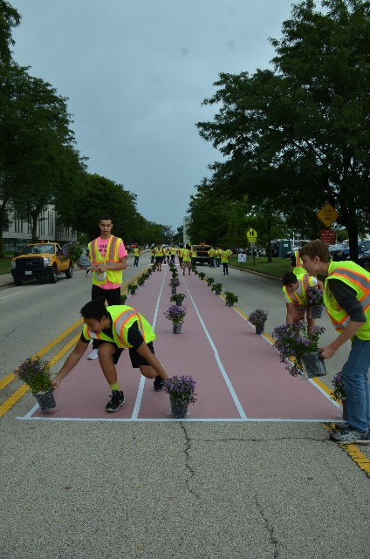
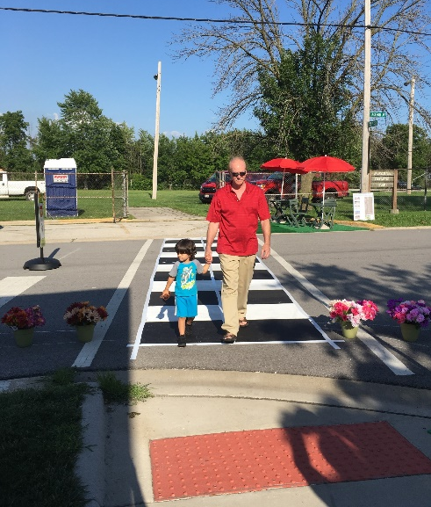
Engagement through tactical suburbanism
https://www.youtube.com/watch?v=Fx4-SXKaxXc
Notes:
After spending a year working on policy development, we wanted to find a way to demonstrate to the steering committees and the community the power of complete streets. We were able to get additional funding to conduct pop-up complete streets demonstrations in 6 communities. Each community chose a block on a local road that had a particular challenge to address. We constructed the facilities and took them down in one day. Here’s a video from the project we did in Skokie, where we worked with the High School engineering class to design and build the project.
Willow Springs - bike lane being built
Skokie - engaged students. wants to put in its CIP
S. Chi Heights - creating a SPZ
Steger - part of a redevelopment project, will incorporate changes
Richton Park - Excess roadway width. in CIP
Midlothian - Ped fatality. part of a corridor study

Slide 45
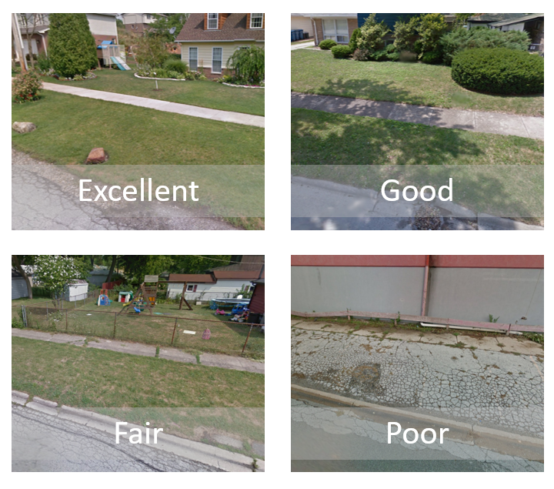
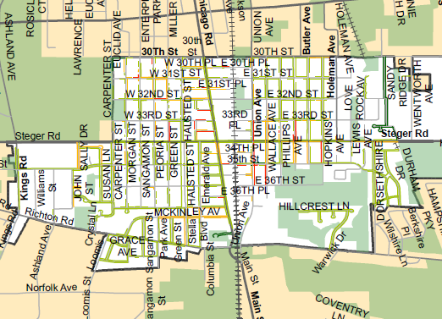
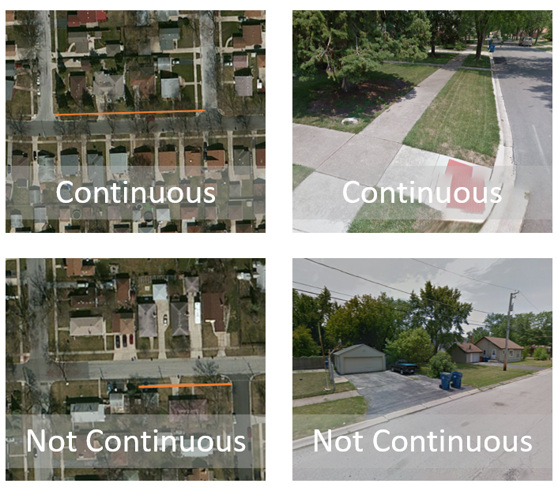
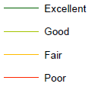
Understand existing conditions…
Notes:
After doing the fun work, we needed to start working with communities to establish systems and protocol for future work. Steger wanted to prioritize sidewalk improvements, including reconstruction. We worked with them to develop an evaluation system for the condition of their sidewalks. We also produced a file for them to view the data and update it in Google Earth so that they did not have to have access to expensive ArcGIS software.

Slide 46
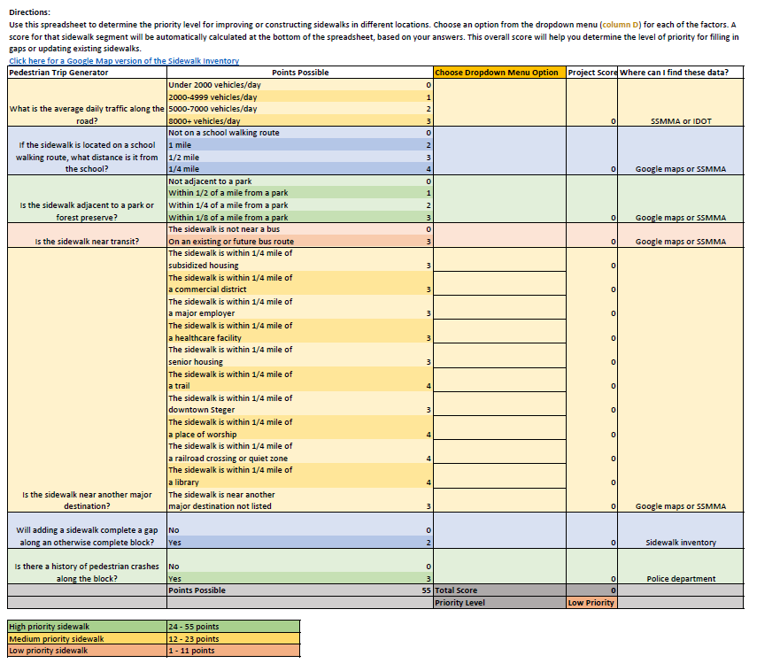
And create a prioritization system
Notes:
After creating the inventory system, we worked with the steering committee to develop a system for prioritizing sidewalk infill and reconstruction. The criteria includes AADT, proximity to schools and parks, and other land use considerations. The scoring criteria gives them an easy way to evaluate each sidewalk project and determine its prioritization.

Slide 47
Create checklists
Notes:
In each community, we worked with the steering committees to develop project review checklists. In most of the communities, the people who review projects are not planners or engineers. They wanted review checklists to help remind them of the considerations to make when reviewing a project and of the tools that could be used to improve the environment for pedestrians, cyclists, and transit users.
In Skokie, the Village developed a complete streets checklist to share with developers, to ensure that properties included pedestrian access, bike racks, and other amenities.

Slide 48
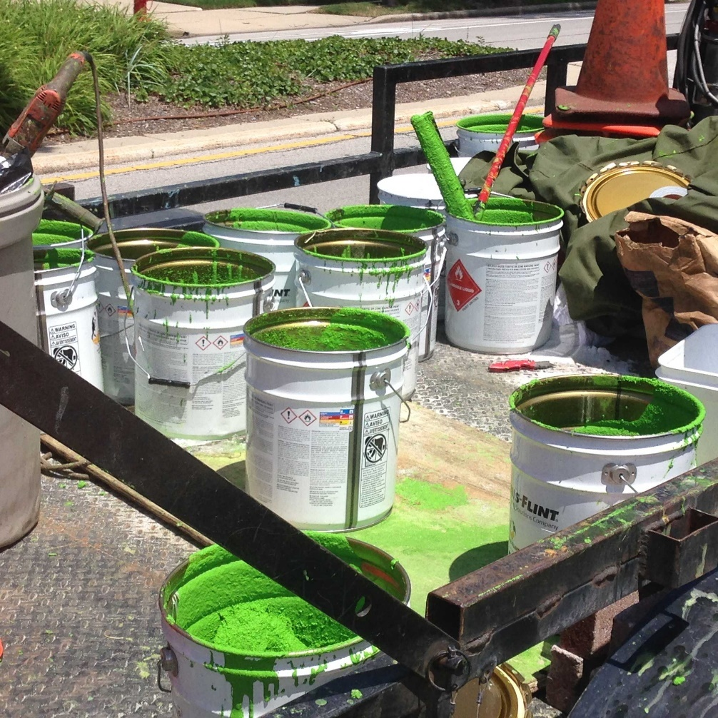
Develop funding strategies
Capital Improvement Plans
CDBG 50/50 sidewalk program
Local gas tax increase
Notes:
We encouraged all communities to consider incorporated complete streets improvements into their CIP. However, due to the lack of funding in many of the municipalities, this is a challenge.Several of them also need plans to help them build a network and better understand where complete streets should be prioritized.
Two communities we are working with have chosen to develop innovative funding strategies for active transportation facilities. In Skokie, the Village uses CDBG funds to serve as the 50 percent match for sidewalk reconstruction for households that cannot afford to pay it. Residents who wish to participate are asked to fill out a simple application and the Village makes sure they are in a CDBG eligible area.
The Village of Summit recently voted to increase its gas tax. It realized that many people were driving over the Chicago border to get gas in Summit because the gas tax was lower. By raising it slightly (still lower than Chicago), the Village was able to increase its revenue. It has earmarked the funds for roadway improvements, and will apply much of it to sidewalk projects and bike lanes.

Slide 49
Leverage policy for additional resources
Notes:
The Village of Midlothian used its policy, a stormwater management plan, and its active transportation plan to help get a local technical assistance grant from the Chicagoland Metropolitan Agency for Planning to focus on a corridor controlled by the Illinois Department of Transportation. The goal is to incorporate the recommendations made in the two plans and use the policy as leverage to get complete streets and stormwater improvements on the corridor. This corridor in particular needs pedestrian crossing improvements. Signalized crossings are spaced 1 mile apart and there is no pedestrian scale lighting. Last summer, a local boyscout was hit and killed while crossing at an unsignalized location. So far, IDOT is resistant to providing crossing improvements at unsignalized locations due to pedestrian safety concerns, but the Village is hoping to use its plans to change the agency’s stance.

Slide 50
Use policy to attract new development
Vacant mobile home development, future TOD site
Future protected bike lane
Notes:
The Village of Calumet Park used its policy and active transportation plan to attract a developer for a TOD site. They are now hoping that the TOD will help them win grant funding from the County to right-size Ashland Avenue and build a protected bike lane on it. This linkage could also connect to the Cal Sag Trail, which is currently being constructed 2 miles south of the development. Unfortunately, the Metra Electric commuter rail recently announced that it would be discontinuing off-peak service to this station in order to increase service to a station adjacent to a more affluent neighborhood in the City of Chicago. This announcement could jeopardize the Village’s bid with the developer. We’re working with the Village to develop talking points and messages for the Metra board to persuade them to reconsider this decision.

Slide 51
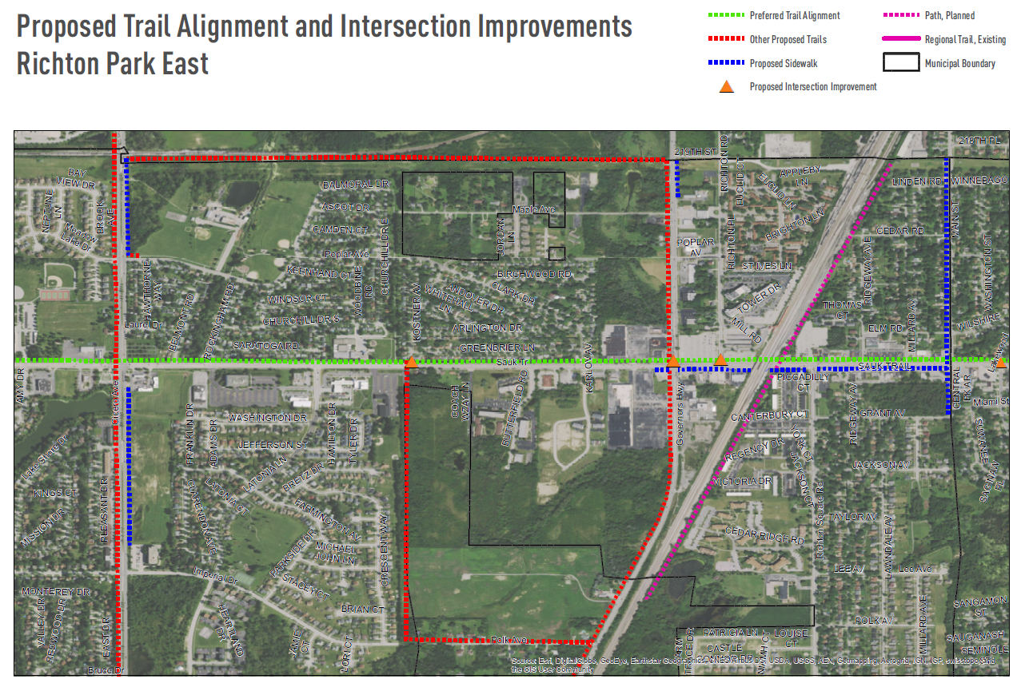
Partner with neighbors
Notes:
Richton Park’s first project was to get a sidepath along Sauk Trail, an arterial that runs through the center of the Village. It realizes the importance of connectivity and noted that a trail picks up about 10 miles away. Rather than stop the sidepath at its eastern border, the Village contacted the 4 communities east of it and asked them to partner on a trail construction project. Together, they applied for a grant to conduct Phase I engineering from Cook County.

Slide 52
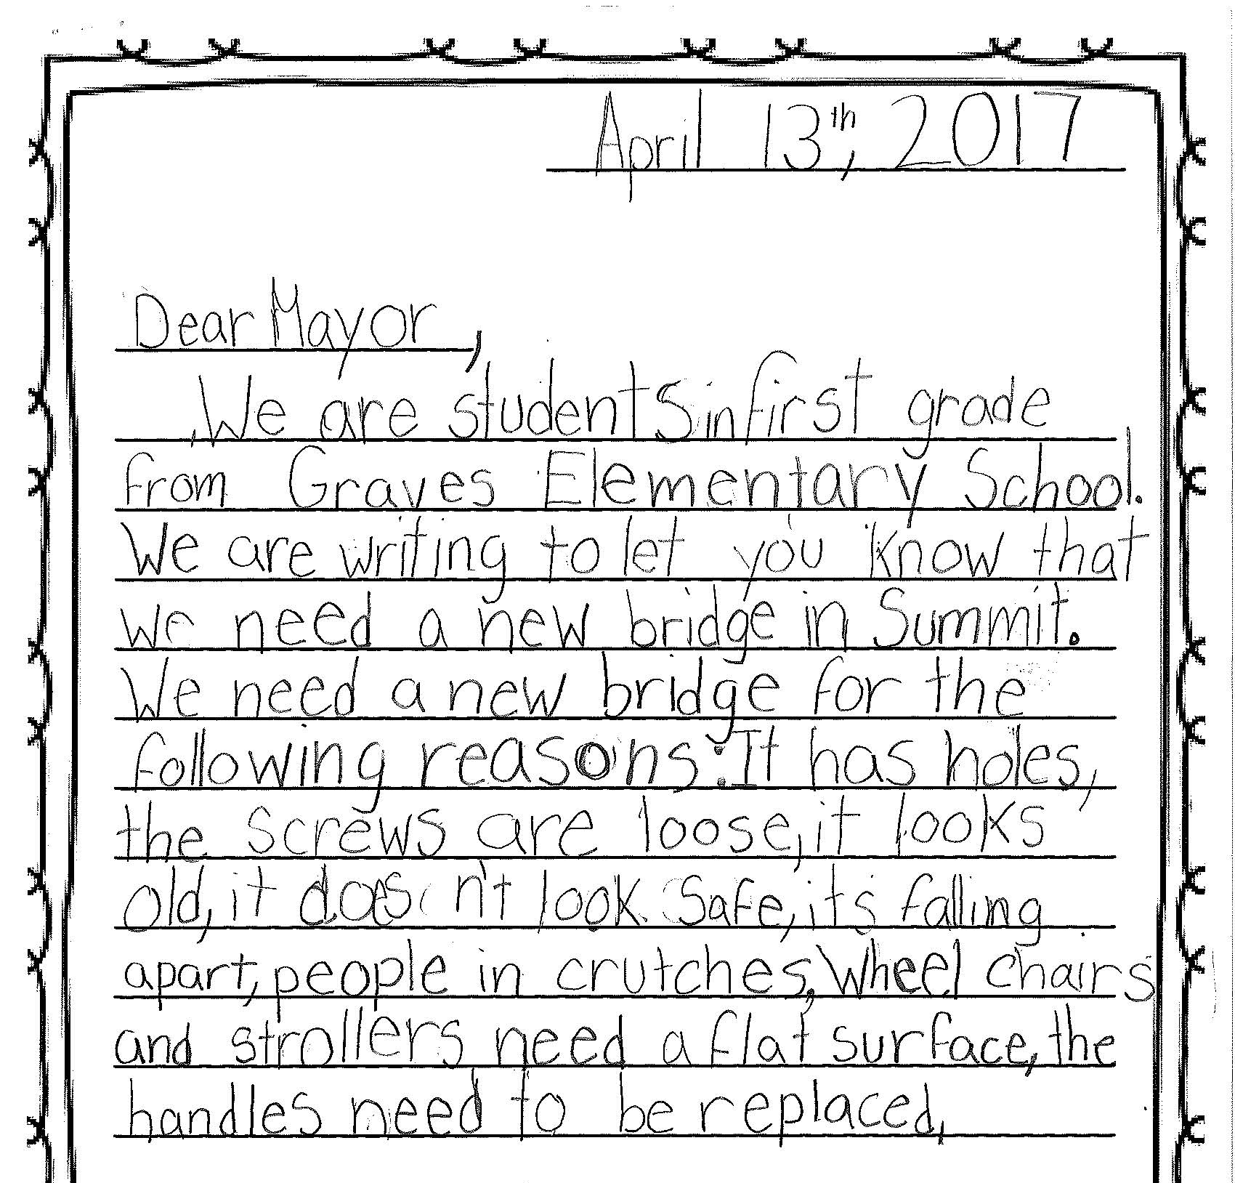
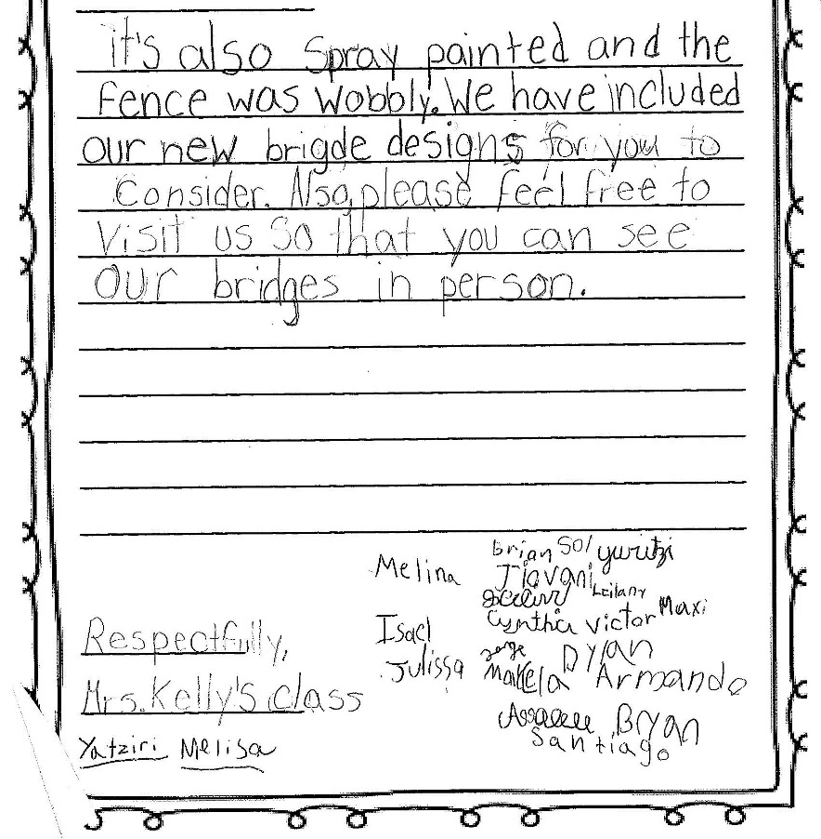
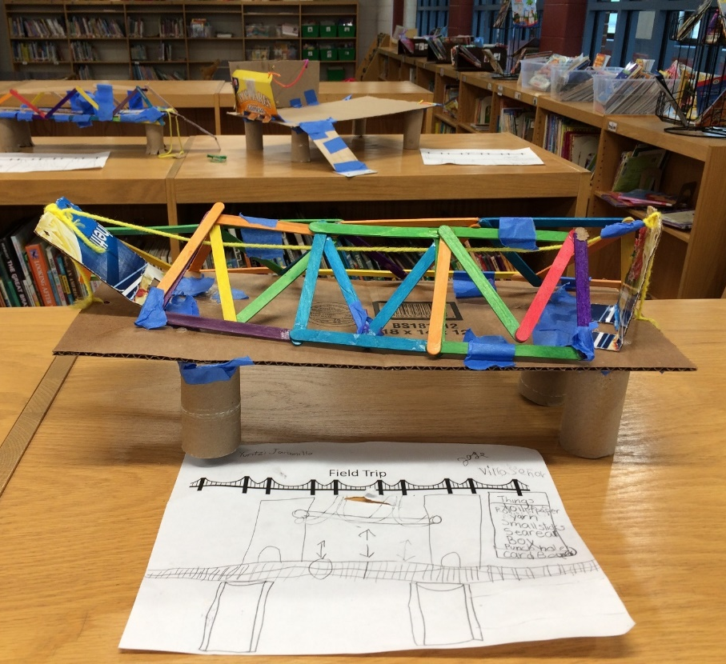
Focus on the problem areas
Notes:
Immediately after adopting its policy, the Village of Summit decided to start working on its most difficult, but most important problem to solve – a rickety, slippery pedestrian bridge that runs over the Indiana Harbor Belt Railway tracks and connects the two sides of the community. It’s so bad that a first grade class wrote the Mayor a letter and asked him to meet with them to discuss it. Each student sketched a new bridge design and then built it out of popsicle sticks and presented their ideas for improvements to the mayor.
Following this, through the HHS program, we were able to bring Mark Fenton out to lead a walk audit with school district and community staff. The group brainstormed temporary bridge improvements, ideas for improving access to the school, and discussed ways to get the railroad on board with constructing a new bridge. The Village will continue to pursue improvements.

Slide 53
Question: What are your implementation success stories?

Slide 54
Challenges & Lessons Learned

Slide 55
Challenges
Staff and elected official turnover
Availability of funding
Getting buy-in from state agency
Developers rule
Land use
Disinvestment and
Notes:
Throughout the course of this project, we’ve experienced many of the typical stories you will hear in communities regarding the challenges to implementing complete. We still haven’t found the magic bullet for complete streets implementation, but I think we’ve gotten closer.
Staff turnover was a big challenge. In Willow Springs, the mayor lost the election and our champion, the Village administrator was laid off. In Steger, the Village Manager retired and was replaced. In Calumet City, the Village manager left prior to policy adoption. It took over a year for us to work with the new manager to get the policy adopted, leaving little time for implementation. And in Cal Park, our staff champion left. It took several months to get the steering committee up and running again, and we lost a lot of steam.
Funding of course is an issue for everyone. Our state has not had a budget in over three years, which means that many communities funds are held up. Federal grants are highly competitive and many of the communities where we are working do not have the resources to apply for funding, or are unable to come up with the funding match.
Our state agency’s design guidelines are not always bicycle and pedestrian friendly. It has begun to update its design guidance to reflect modern standards, but it will take a while before staff at the local districts adjust and projects start to happen.
Developers still have the upperhand in communities that are desperate to attract new businesses and housing developments. They often have the final say in the facilities that are included and village boards usually do not say no.
Our land use patterns are at odds with complete streets principles in many suburban communities. Streets are not the only thing that have to change, development patterns must also be updated.
Chicago’s south suburban communities are predominantly low-income and African American. These communities are suffering from decades of decisions that resulted in disinvestment, such as redlining, our property tax system, and other structural racism. Complete streets are often the low priority on the totem pole of needs in these communities, and advocates and decision makers need to understand that when talking about Complete Streets. We need to acknowledge that economic development, housing policy, land use policy, health, and social services are just as much a part of the Complete Streets conversation as bike lanes, bump-outs, and bus shelters.

Slide 56
Lessons learned
Meet regularly
Use every project as an opportunity to discuss complete streets
Get buy-in from all affected staff and decision makers
Establish protocols beyond the policy
Workshop ideas and iterate before establishing a process or constructing a project

Slide 57
Resources
AtPolicy.org
Complete Streets Complete Networks
Rural Companion
National Complete Streets Coalition
Notes:
Active Transportation Alliance has created design guide, policy development resources and fact sheets on the benefits of complete streets that you can find at ATPolicy.org
The National Complete Streets Coalition grades and publishes a list of the top policies from around the country, language from which can be used as a model for your policy. They also produce fact sheets and reports on the benefits of Complete Streets.
Your local MPO can be a great resource for complete streets implementation in facilitating project collaboration between communities and funding opportunities.
You can also look to peer communities on ideas and resources. The Peoria MPO is a great example of what happens when complete streets are incorporated into project selection for funding opportunities. They award points for projects with bike and pedestrian components on STP applications. 10 out of 100 points go to bike and pedestrian components. Roughly 30% of the applications before the reworked scoring had pedestrian and bike components and now these elements are included in at least 90% of applications. Getting bike and pedestrian into the criteria was key.
Having a bicycle and pedestrian coordinator can be a powerful step to implementation. The position doesn’t have to be fulltime. It could be helpful even if it’s an existing staffer with several hours a week dedicated to the position.

Slide 58
Contact: heather@activetrans.org

Slide 59
Discussion

