Slide 1
Building Towards a Multi-Modal Future
Suzanne Carlson
Innovate memphis
June 2017

Slide 2
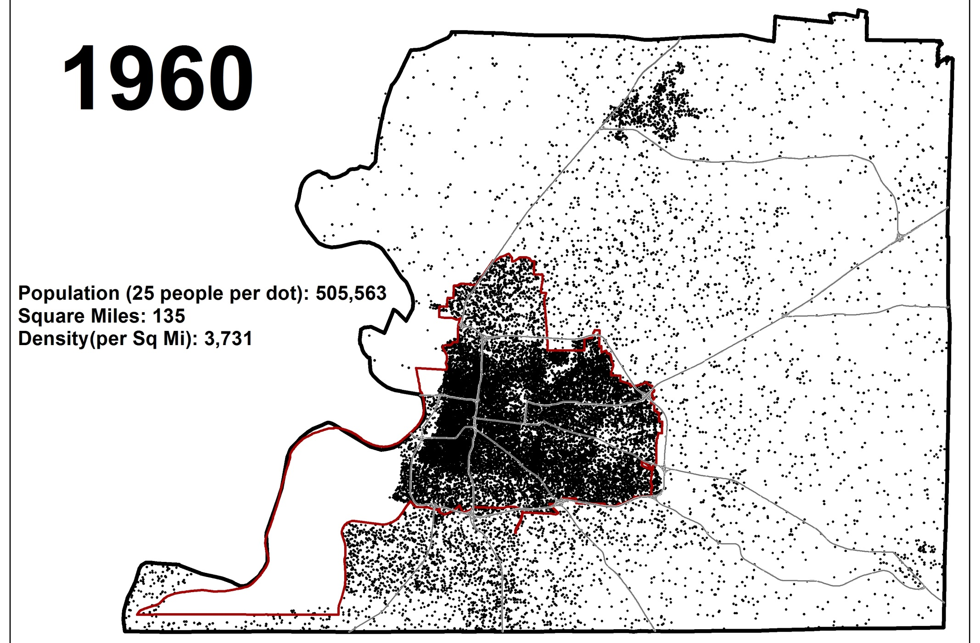
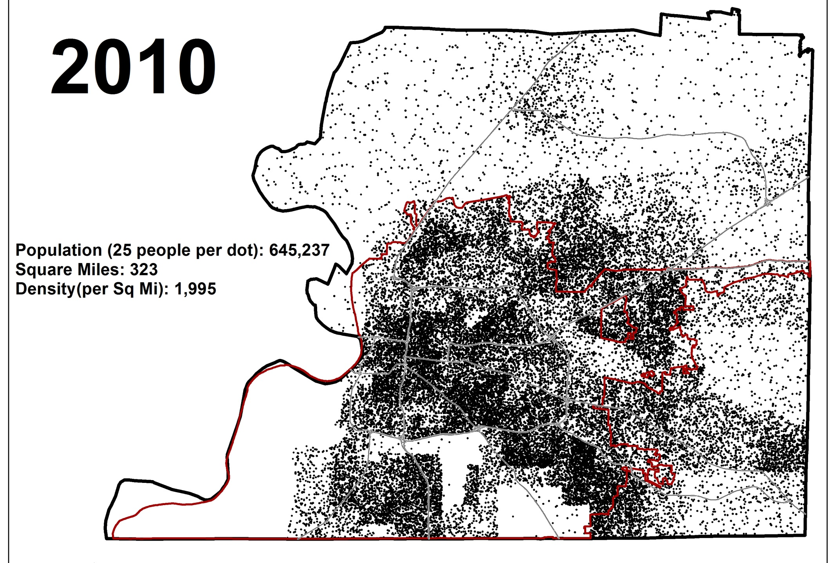
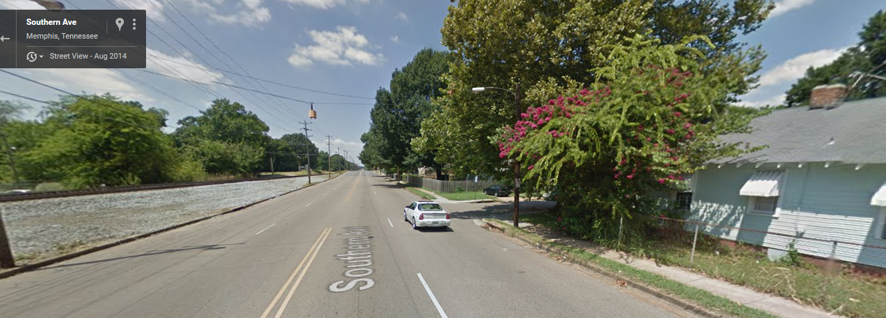
Notes:
Deficits: land use patterns, lack of congestion, parking supply,

Slide 3
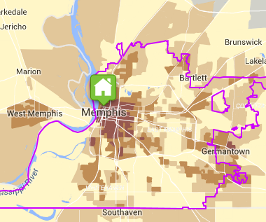
Transit Access & Commute Share
Notes:
Carpooling higher than average – slightly lower average car ownership. More likely to have one-car household.
Overall Transit Access Score (TAS) based on connectivity, access to land area and jobs, and frequency of service.
Memphis Average TAS is 2.1 on a scale of 0 (low transit access) to 10 (high transit access). This means it is, on average, car-dependent with limited access to public transportation. Moreover,
64% of Memphis households live in areas with TAS of just 2.5 or less.
Only 10.5% of households live in areas with TAS of 5 or higher.
Comparatively,
Nashville, TN has an Average TAS of 3.0
Knoxville, TN has an Average TAS of 3.5
Chattanooga, TN has an Average TAS of 2.4
New Orleans has an Average TAS of 6 and 53% of New Orleans households live in areas with TAS of 7.5 or higher.

Slide 4
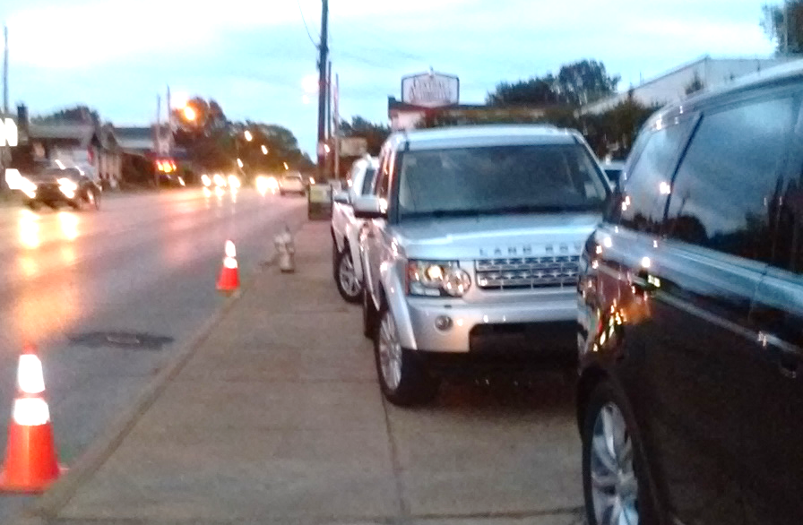
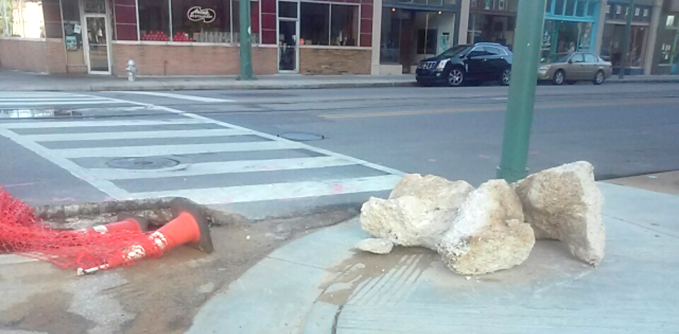
Standard Ops

Slide 5
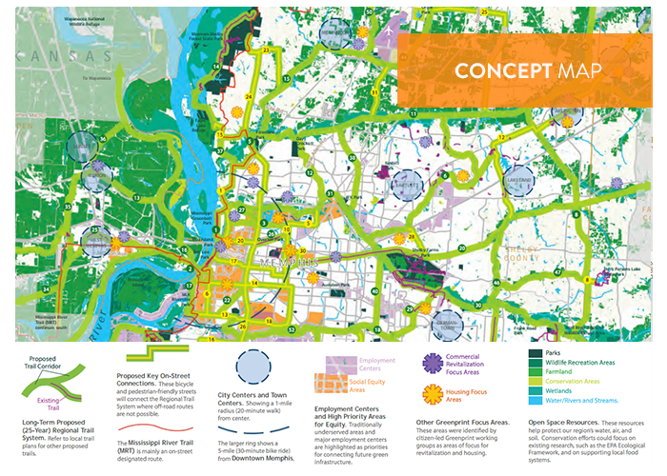
Vision for Accessible, Connected Future

Slide 6
Memphis Context & Assets
Strong philanthropic community
Access to decision makers
Experiments in innovation
Support for job access and increasing prosperity
Old methods no longer working
Increasing # partner groups and individuals
Structured regional planning efforts

Slide 7
Innovation Strategies
Implement Quick Wins
Small Steps
  Commute Options program
Build Demand for Change
  Speaker Series, communications, partnerships
  Inside/Outside Game
Access Untapped Financing
Change the Landscape
  Land use policies, long term goals

Slide 8
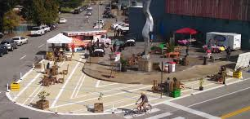
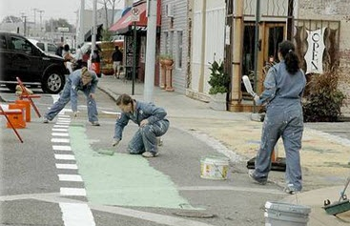
Implement Quick Wins
MEMFix & Great Streets – Tactical Urbanism
Bike lanes & complete streets policy
Car share expansion
TransLoc innovation partnership

Slide 9
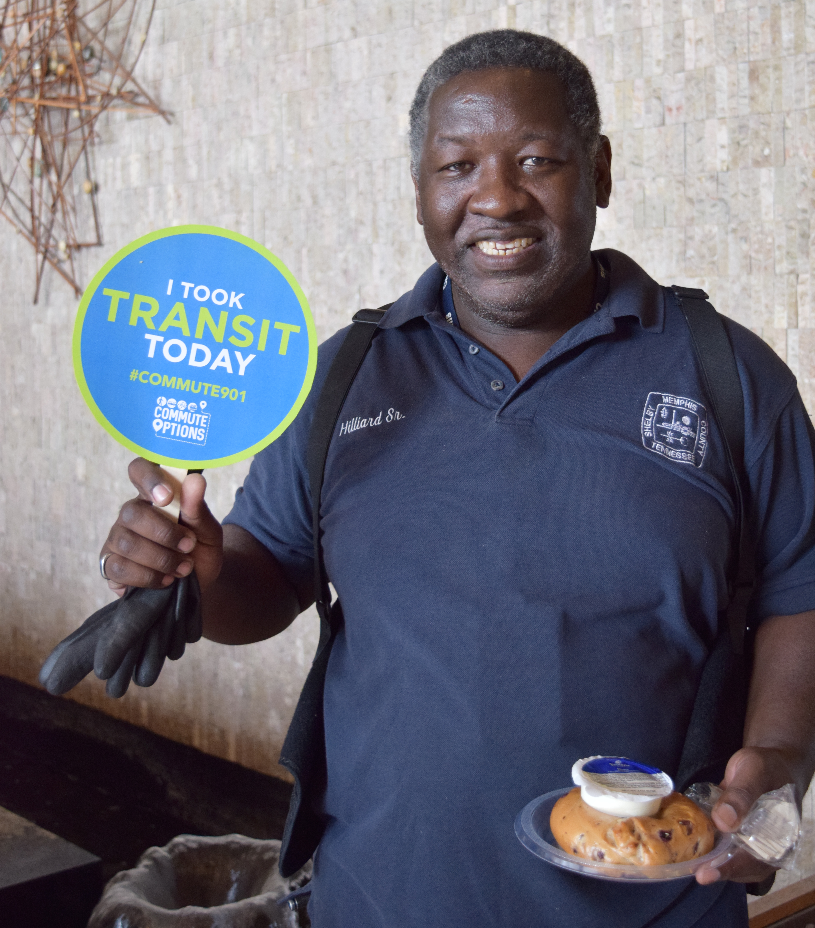
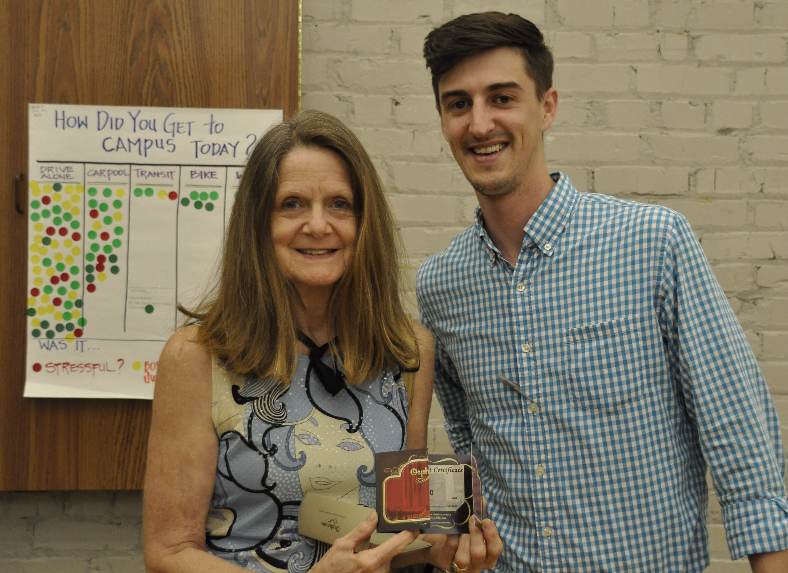
Small Steps: Commute Options TDM
Workplace program w CMAQ funding
Build on national models
Behavior change strategies

Slide 10
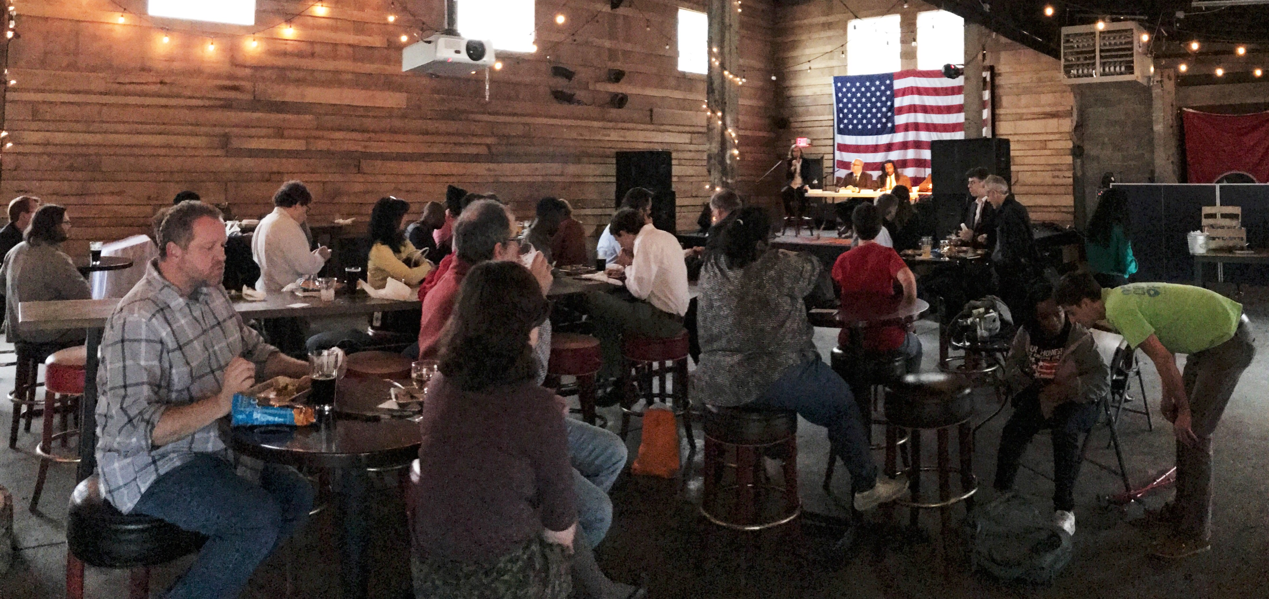
Building Demand for Change
White Paper on Transit Funding
Parking Summit
How to Leave Your Car at Home
Partners in advocacy

Slide 11
Access Untapped Financing
Provide capacity for grant-writing….
And others do the work!

Slide 12
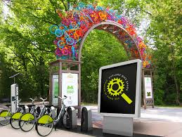

Changing the Landscape
Explore Bike Share
  Equity and Access Priorities
  Distances/Density
MidSouth Regional
Greenprint
Memphis 3.0 Comp Plan
Transit Vision 2020/2040

Slide 13
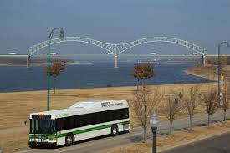
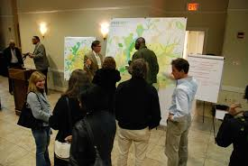
Future Opportunities
Inclusive engagement & outreach
Transportation Management Authority
Partnerships
  Health and Wellness
  Employers and workforce development

